Slide 1
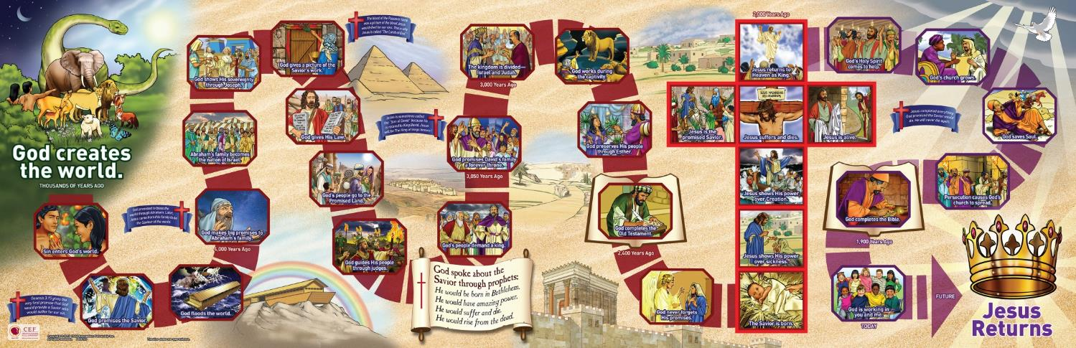
Notes:
Instructions:
First slide—click on individual boxes to show zoomed in versions. To go back to the Timeline picture click the “home” button in the bottom right-hand corner. To proceed to the next box in the Timeline sequence click the arrow next to the home button.

Slide 2
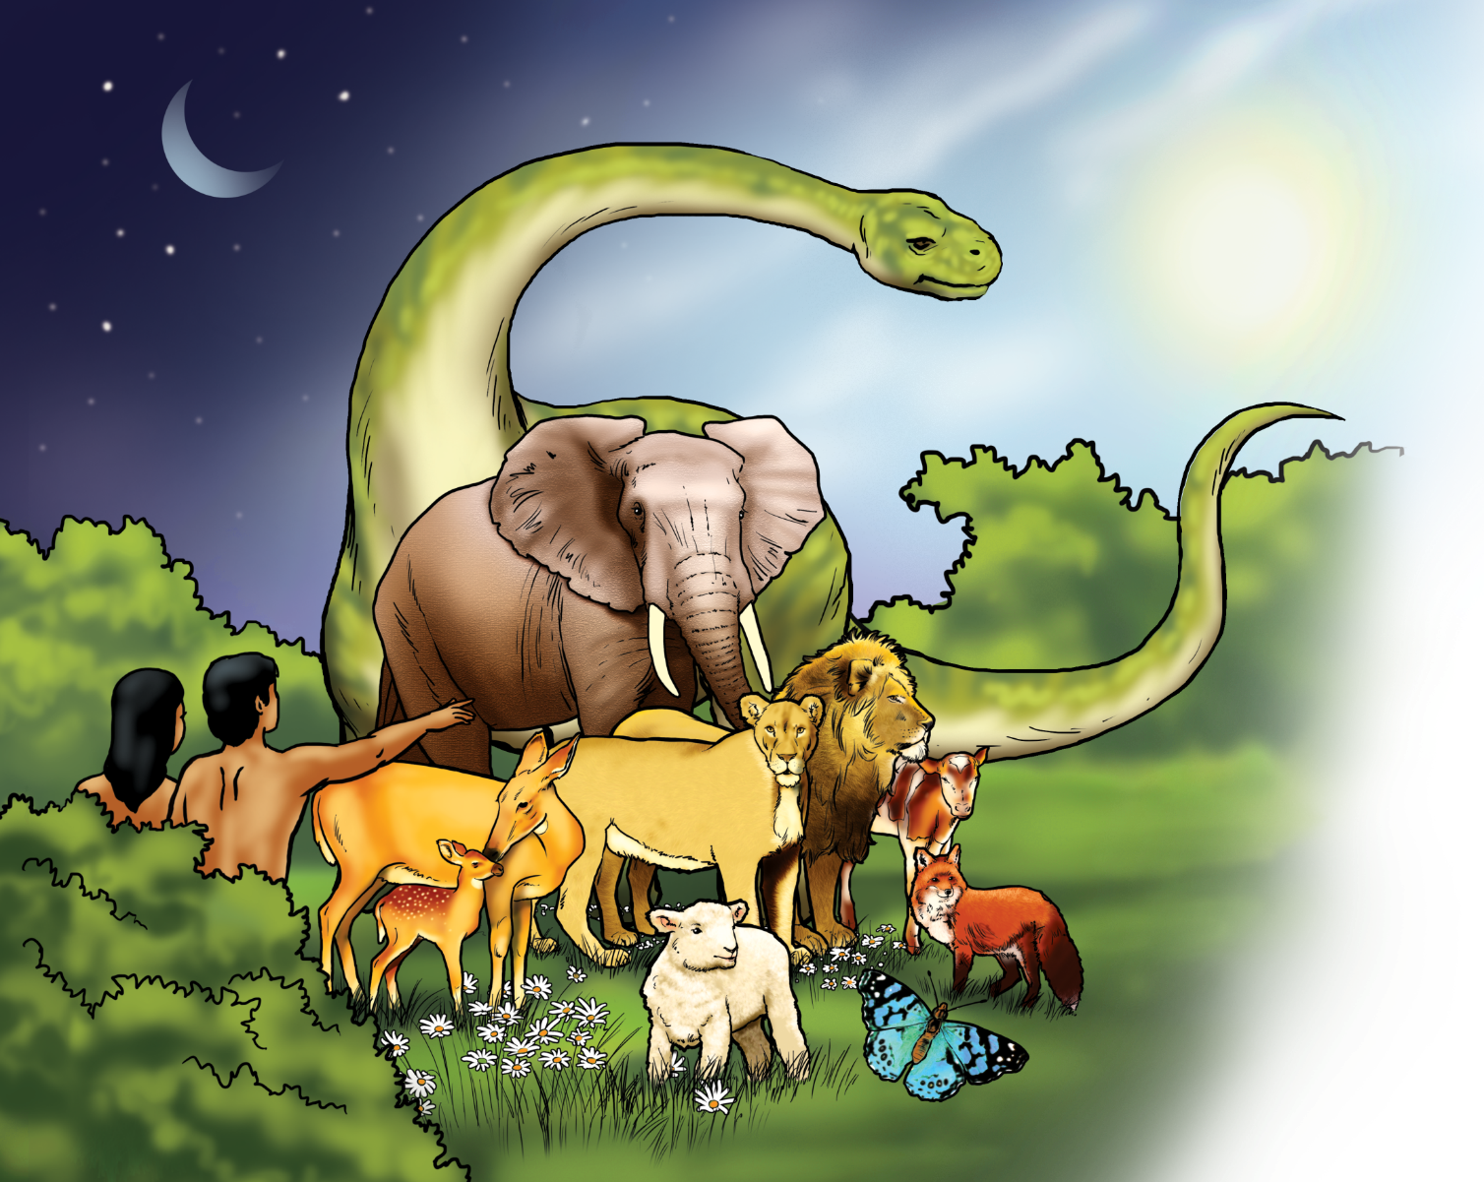

God creates the world.

Slide 3
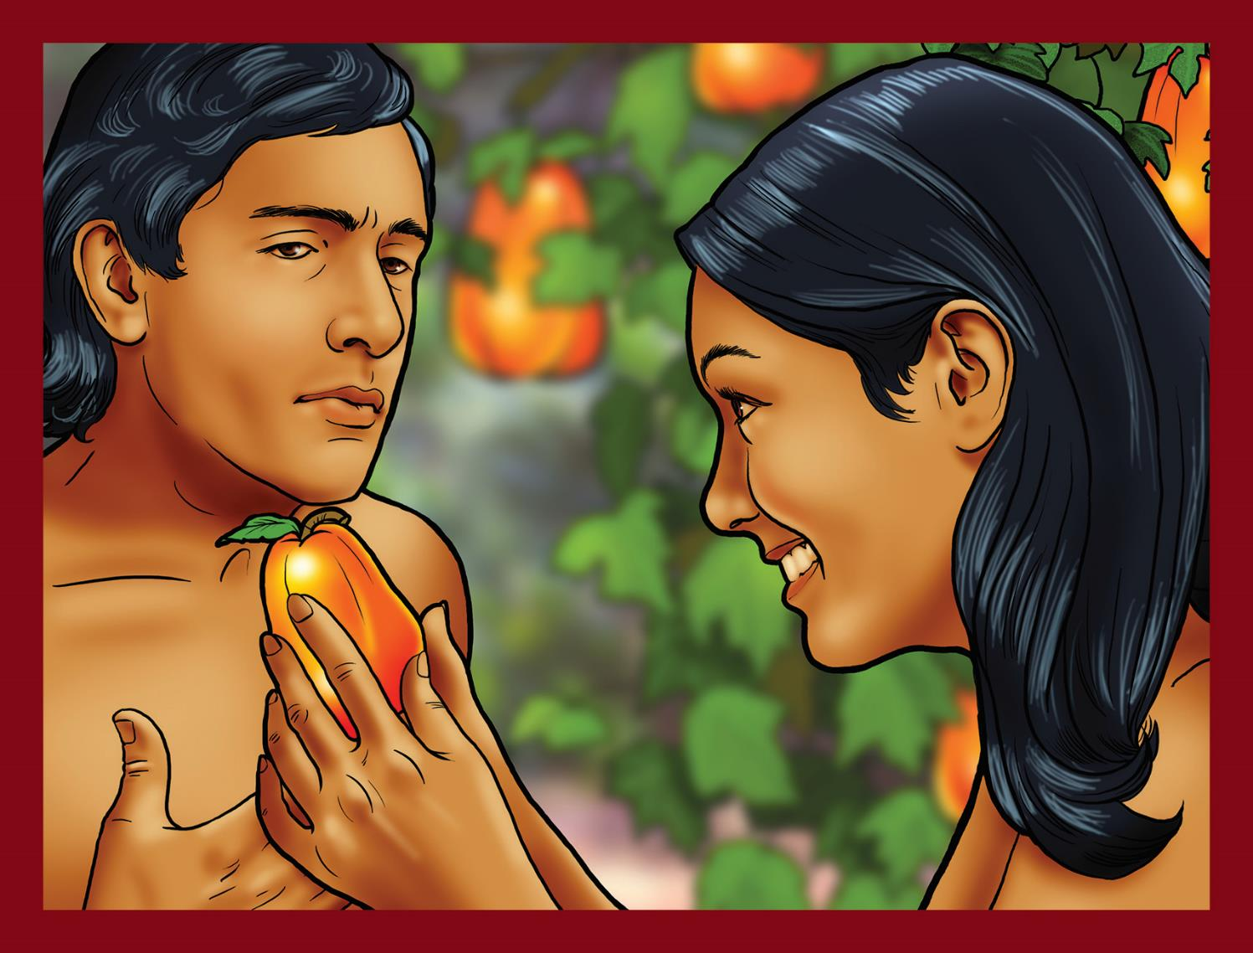
Sin enters God’s world.

Slide 4
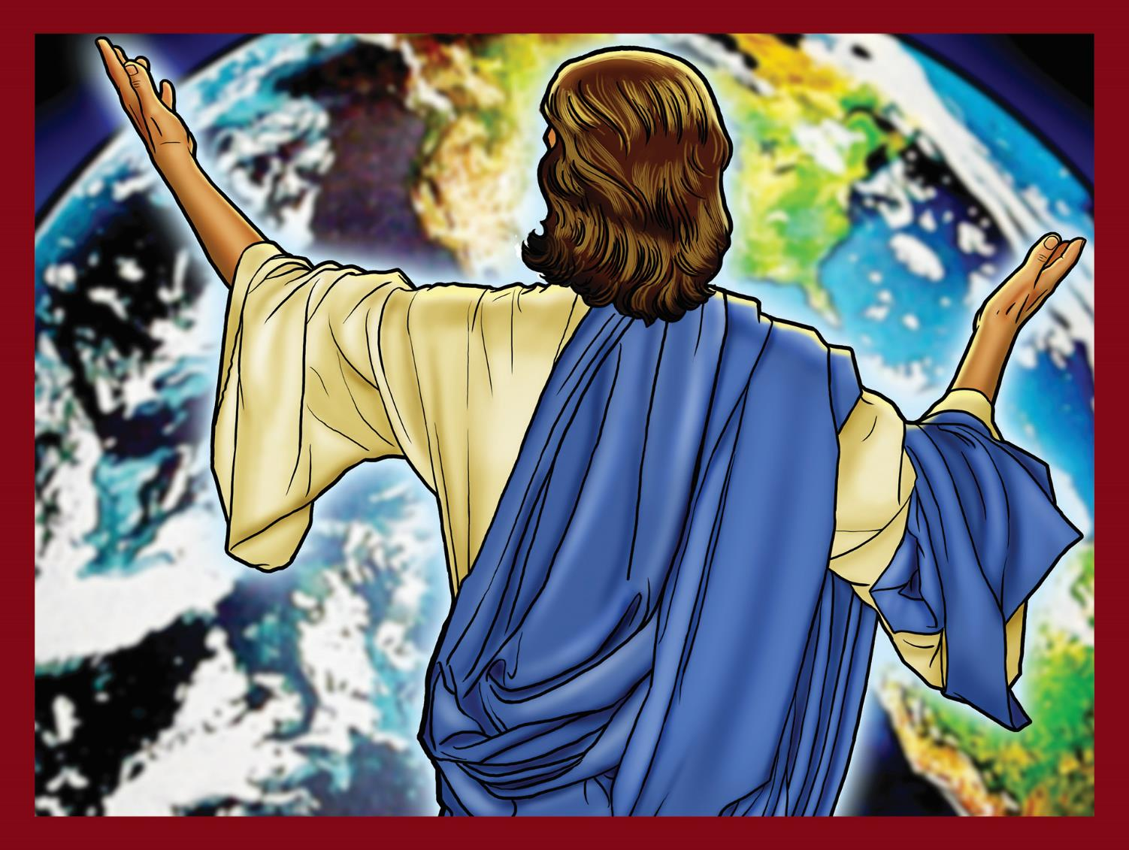
God promises the Savior.

Slide 5
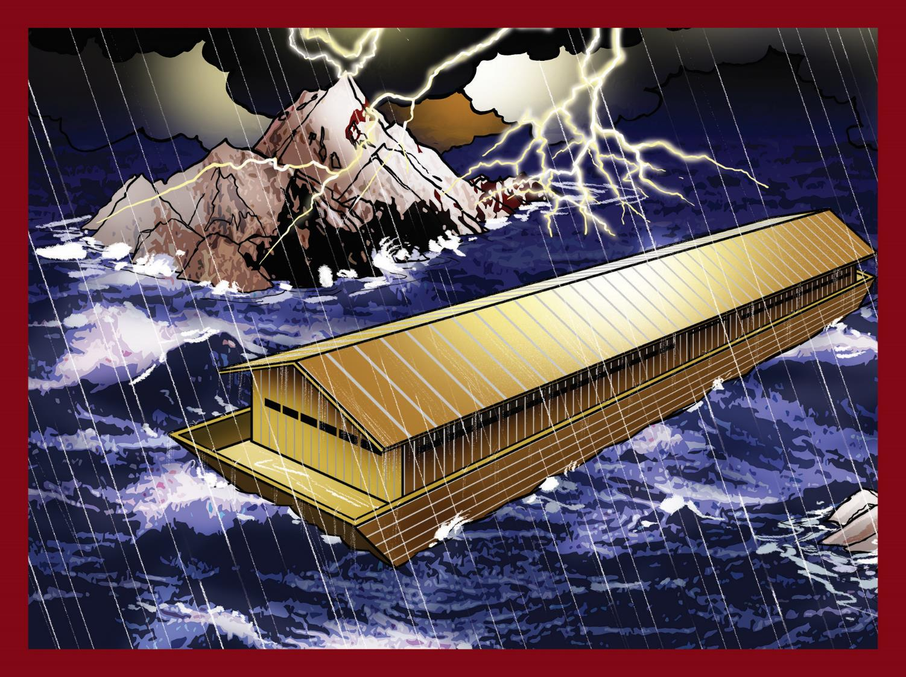
God floods the world.

Slide 6
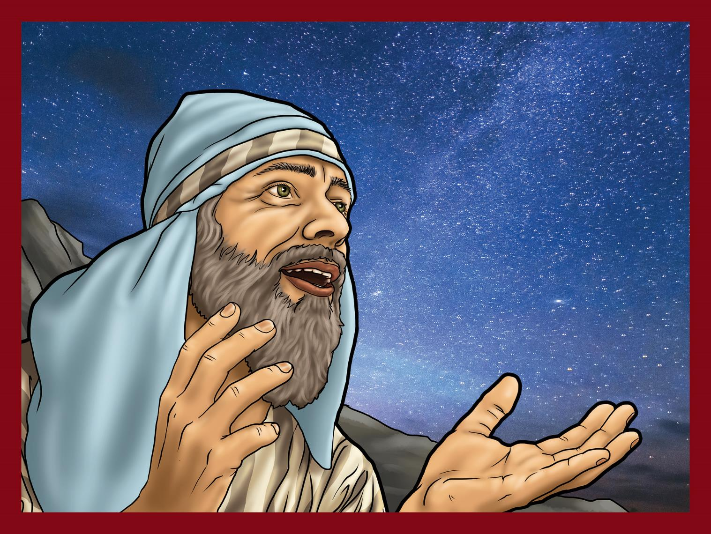
God makes big promises to Abraham’s family.

Slide 7
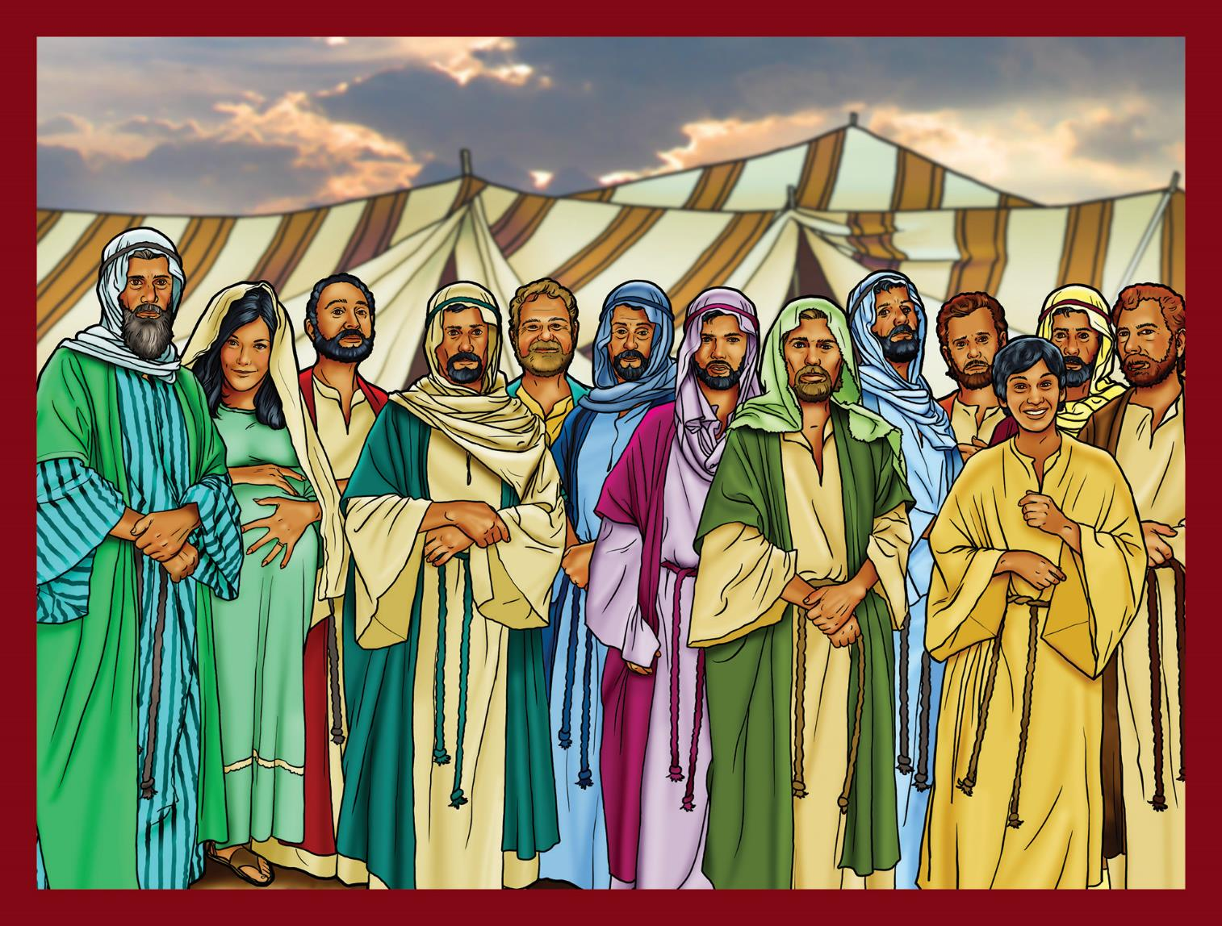
Abraham’s family becomes the nation of Israel.

Slide 8
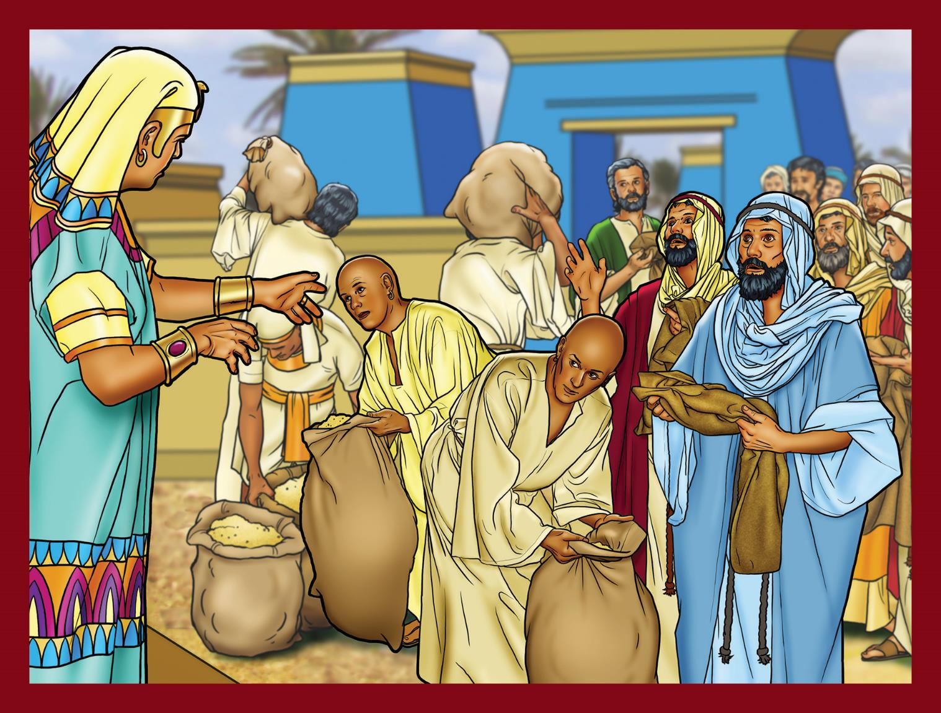
God shows His sovereignty through Joseph.

Slide 9
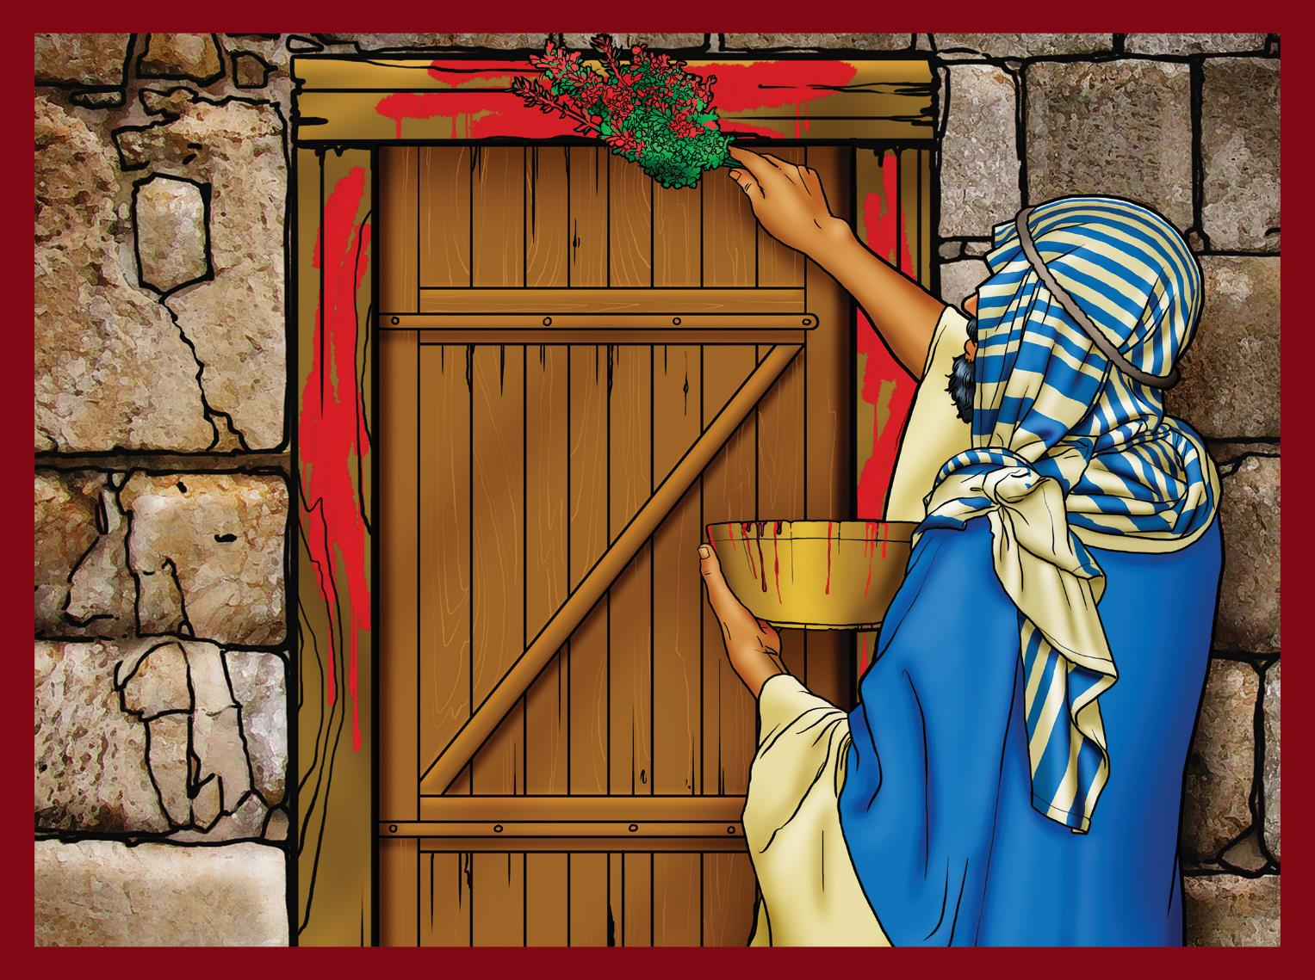
God gives a picture of the Savior’s work.

Slide 10
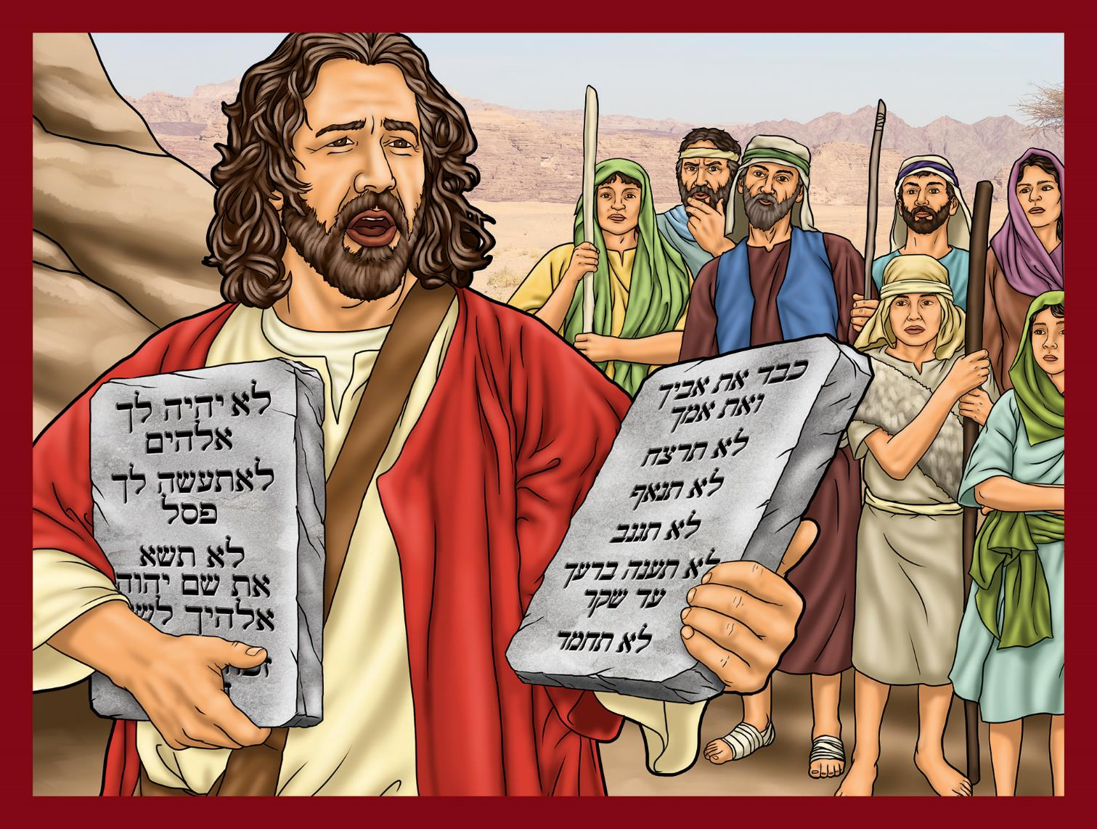
God gives His law.

Slide 11
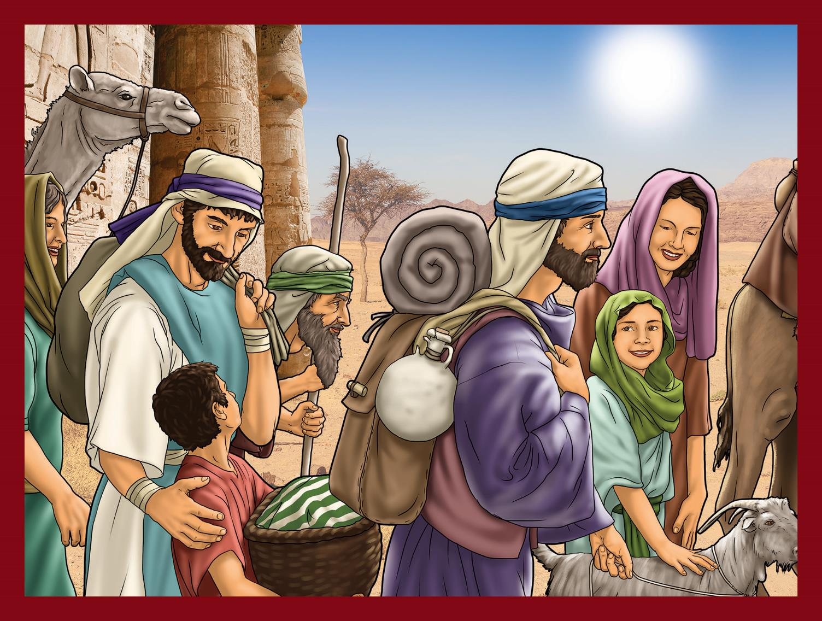
God’s people go to the Promised Land.

Slide 12
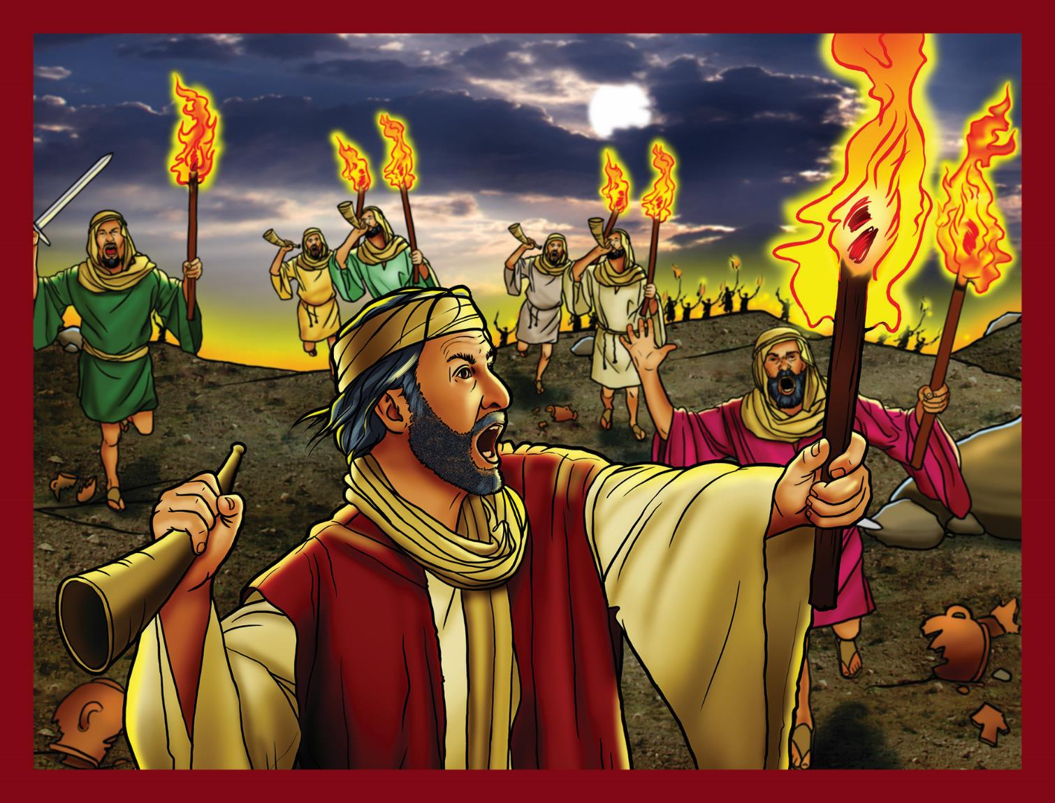
God guides His people through judges.

Slide 13
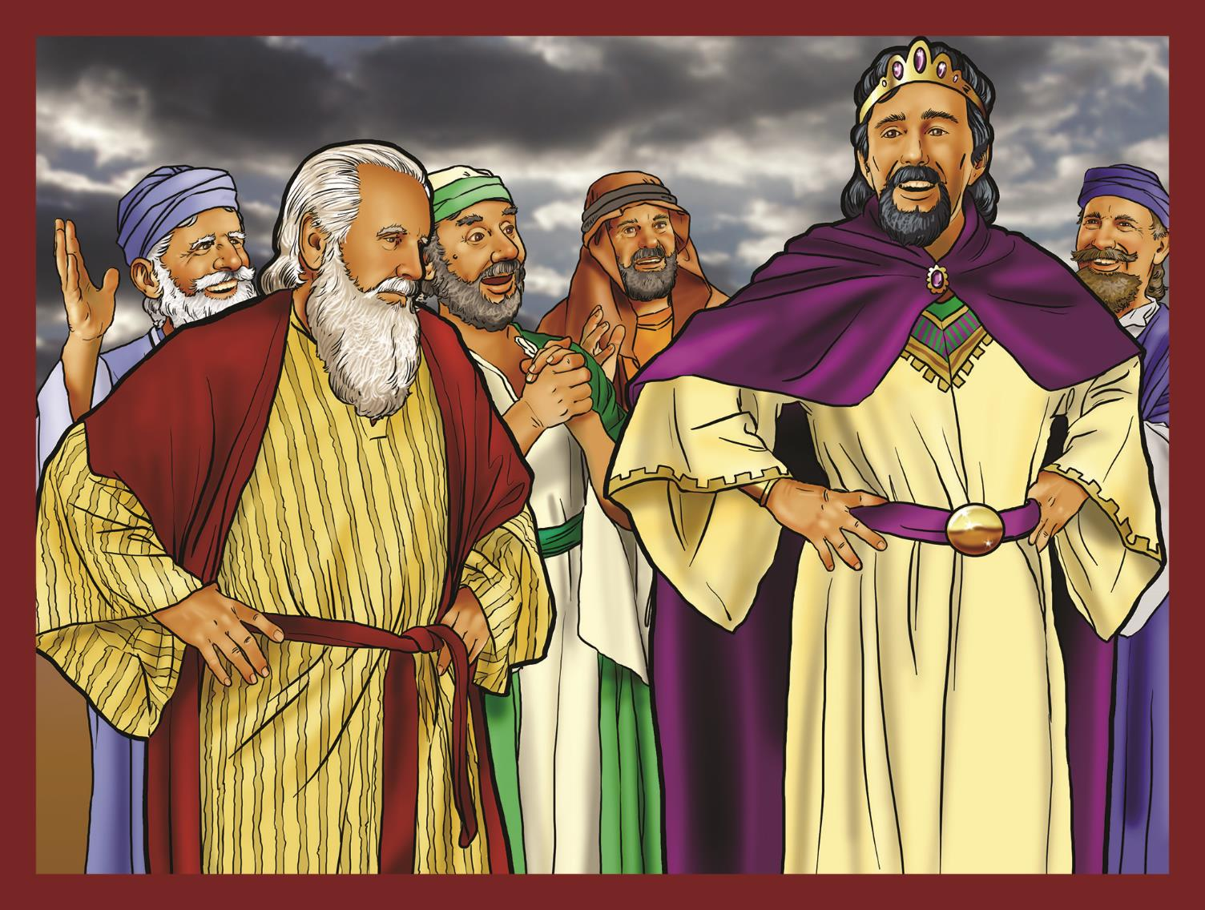
God’s people demand a king.

Slide 14
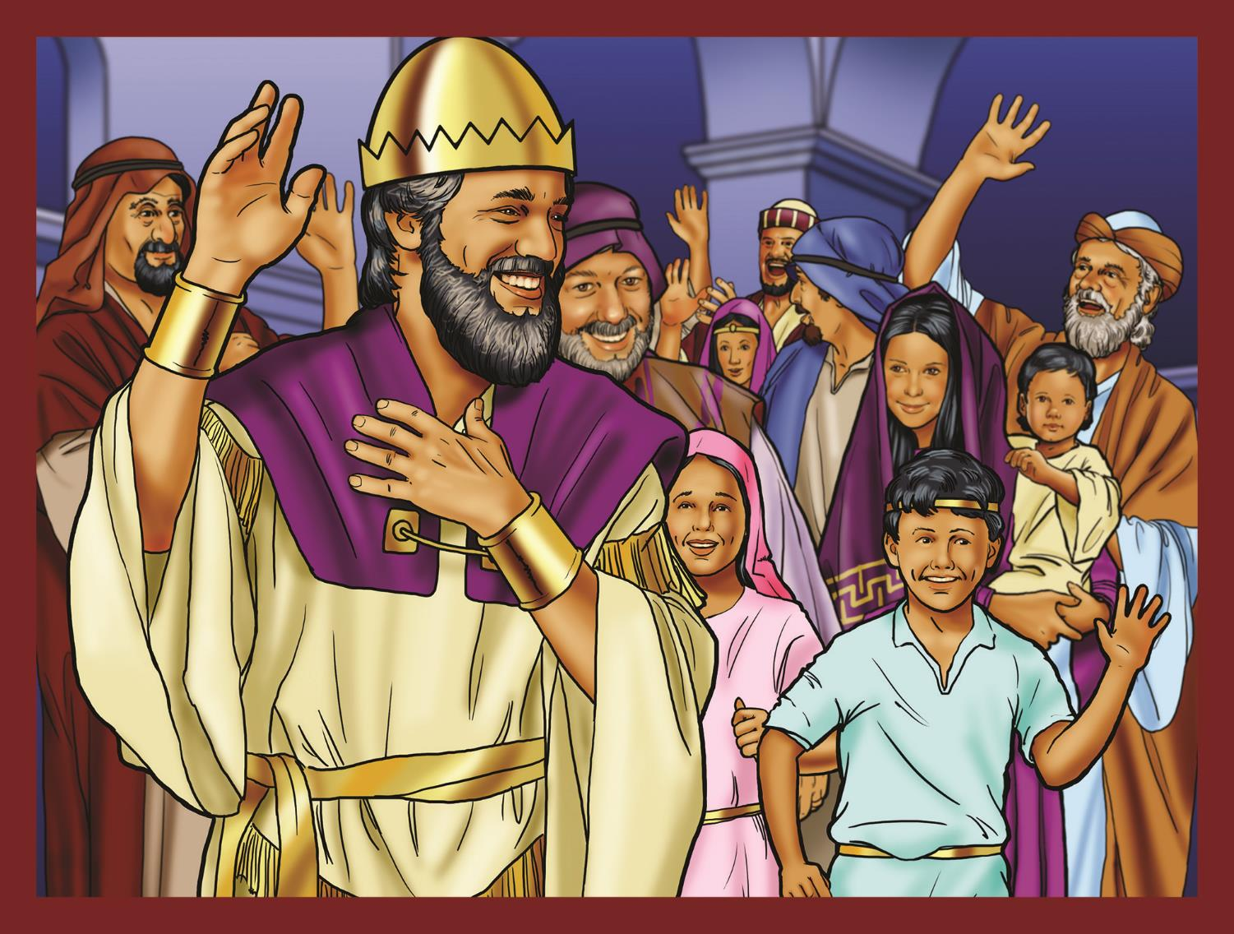
God promises David’s family a forever throne.

Slide 15
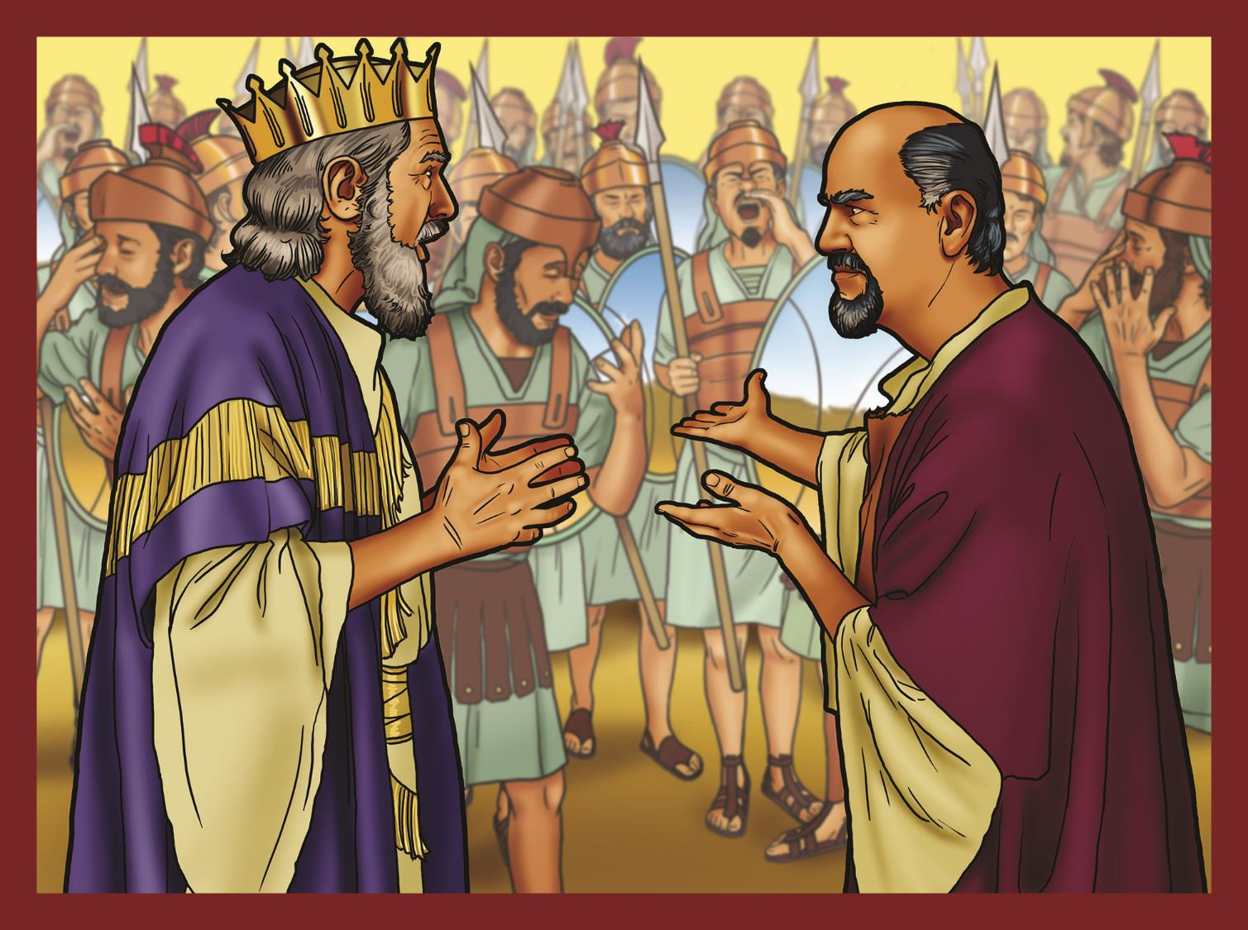
The kingdom is divided—Israel and Judah.

Slide 16
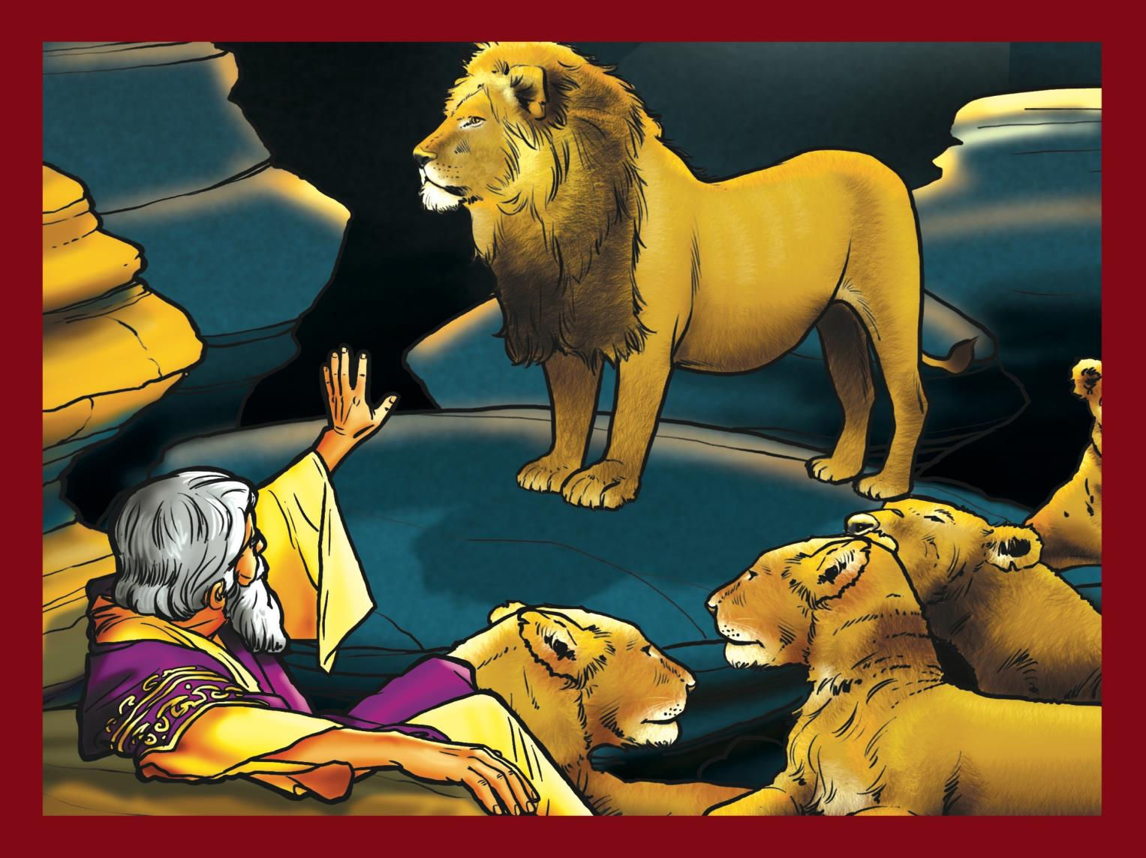
God works during the captivity.

Slide 17
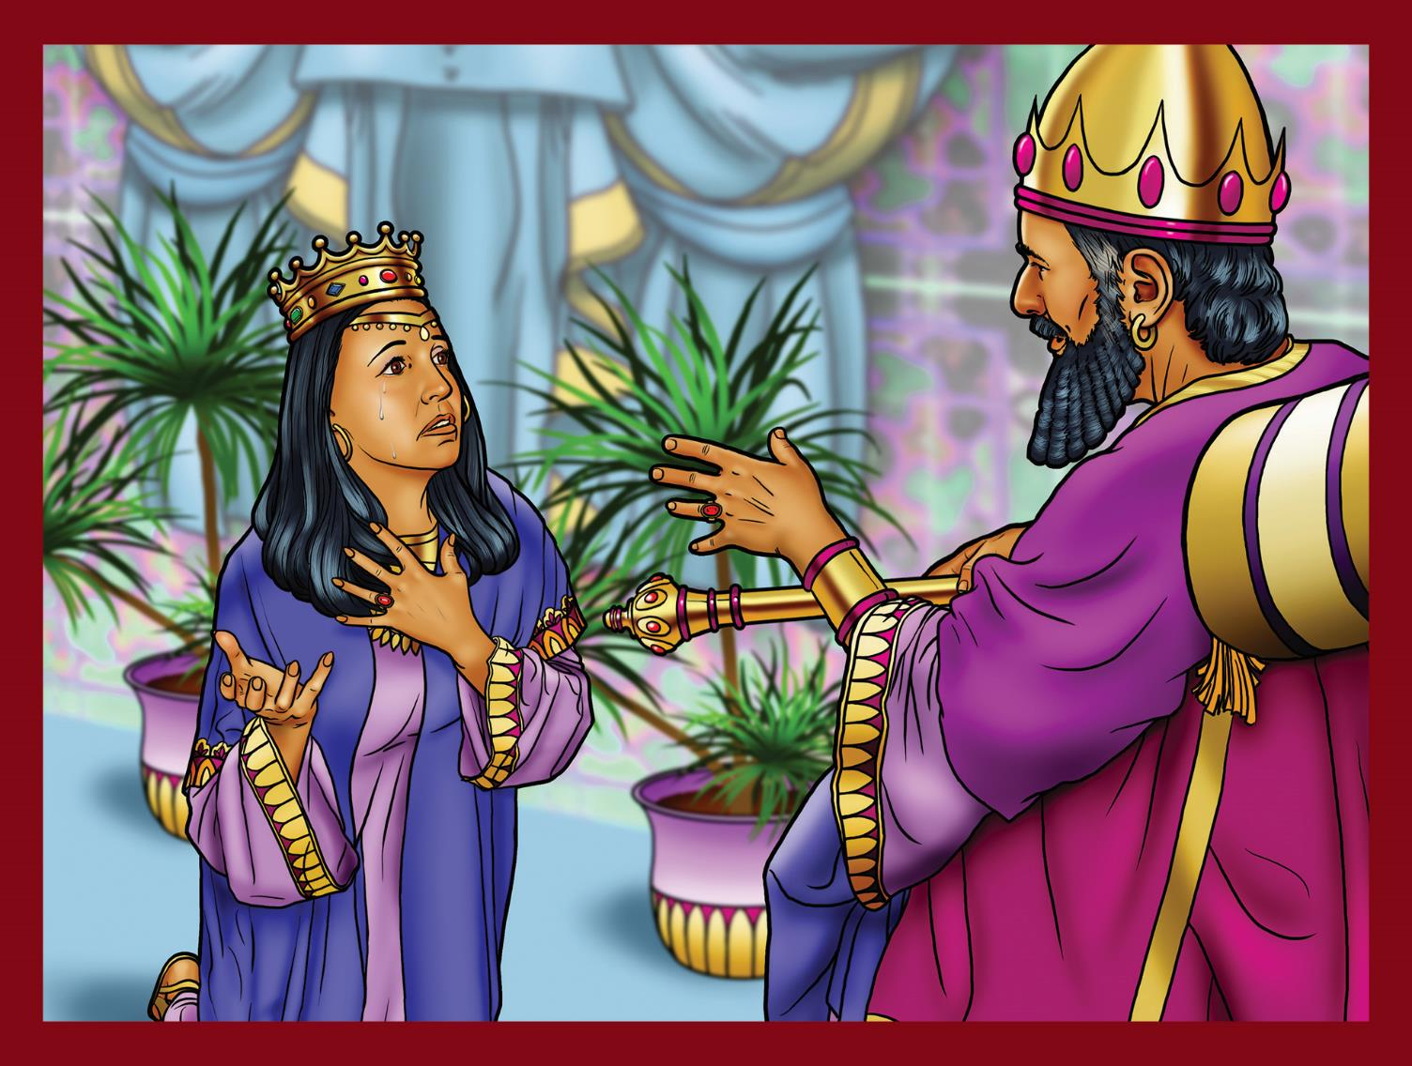
God preserves His people through Esther.

Slide 18
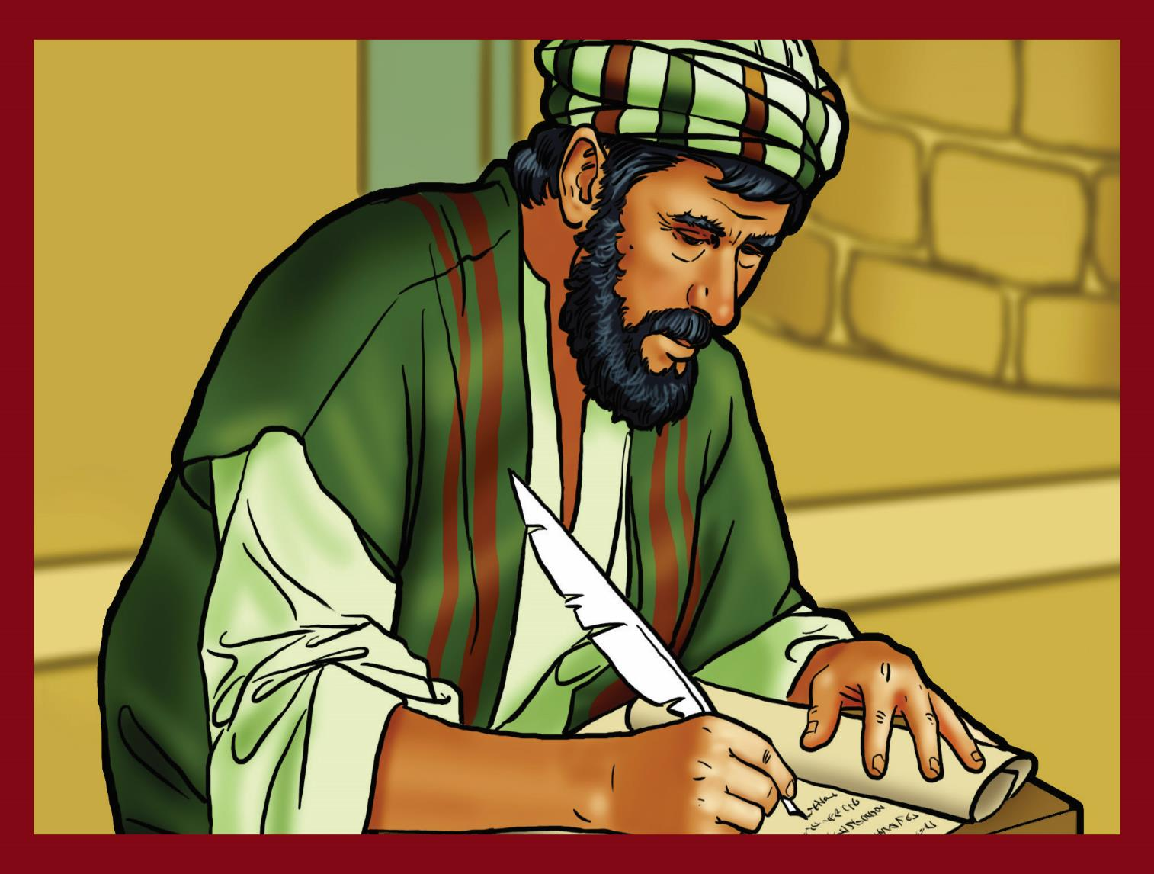
God completes the Old Testament.

Slide 19
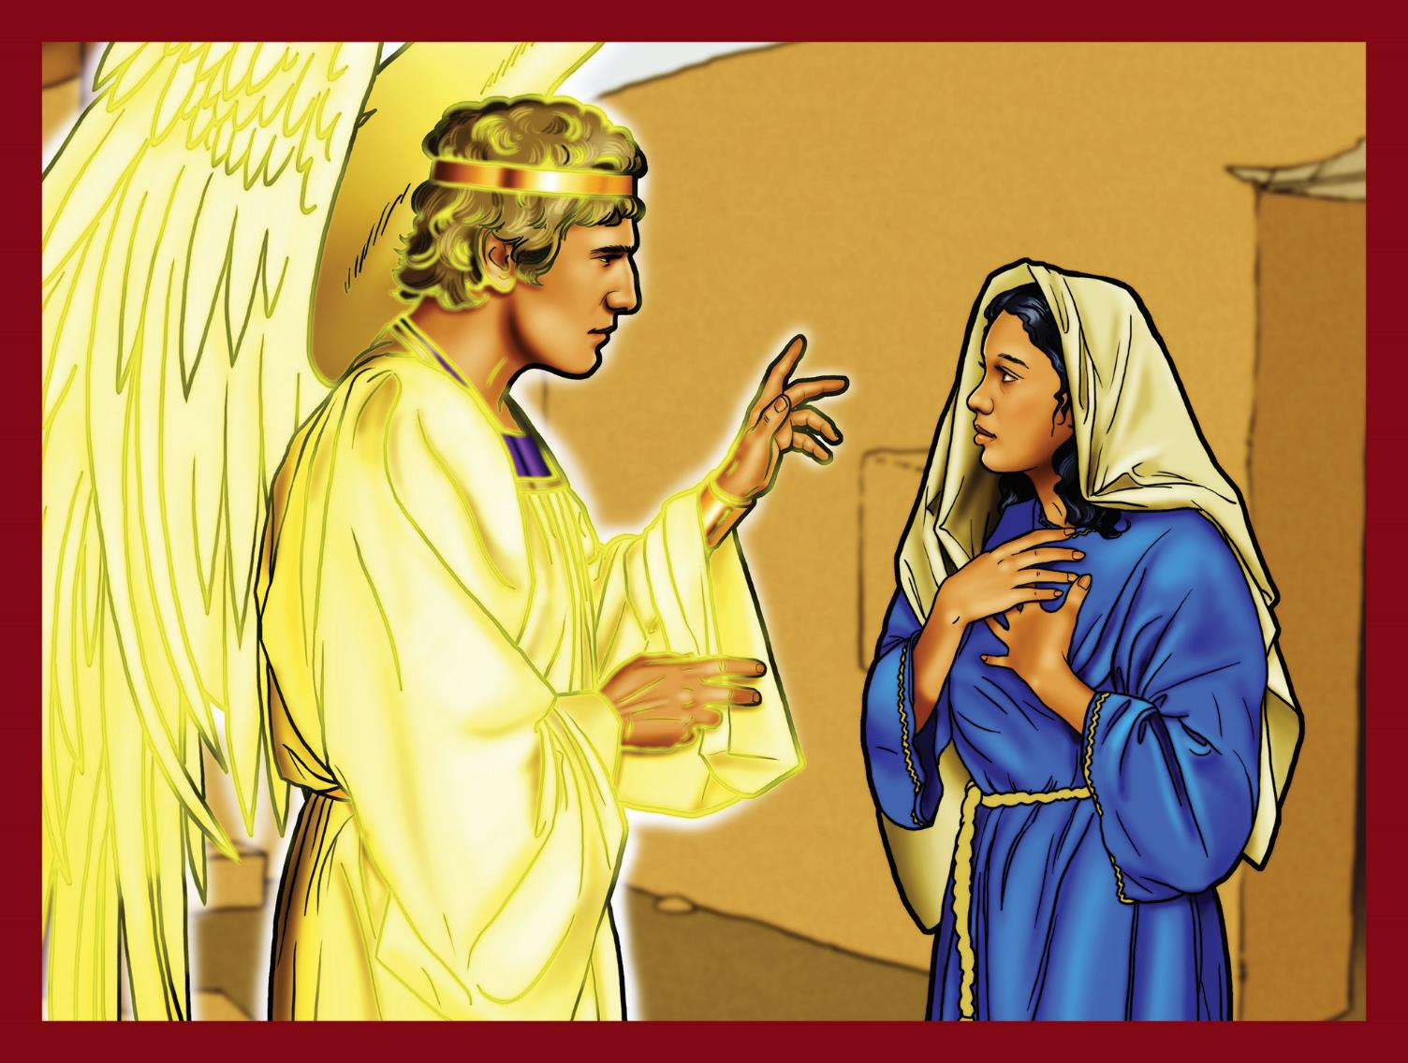
God never forgets His promises.

Slide 20
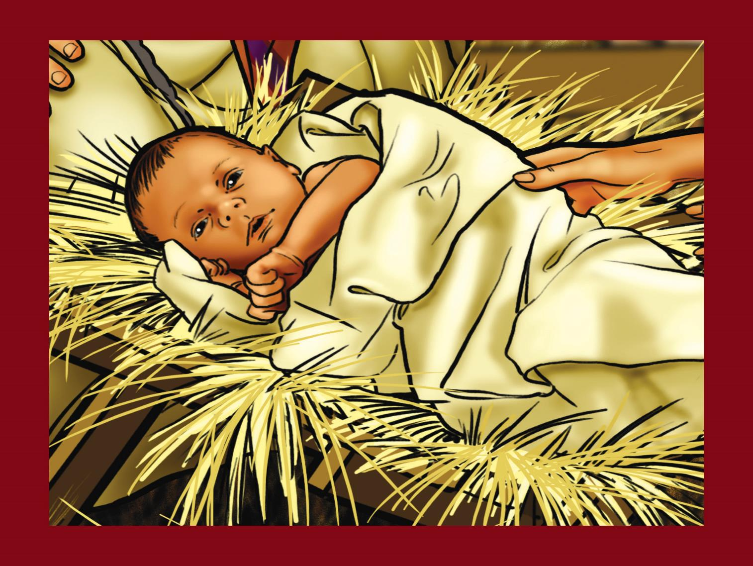
The Savior is born.

Slide 21
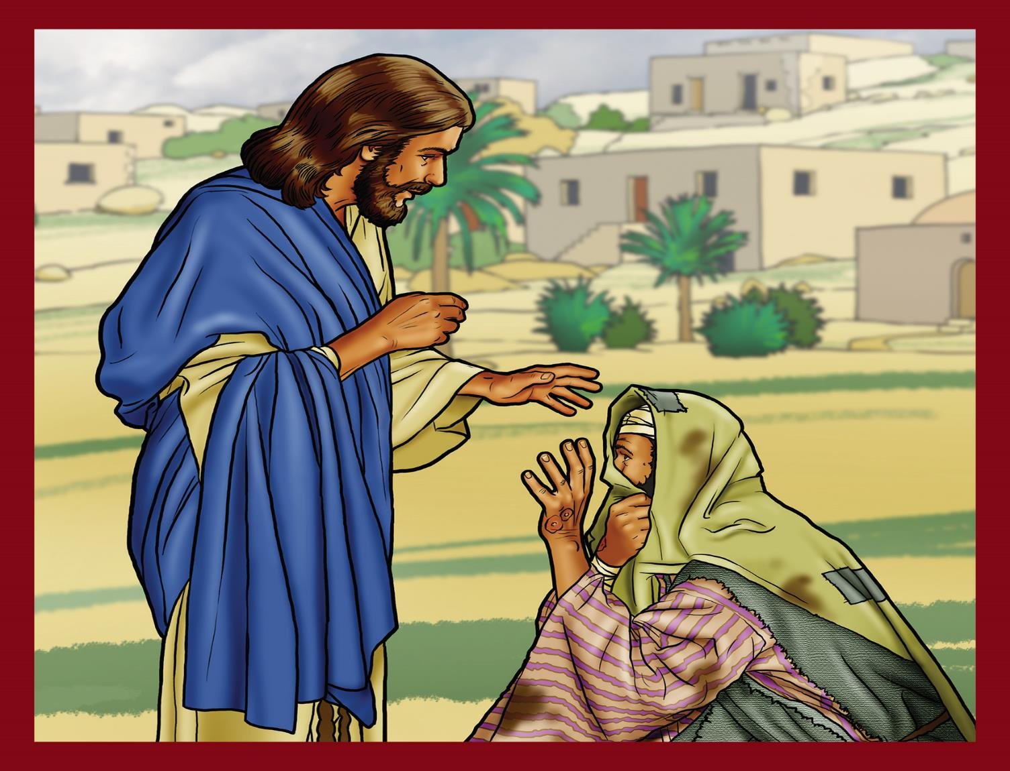
Jesus shows His power over sickness.

Slide 22
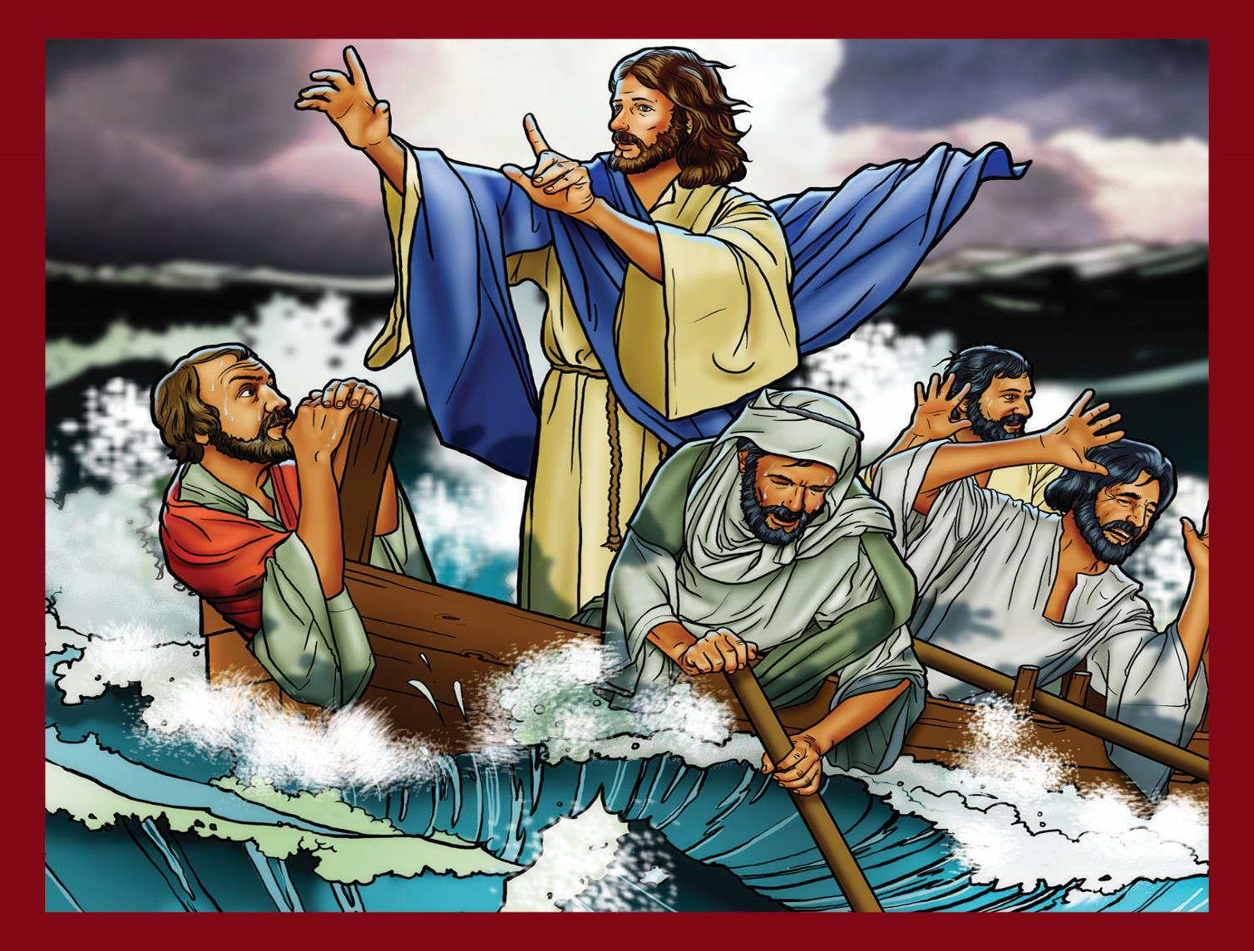
Jesus shows His power over Creation.

Slide 23
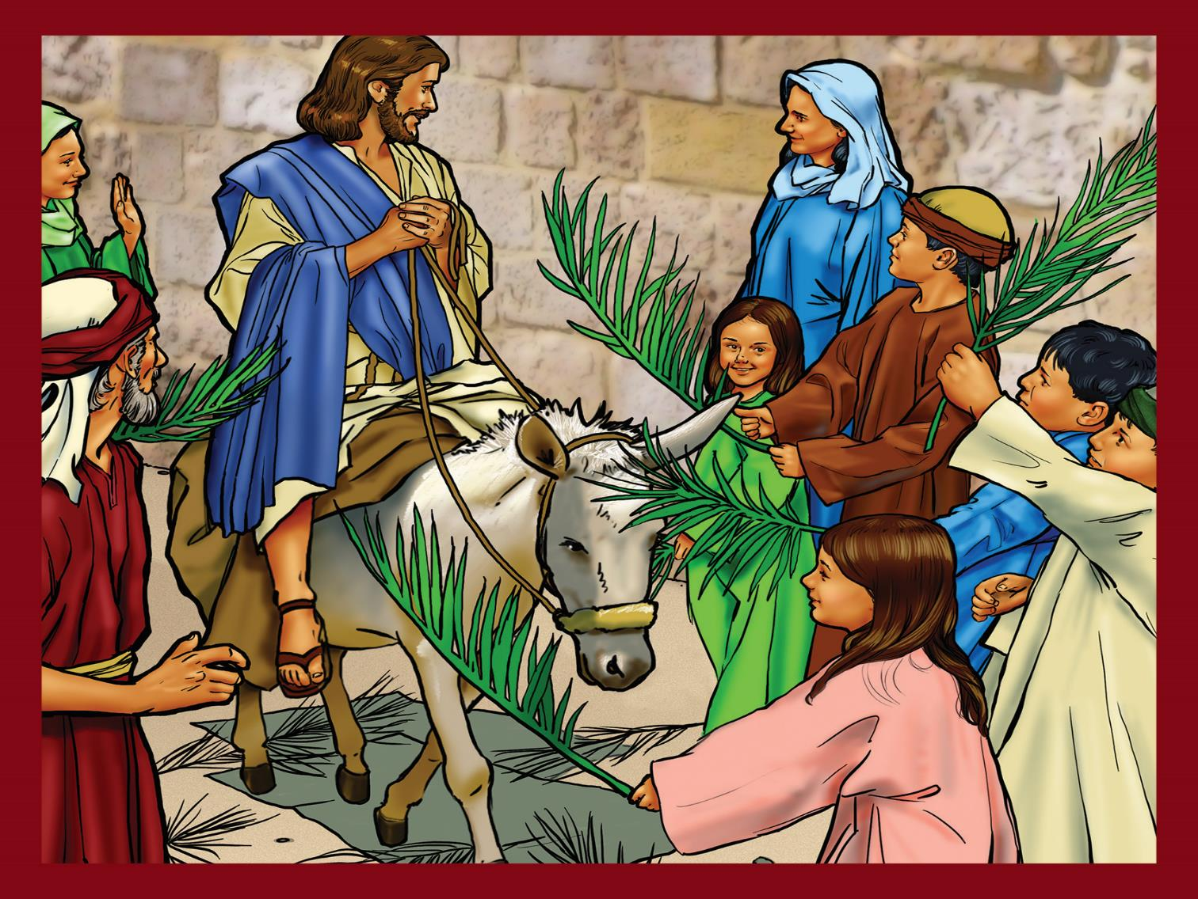
Jesus is the promised Savior.

Slide 24
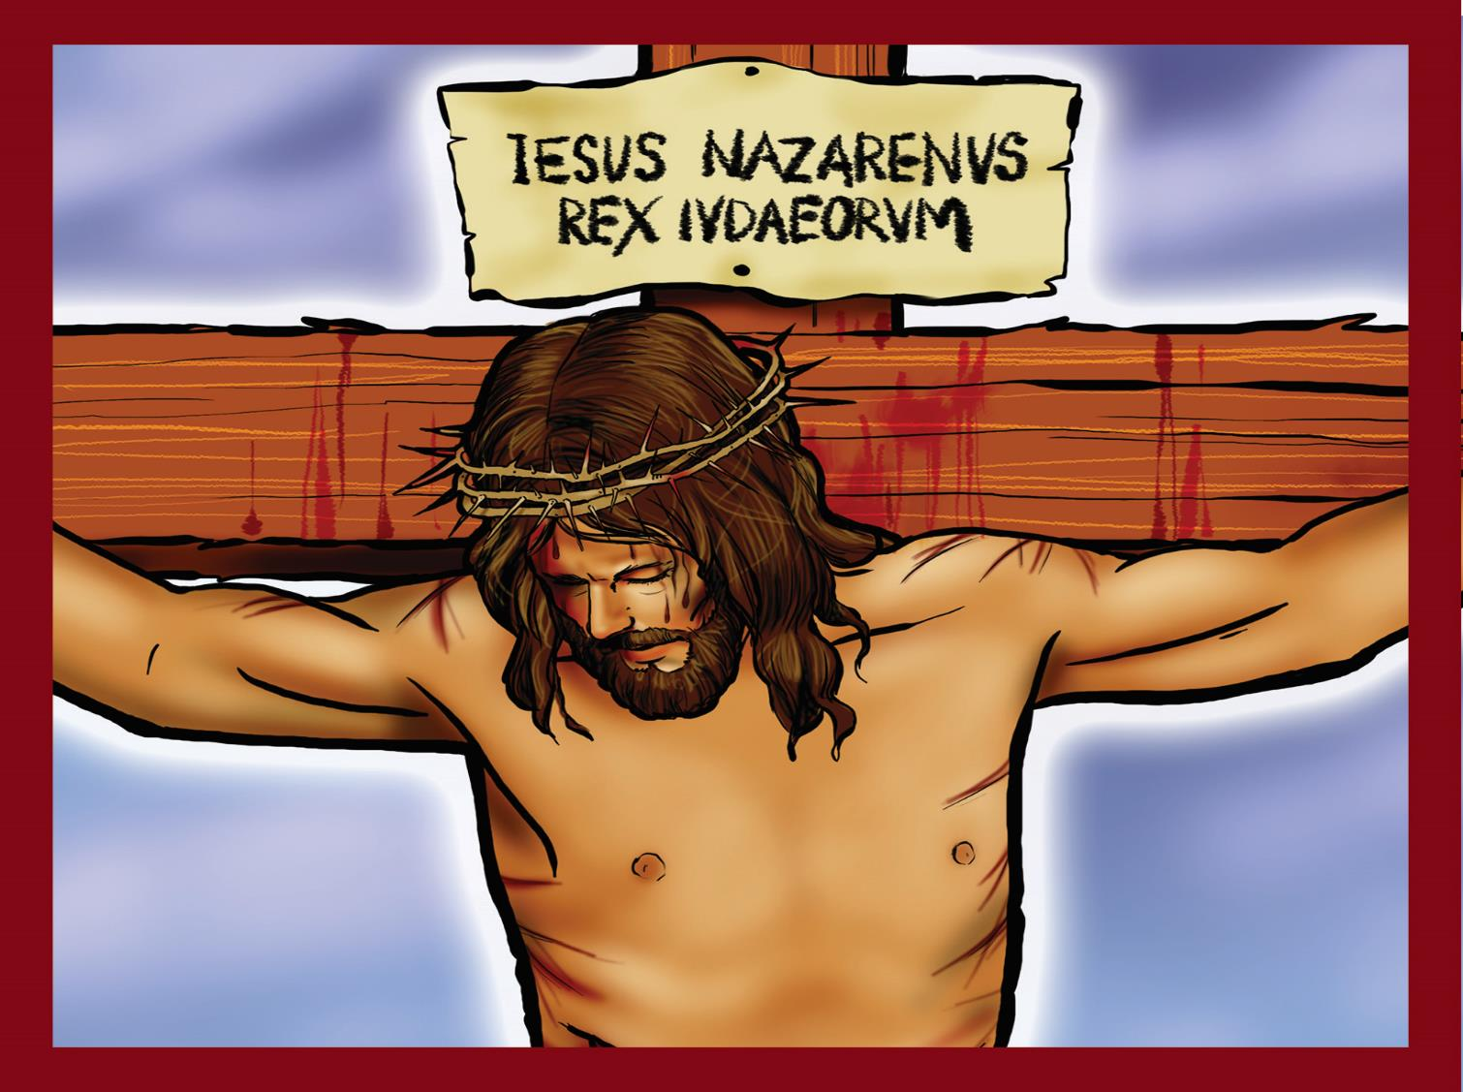
Jesus suffers and dies.

Slide 25
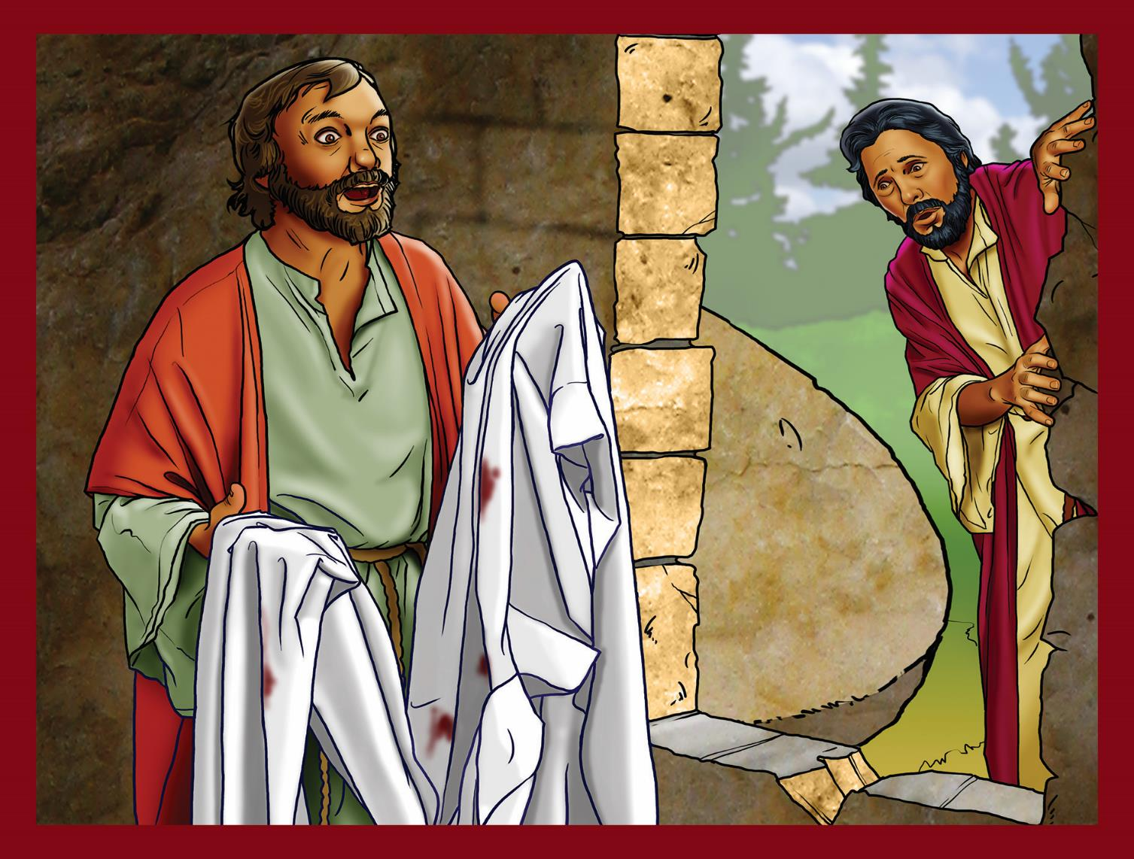
Jesus is alive.

Slide 26
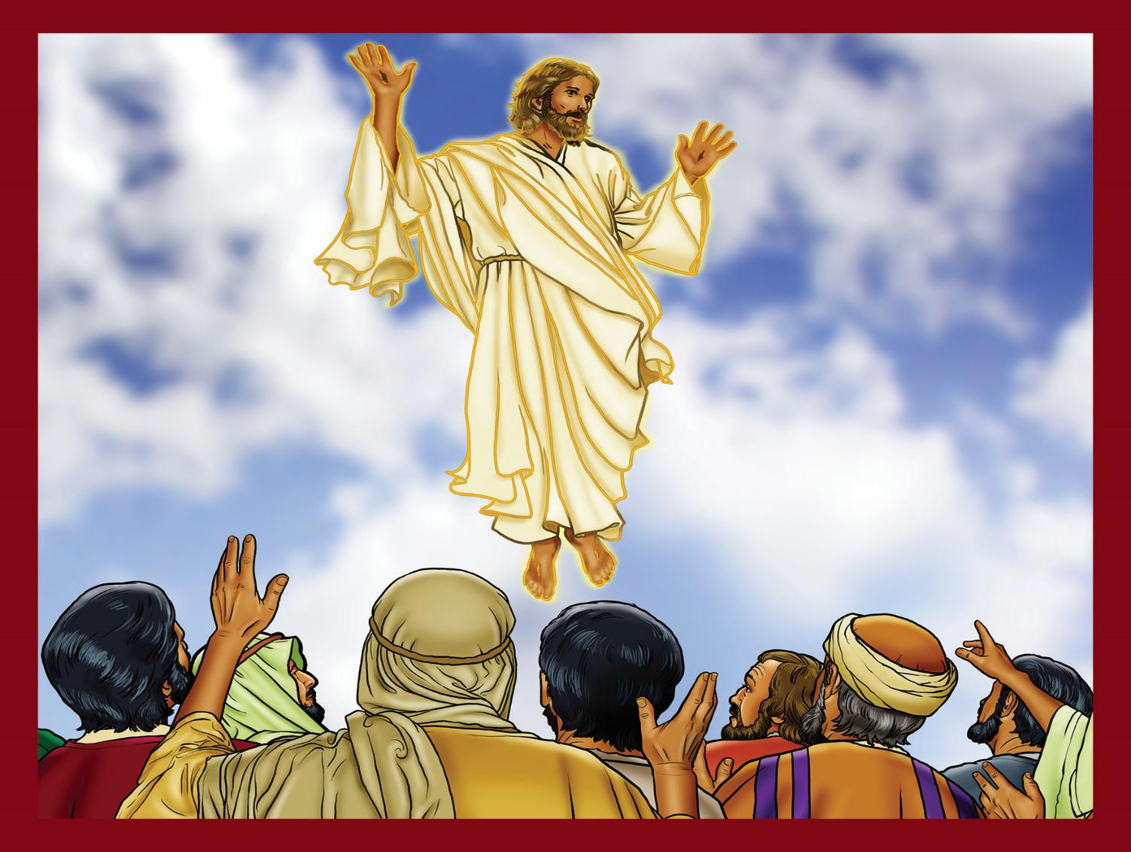
Jesus returns to Heaven as King.

Slide 27
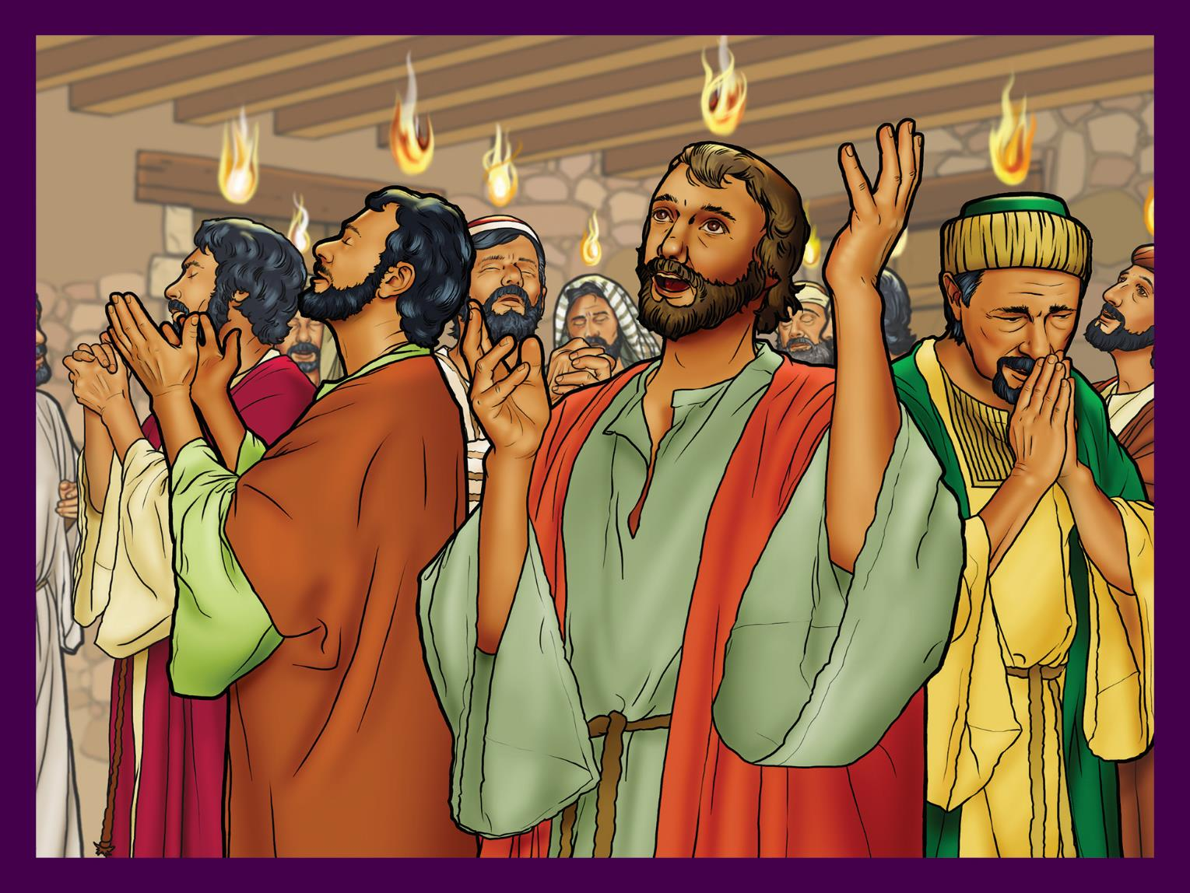
God’s Holy Spirit comes
to help.

Slide 28
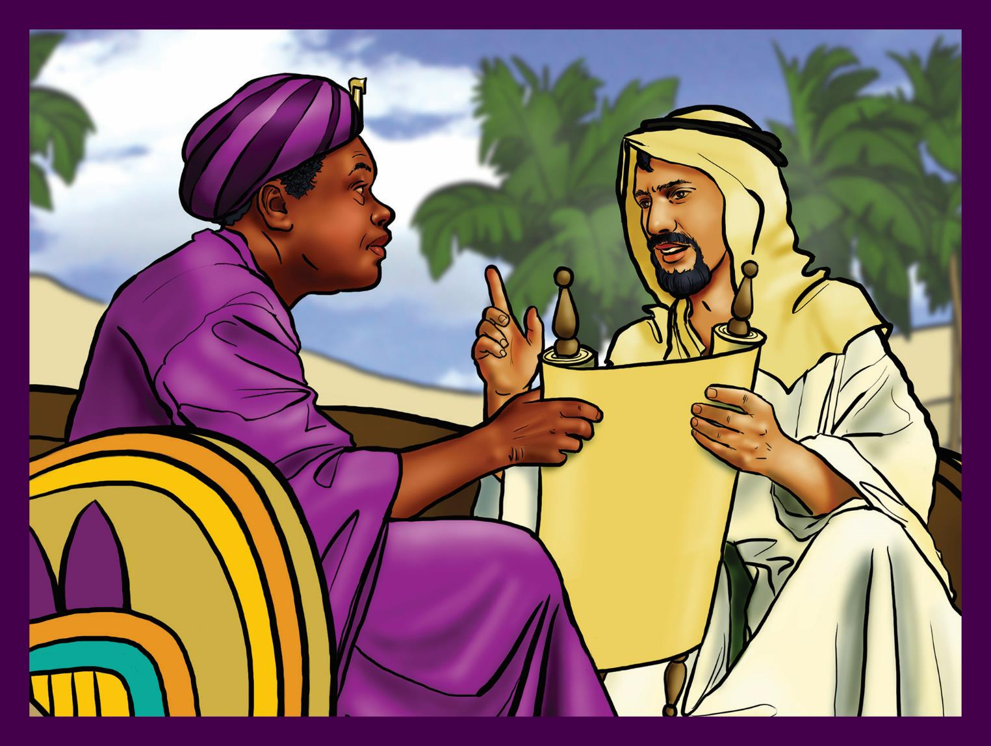
God’s church grows.

Slide 29
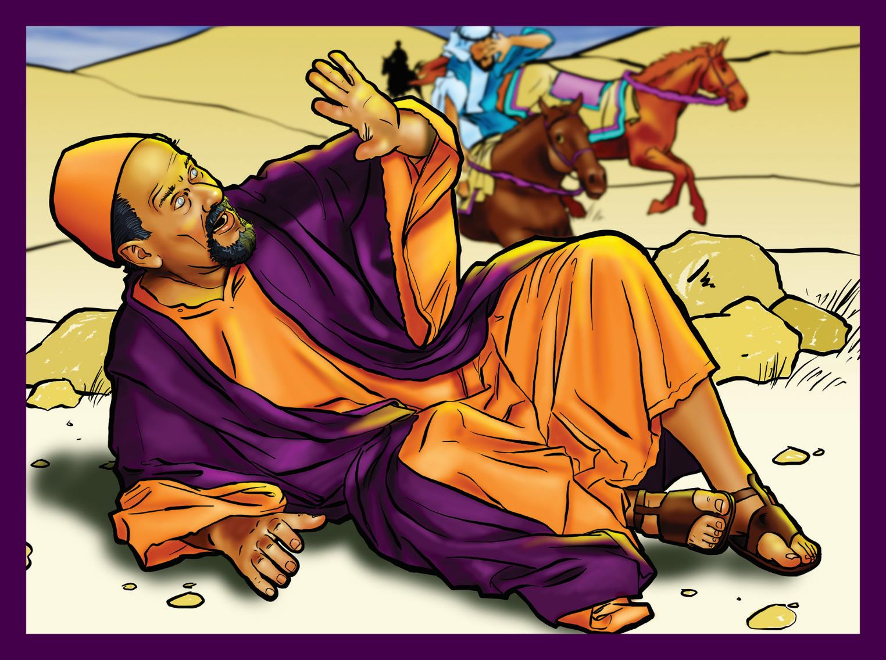
God saves Saul.

Slide 30
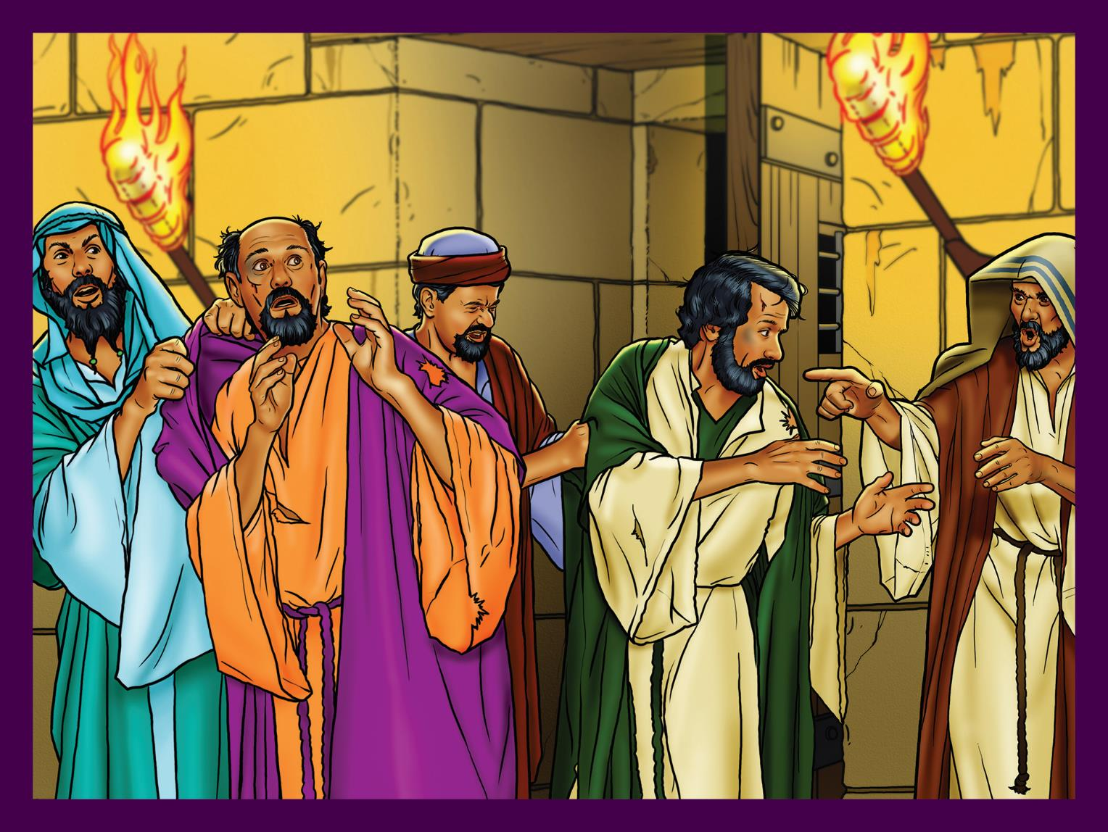
Persecution causes God’s church to spread.

Slide 31
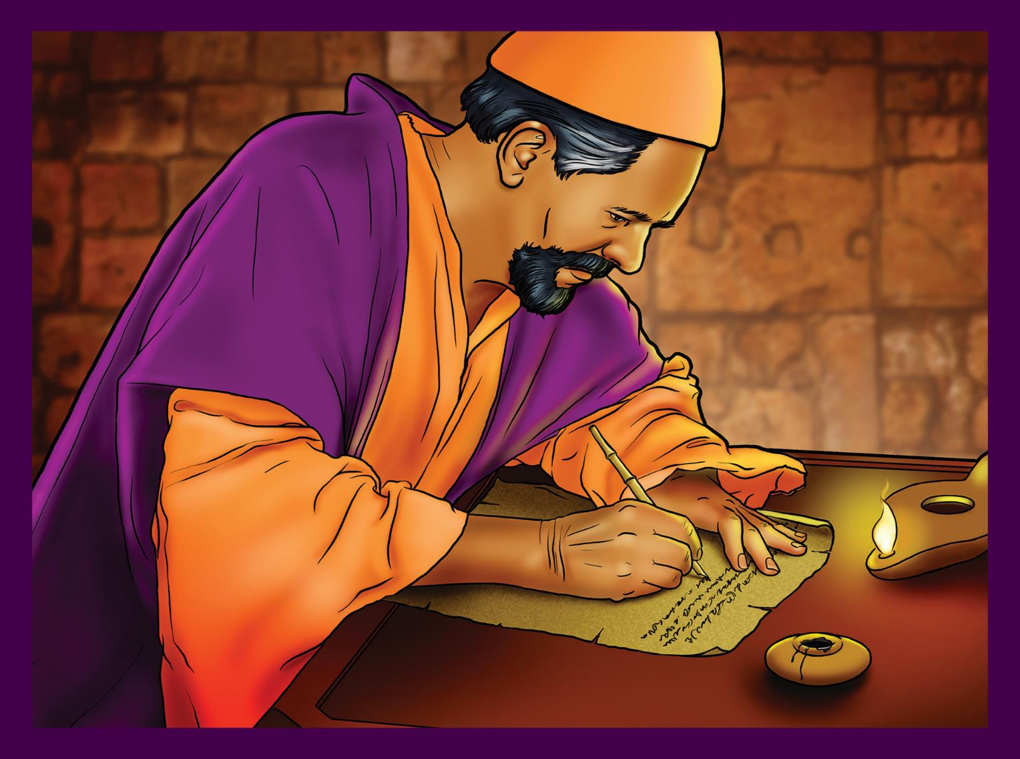
God completes the Bible.

Slide 32

God is working in you and me.

Slide 33


Jesus Returns

Slide 34
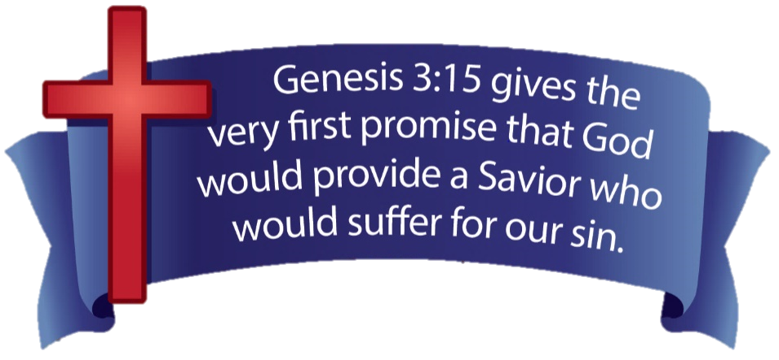

Slide 35
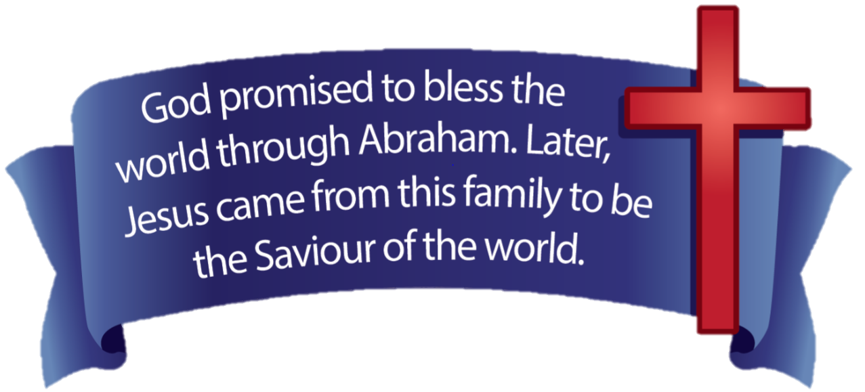

Slide 36
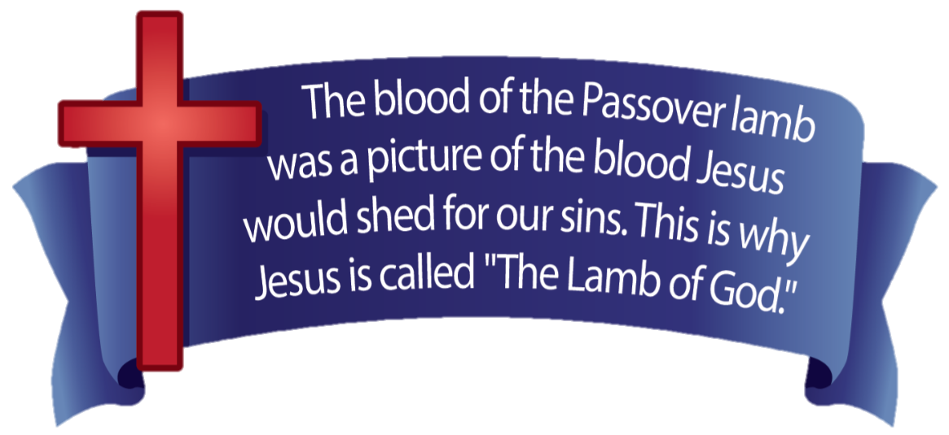

Slide 37
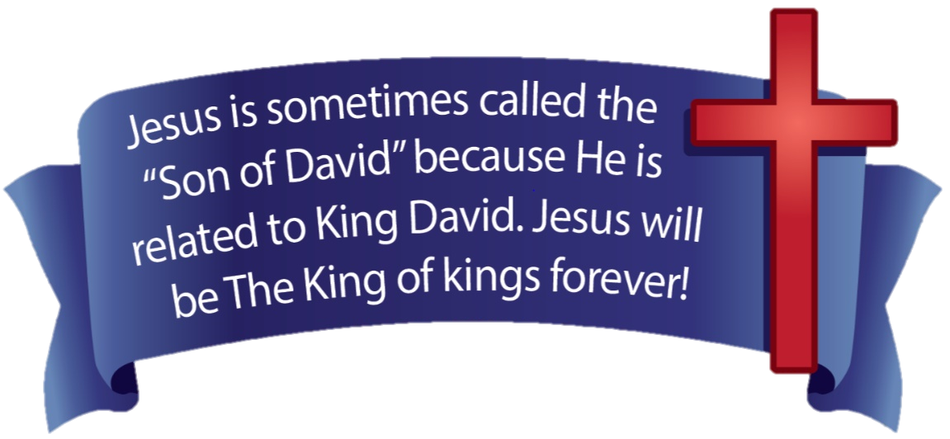

Slide 38
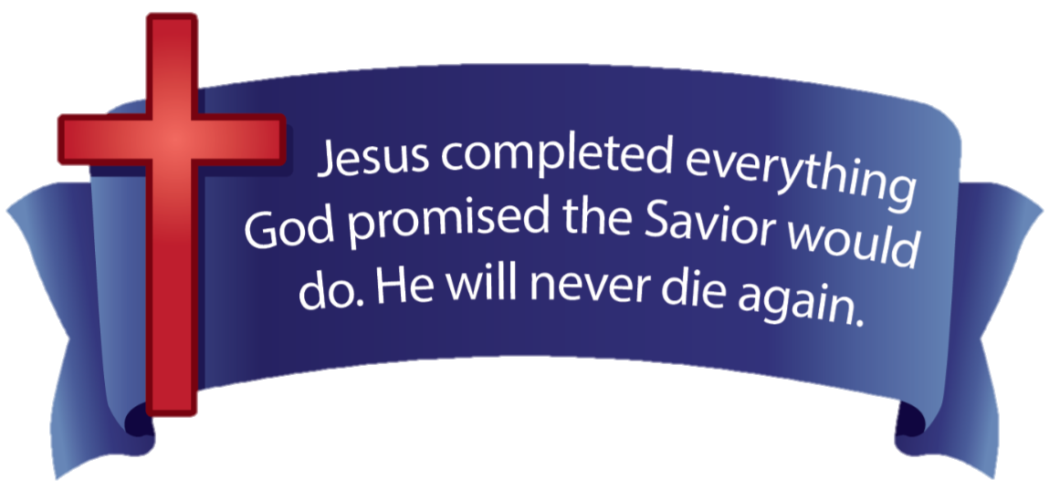

Slide 39
