Slide 1

We’re gonna do
what the Bible tells us.
We’re gonna learn
what it means to obey.
And though the world
sometimes tries to tempt us,
we’re gonna do things God’s way!

Slide 2


There is only one thing
we can be sure of
a command that is true.
It’s a message
we’re badly in need of
coming straight to
me and you.

Slide 3



We’ve got to do
what is right
Standing for what
is true by His
power and
might!

Slide 4
We’re gonna do
what the Bible tells us.
We’re gonna learn
what it means to obey.
And though the world
sometimes tries to tempt us,
we’re gonna do things God’s way!

Slide 5
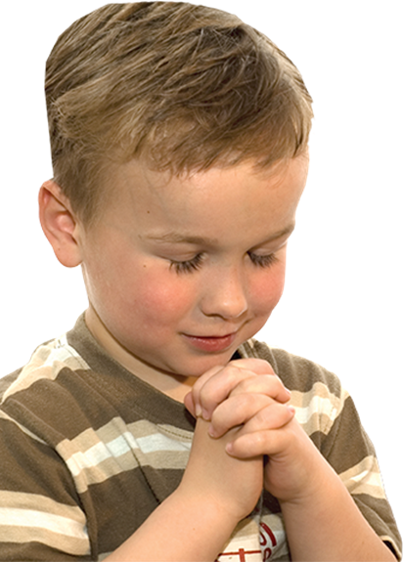
There is only one way
to find real joy
in all that comes
your way.
It’s to follow God’s
loving direction
trusting Him
each day.

Slide 6

He’ll give you all that you need
to make choices that are right.
Just trust and believe!

Slide 7
We’re gonna do
what the Bible tells us.
We’re gonna learn
what it means to obey.
And though the world
sometimes tries to tempt us,
we’re gonna do things God’s way!

Slide 8
And though the world
sometimes tries to tempt us,
we’re gonna do things God’s way!

