Slide 1

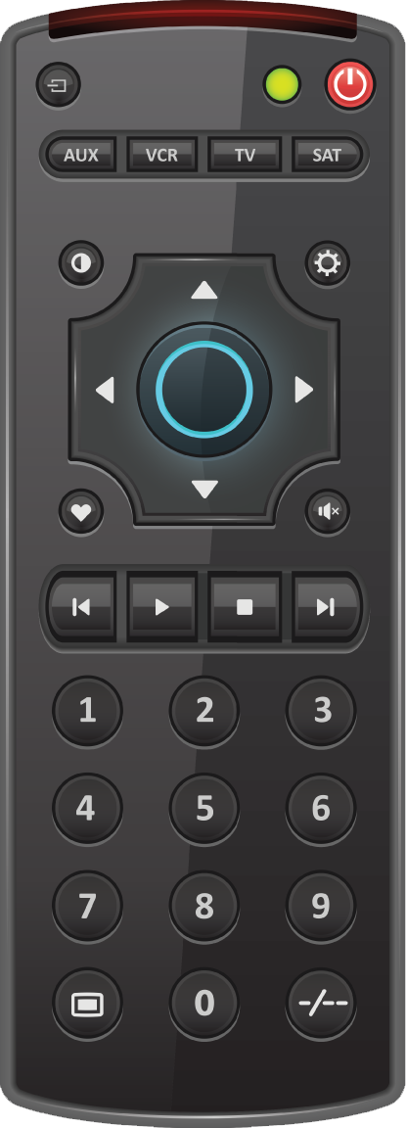






Notes:
Instructions: Divide the children into two teams. To start playing click the power button on the remote to turn on the “TV.” Then click the “rewind” button (the one left of the play button) to advance to the next screen. Discuss with the children what the Flashcard is talking about and then click the screen to advance to that week’s “Word Up!” and have the children say it. Click on the words to bring the remote onto the screen and click the “rewind” button to advance to the hearts slide. Ask the children the two review questions from that week, one for each team. Have the child who answered correctly pick which heart they want for their team. Click the chosen heart to reveal the amount of points for that team. You will want to have another teacher keep track of points as you go along. After asking the questions from that week click the “Remote” button in the bottom right corner to bring up the remote. Click the rewind button to go to the next Flashcard. Continue to do this with lessons 4-1. After asking the questions for Lesson 1,………. click the arrow in the bottom right corner to take you to the slide with the TV and click the “power” button to turn it off. The team with the most points at the end wins!

Slide 2
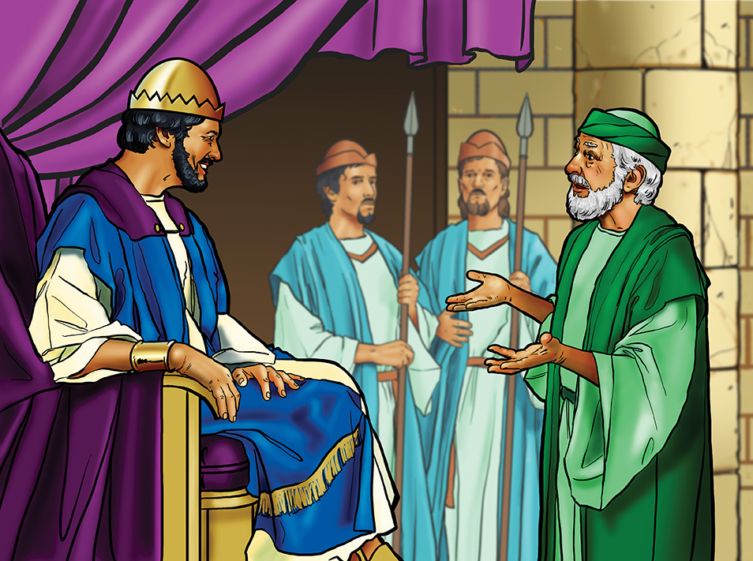

Slide 3


Slide 4

1
2
3
4
100
ZERO
500
200
5
6
7
8
100
200
300
500
9
10
11
300
100
ZERO
Remote

Slide 5
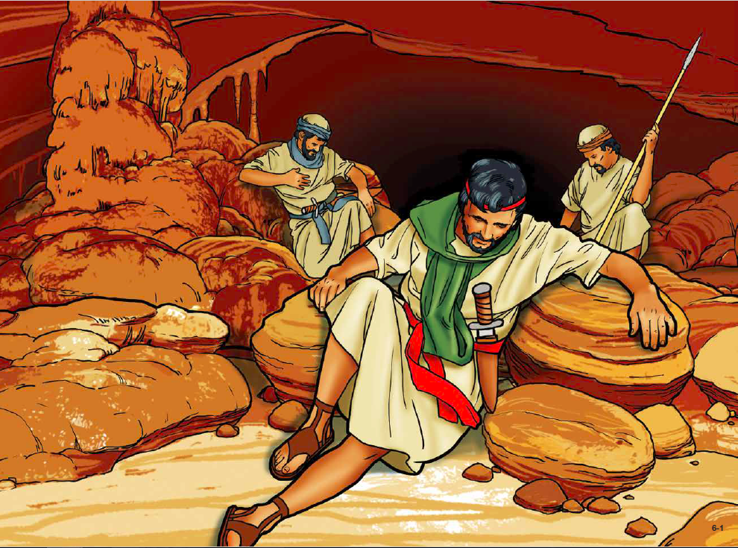

Slide 6


Slide 7
1
2
3
4
500
100
300
400
5
6
7
8
100
ZERO
500
100
9
10
11
ZERO
100
400
Remote

Slide 8
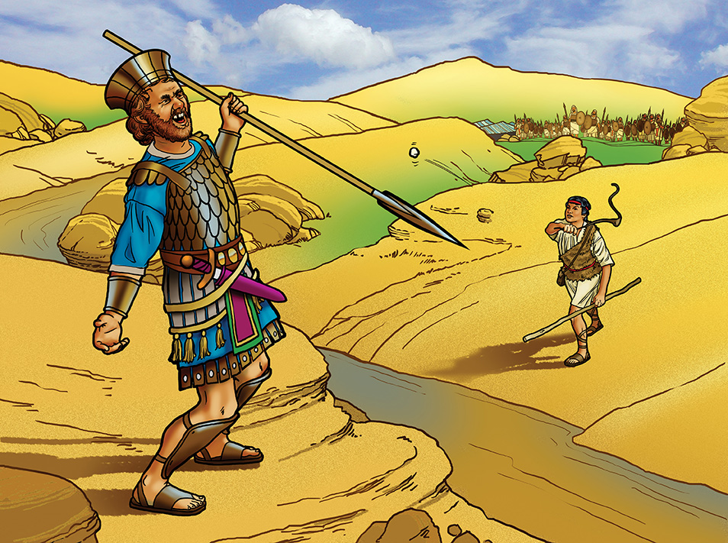

Slide 9


Slide 10
1
2
3
4
100
ZERO
500
200
5
6
7
8
100
200
300
500
9
10
11
300
100
ZERO
Remote

Slide 11
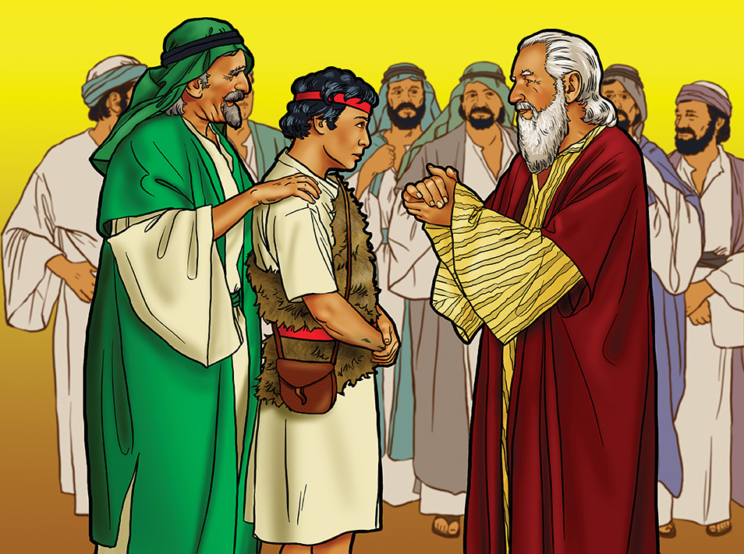

Slide 12


Slide 13
1
2
3
4
500
100
300
400
5
6
7
8
100
ZERO
500
100
9
10
11
ZERO
100
400
Remote

Slide 14
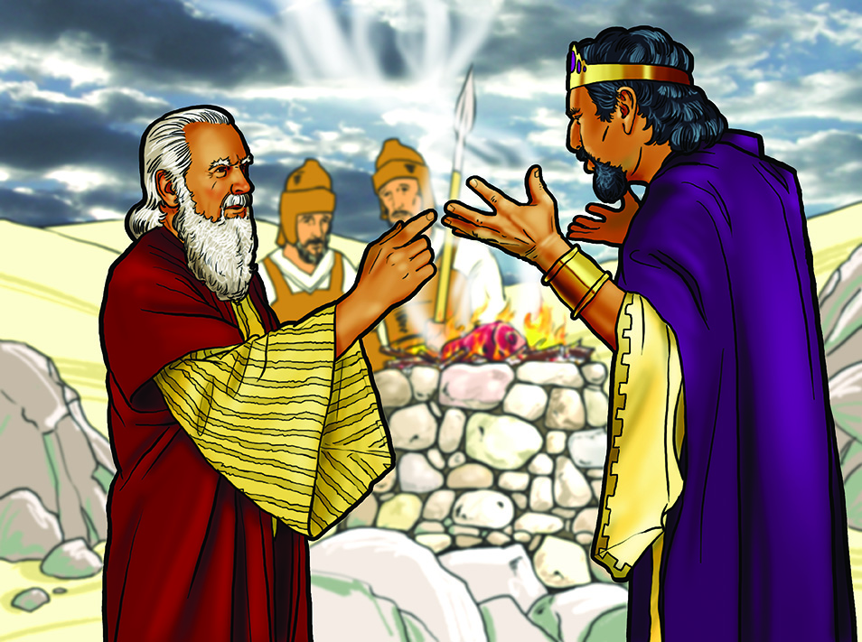

Slide 15


Slide 16
1
2
3
4
100
ZERO
500
200
5
6
7
8
ZERO
200
100
500
9
10
11
ZERO
300
400

