Slide 1
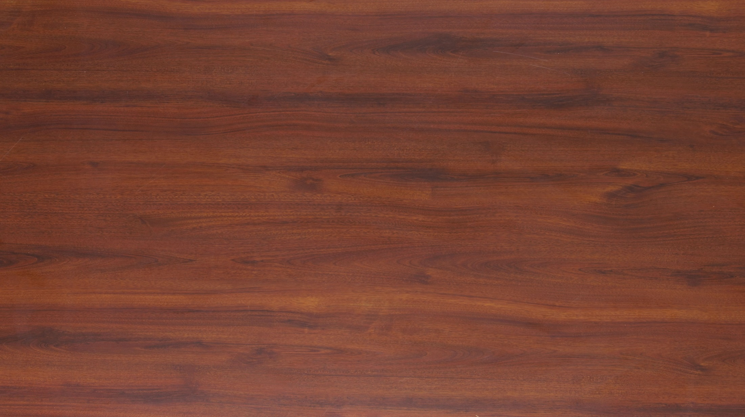











Team 1
Team 2
Notes:
Instructions: Divide the children into two teams. Choose points ahead of time for each table setting piece at the bottom of the screen but do not tell the children what point values the items have. When a child answers a question correctly, he may choose an item to set his team’s side of the table. Click on the arrow pointing toward his team’s side of the table to move that item to his table setting. The children can pick each piece up to three times for their team. At the end of the game, tell the children how many points each piece is worth and add up the points. I.e., if cups are worth 500 points and the team has 2 cups on their place setting, their team would get 1000 points.

