Slide 1

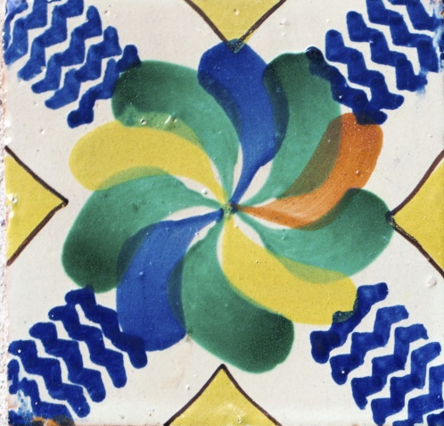






1
2
3
4
5
6
Notes:
Instructions: To play have a child pick a square then click that square and it will reveal an action such as “hop.” Click the word to advance to the verse slide. Then say the verse while doing the action described on every other word. Click the arrow in the bottom right hand corner and have another child pick the different square and repeat as time allows.

Slide 2
Psalms 119:9-11
How can a young man keep his way pure? By guarding it according to your word. With my whole heart I seek you; let me not wander from your commandments! I have stored up your word in my heart,
that I might not sin against you.
Psalms 119:9-11

