Slide 1
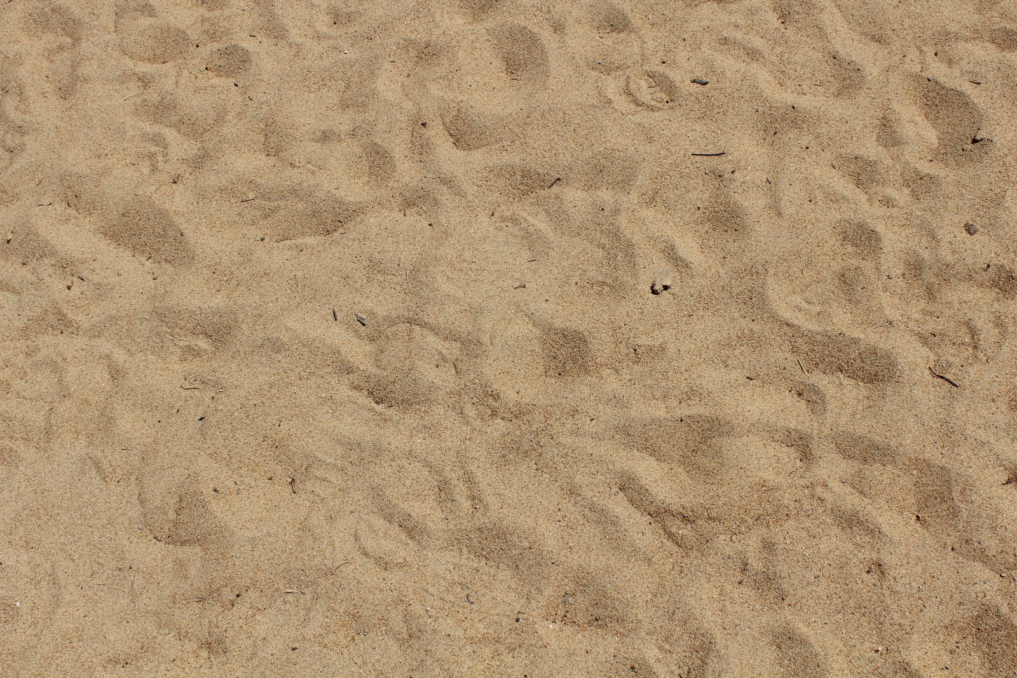
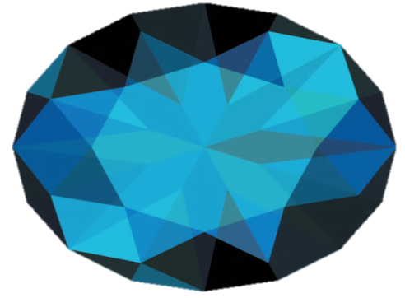












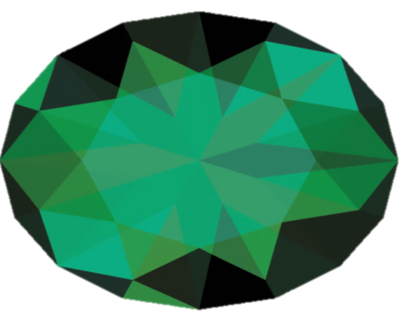

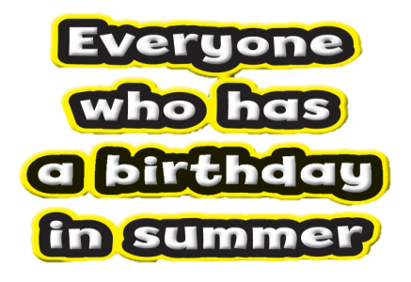
Notes:
Have a child choose a jewel. Click on the jewel to reveal what actions the children will be doing as they say the verse. Click on the action to go to the verse. Click in the home button in the right lower corner of the verse slide to return to the treasure hunt. Repeat as time allows.

Slide 2
Psalm 119:11
I have stored up
your word in my heart, that I might
not sin against you.
Psalm 119:11

