Slide 1
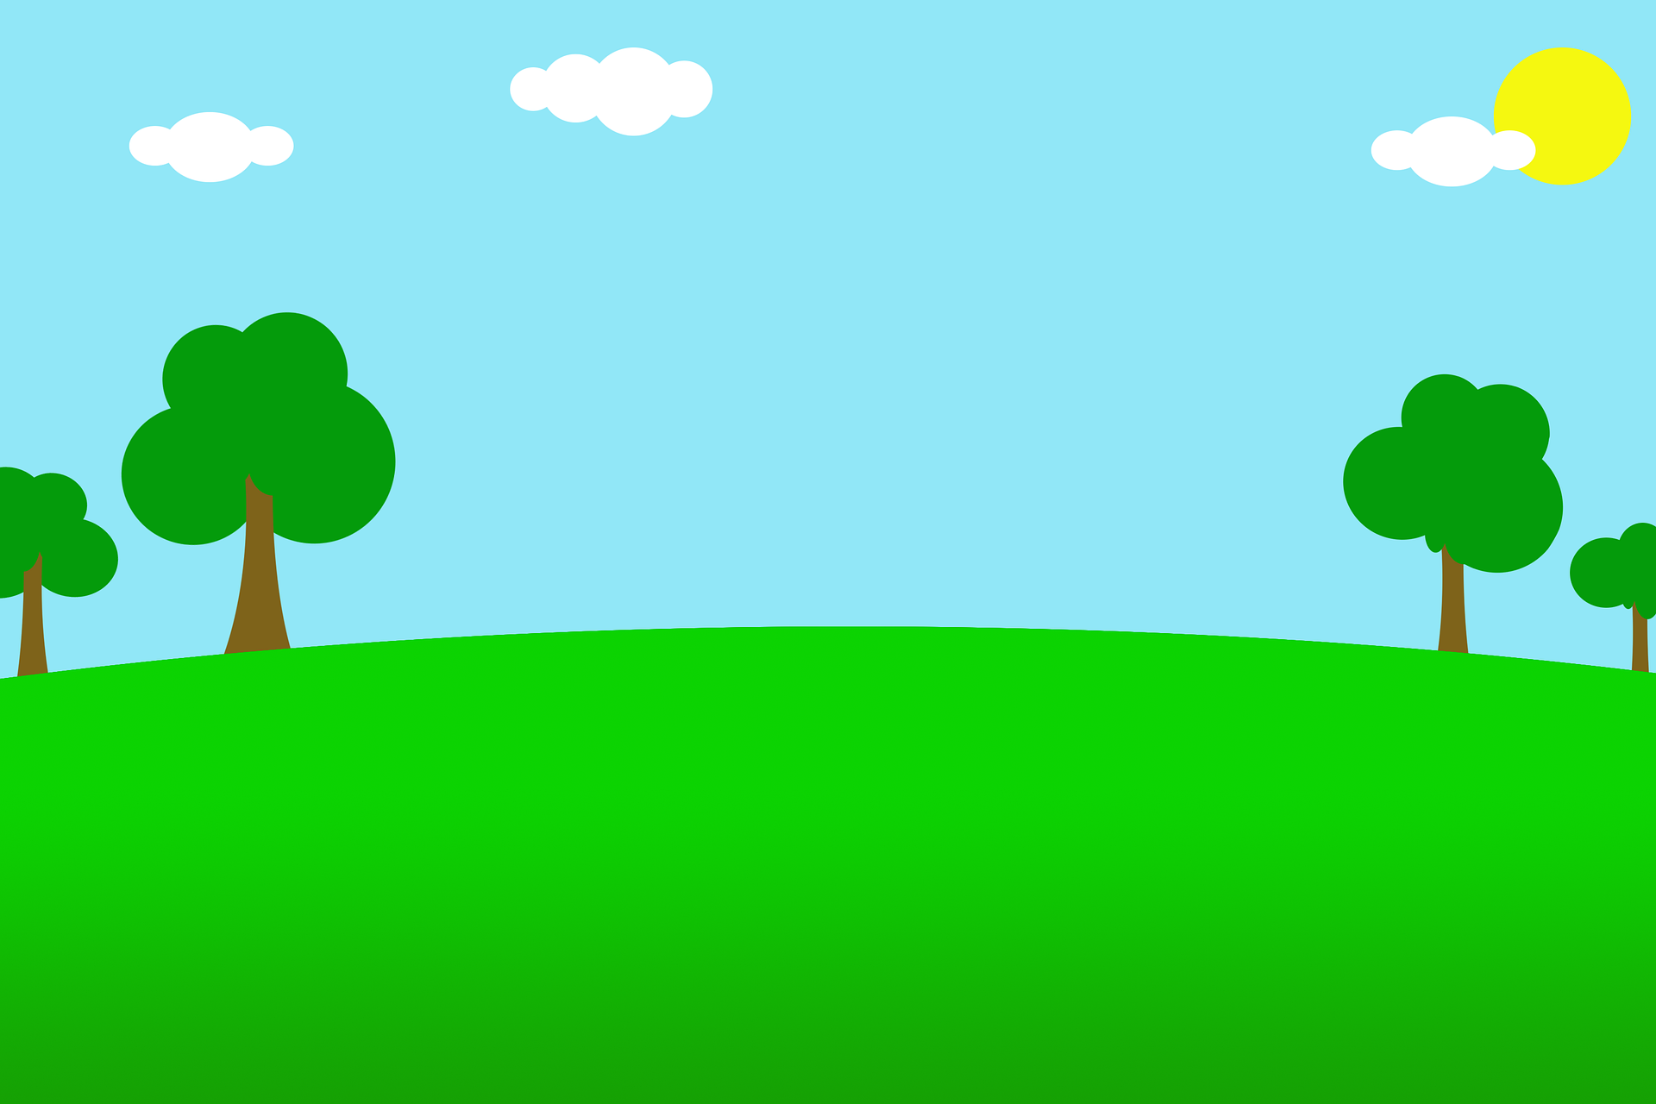
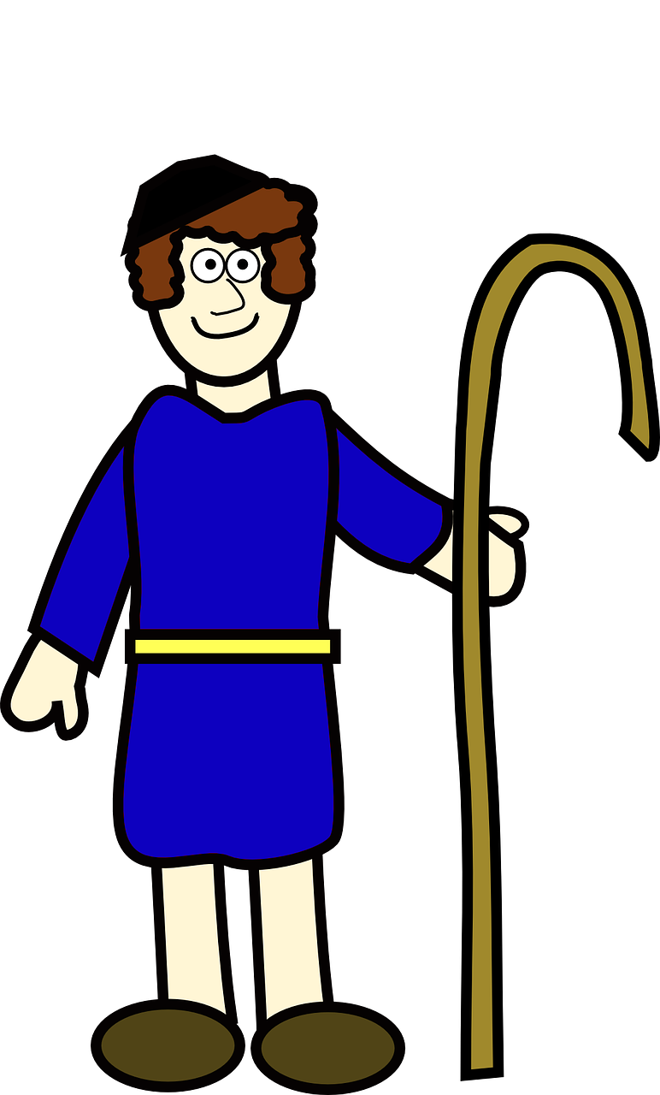
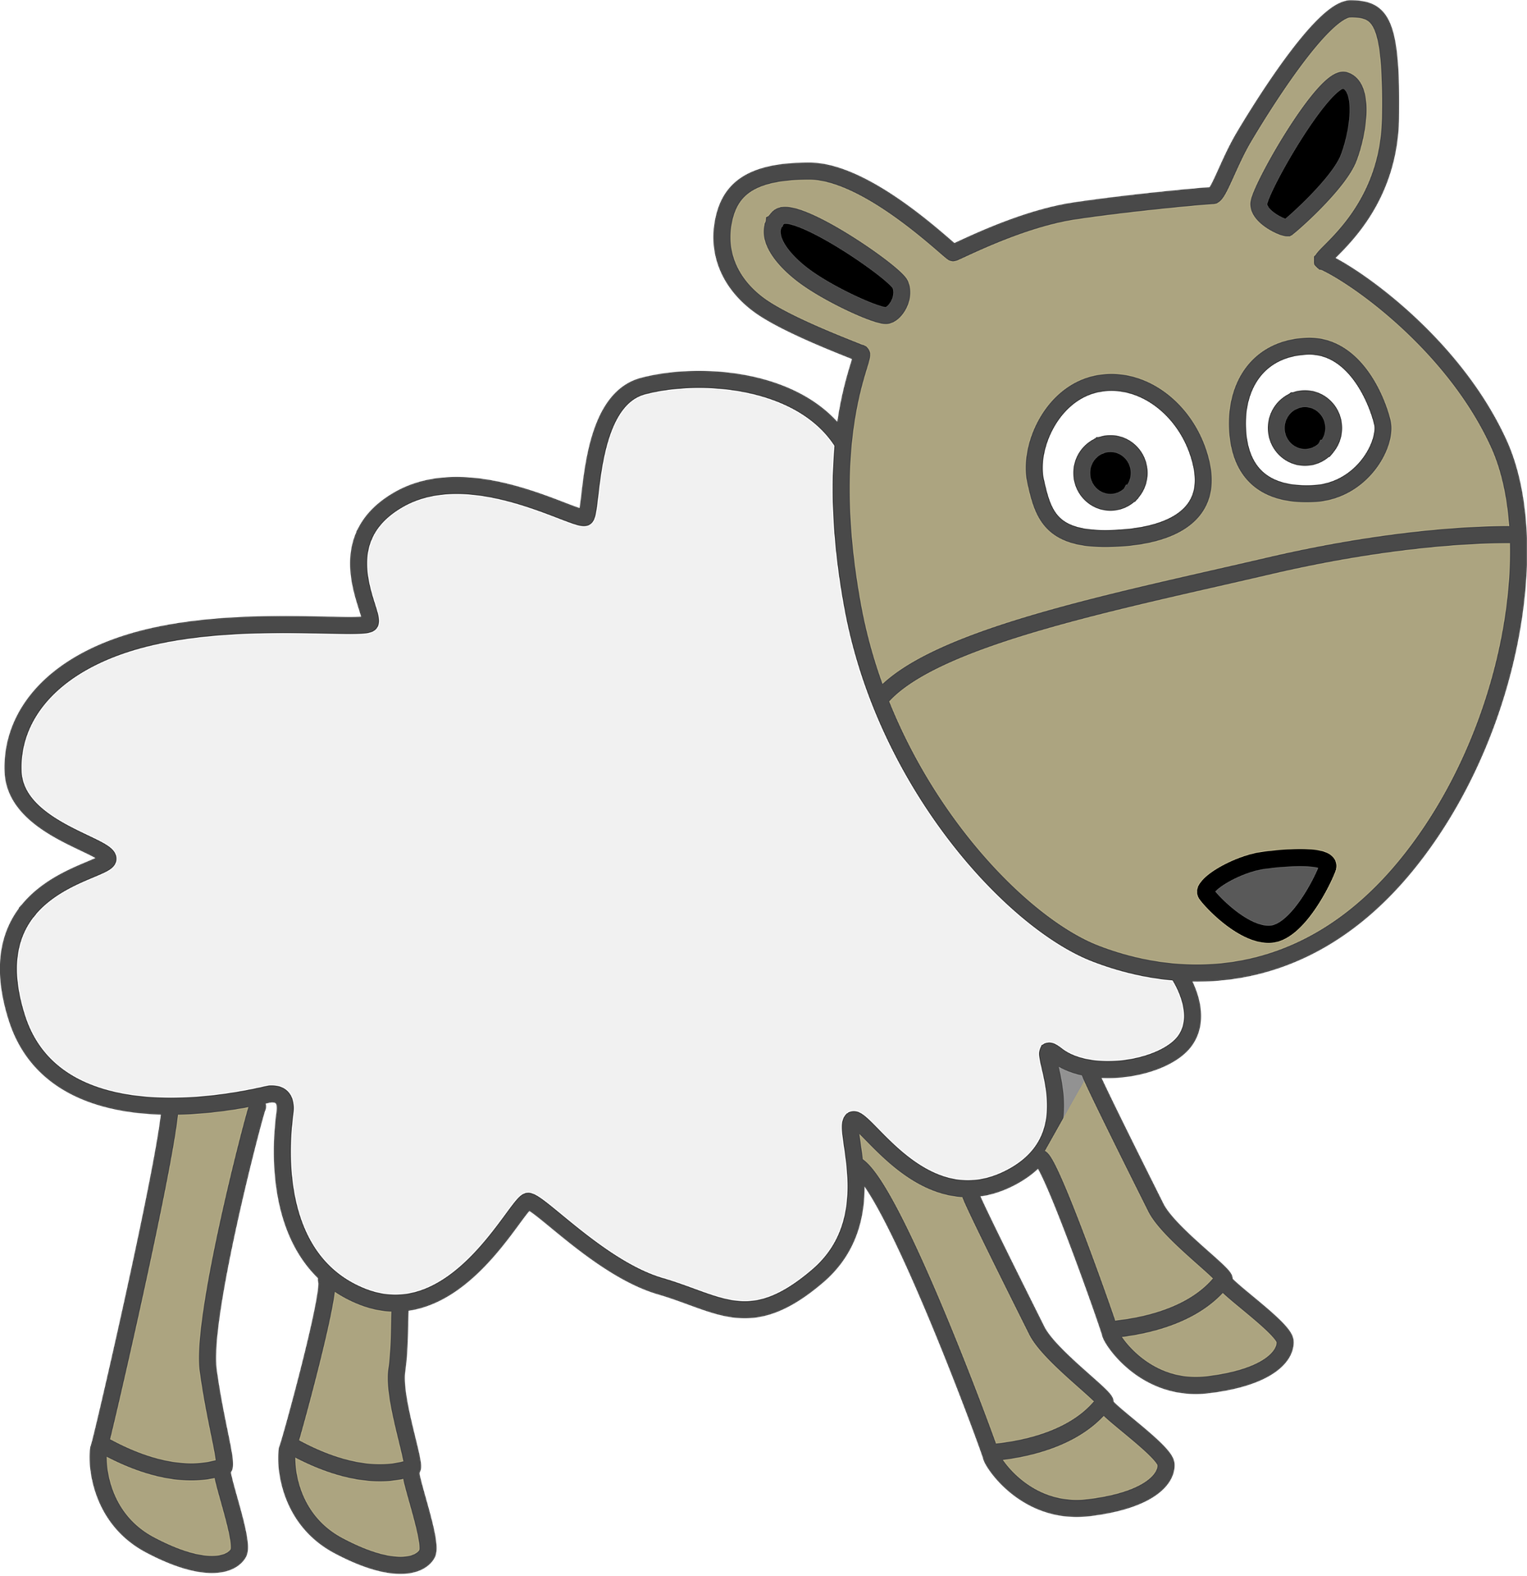
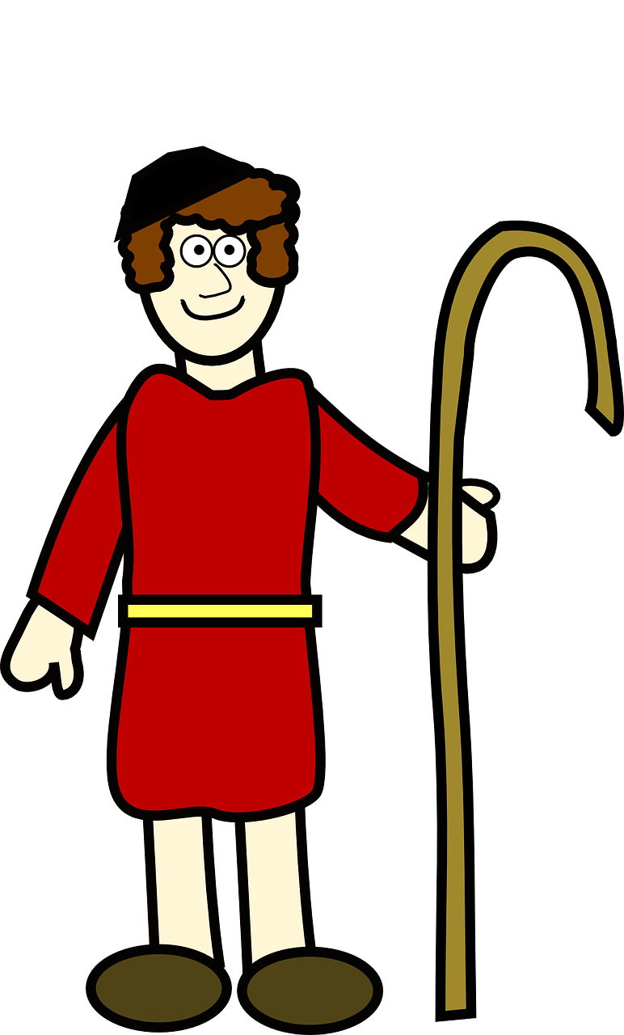
- - - - - - - - - - - - - - - - - - - - - - -
- - - - - - - - - - - - - - - - - - - - - - -
Notes:
Instructions: Divide children into two teams. Assign each team a shepherd, red to one and blue to the other. When a child answers a review question correctly, click on the sheep from that team to move it forward a step. The team whose sheep reaches the shepherd first or is closest to the shepherd at the end of the game wins.

