Slide 1
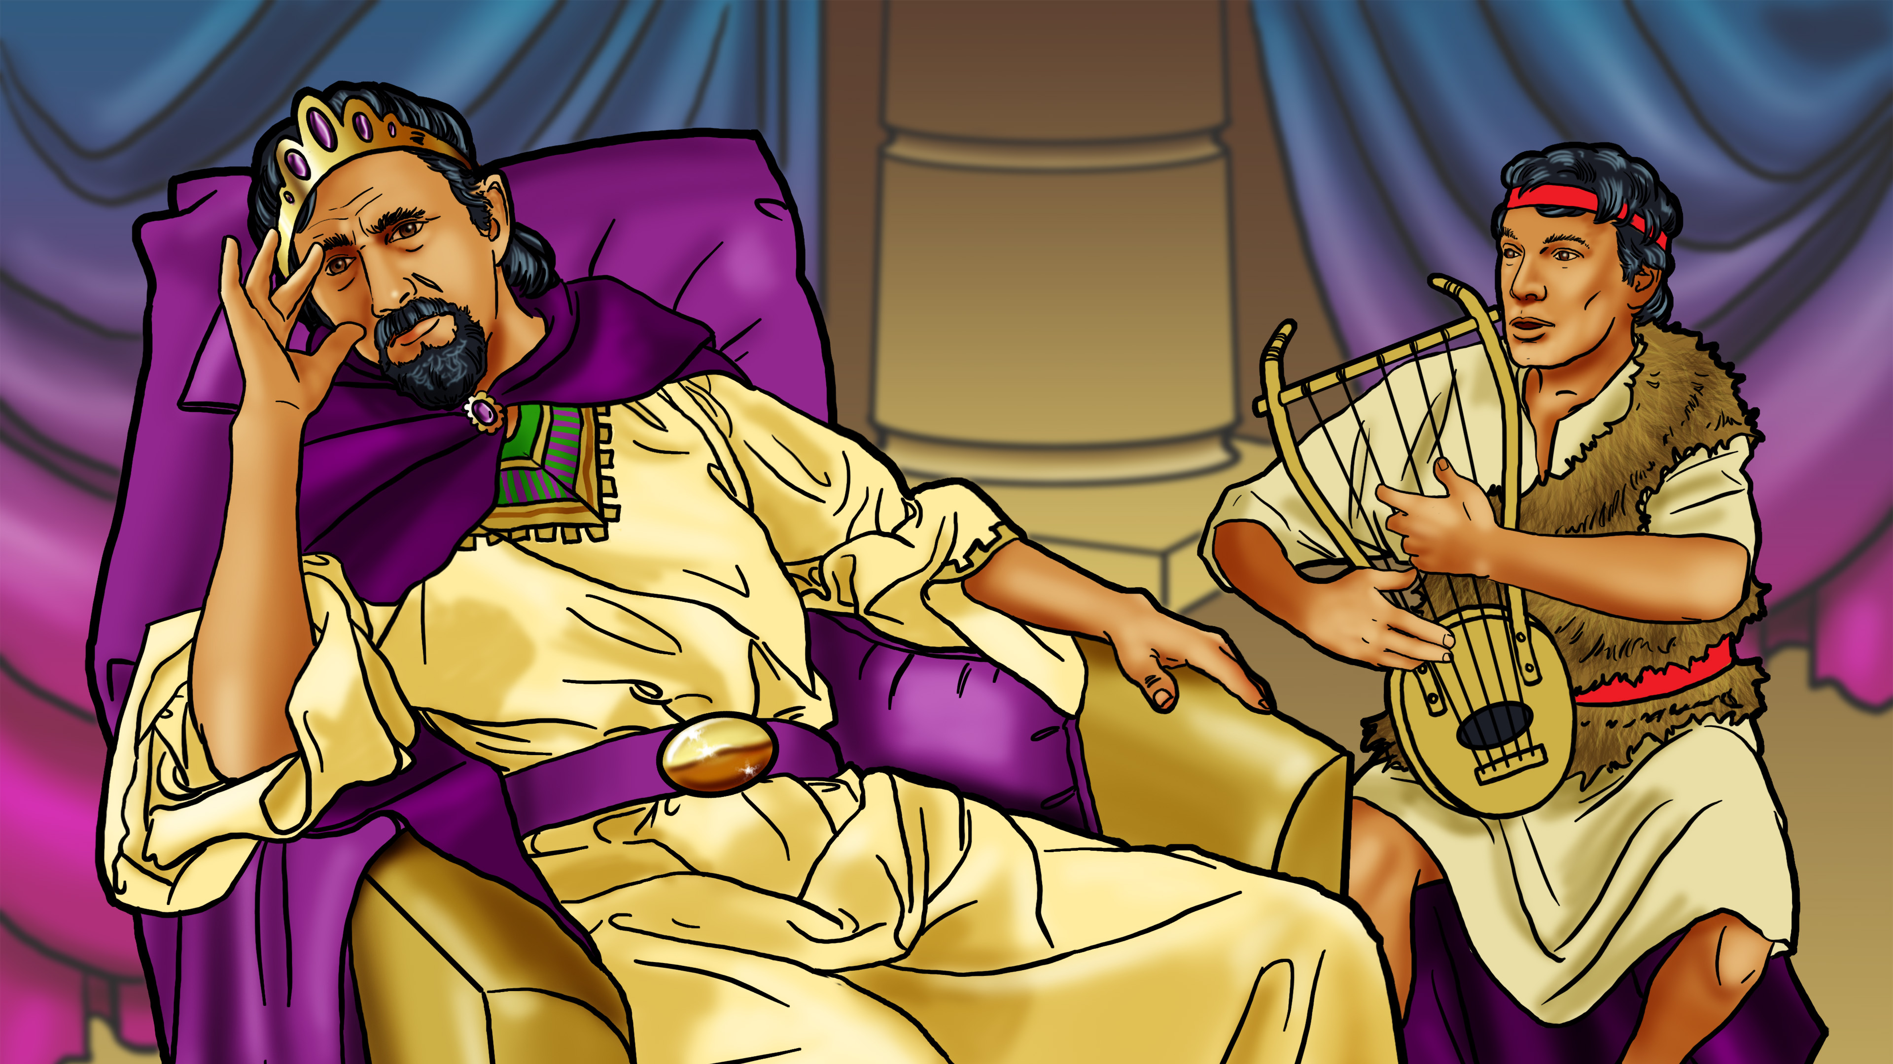

Slide 2
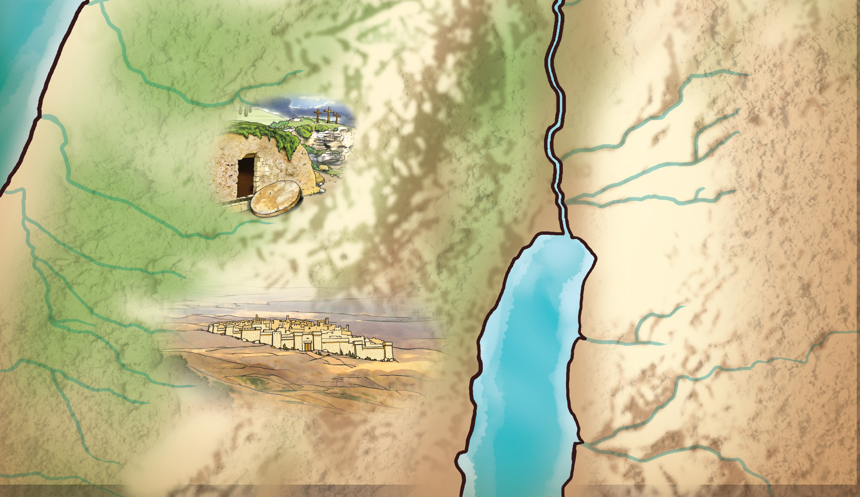
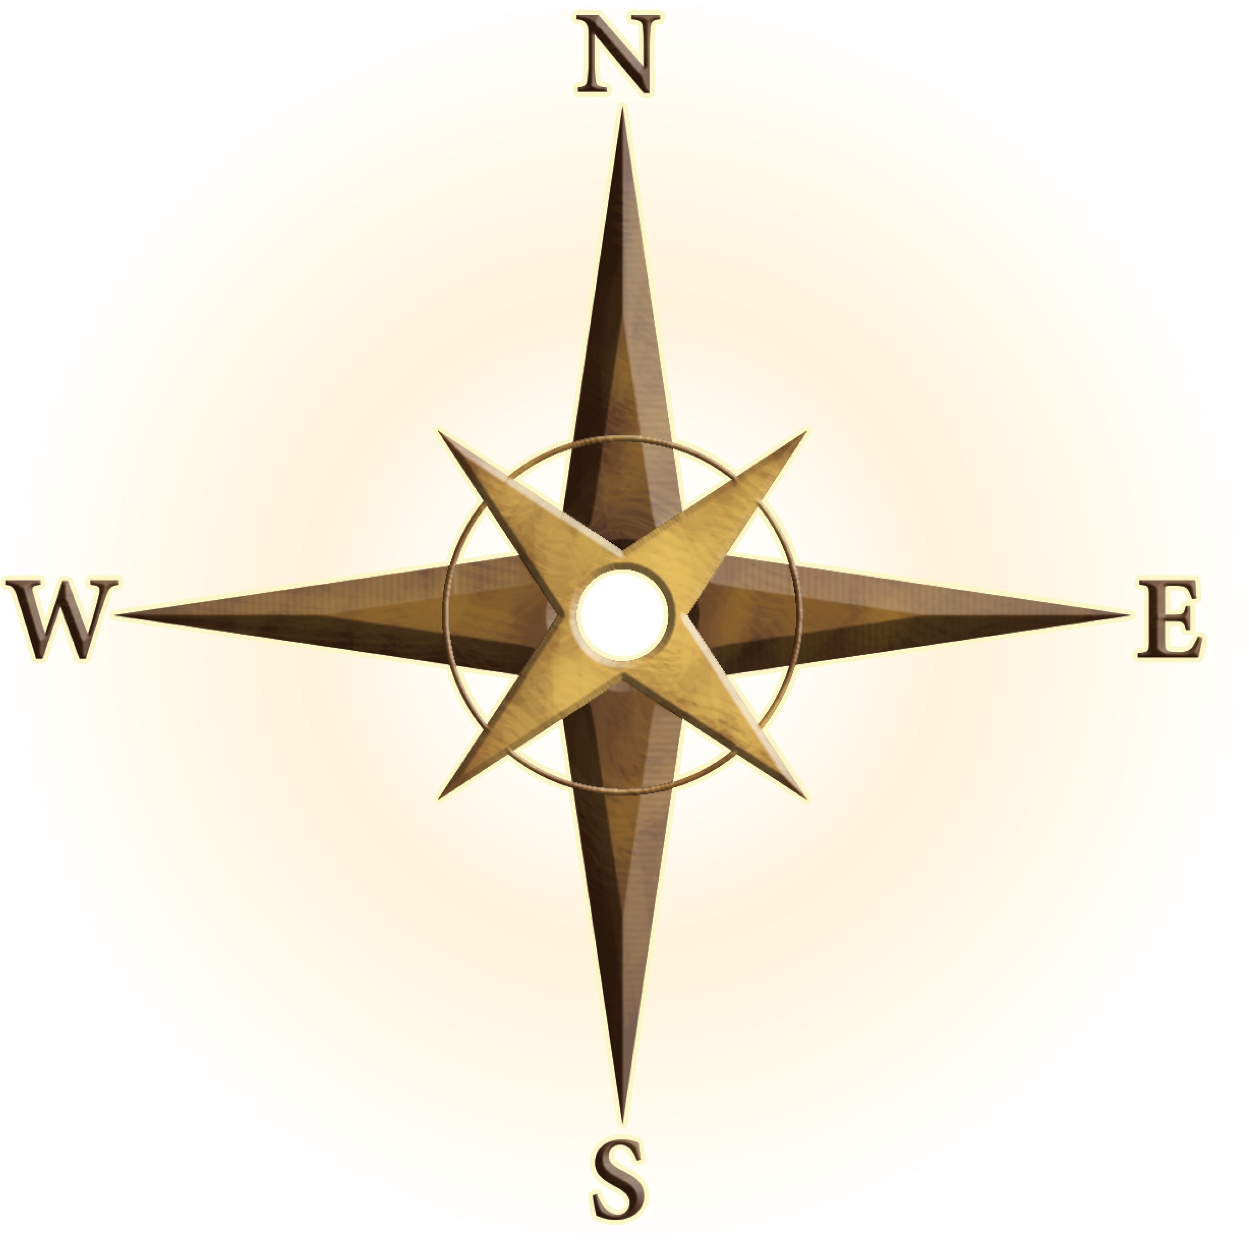
Shiloh
Bethel
Jordan River
JUDEA
Jericho
Mount of
Olives
Jerusalem
Bethlehem
Bethany
MOAB
Dead
Sea
PHILISTIA

Slide 3
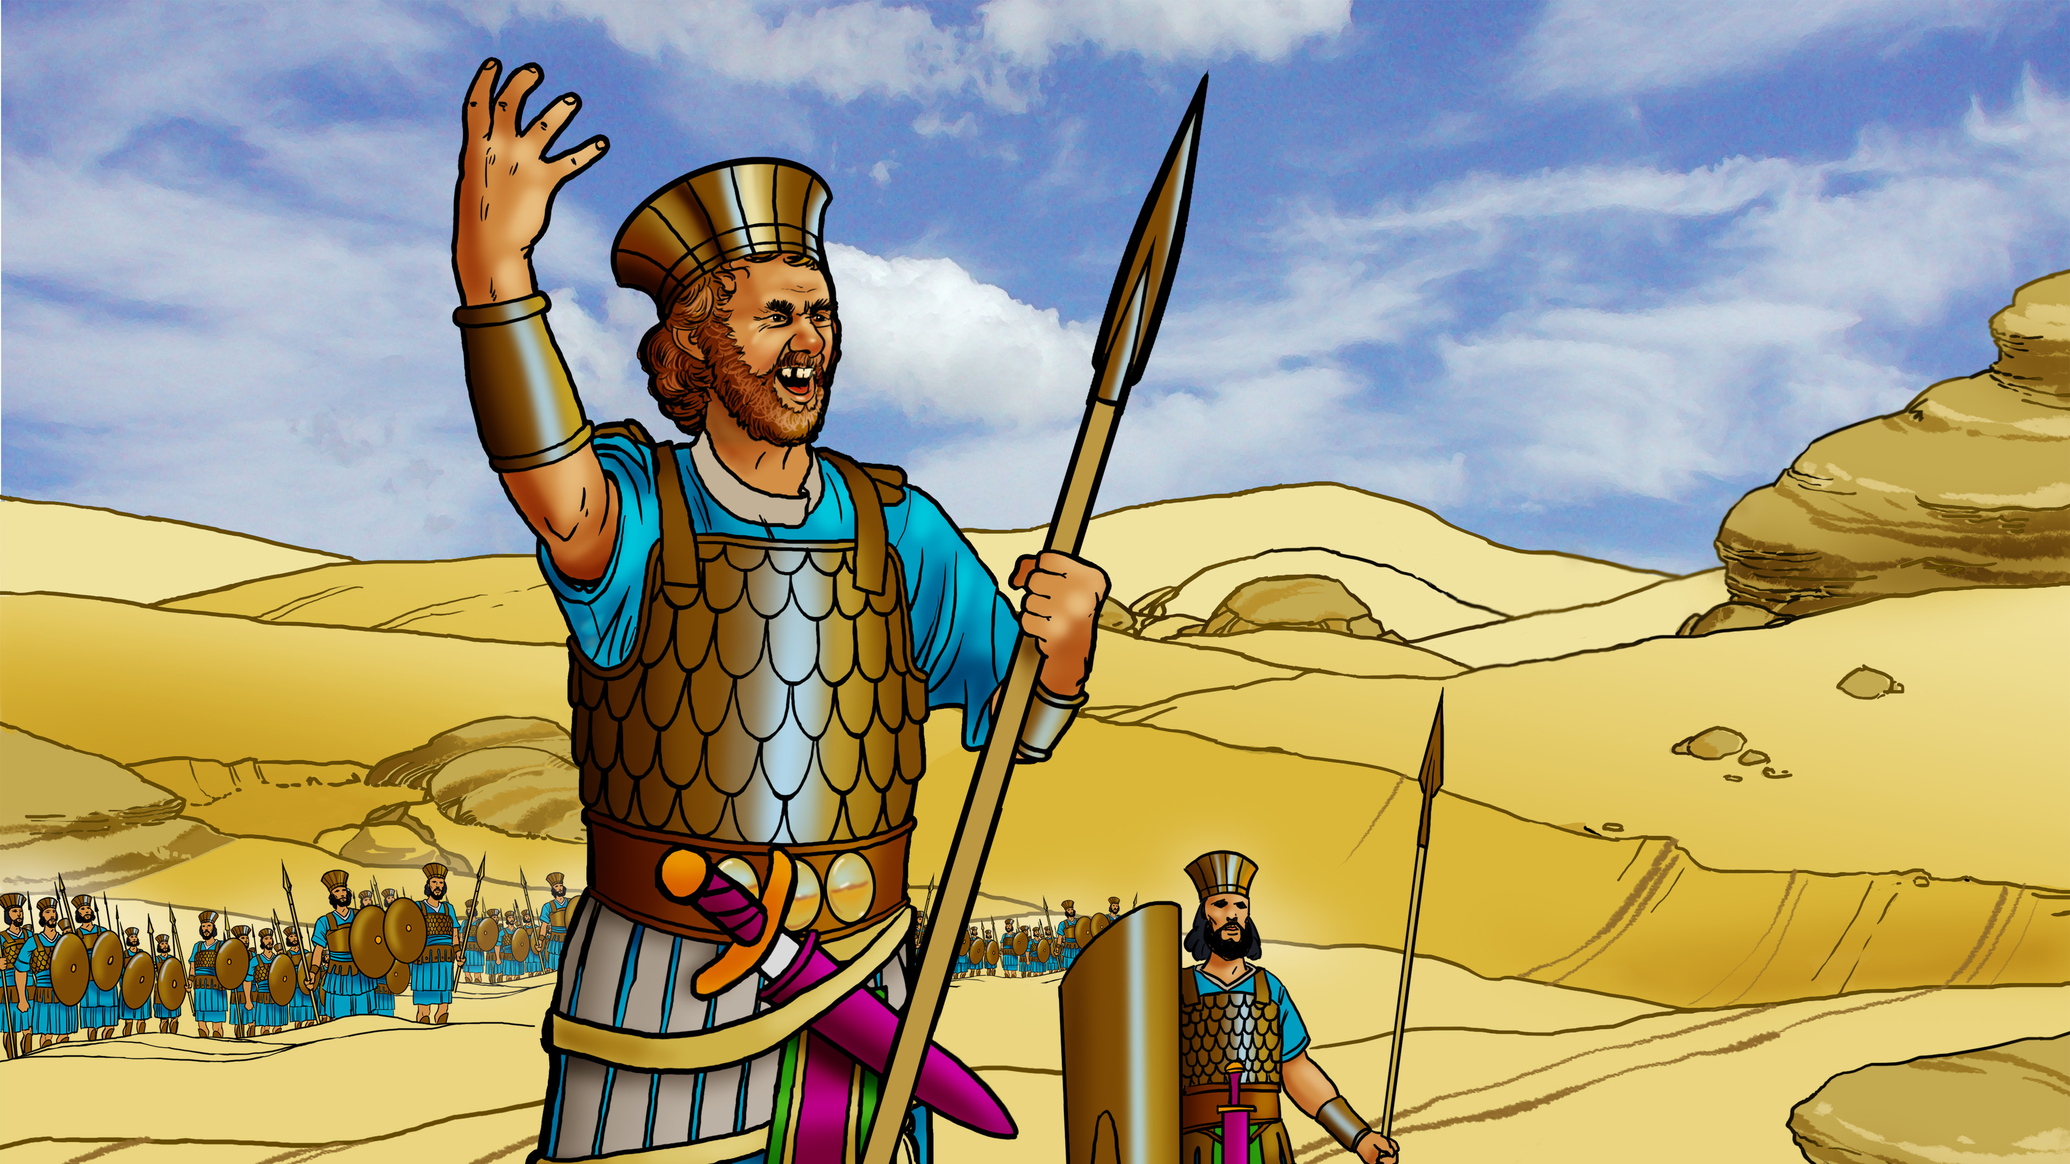

Slide 4

God is the
Champion!

Slide 6
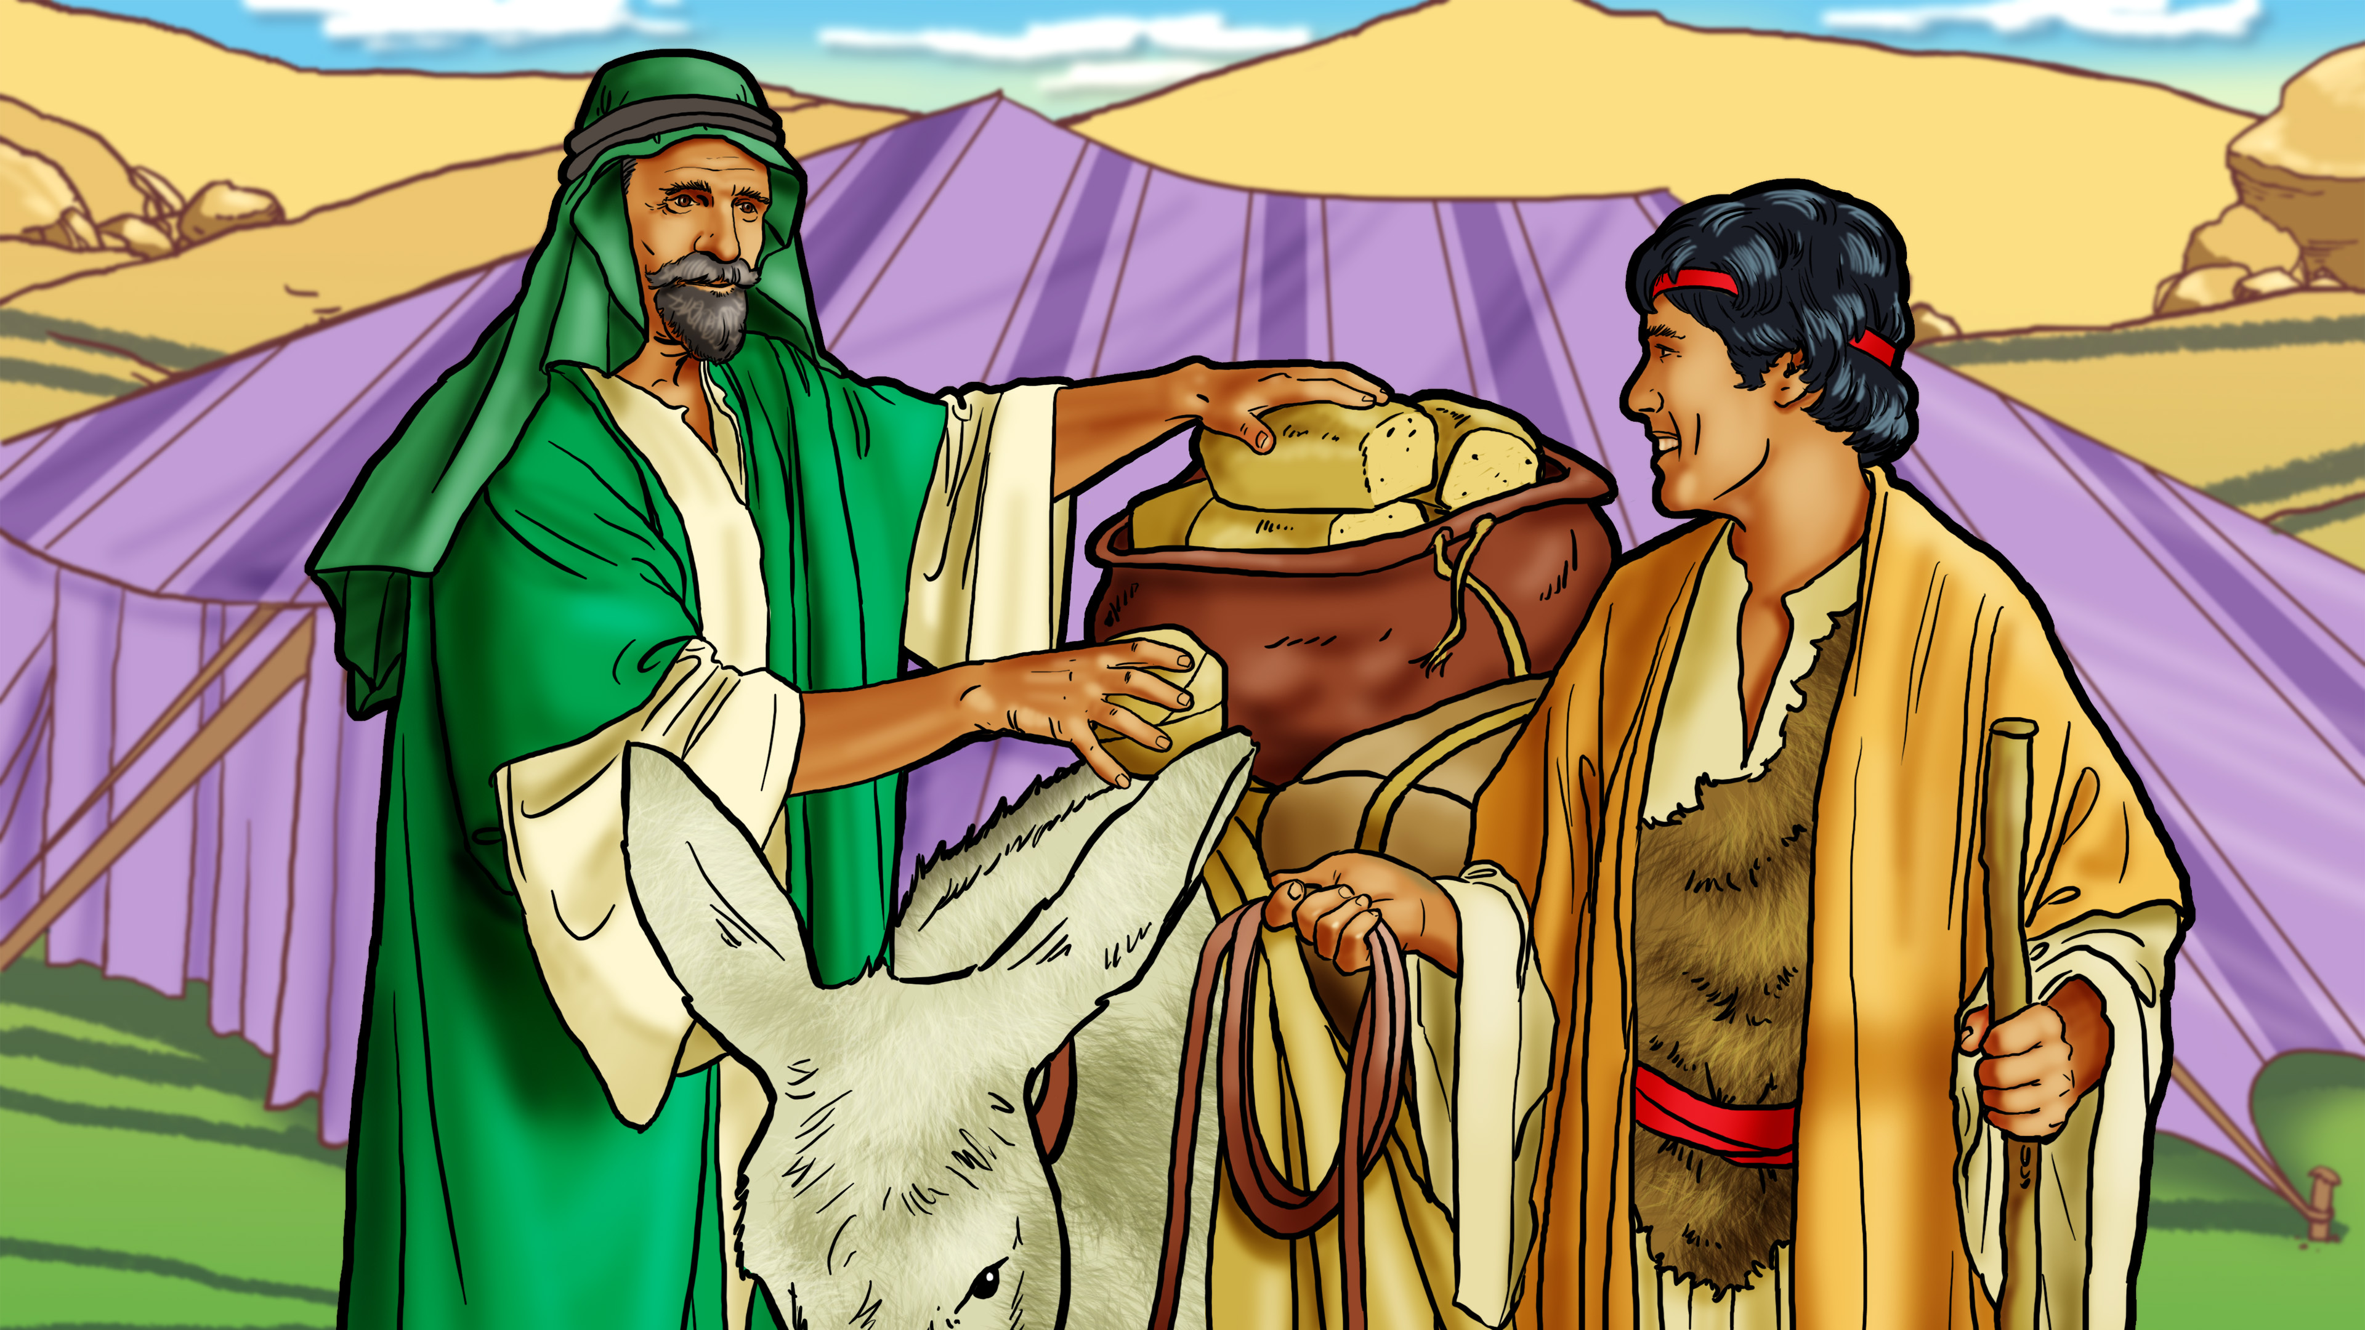

Slide 7
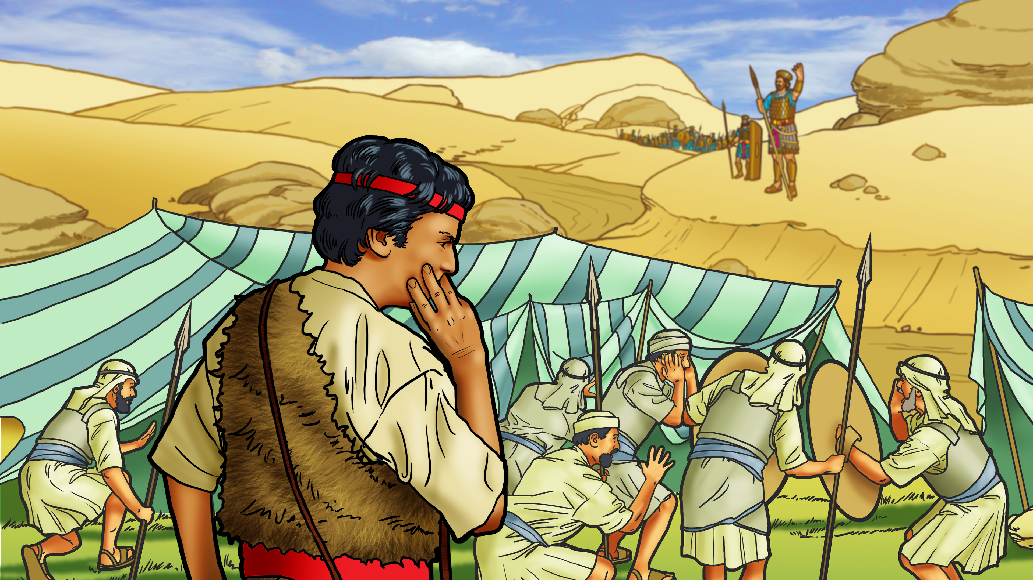

Slide 8
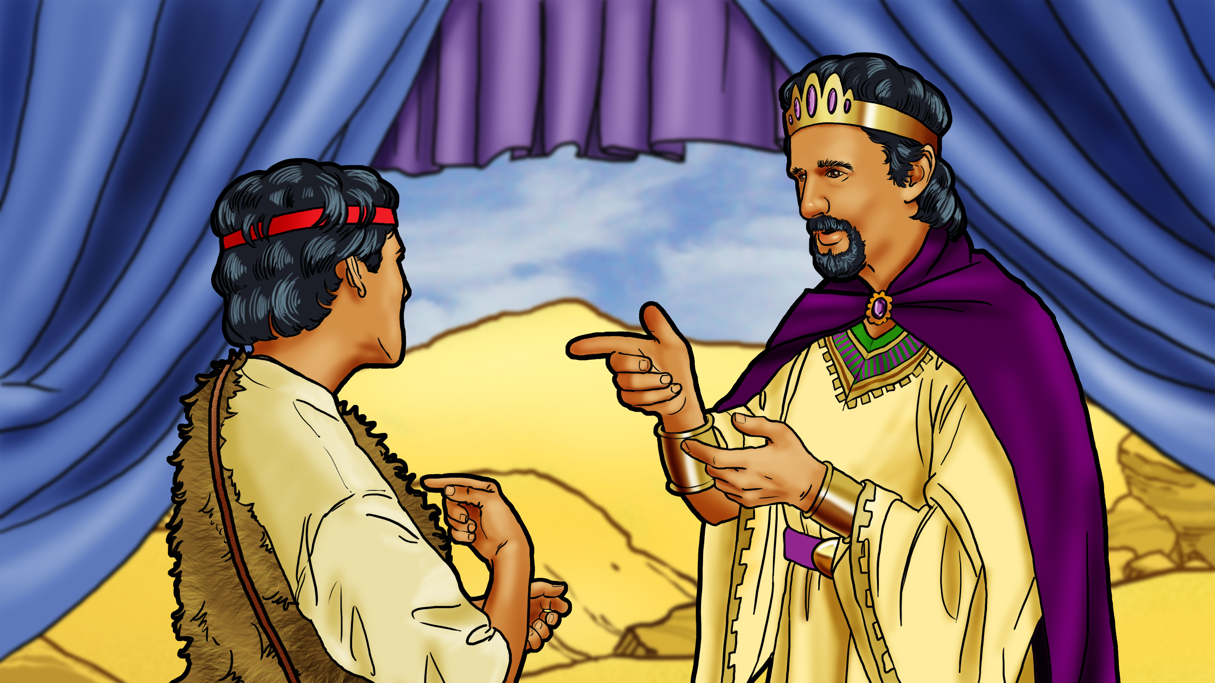

Slide 9
God is the
Champion!

Slide 11
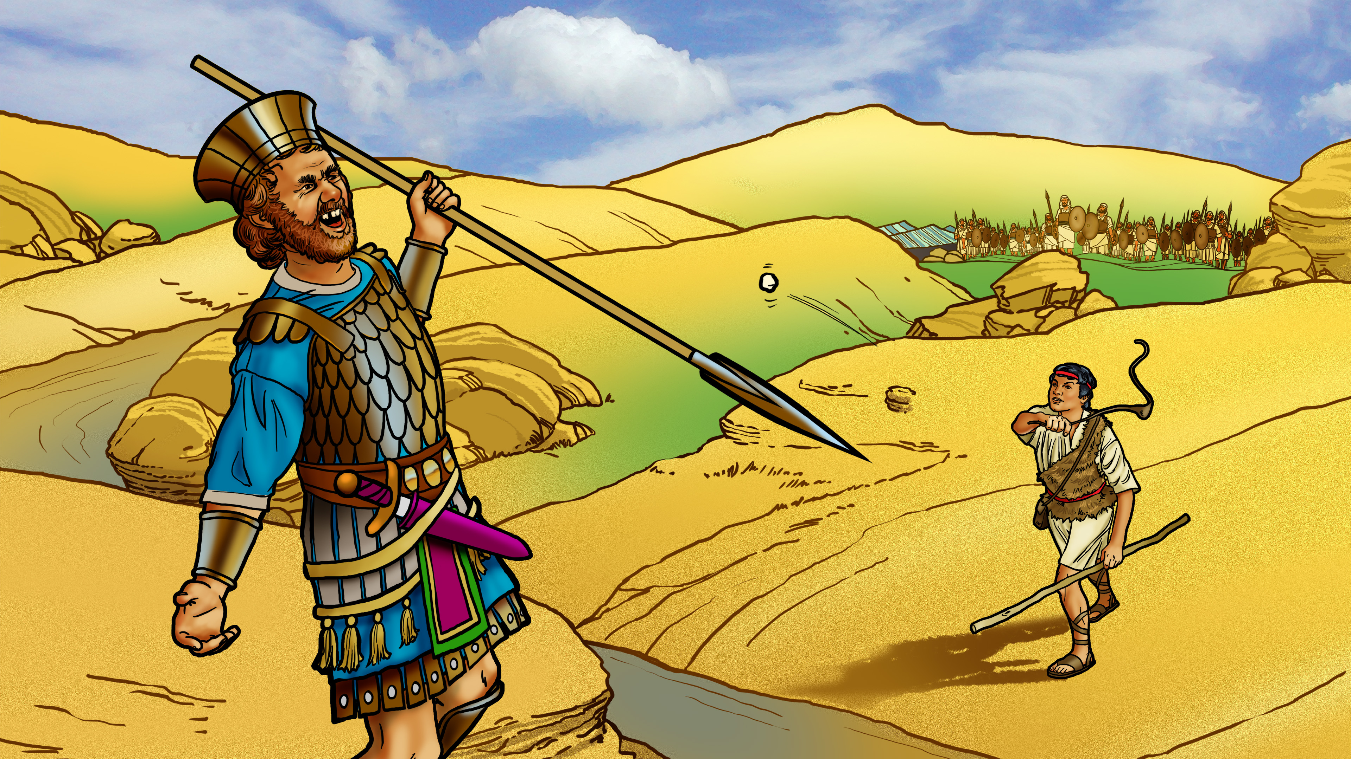

Slide 12
God is the
Champion!

Slide 14
God is the
Champion!

