Slide 1
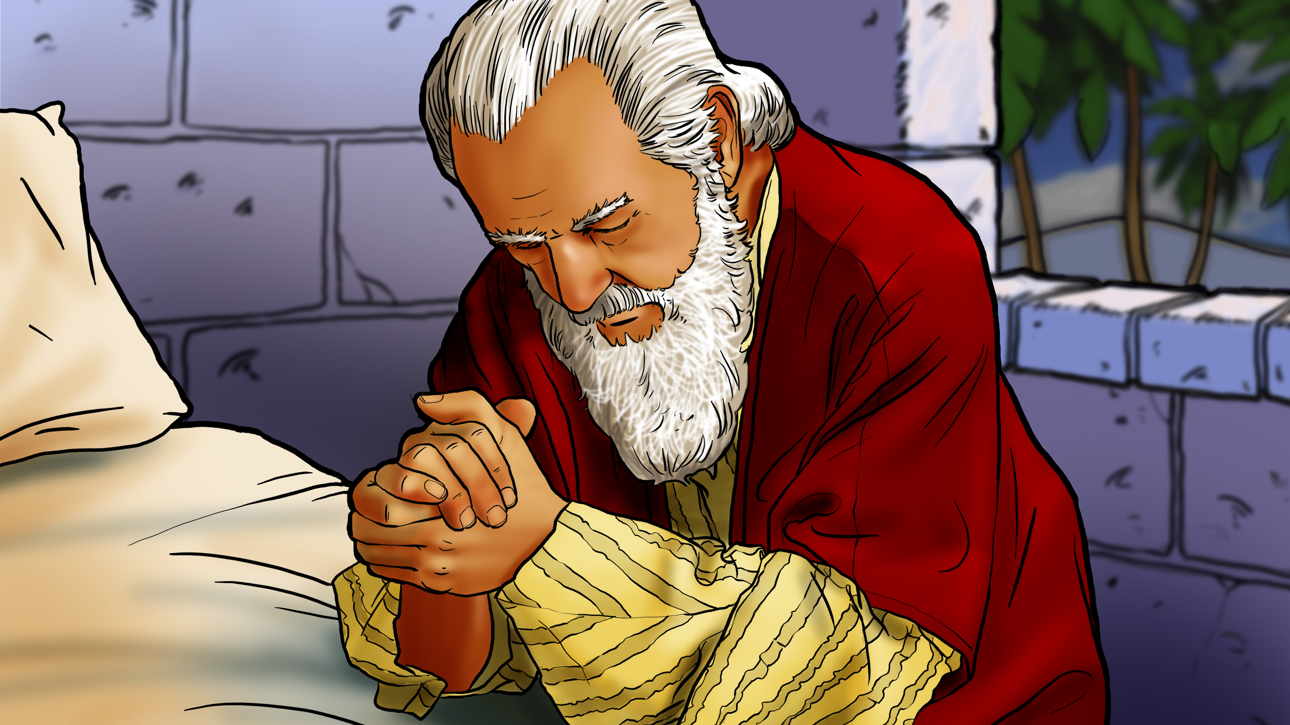

Slide 2

God
sees my
heart!

Slide 4
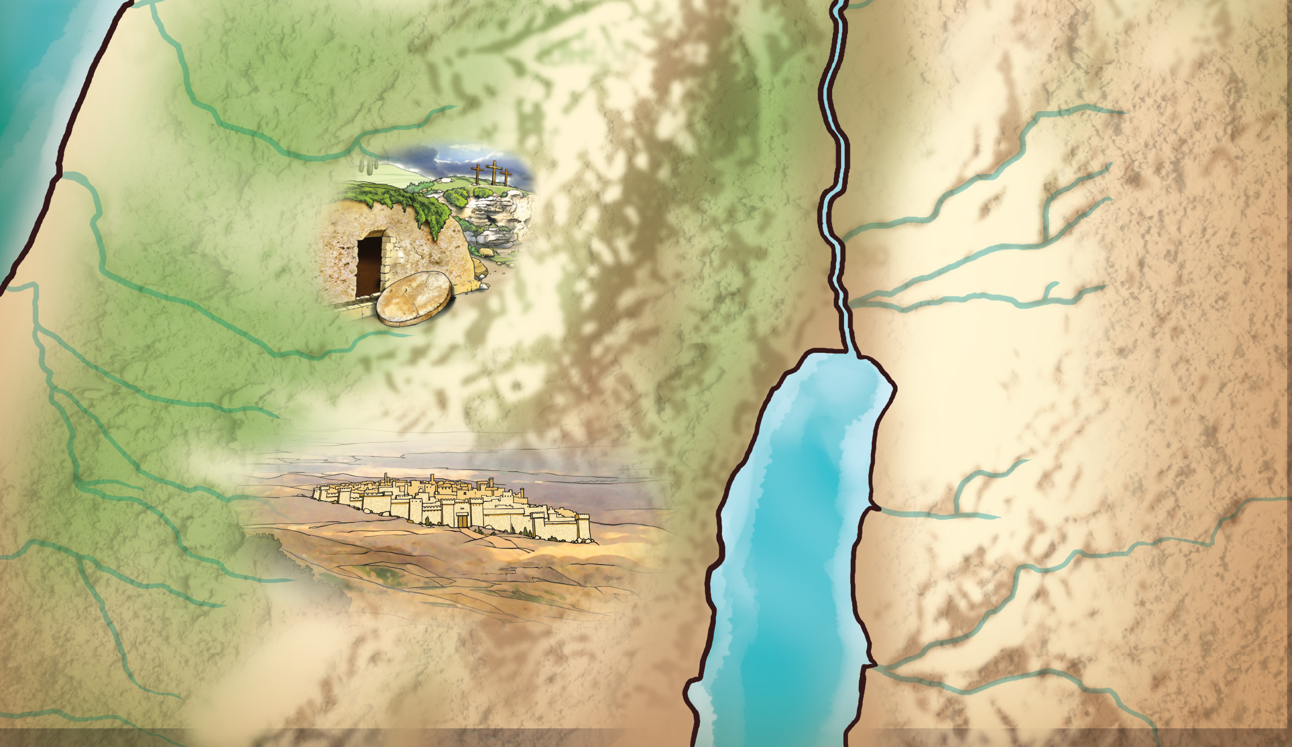
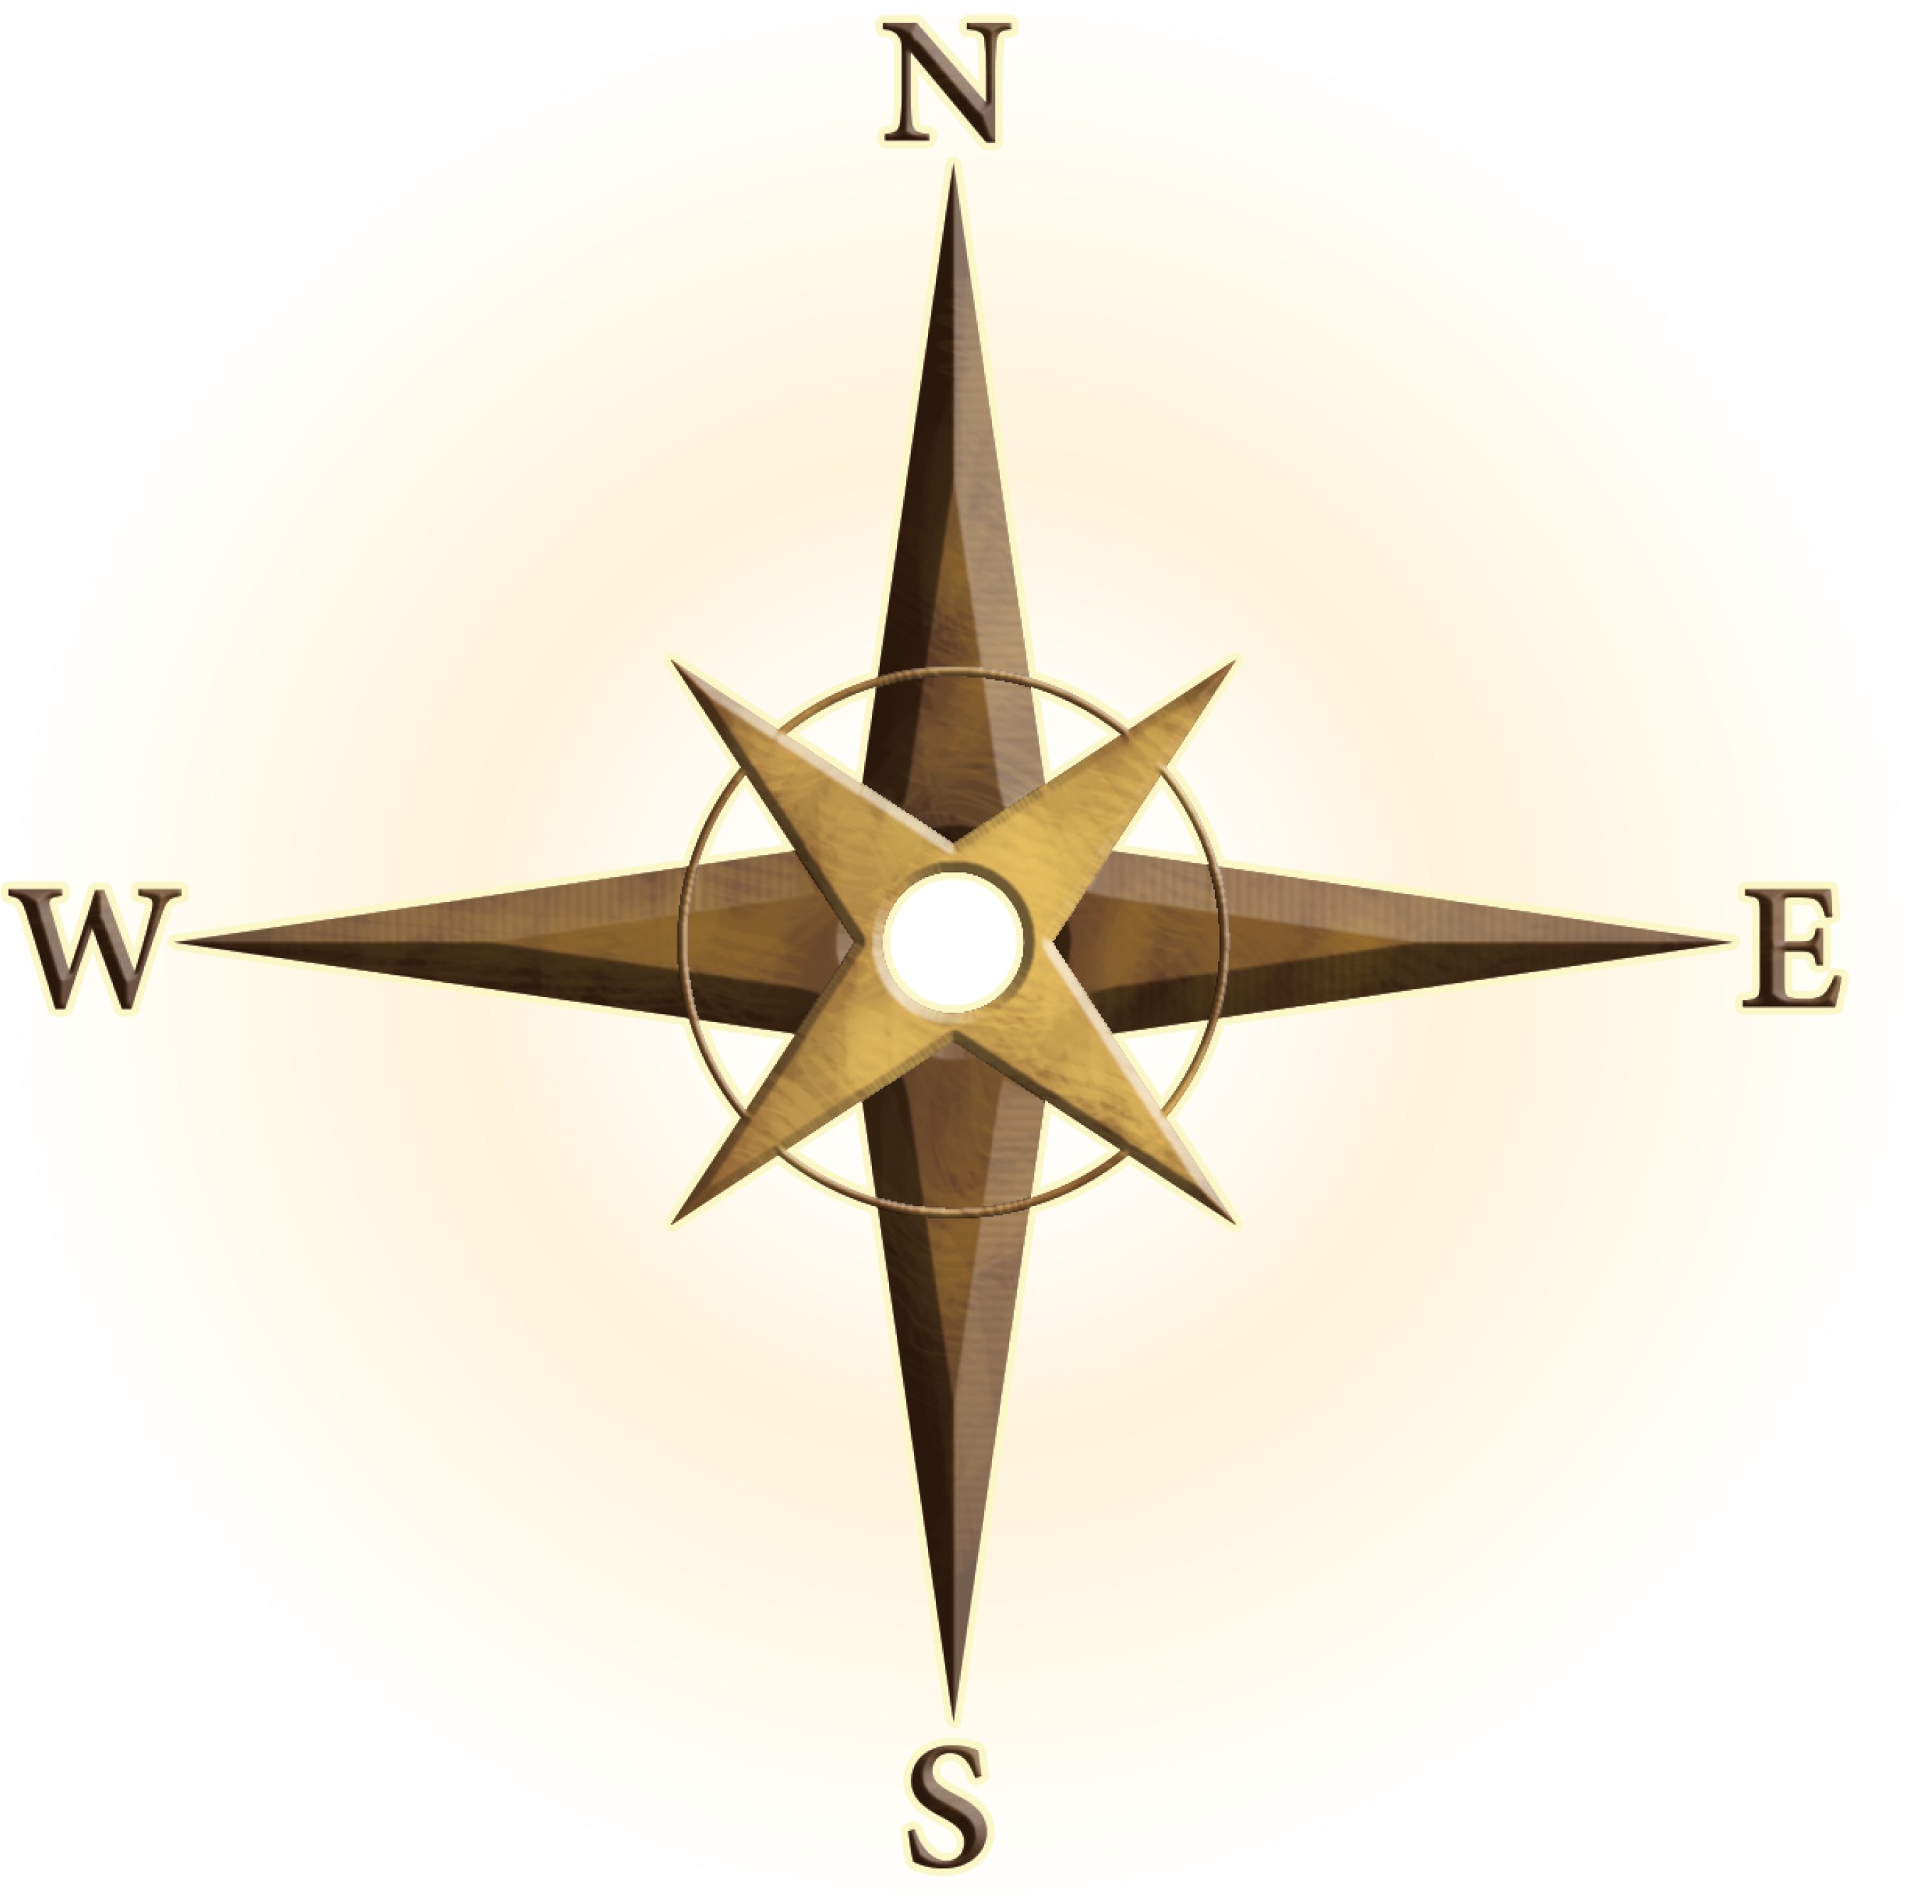
Shiloh
Bethel
Jordan River
JUDEA
Jericho
Mount of
Olives
Jerusalem
Bethlehem
Bethany
MOAB
Dead
Sea
PHILISTIA

Slide 6
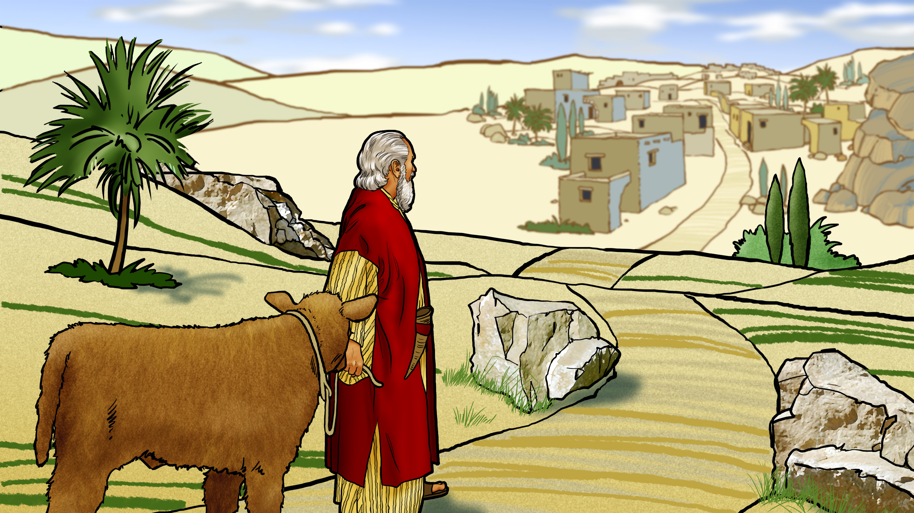

Slide 7
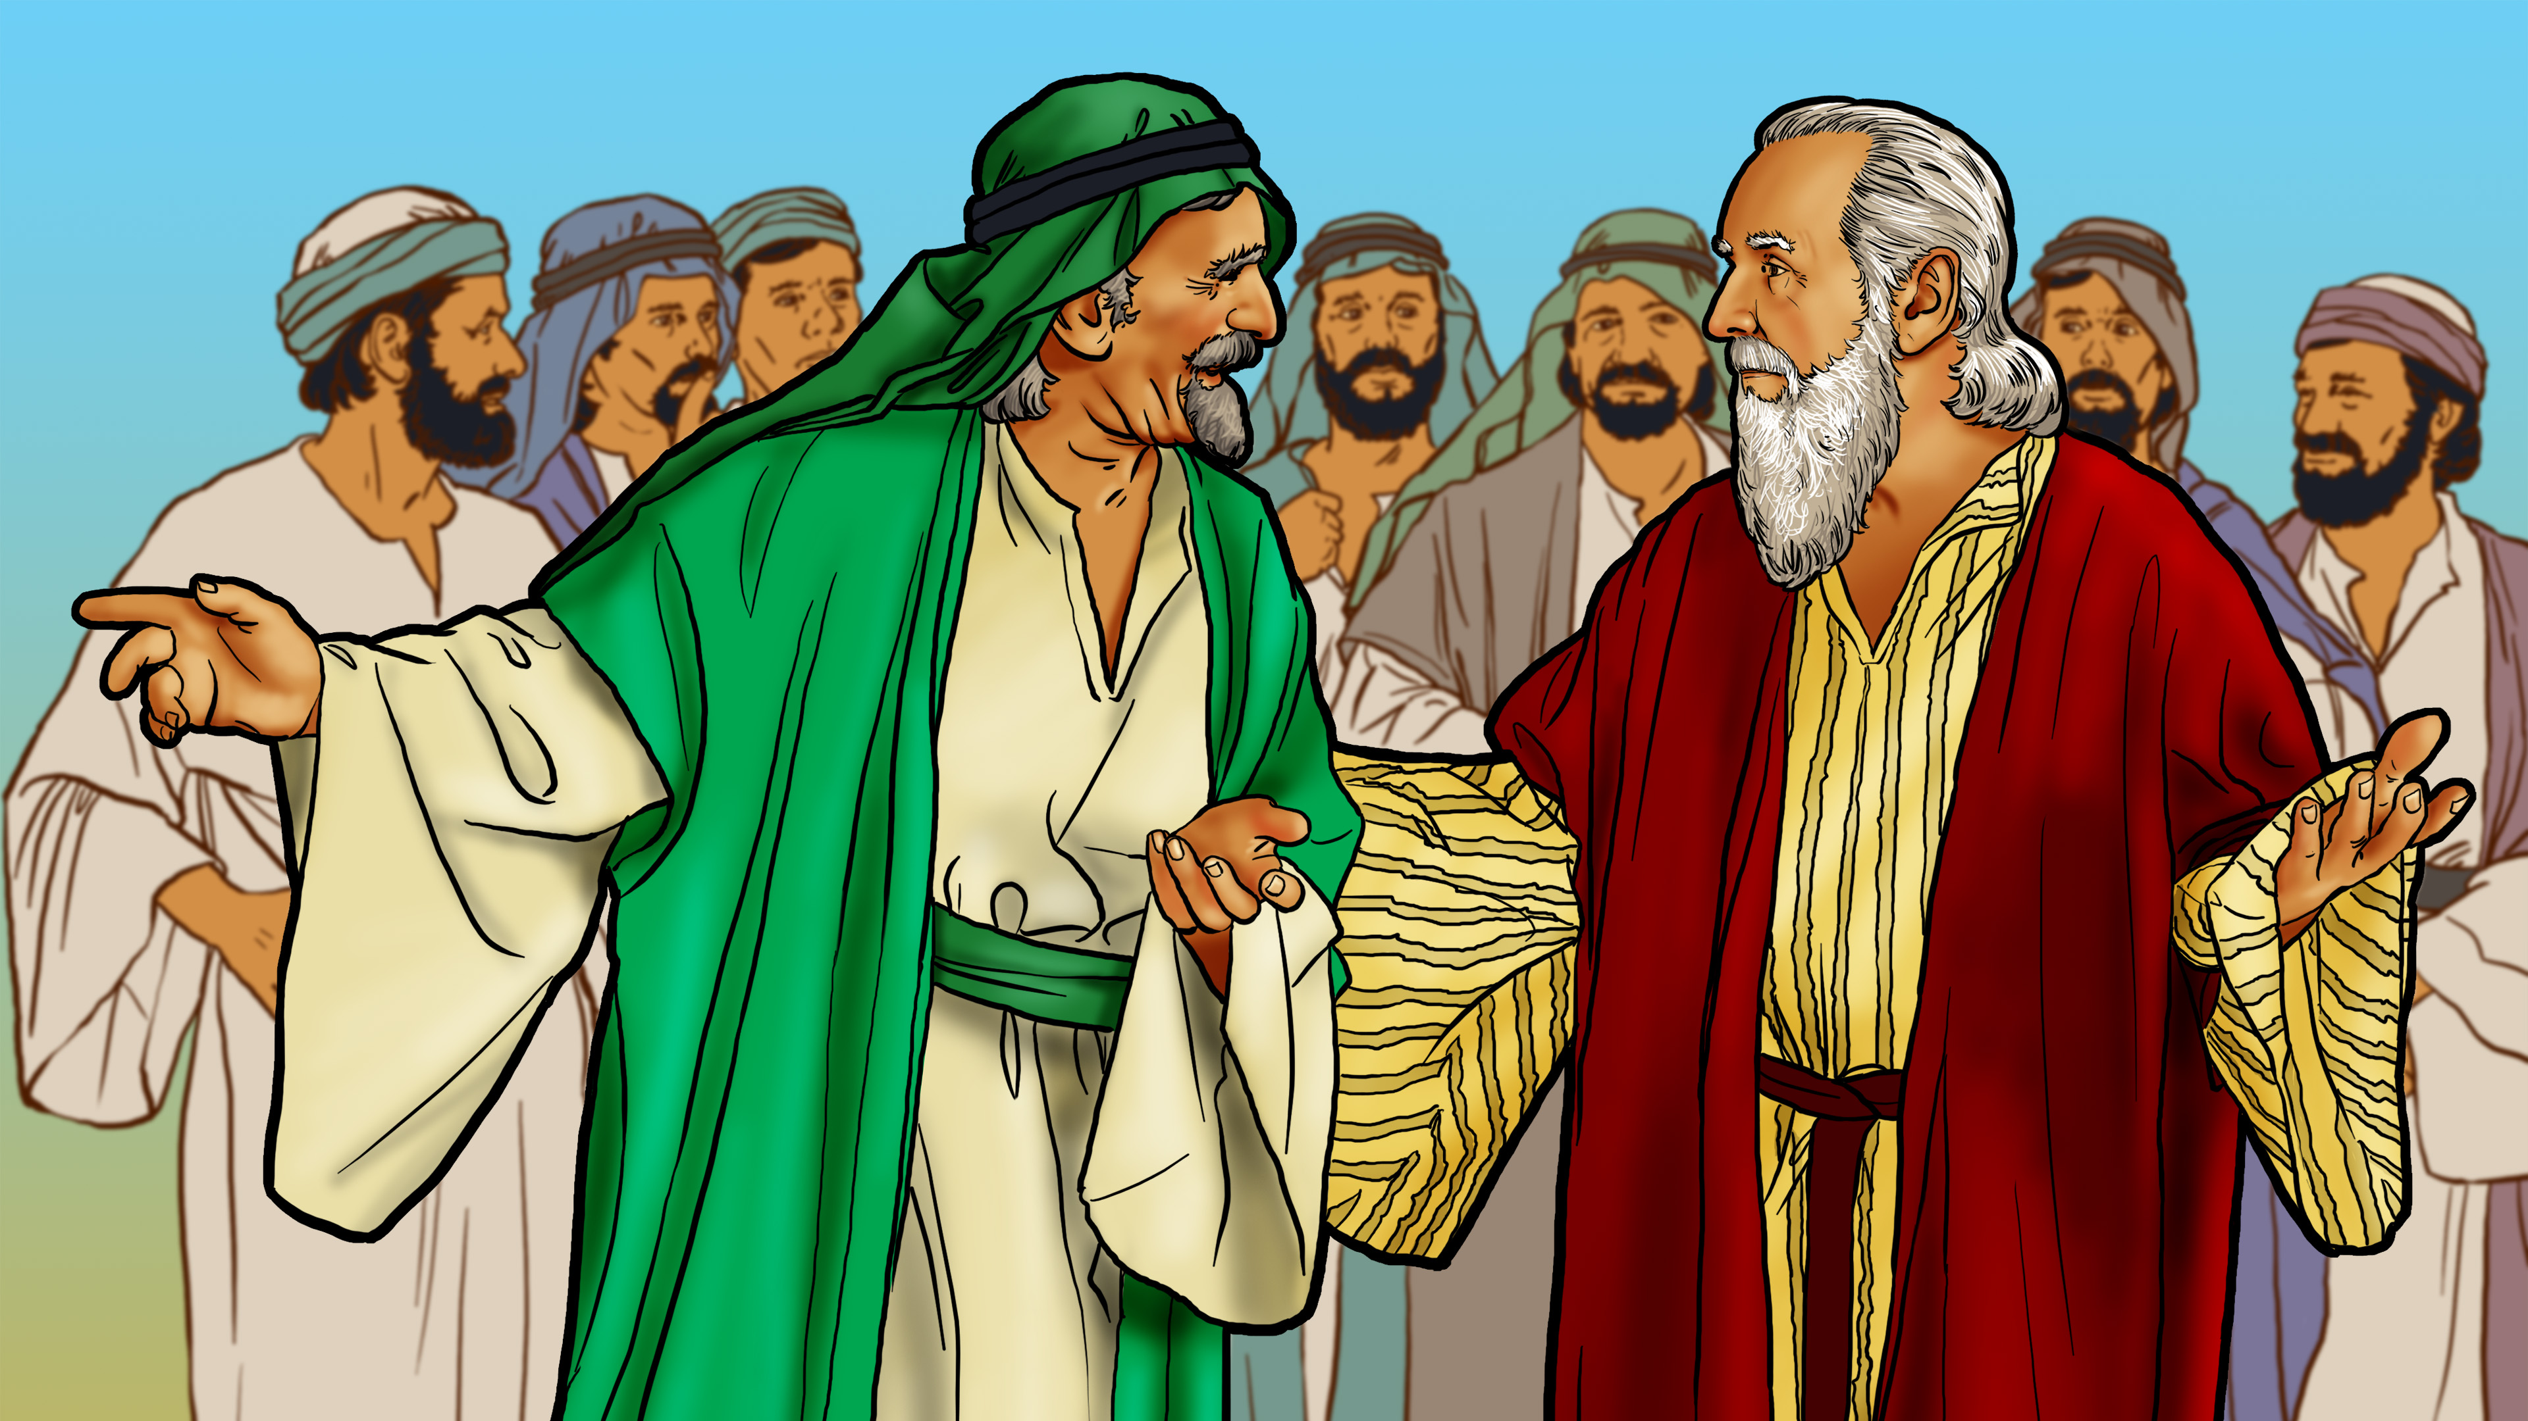

Slide 8
OMNISCIENT

Slide 9
God
sees my
heart!

Slide 11
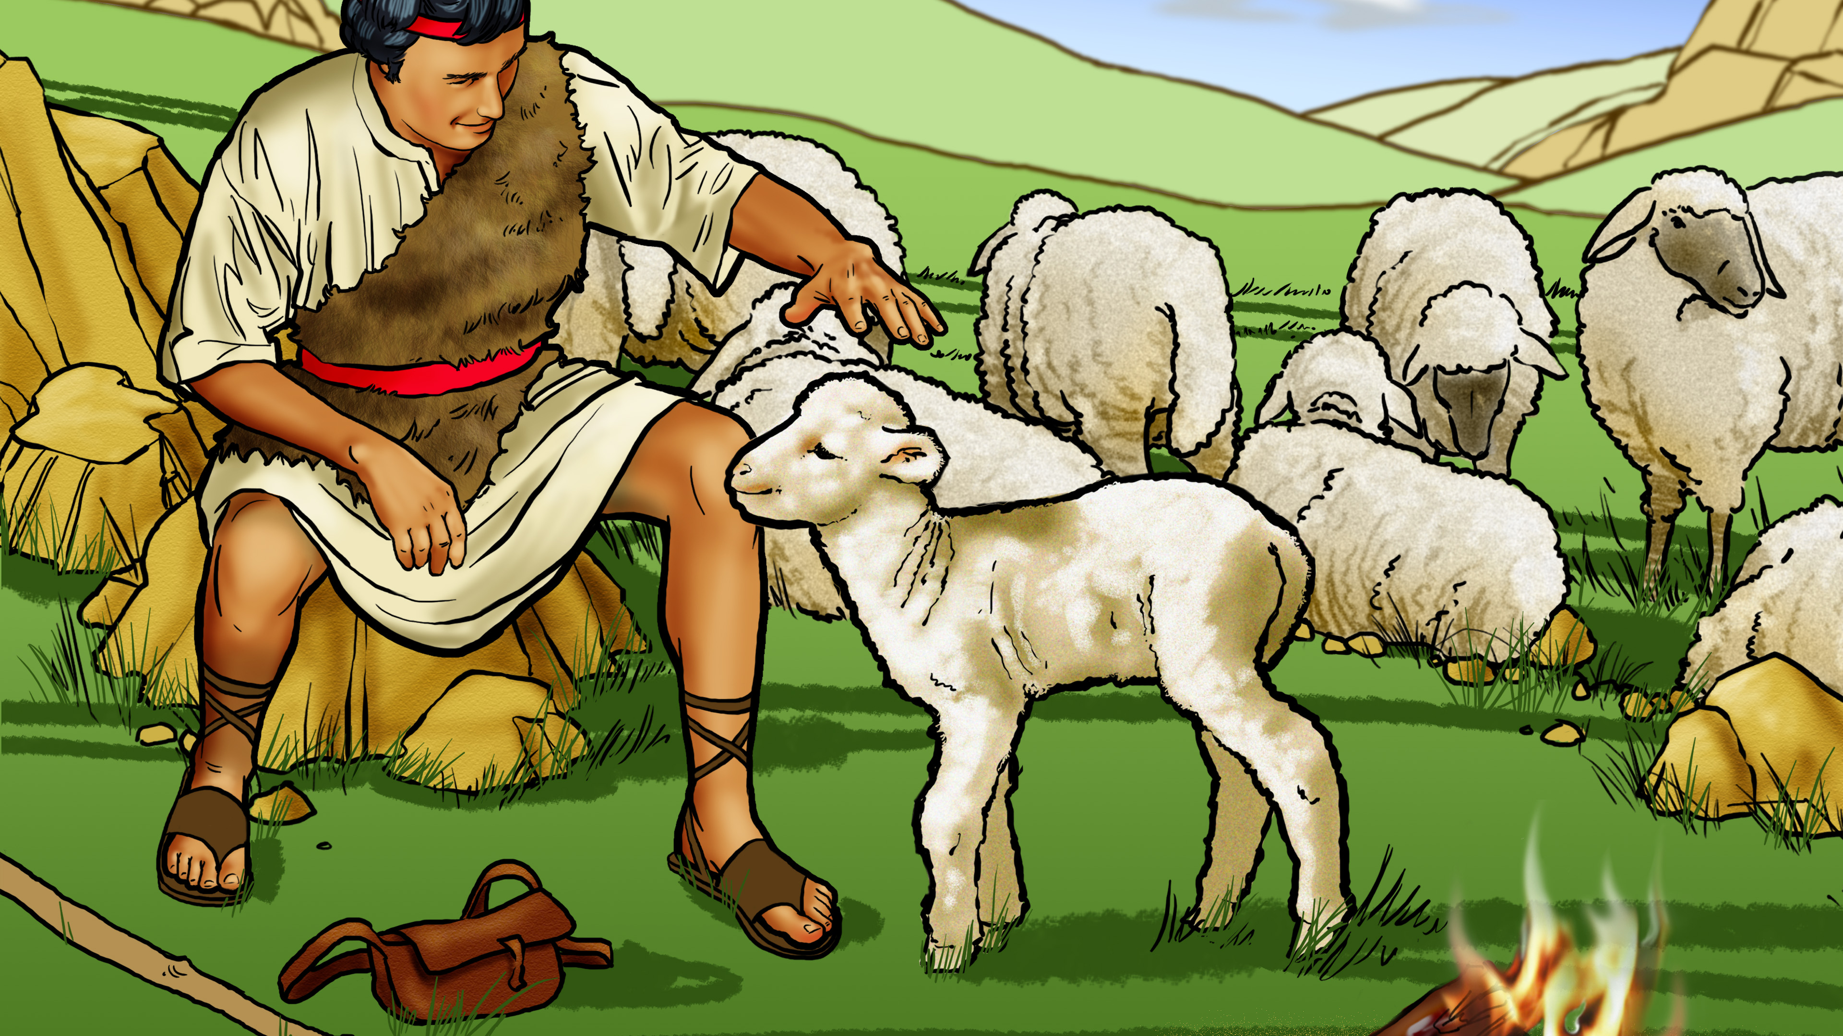

Slide 12
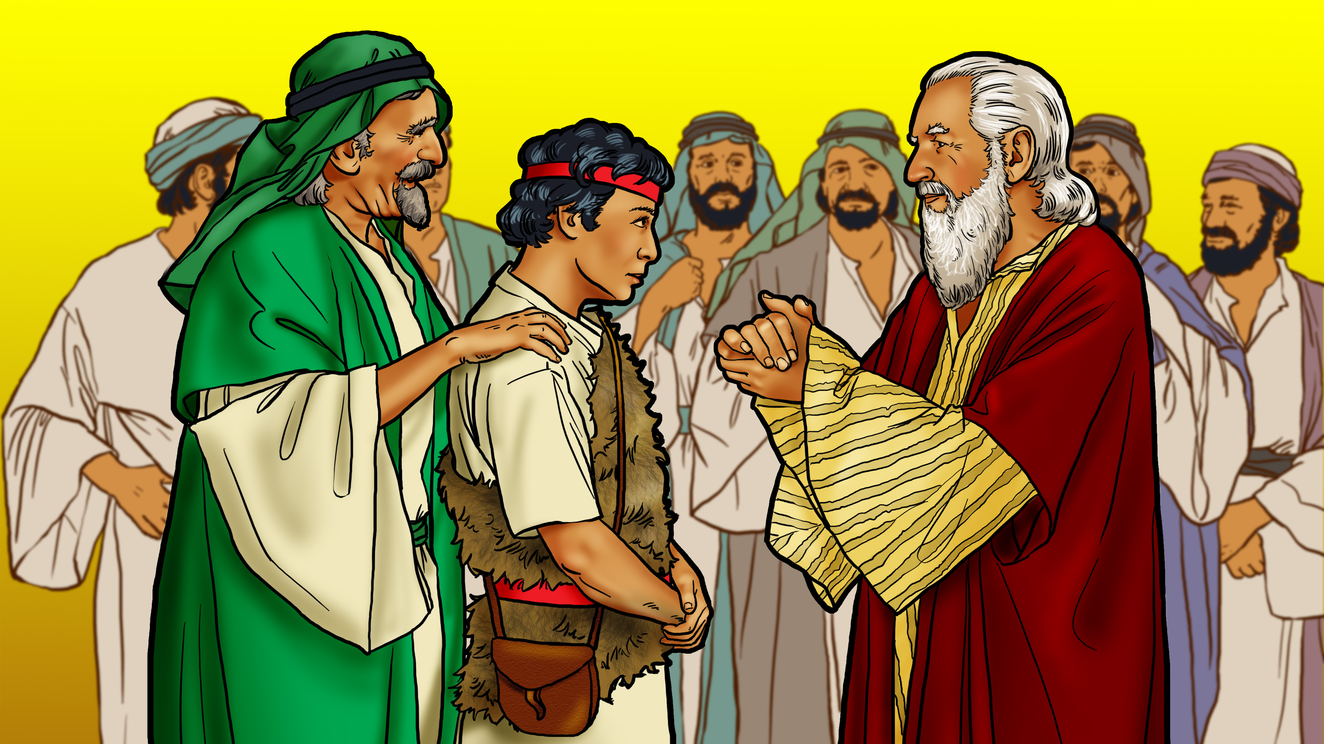

Slide 13
God
sees my
heart!

Slide 14
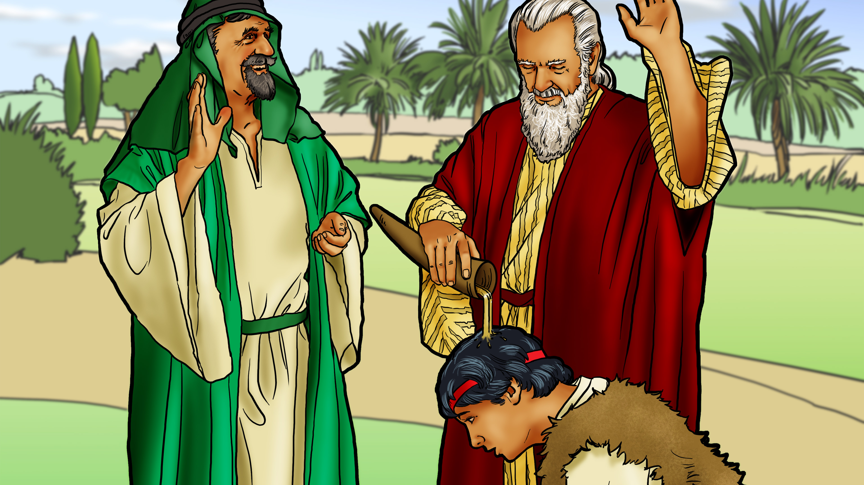

Slide 15
God
sees my
heart!

