Slide 1

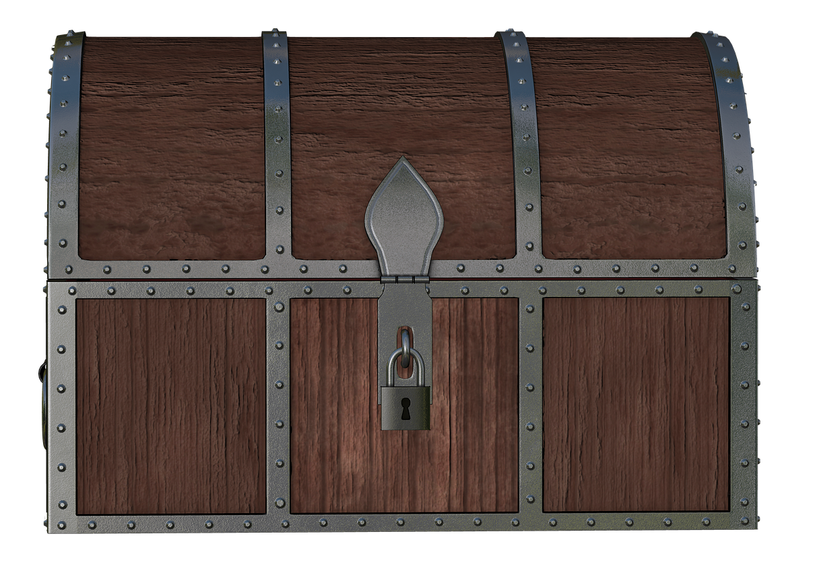



1
2
3
4
Notes:
Instructions: Divide the children into teams. Ask questions, alternating between teams. When a child correctly answers a question, award his team 1,000 points and have him choose a treasure chest. Click on the treasure chest chosen. If a crown appears, the child wins 100 extra points his team. If an X appears, then they do not get extra points. Tap the arrow key in the bottom to move on to the next slide.

Slide 2
1
2
3
4

Slide 3
1
2
3
4

Slide 4
1
2
3
4

Slide 5
1
2
3
4

Slide 6
1
2
3
4

Slide 7
1
2
3
4

Slide 8
1
2
3
4

Slide 9
1
2
3
4

Slide 10
1
2
3
4

Slide 11
1
2
3
4

Slide 12
1
2
3
4

