Slide 1


Wash the car
Clean Up Action
Clean Up Action
Mop the floor
Mow the lawn
Fold the towels
Clean Up Action
Clean Up Action
Vacuum the carpet
Clean Up Action
Clean Up Action
Wash the dishes
Make your bed
Clean Up Action
Feed your pet
Clean Up Action
Notes:
Have a child pick a Clean Up Action card. Click on the card to reveal the action you will be doing. Then click on the words to show the verse. Say the verse with the children while doing the clean up action. Click the home button (bottom right hand corner) to go back to the Clean Up Action cards and repeat as time allows.

Slide 2
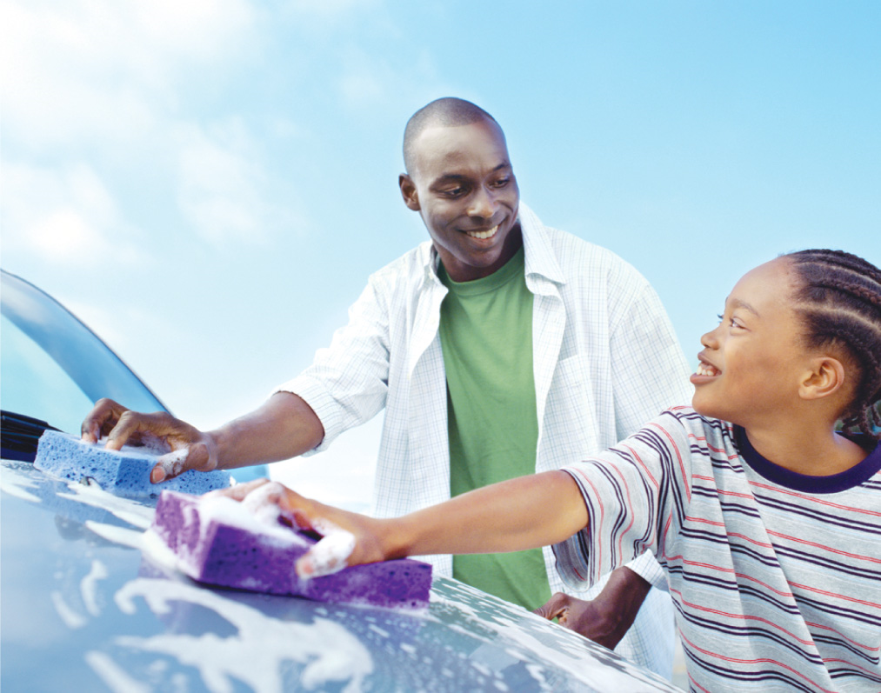
Wherewithal shall a young man cleanse his way? by taking heed thereto according to thy word.
Psalm 119:9

Slide 3
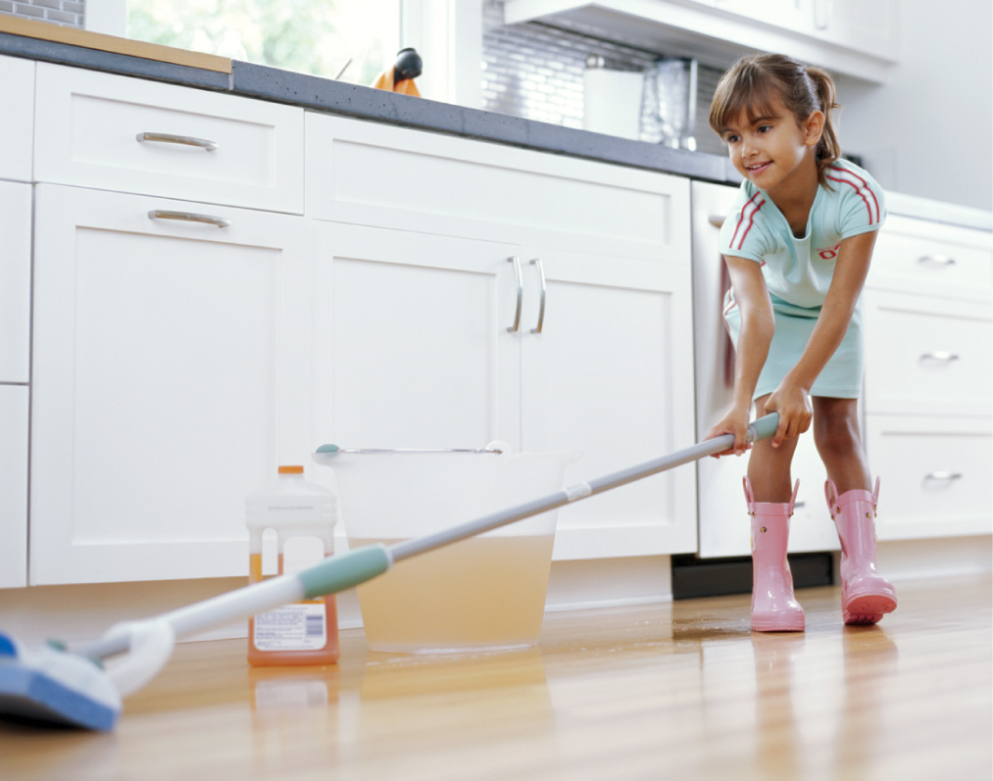
Wherewithal shall a young man cleanse his way? by taking heed thereto according to
thy word.
Psalm 119:9

Slide 4
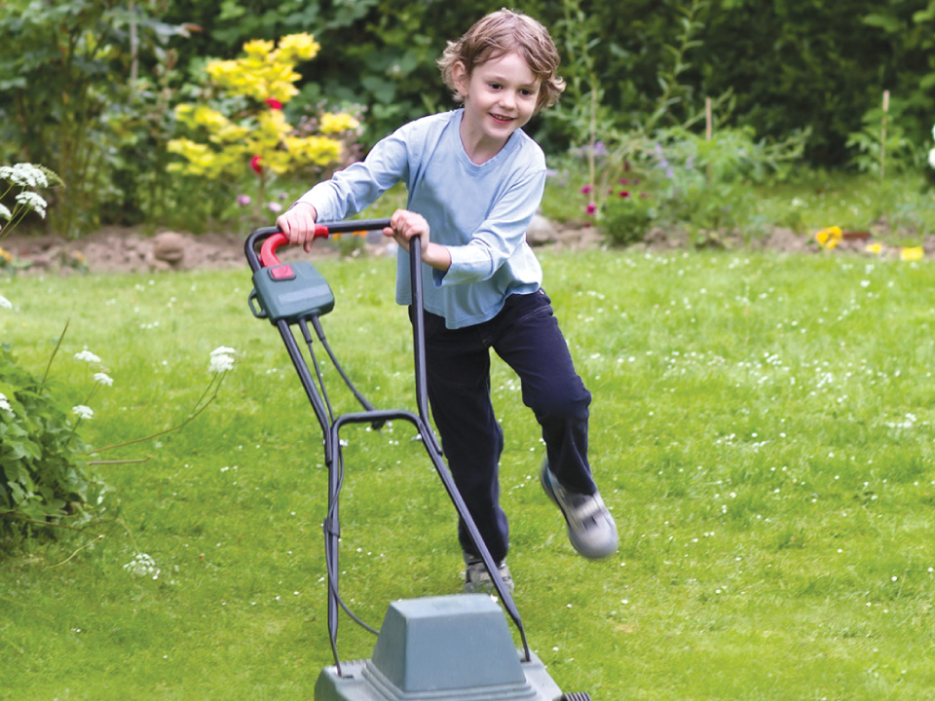
Wherewithal shall a young man cleanse his way? by taking heed thereto according to thy word.
Psalm 119:9

Slide 5
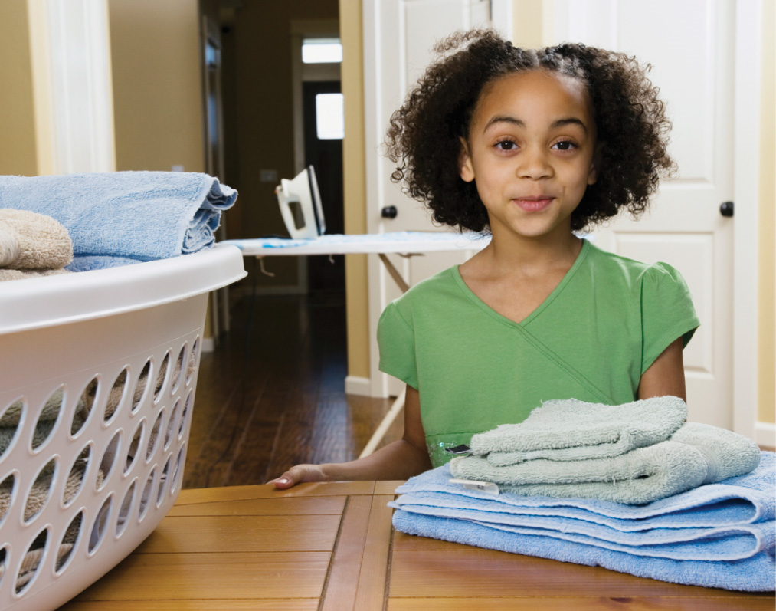
Wherewithal
shall a young
man cleanse his way? by taking heed thereto according to
thy word.
Psalm 119:9

Slide 6
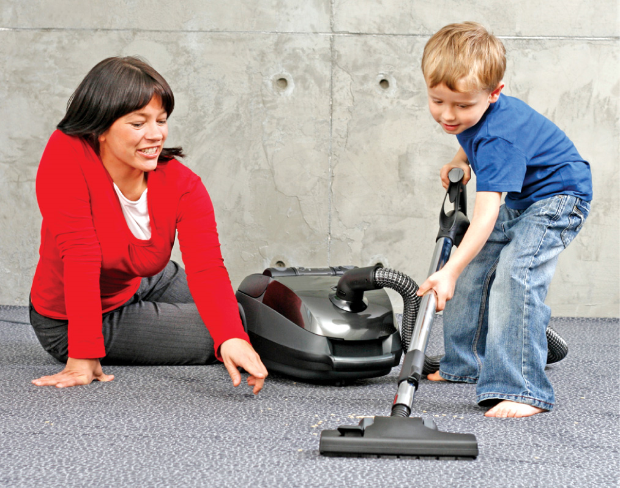
Wherewithal shall a young man cleanse his way?
by taking heed thereto according to thy word.
Psalm 119:9

Slide 7
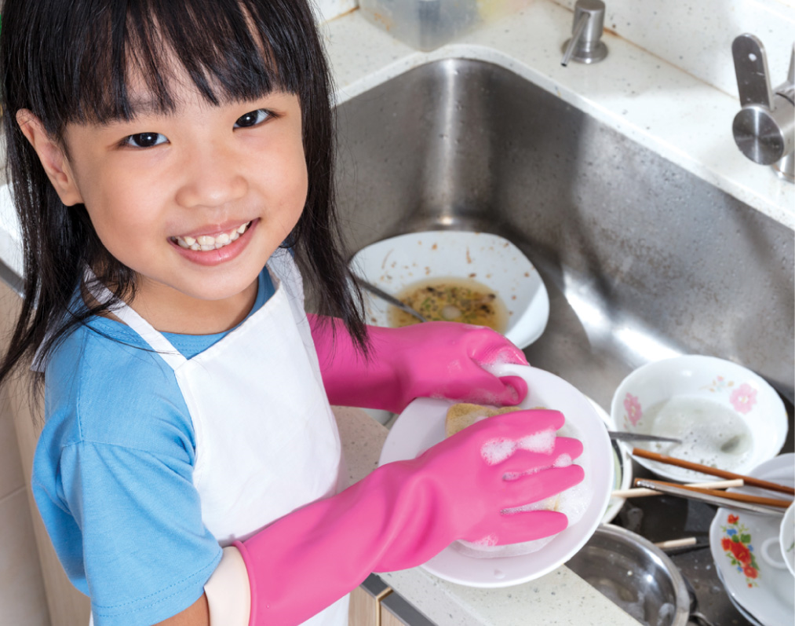
Wherewithal
shall a young
man cleanse his way? by taking heed thereto according to
thy word.
Psalm 119:9

Slide 8

Wherewithal shall a young man cleanse his way?
by taking heed thereto according to thy word.
Psalm 119:9

Slide 9
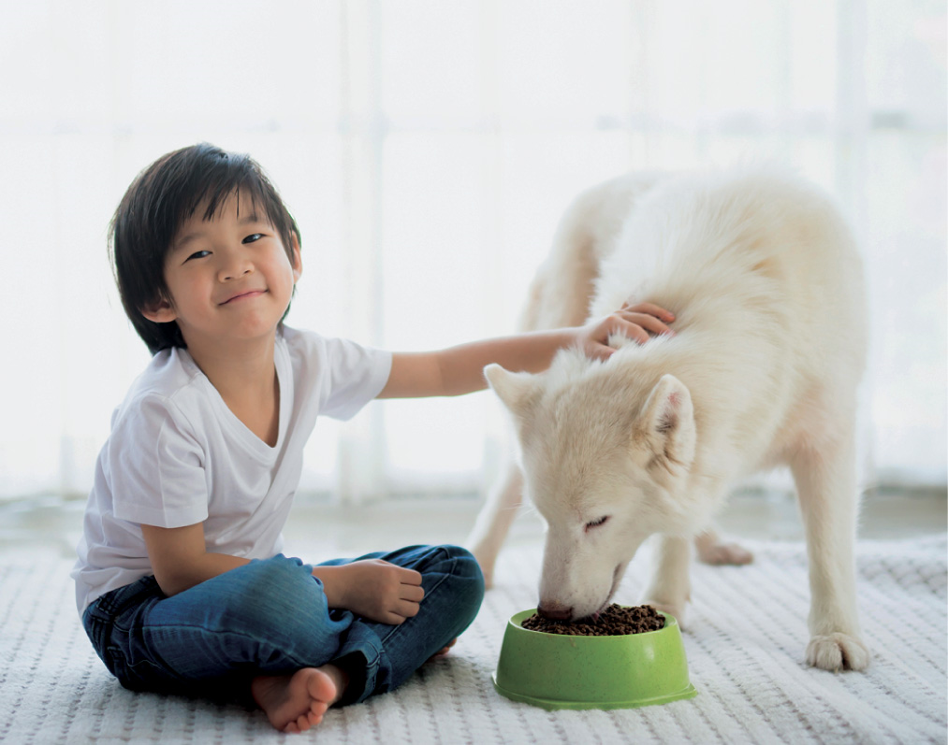
Wherewithal shall a young man cleanse his way?
by taking heed thereto according to thy word.
Psalm 119:9

