Slide 1


Wash the car
Clean Up Action
Mop the floor
Clean Up Action
Mow the lawn
Fold the towels
Clean Up Action
Clean Up Action
Vacuum the carpet
Clean Up Action
Wash the dishes
Clean Up Action
Make your bed
Clean Up Action
Feed your pet
Clean Up Action
Notes:
Have a child pick a Clean Up Action card. Click on the card to reveal the action you will be doing. Then click on the words to show the verse. Say the verse with the children while doing the clean up action. Click the home button (bottom right hand corner) to go back to the Clean Up Action cards and repeat as time allows.

Slide 2
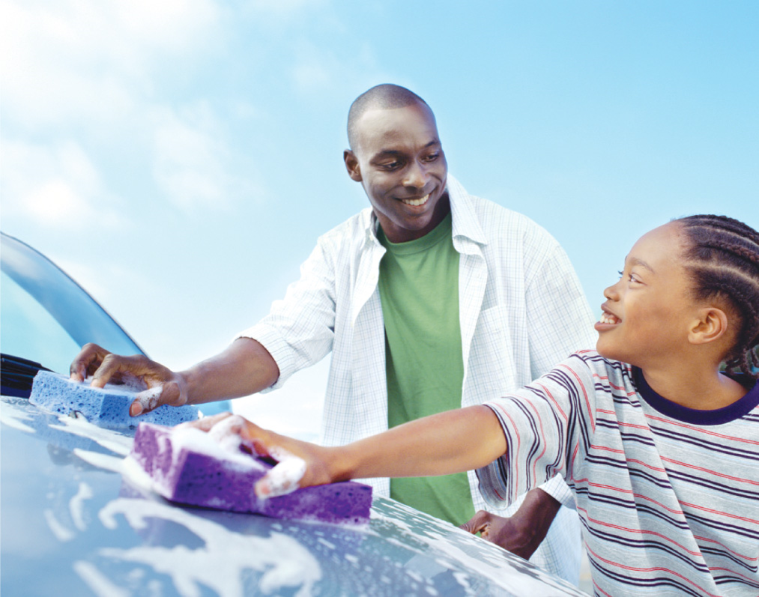
How can a young man keep his way pure? By guarding it according to your word.
Psalm 119:9

Slide 3
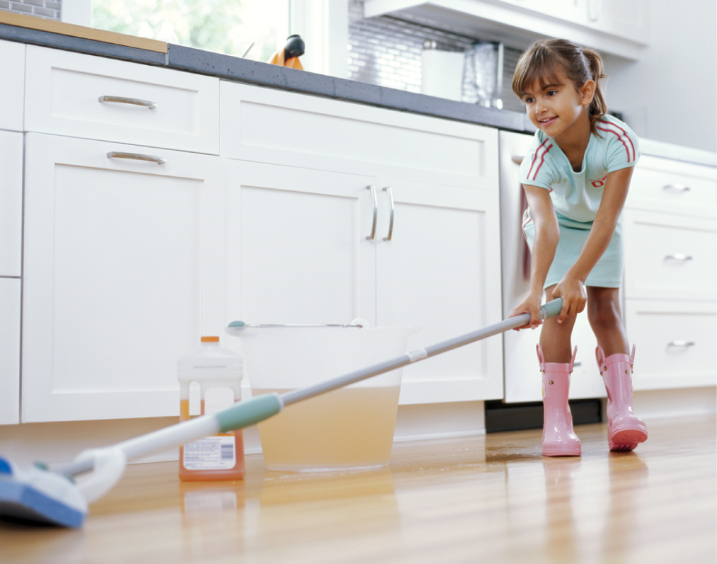
How can a young man keep his way pure? By guarding it according to your word.
Psalm 119:9

Slide 4
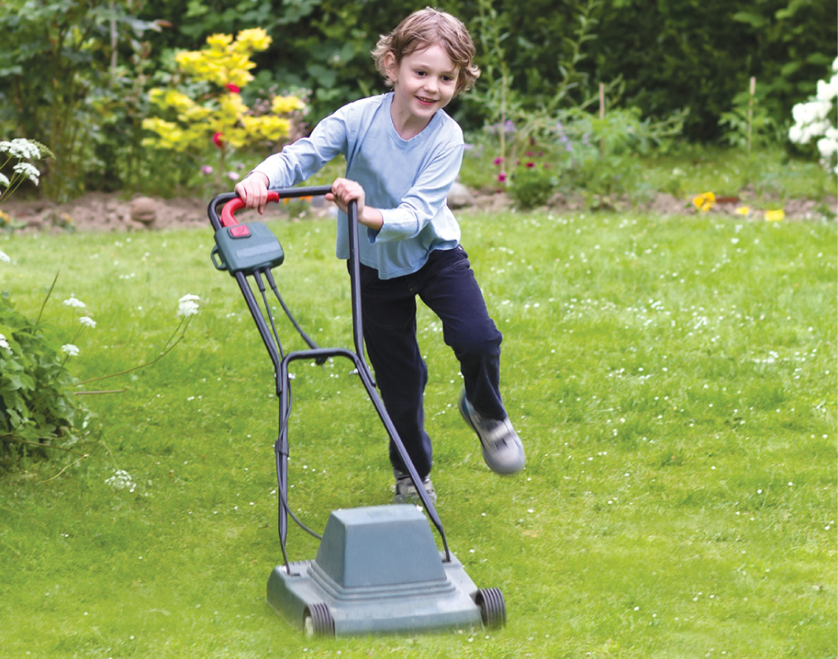
How can a young man
keep his way pure? By guarding it according to your word.
Psalm 119:9

Slide 5
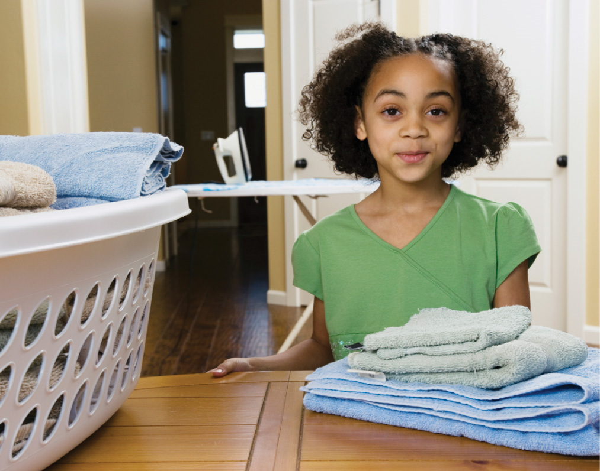
How can a young
man keep his
way pure?
By guarding
it according to
your word.
Psalm 119:9

Slide 6
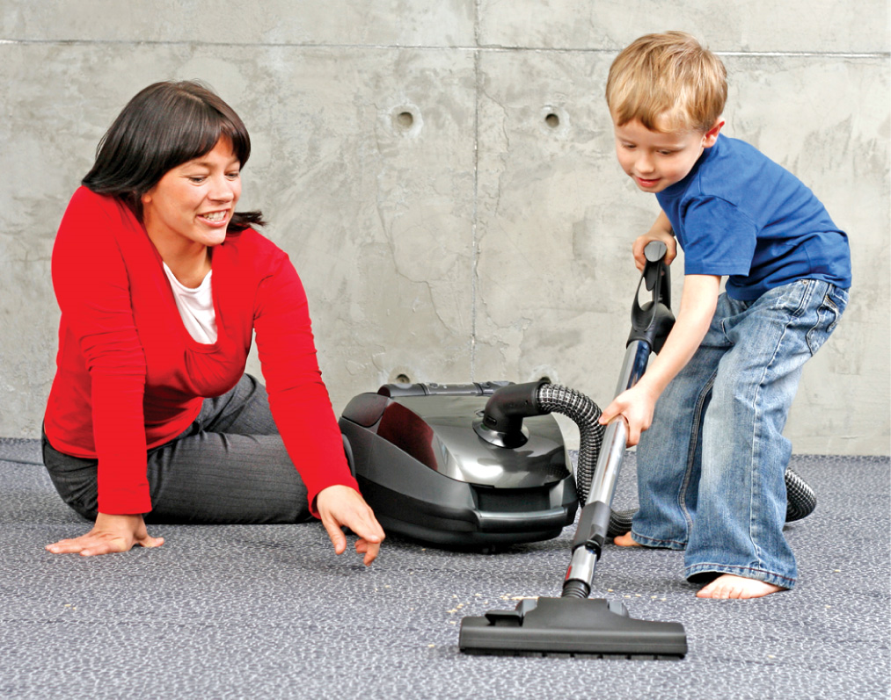
How can a young man keep his way pure? By guarding it
according to your word.
Psalm 119:9

Slide 7
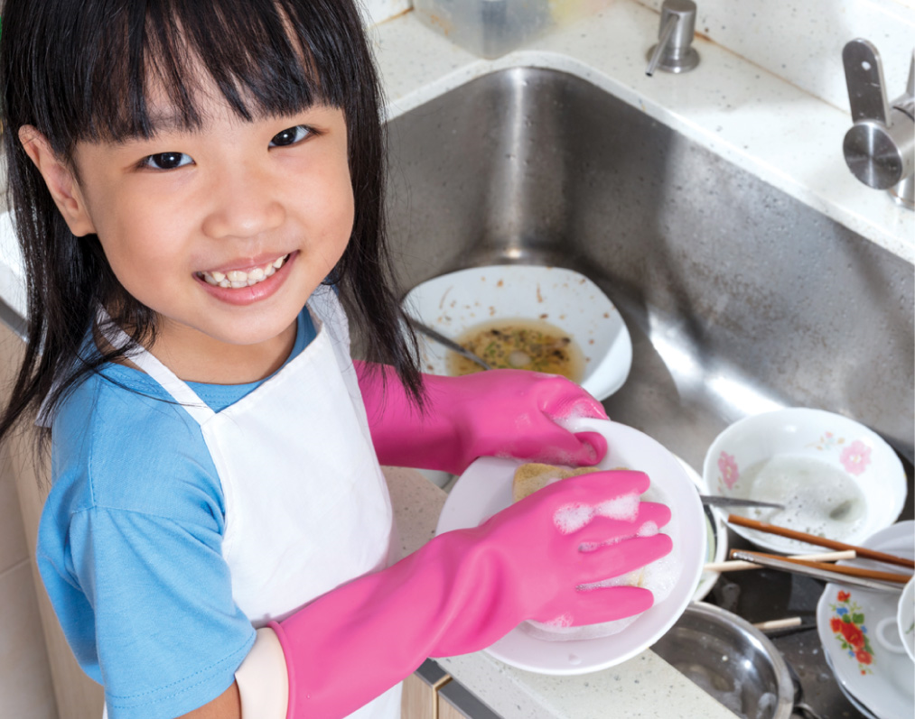
How can a young man keep his
way pure?
By guarding it according to
your word.
Psalm 119:9

Slide 8

How can a young man keep his way pure? By guarding it according to your word.
Psalm 119:9

Slide 9
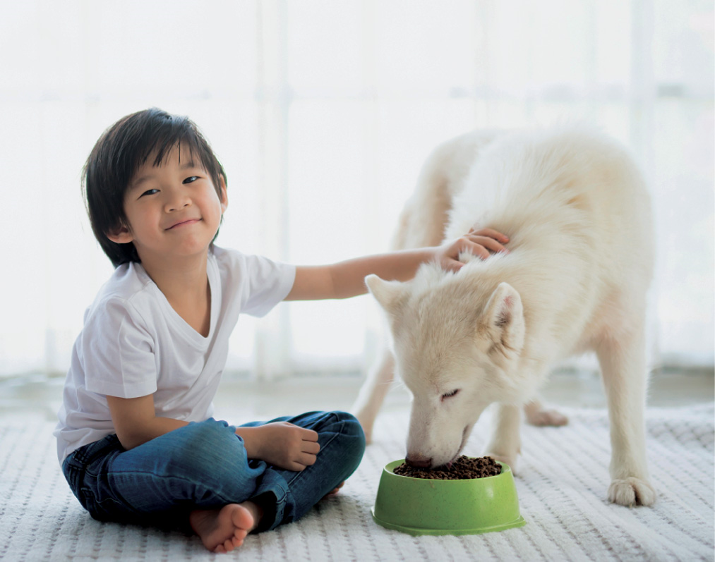
How can a young man keep his way pure? By guarding it according to your word.
Psalm 119:9

