Slide 1
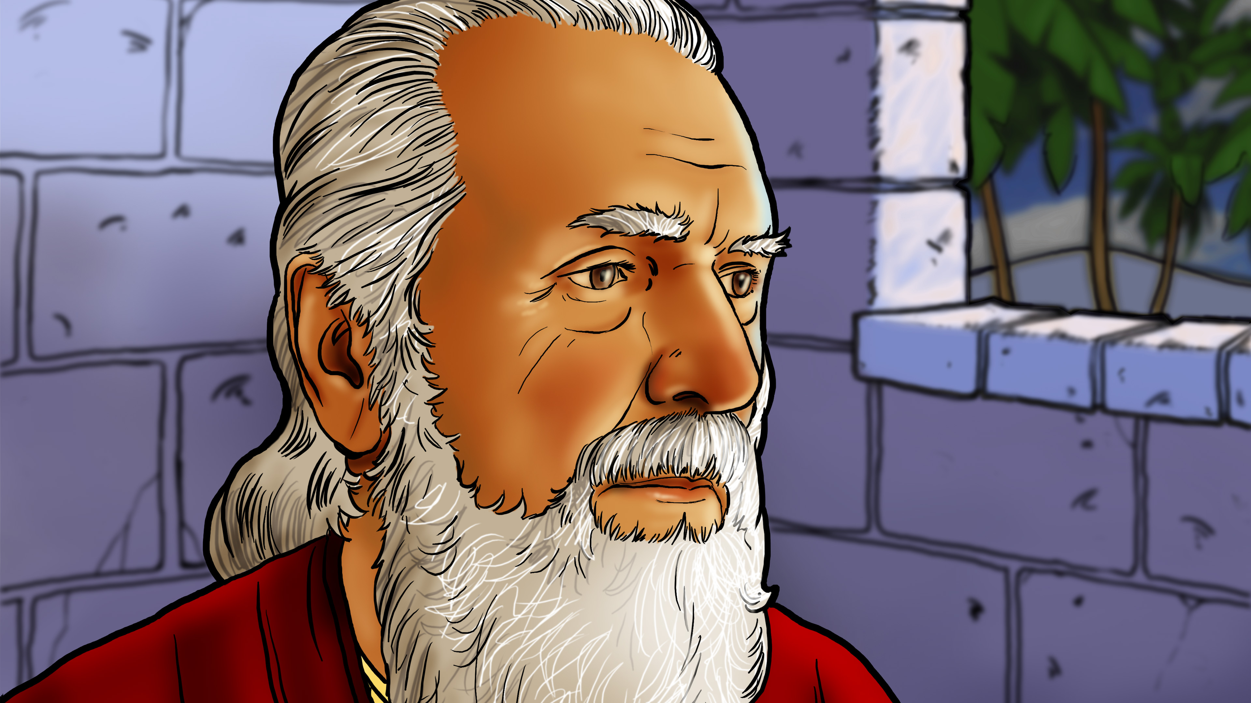

Slide 2
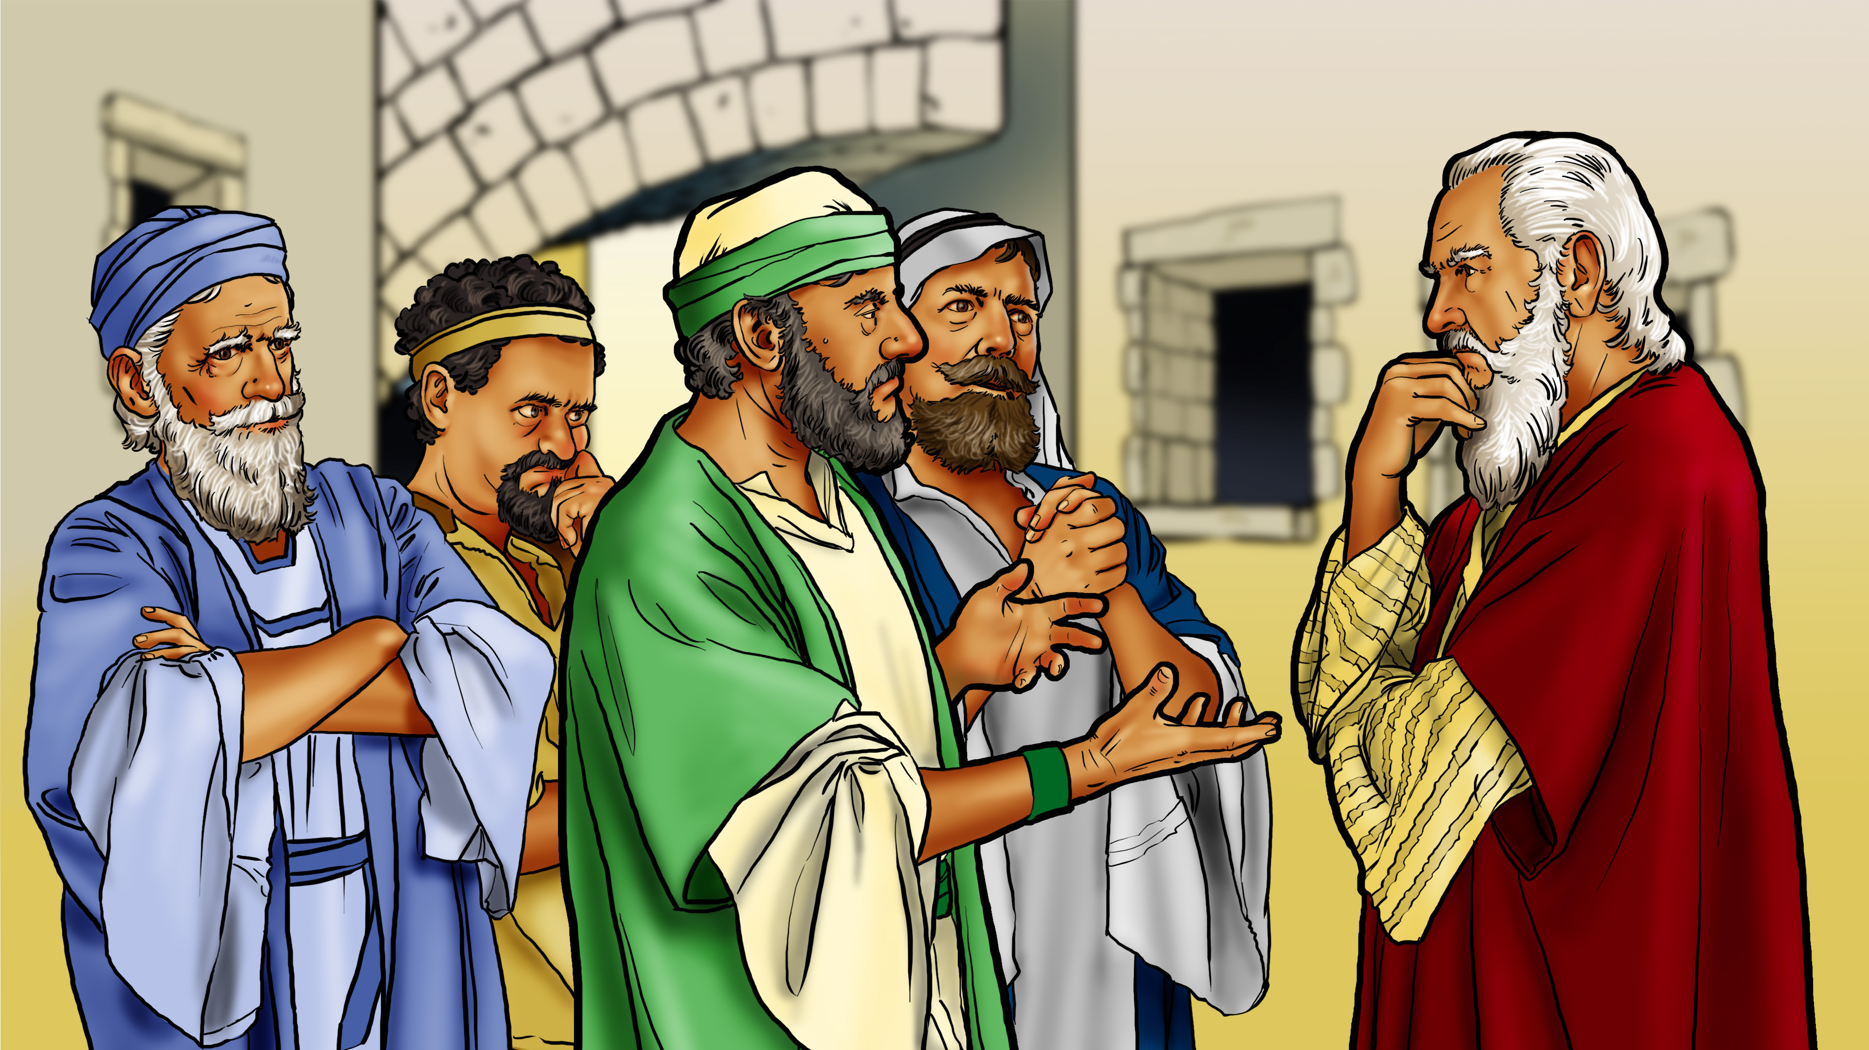

Slide 3
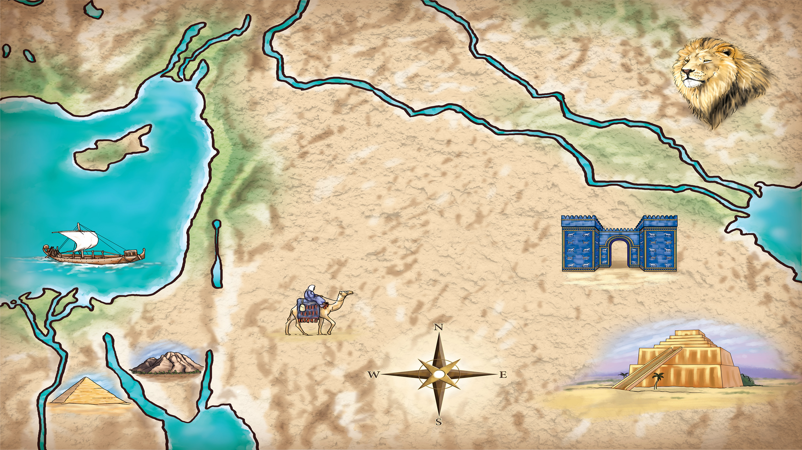
Mesopotamia
Assyria
Lebanon
Persia
Mediterranean
Sea
Babylonia
Israel
(Canaan)
Arabian
Desert
Mt. Sinai
Egypt
Red Sea

Slide 5
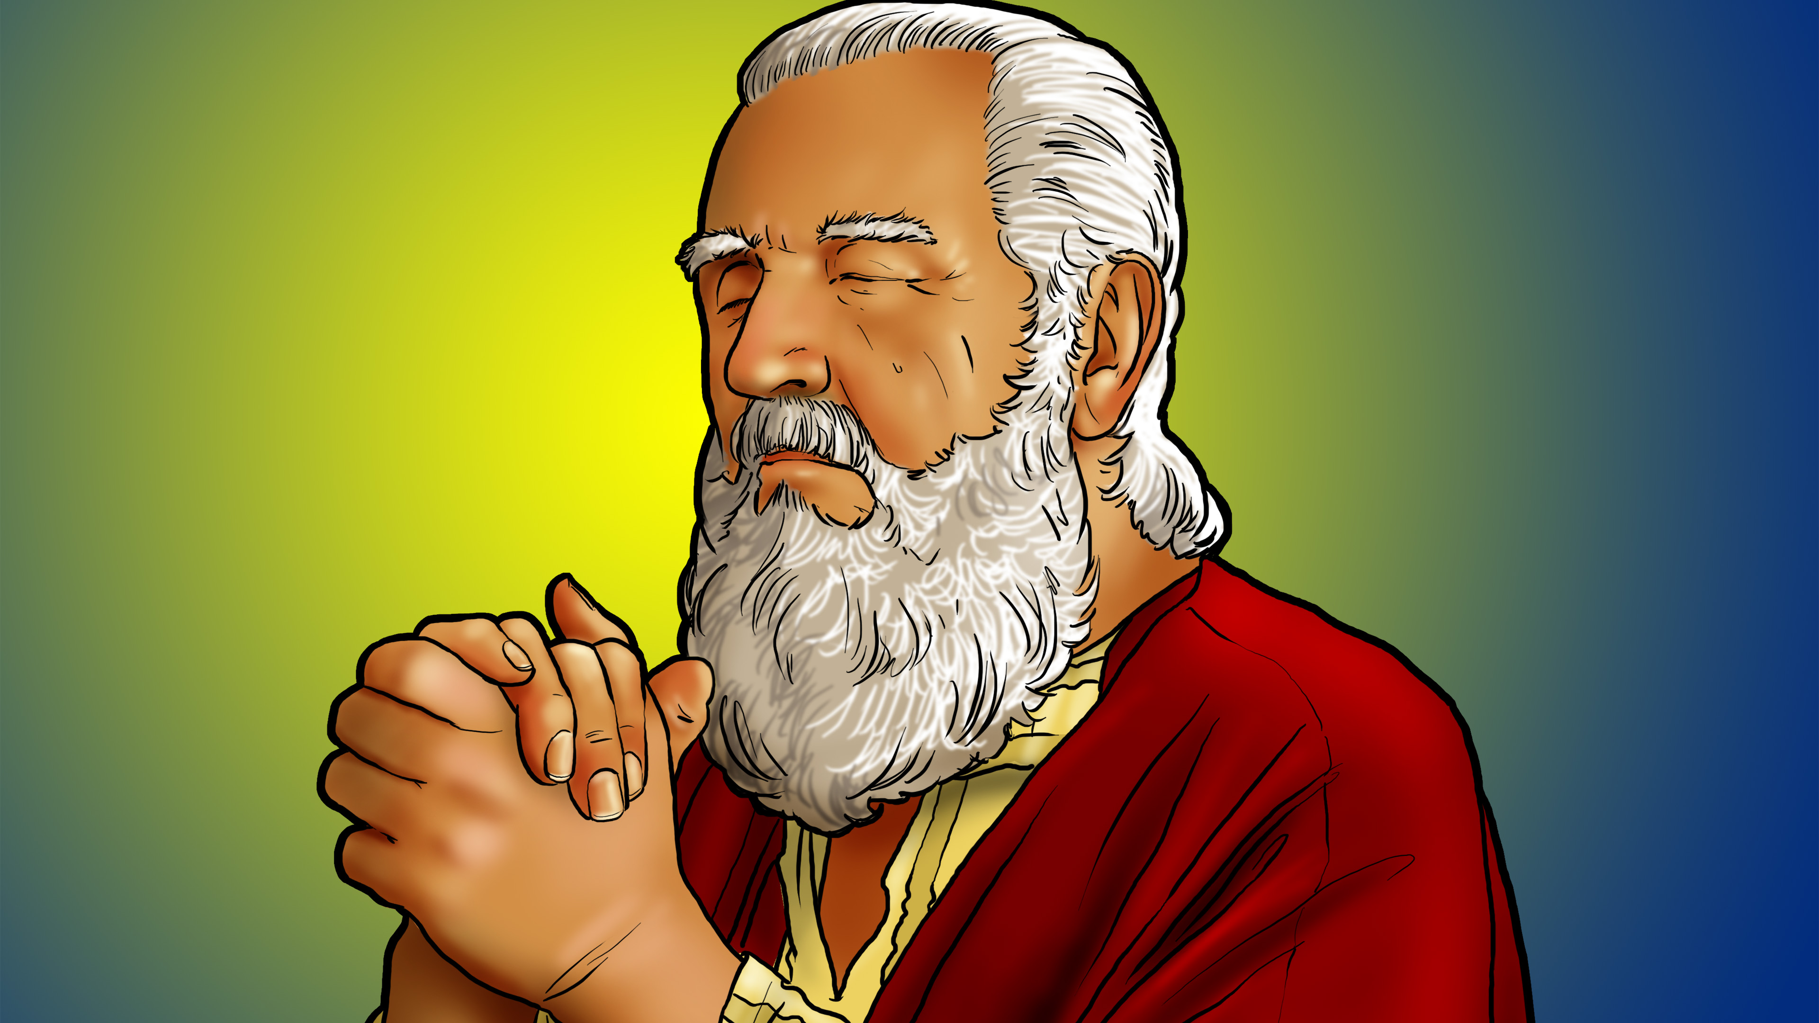

Slide 6

Follow God!

Slide 8
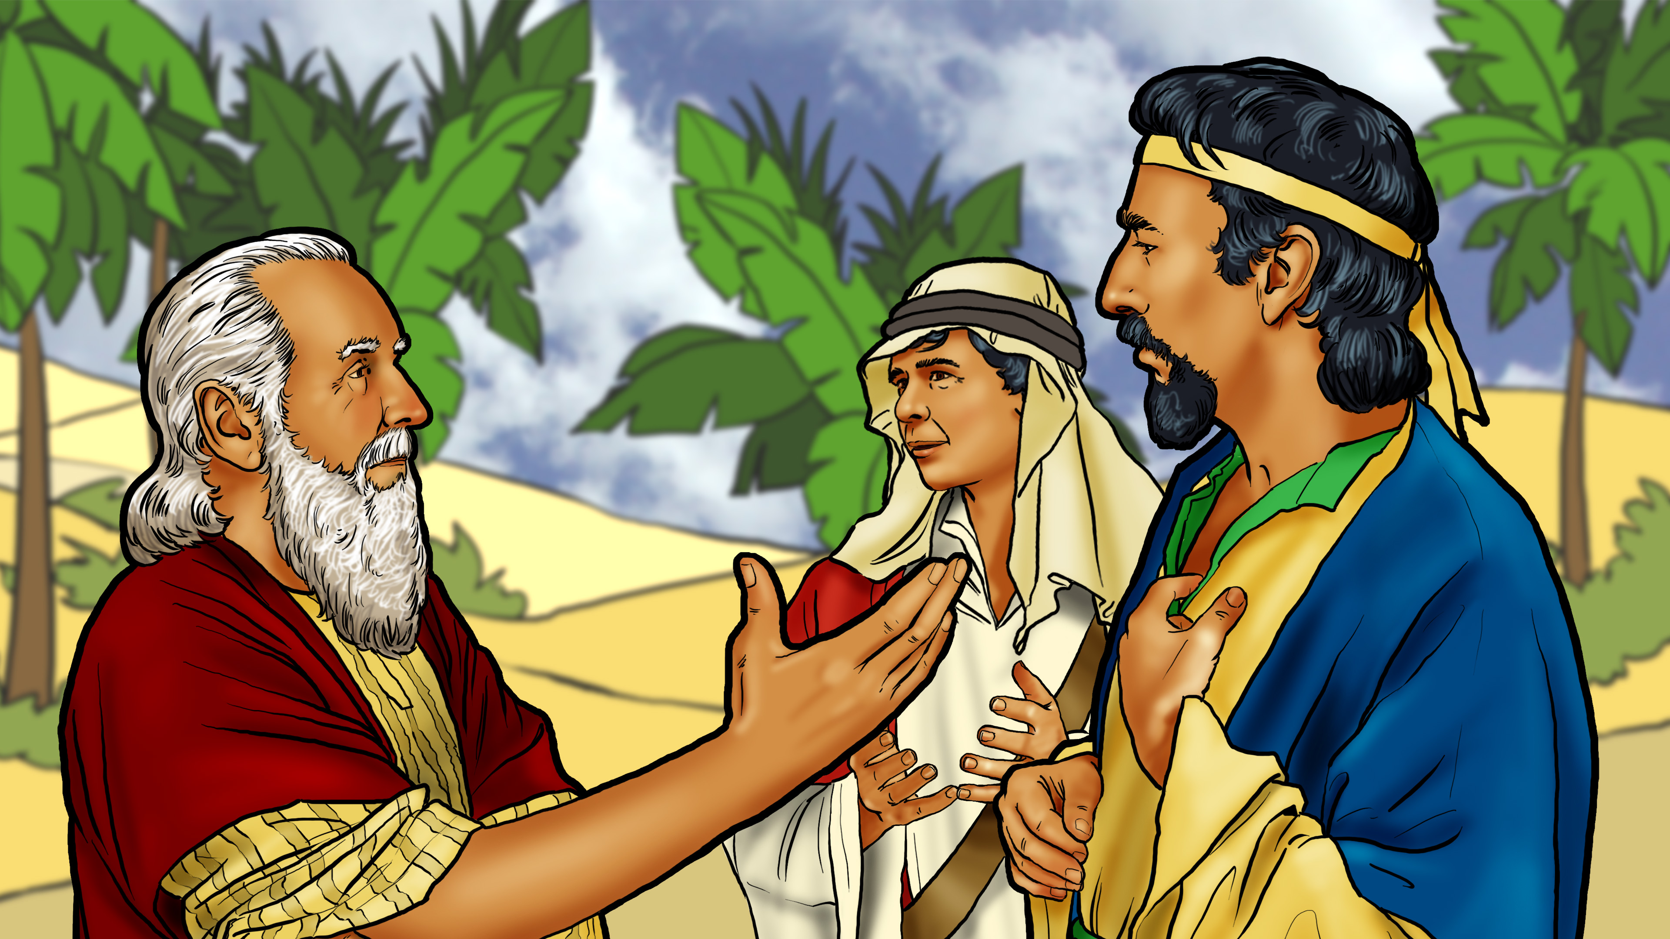

Slide 9
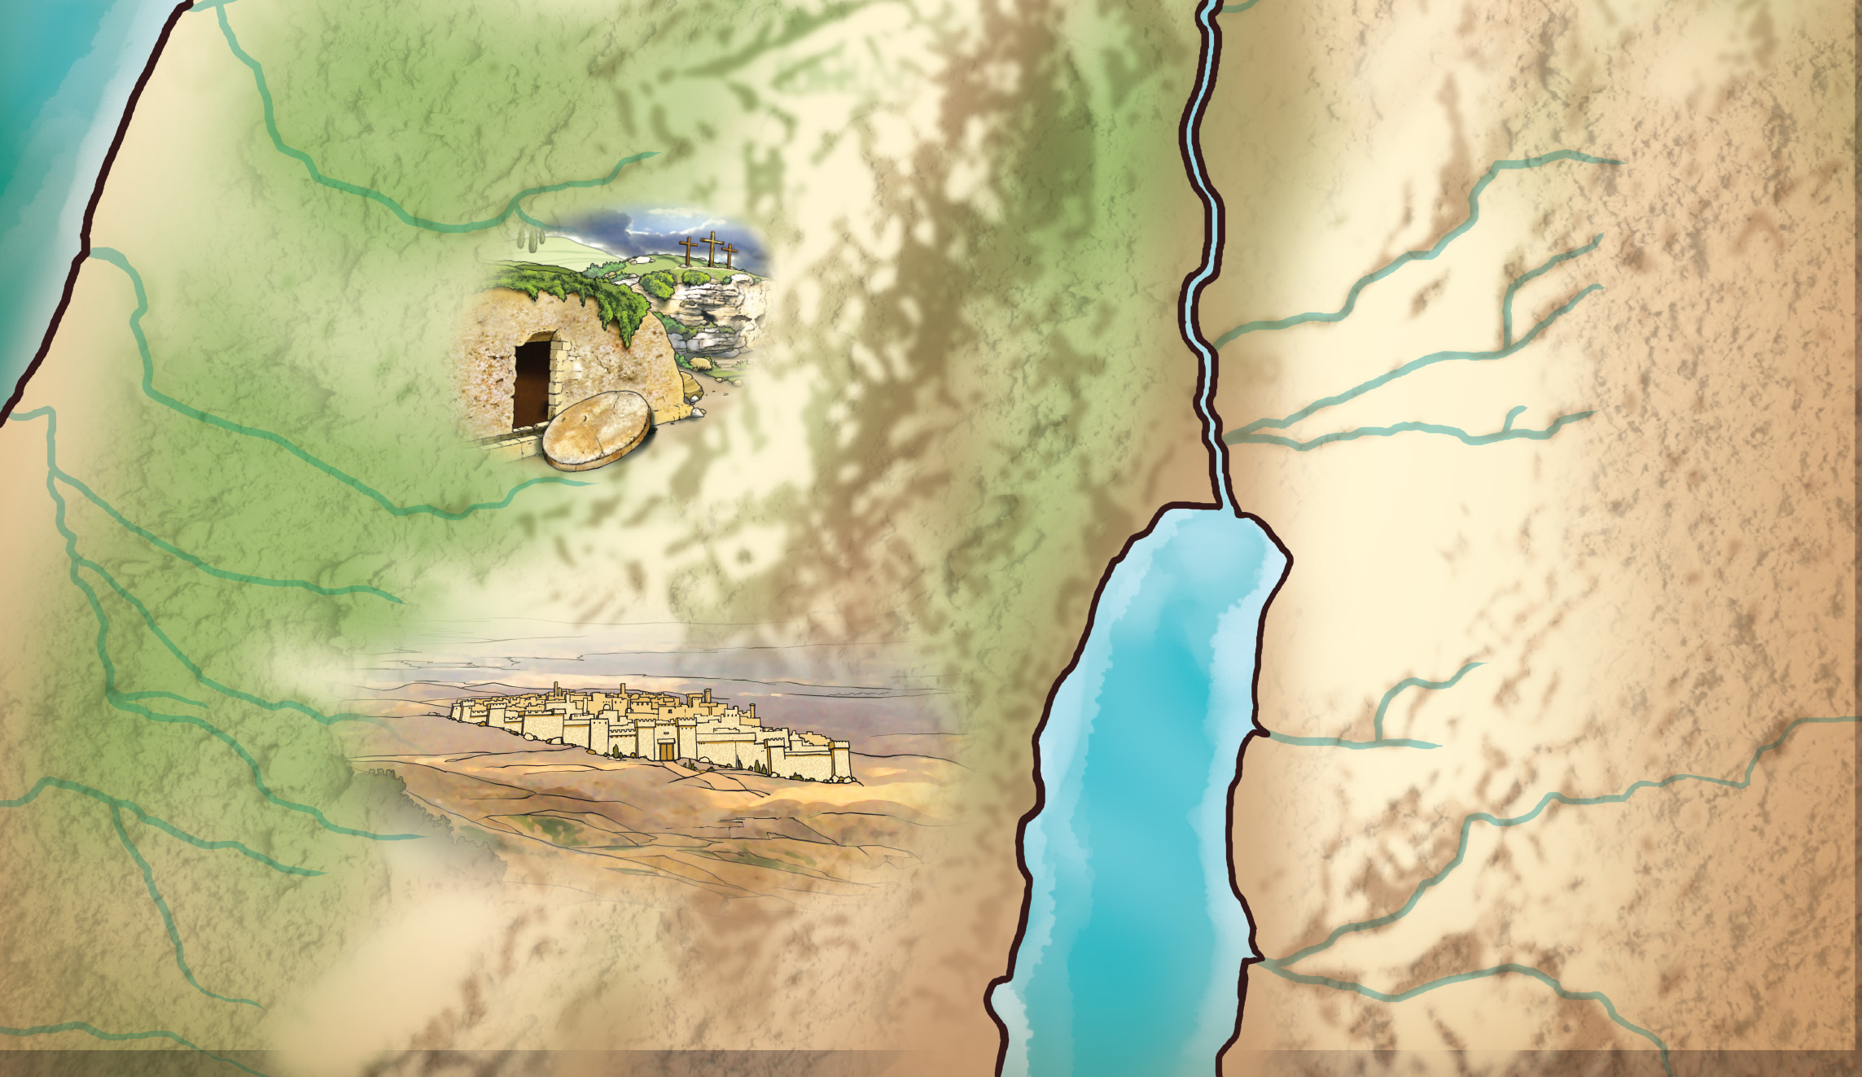
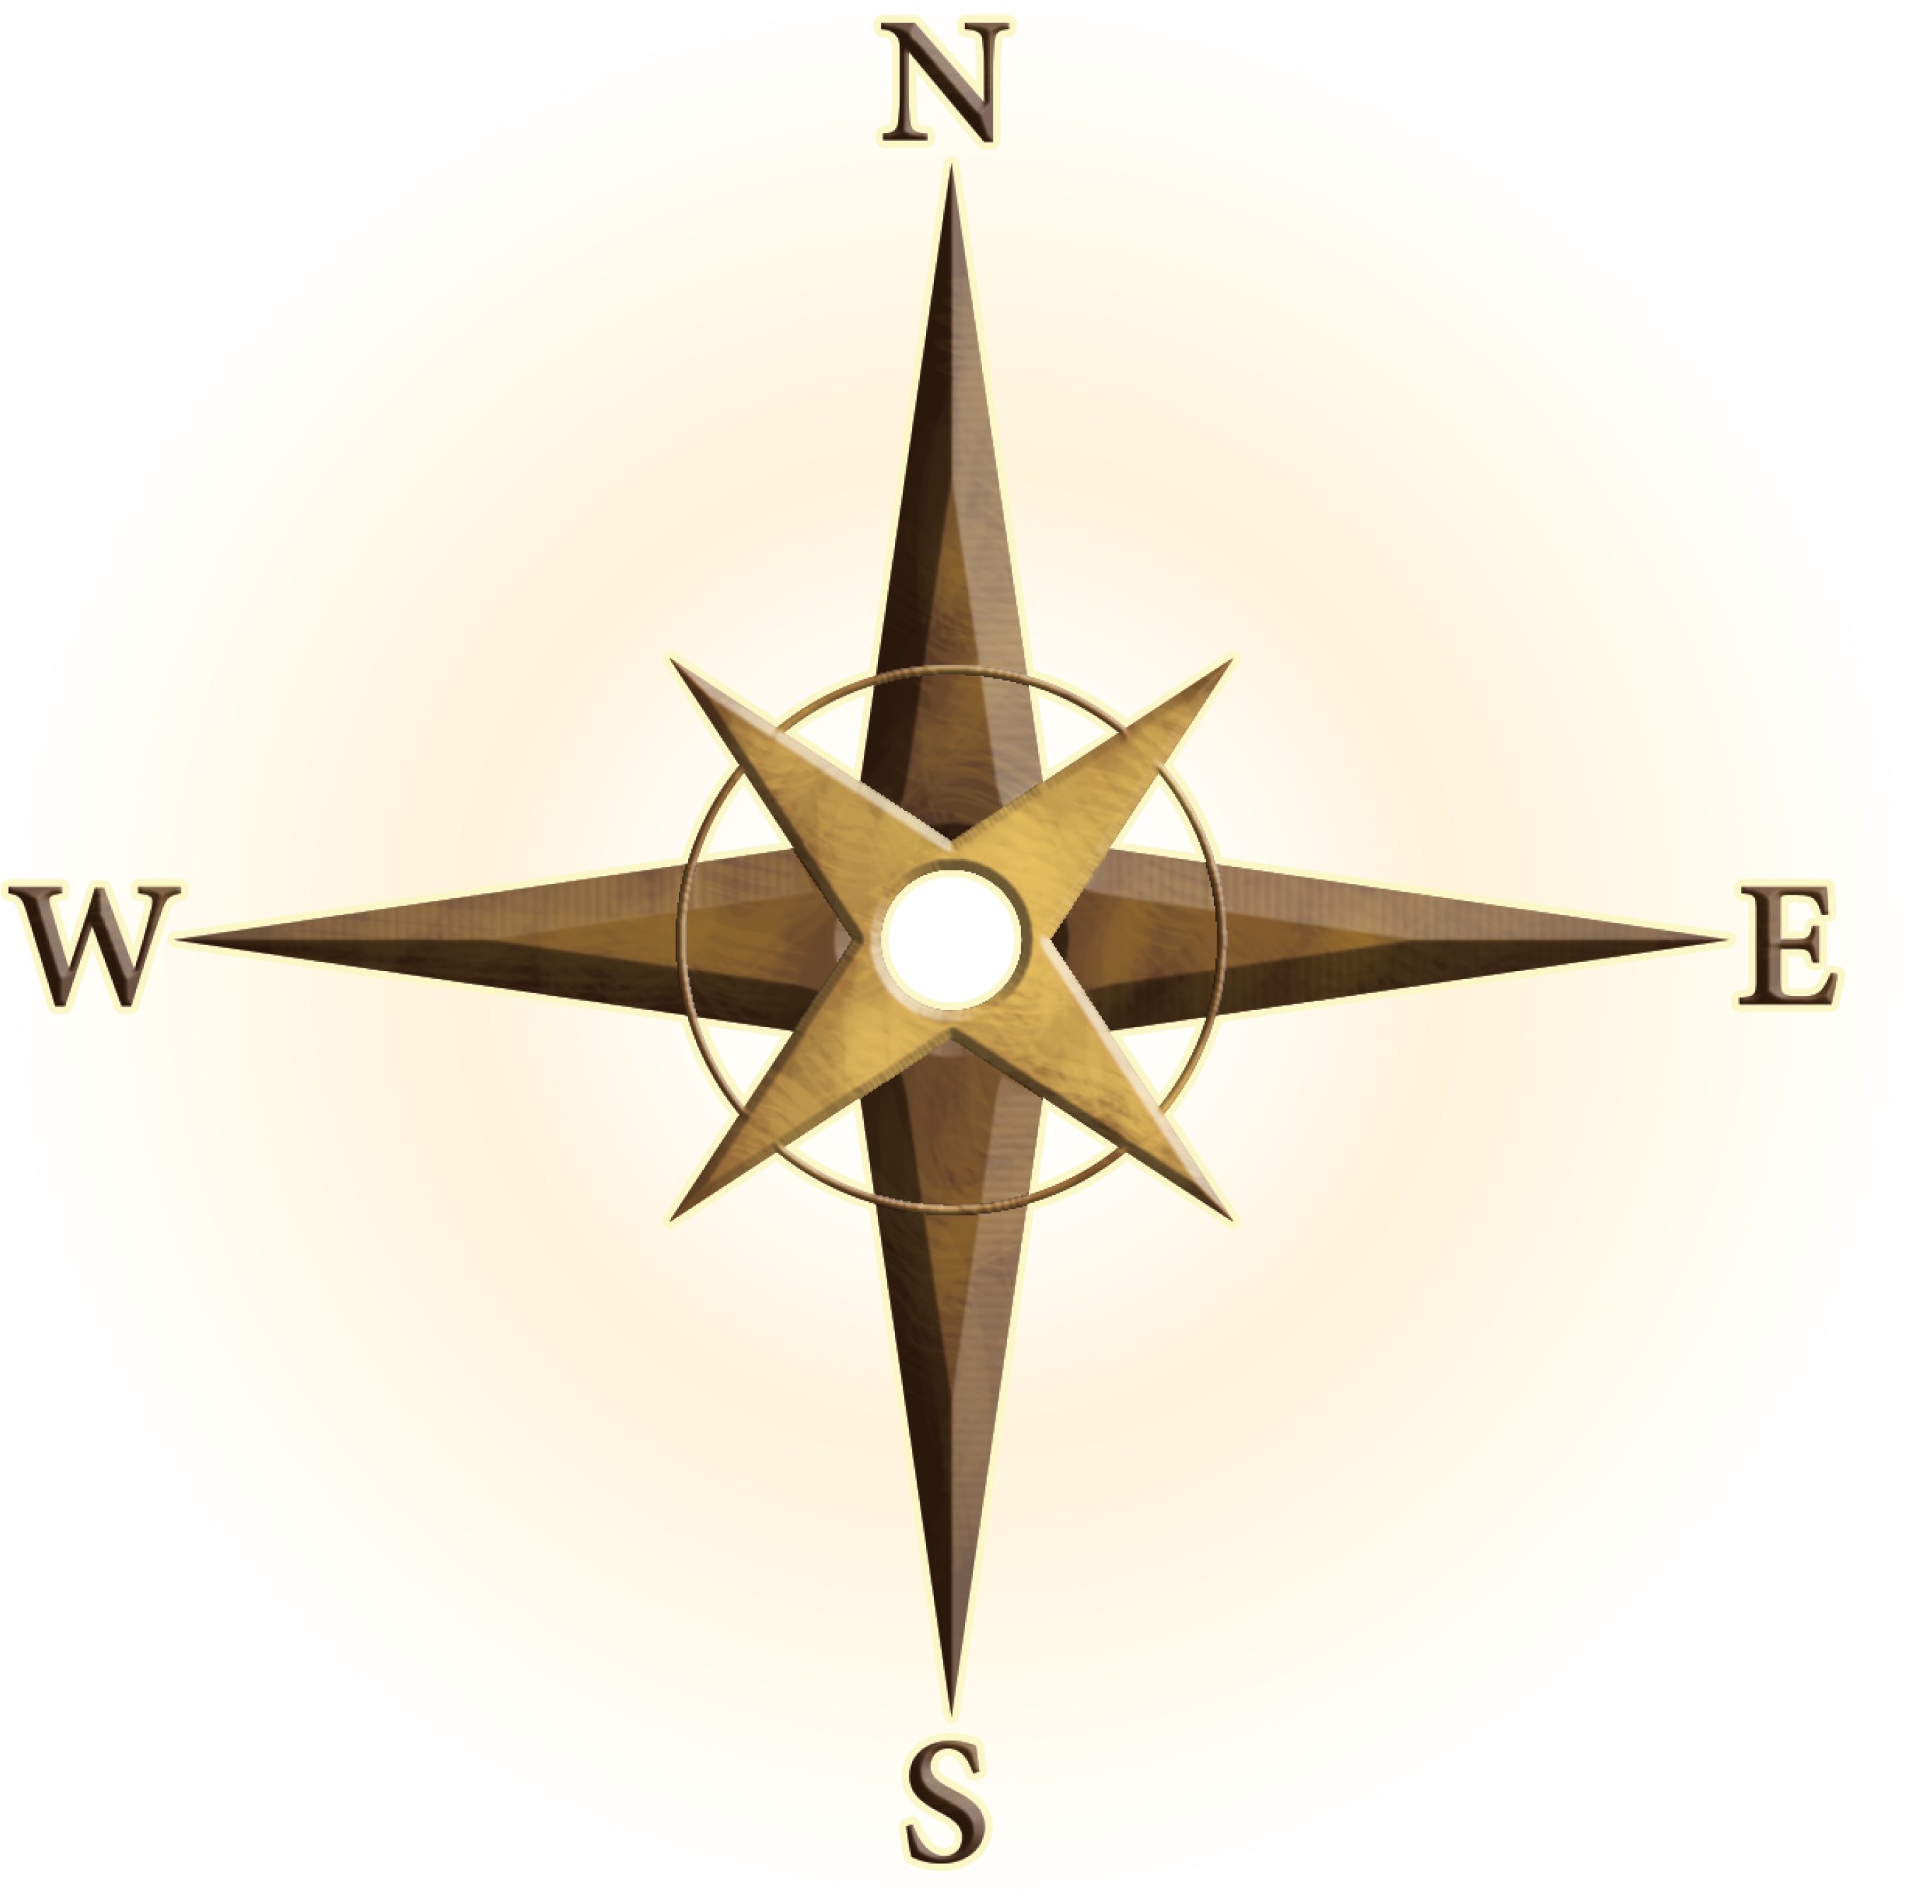
Shiloh
Bethel
Jordan River
JUDEA
Jericho
Mount of
Olives
Jerusalem
Bethlehem
Bethany
MOAB
Dead
Sea
PHILISTIA

Slide 10
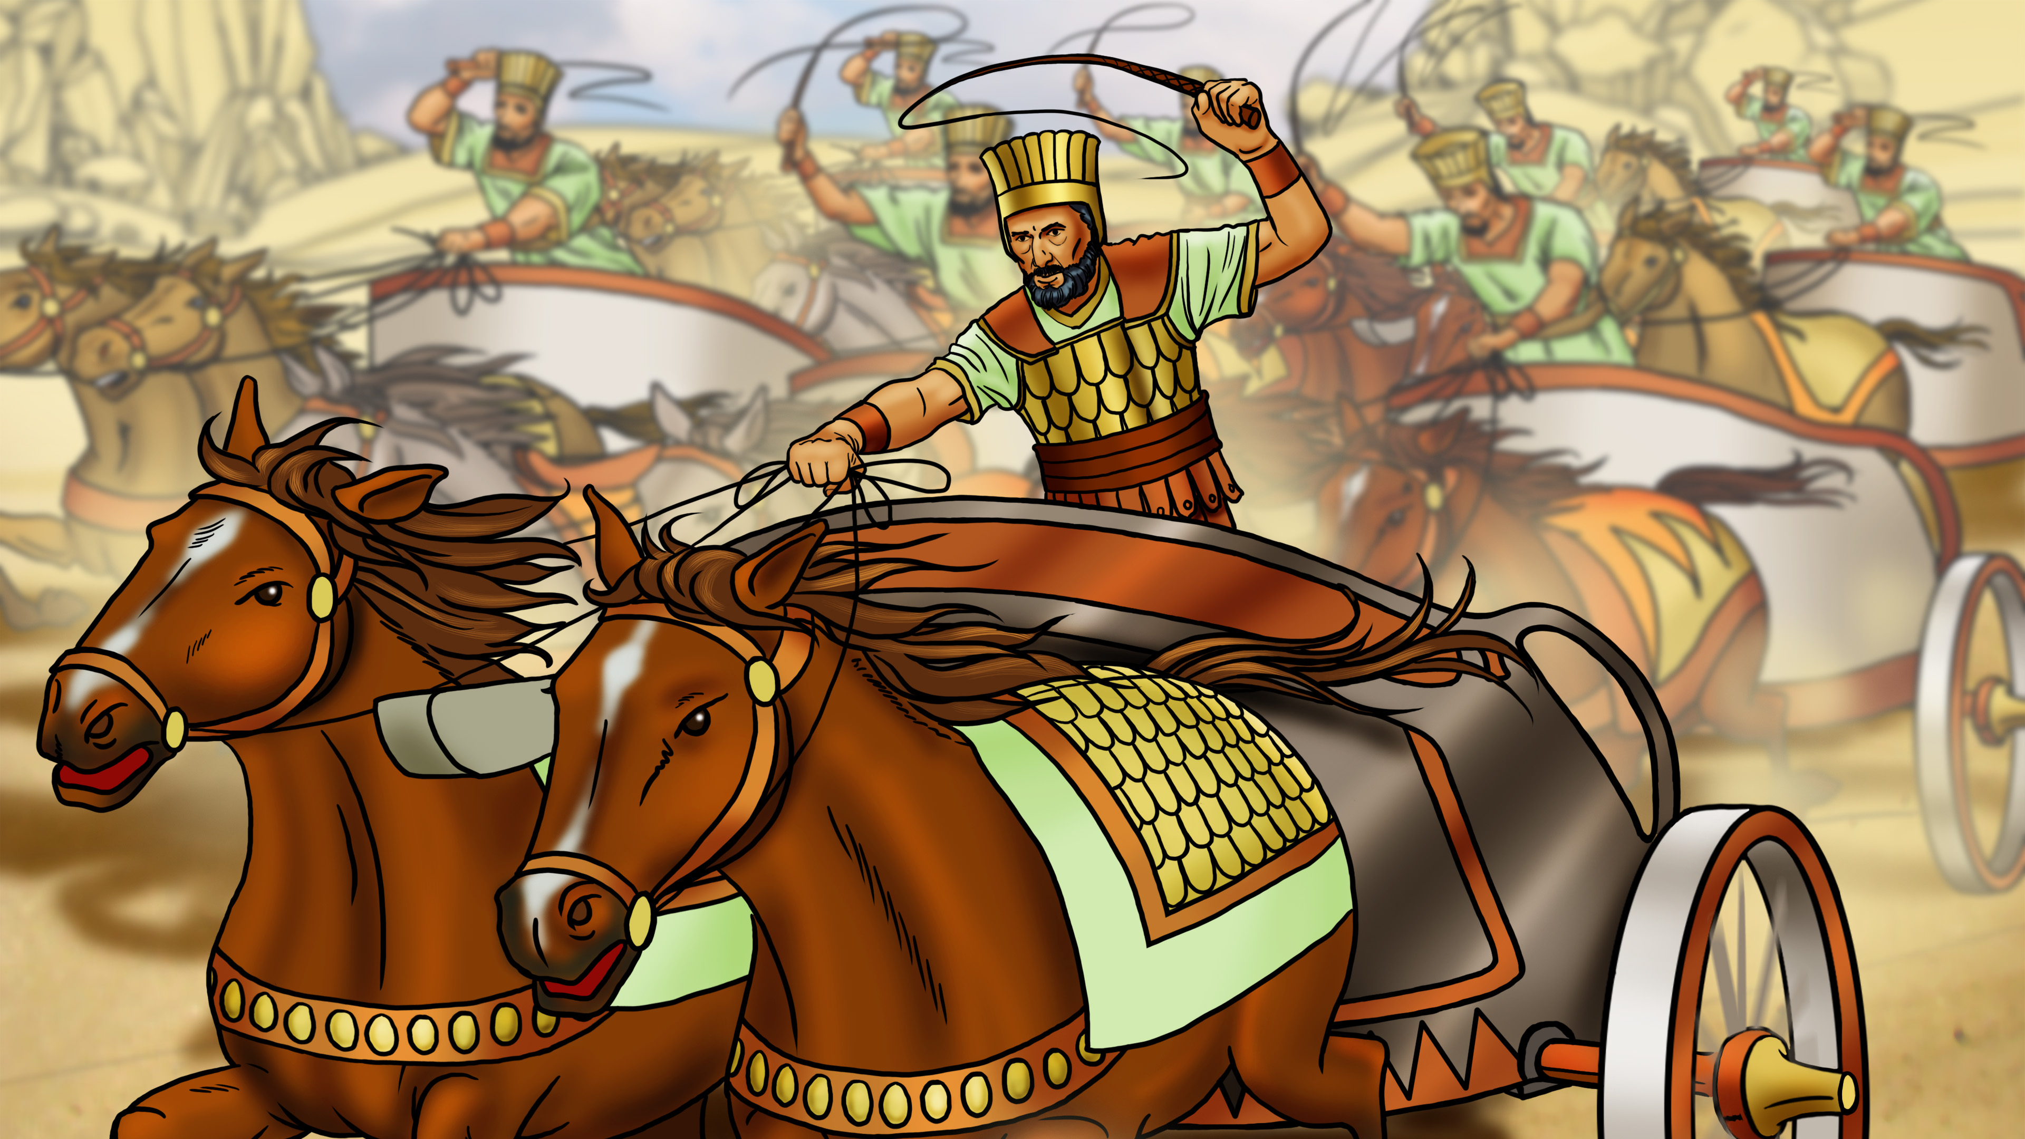

Slide 11
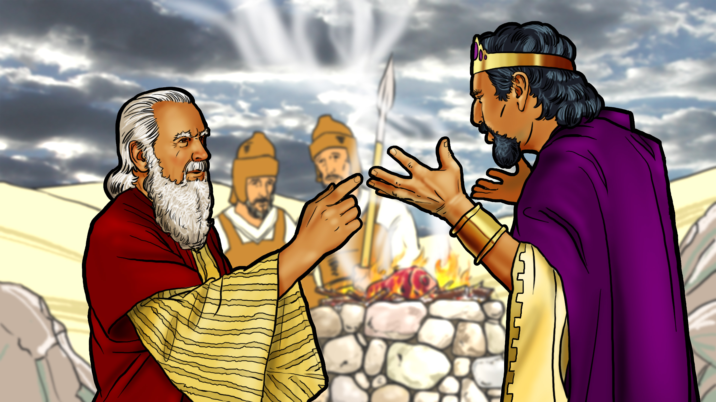

Slide 12
Follow God!

Slide 14
Follow God!

