Slide 1
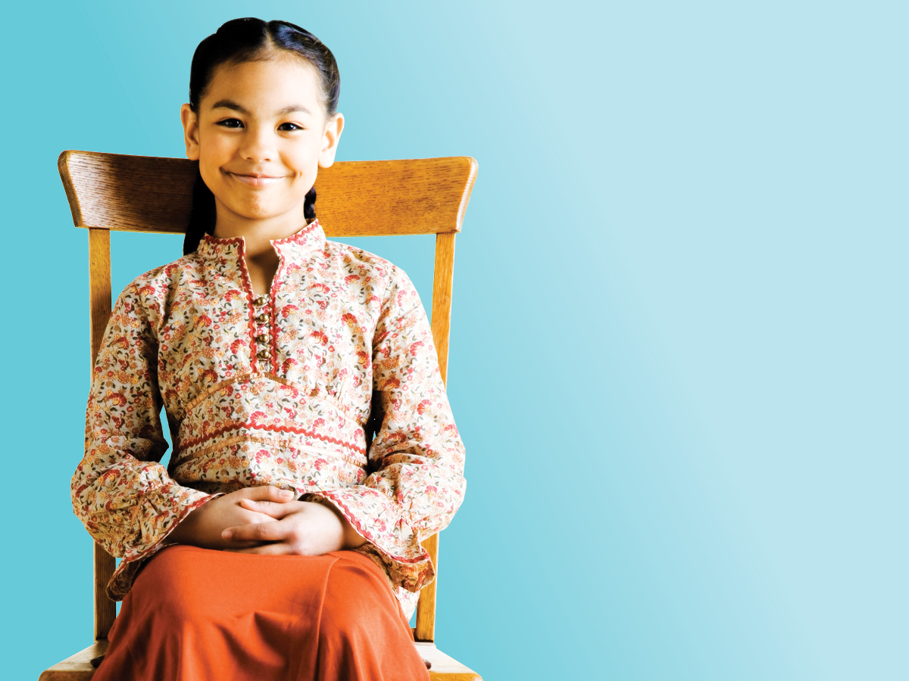
Sit up

Slide 2

Look up

Slide 3

Listen up

Slide 4

Hand up

Slide 5

Zip up

Slide 6

Sit up
Look up
Listen up
Zip
up
Hand
up

