Slide 1


Slide 2

OMNISCIENT

Slide 3
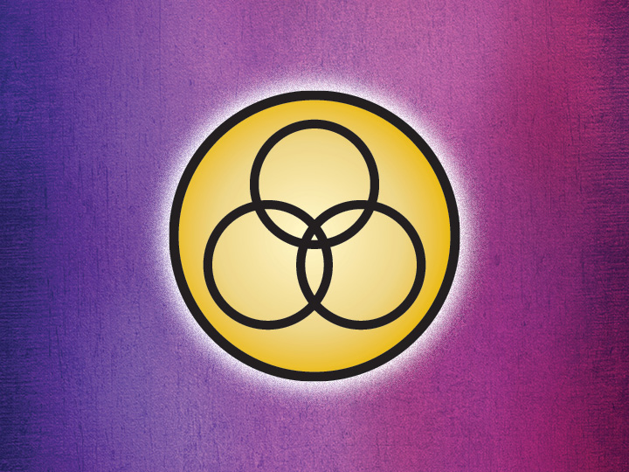

Slide 4


Slide 5


Slide 6


Slide 7

OMNIPOTENT

Slide 8


Slide 9


Slide 10


