Slide 1
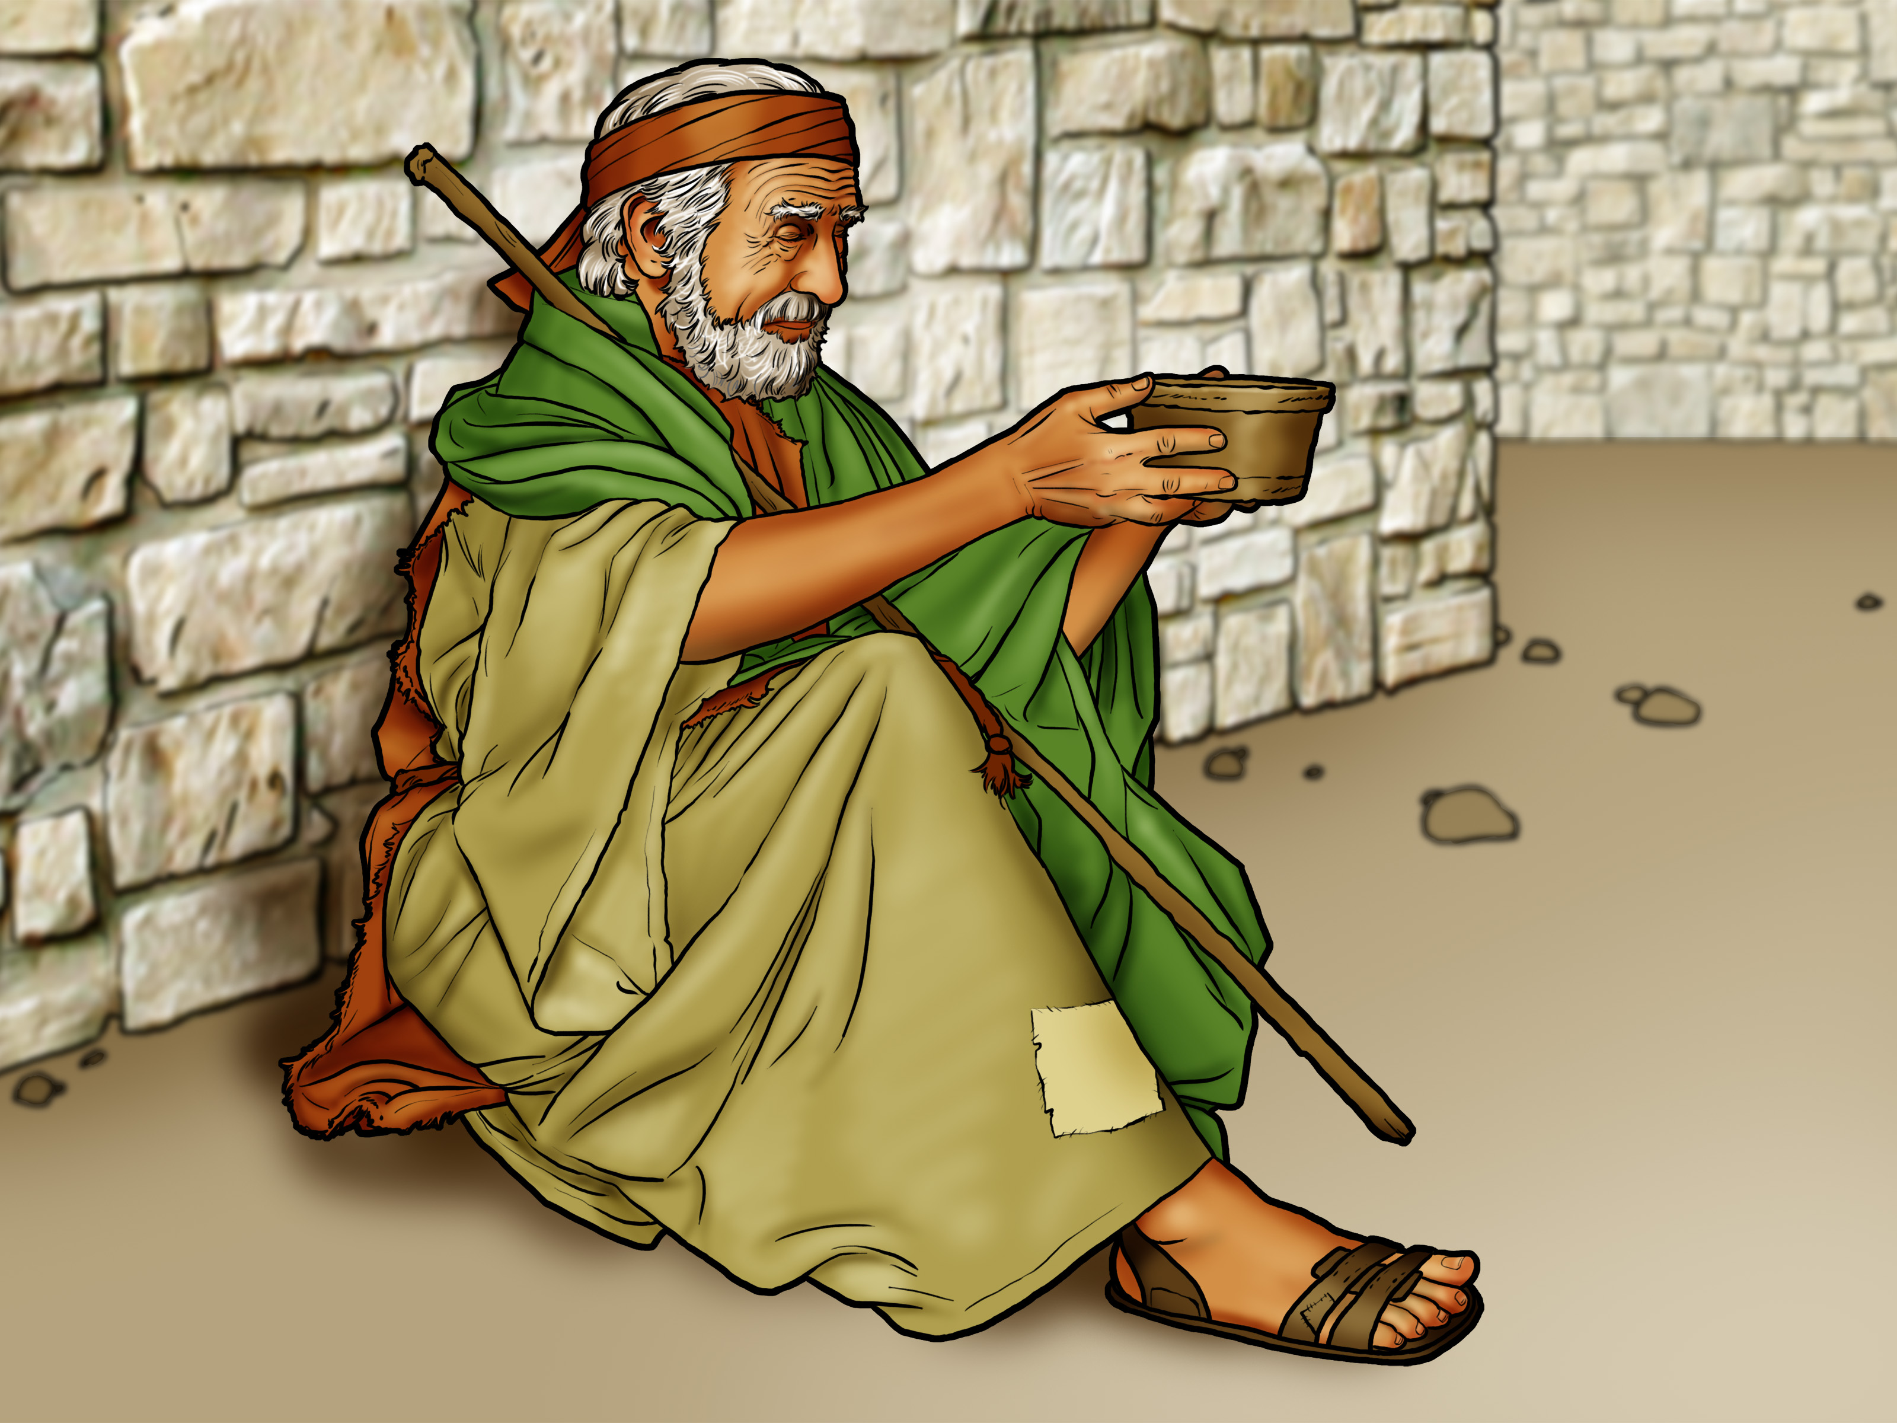

Slide 2
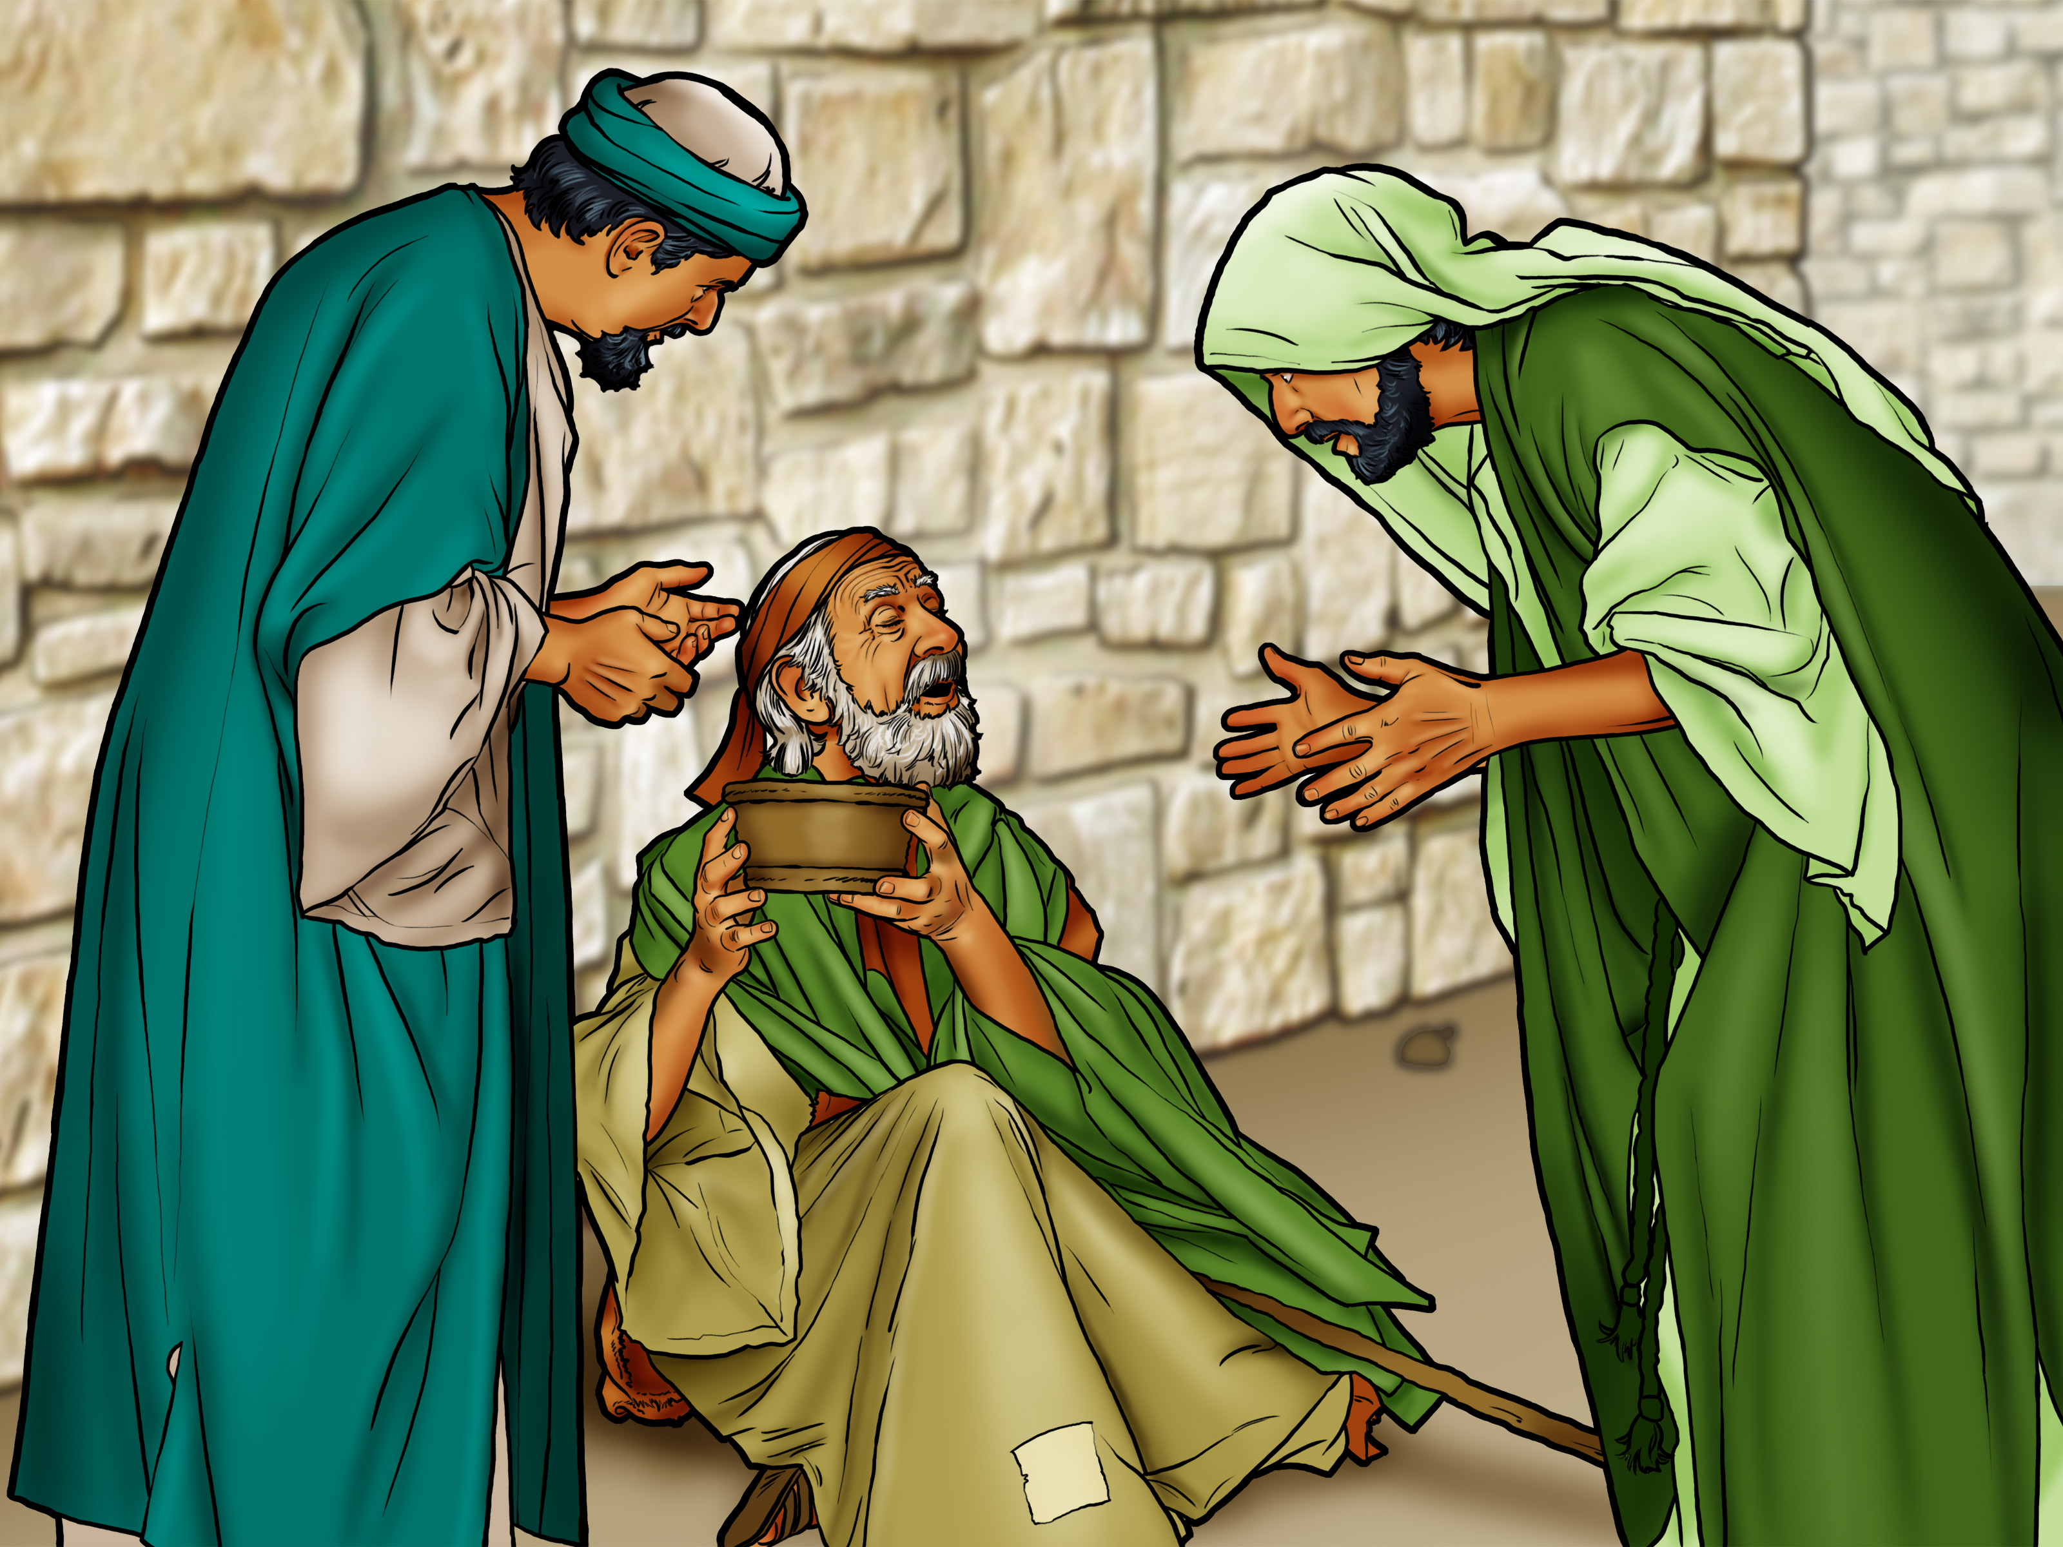

Slide 3

Nazareth
Mt. Carmel
Mediterranean Sea
SAMARIA
Jordan River
Shiloh
Bethel
Jericho

Slide 4
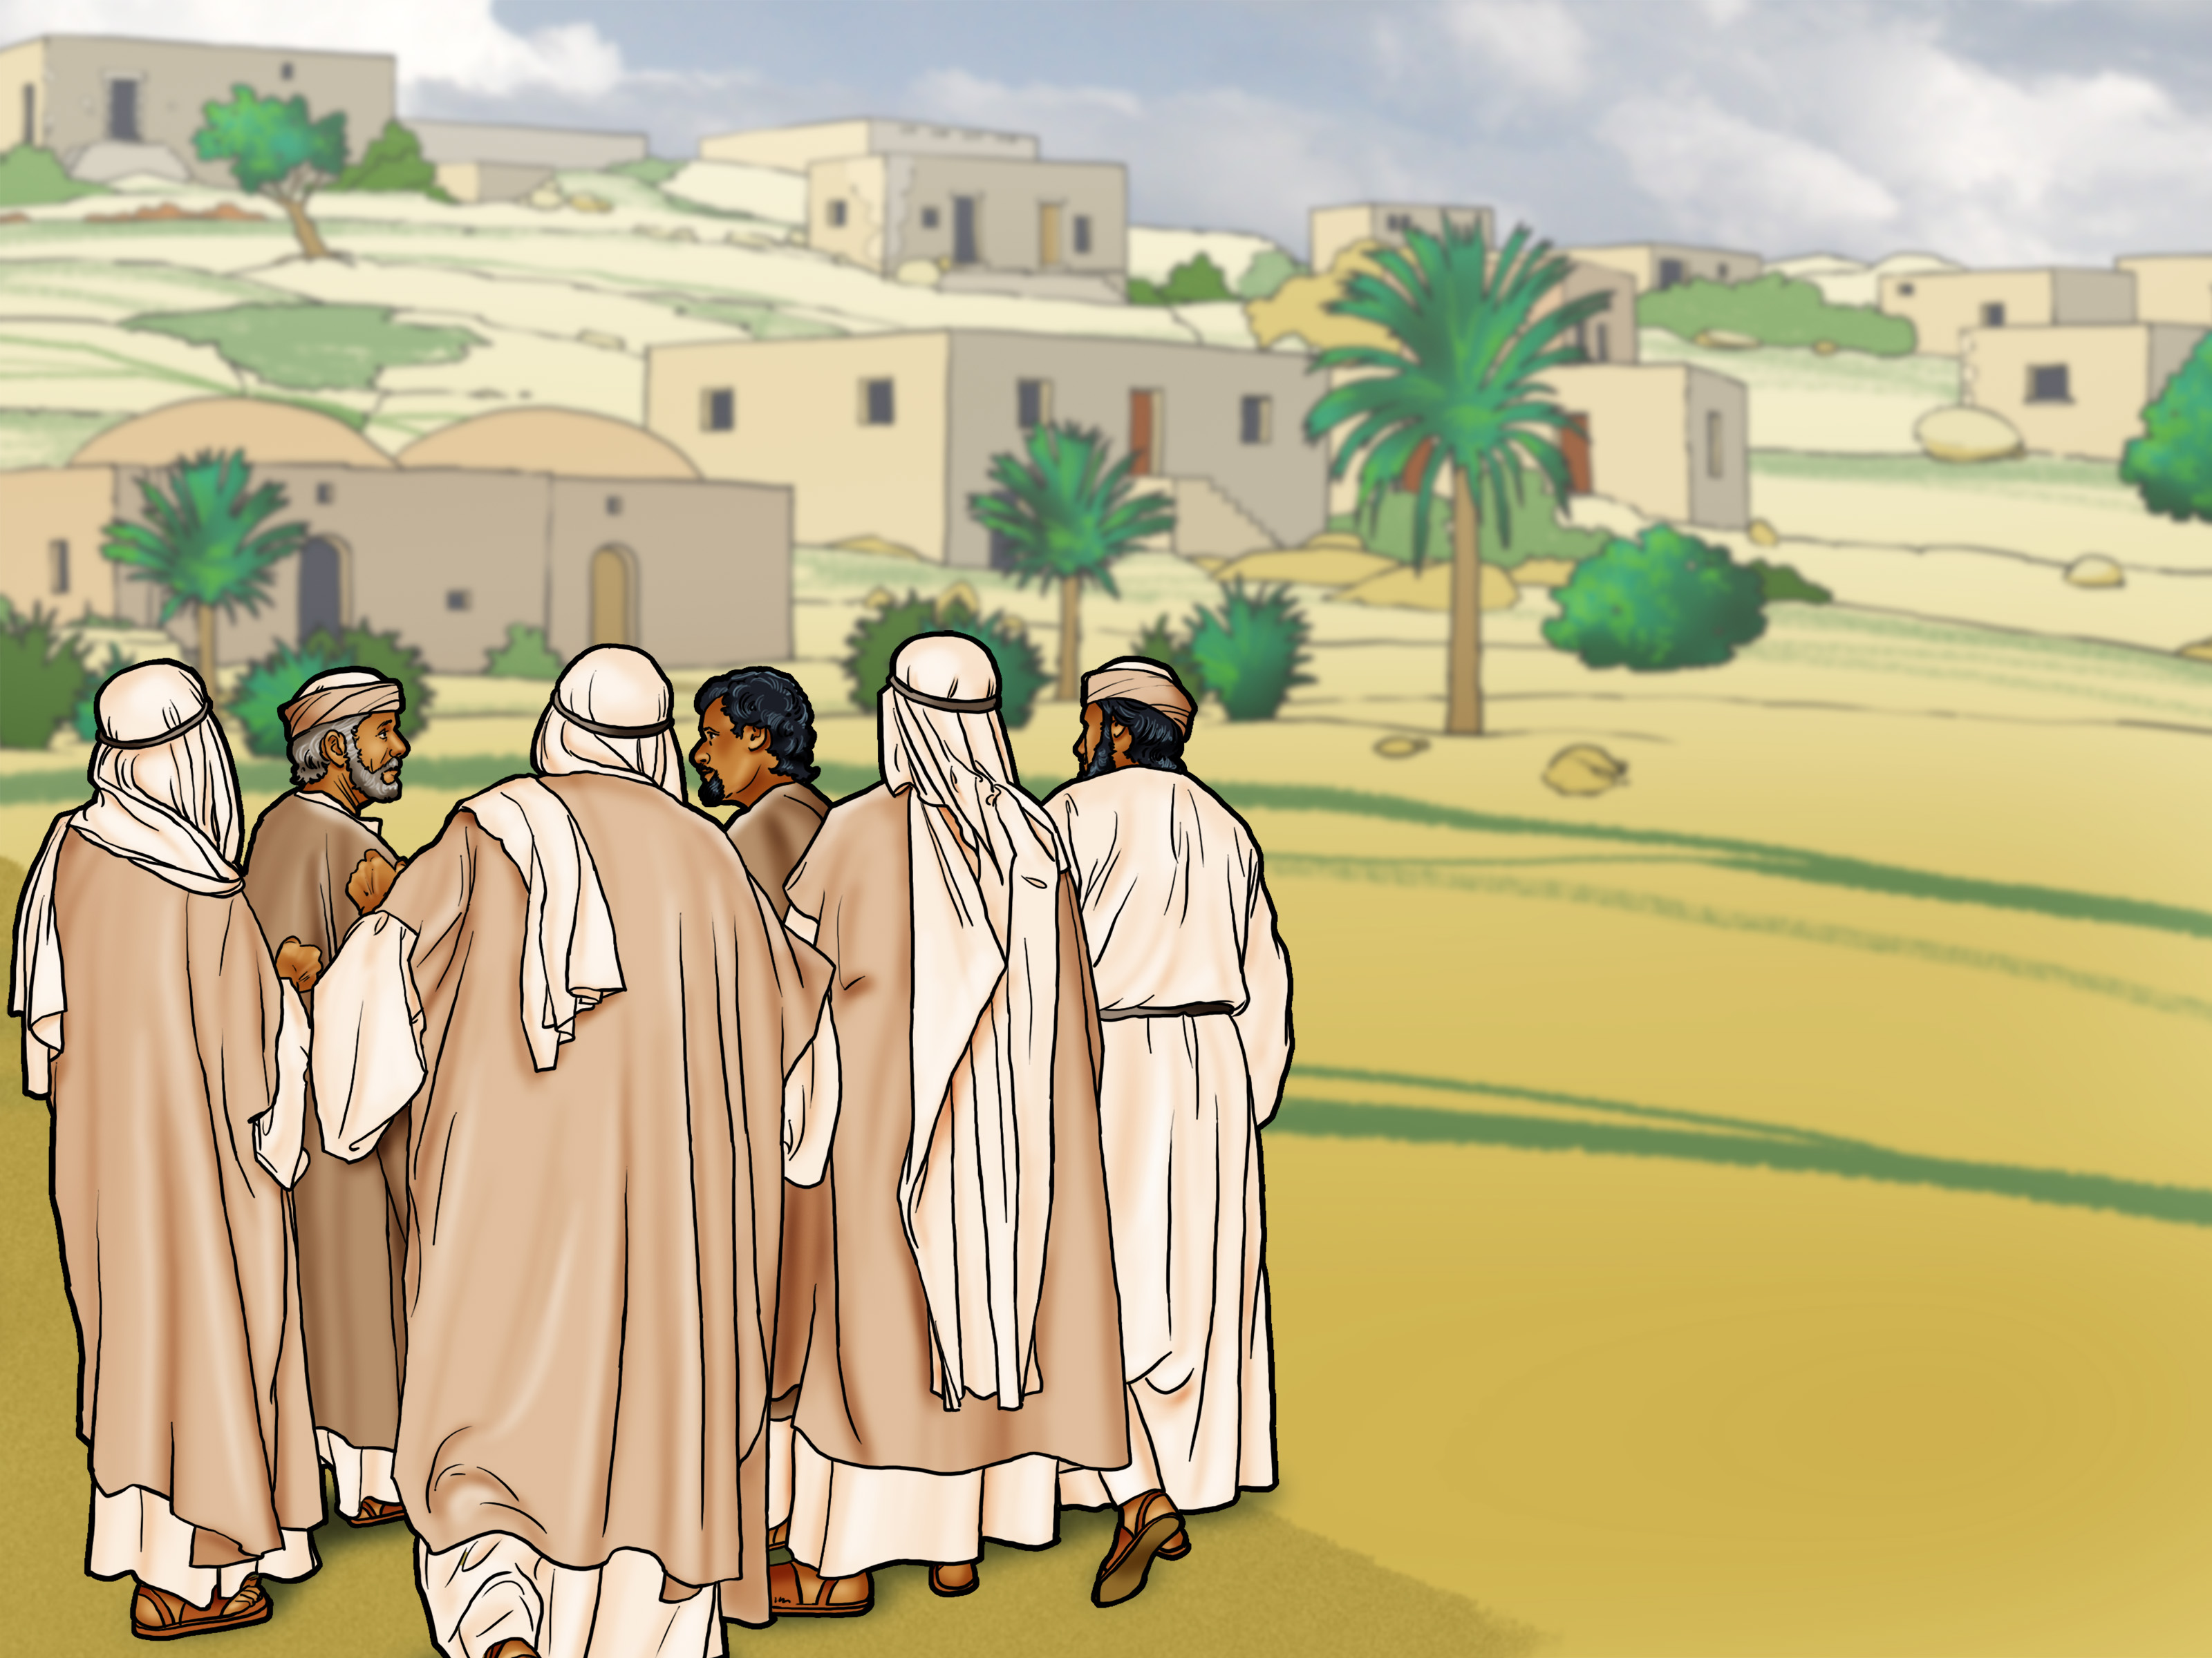

Slide 5
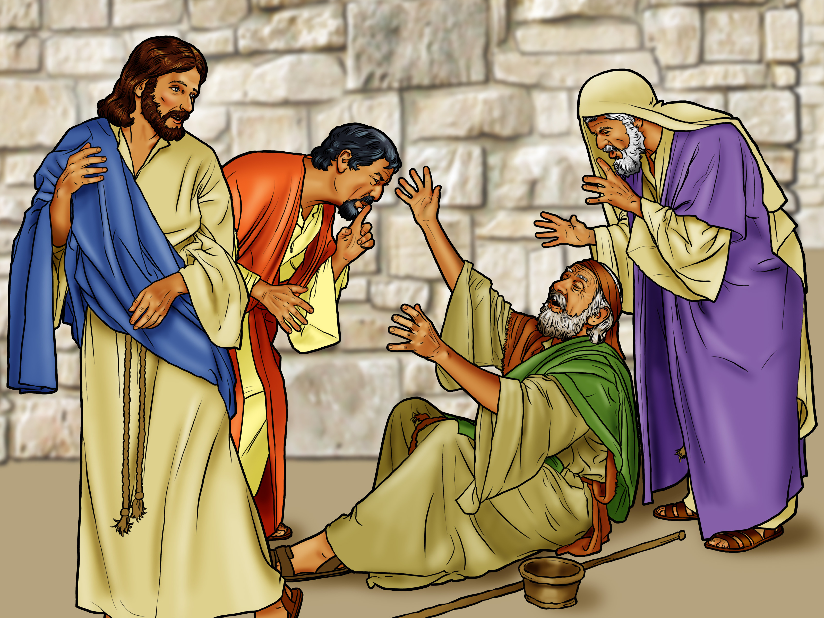

Slide 6

Praise God
for His Mercy!

Slide 8
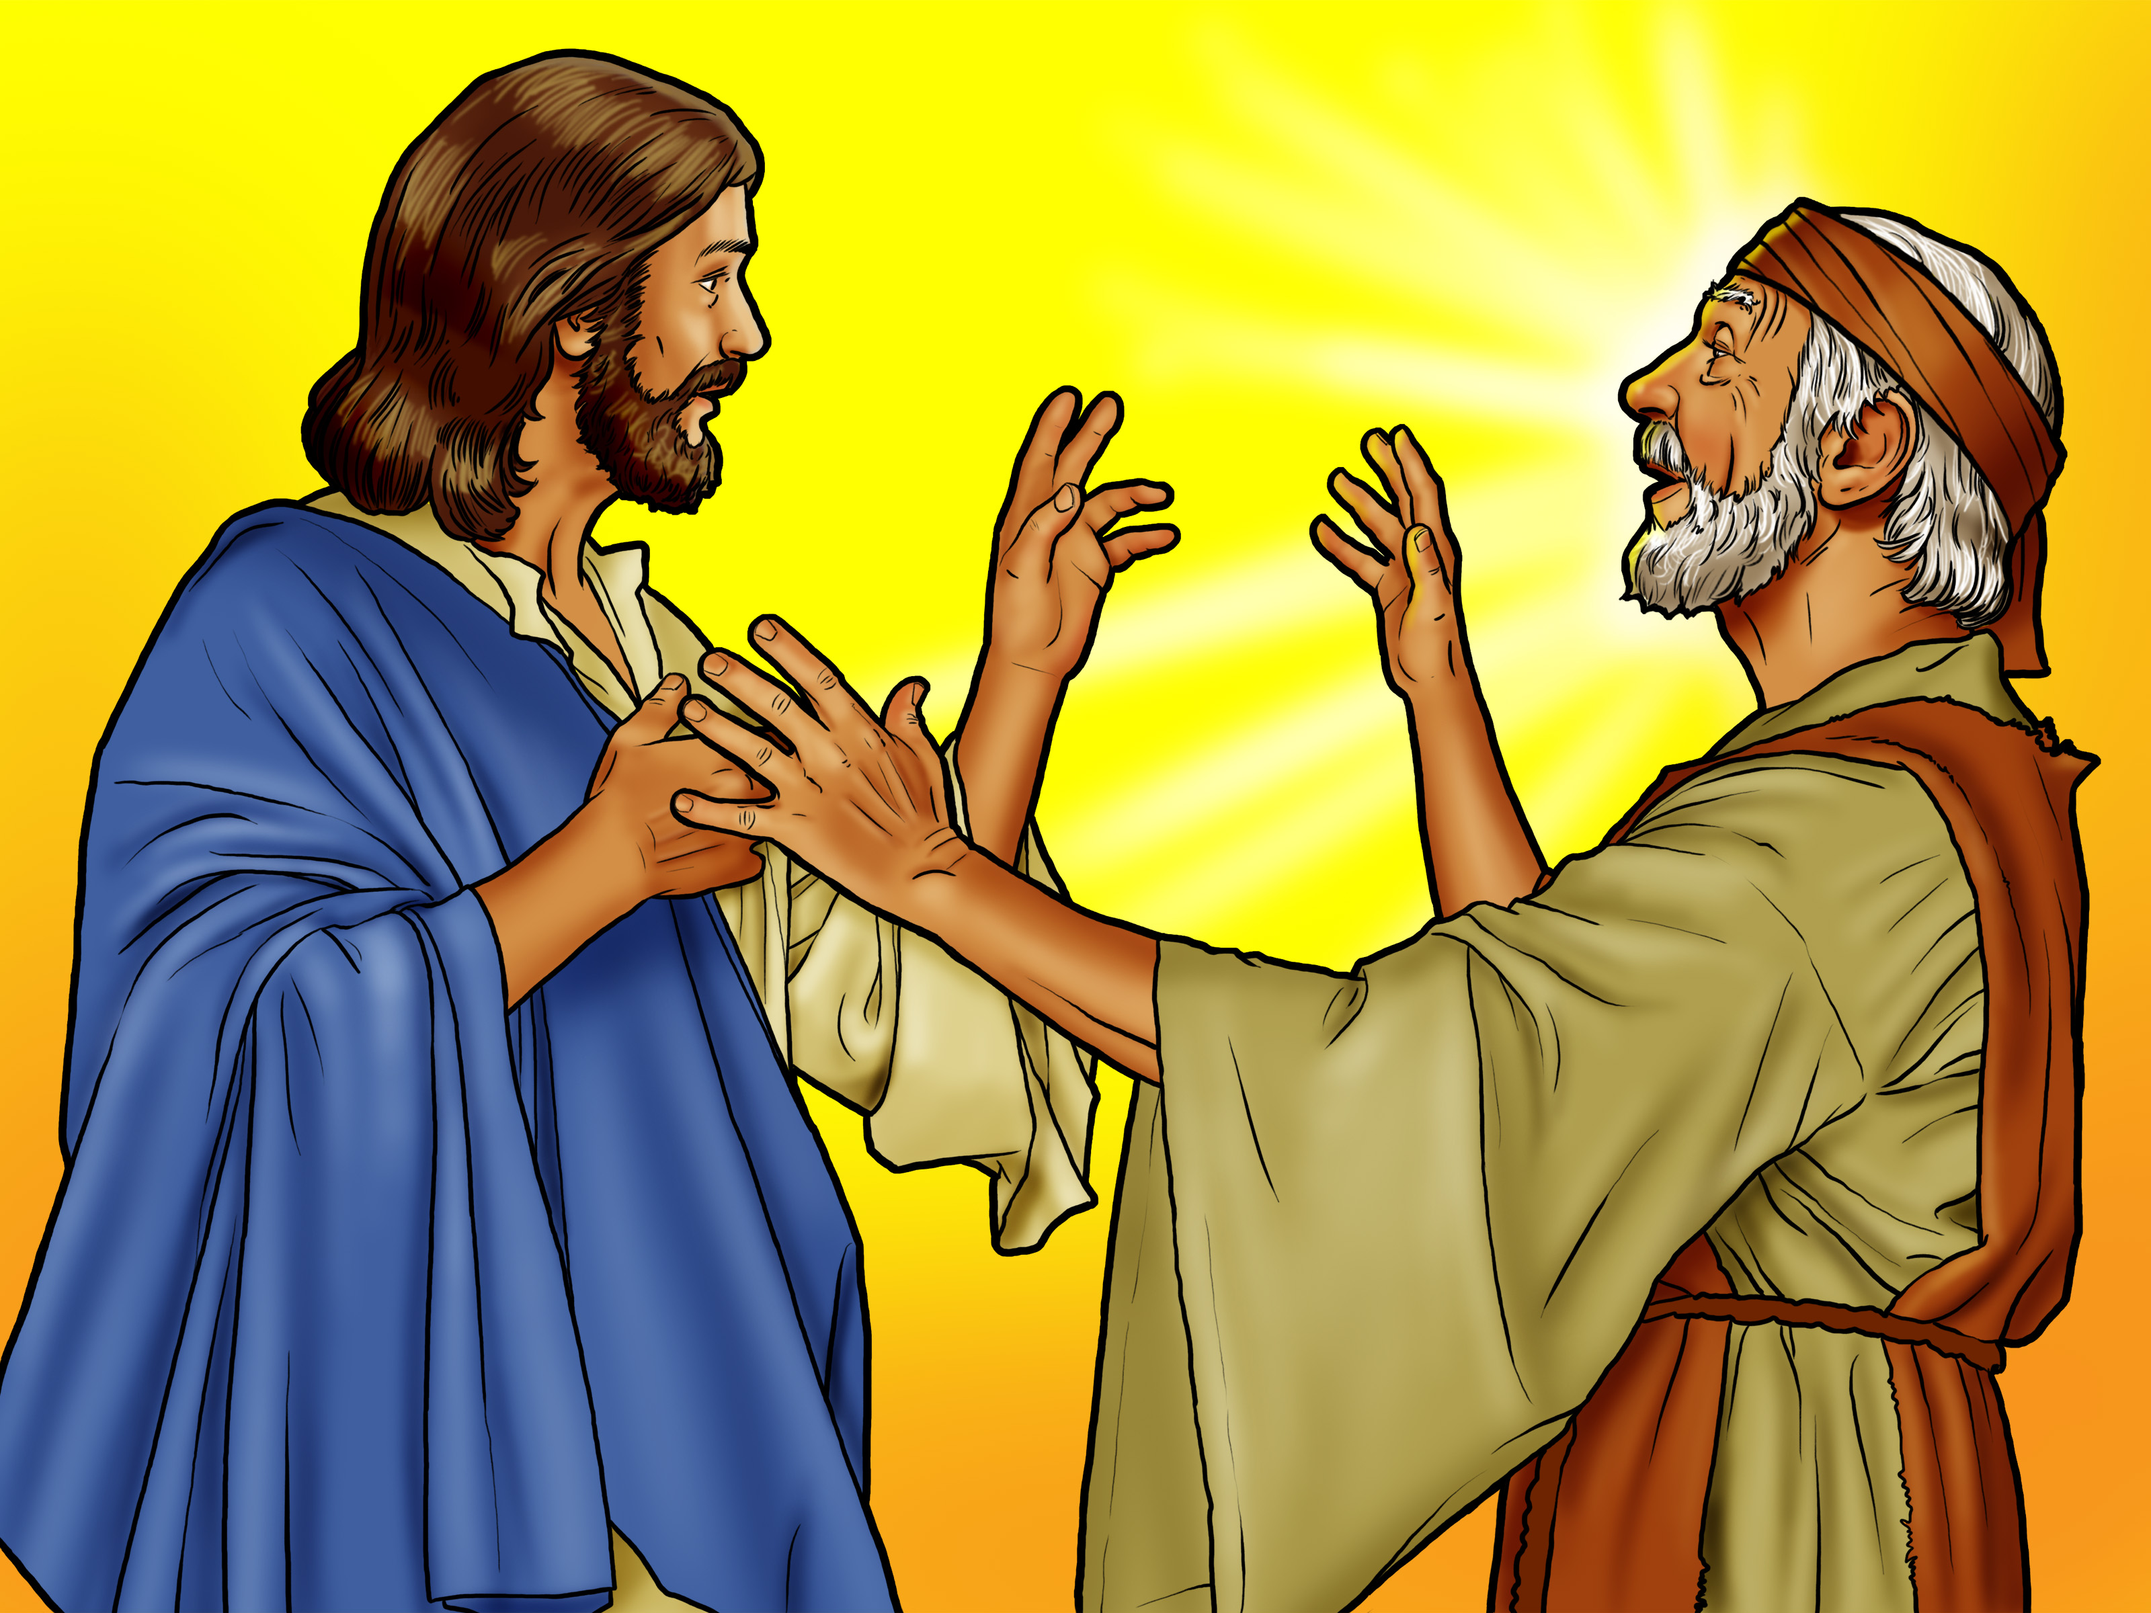

Slide 9
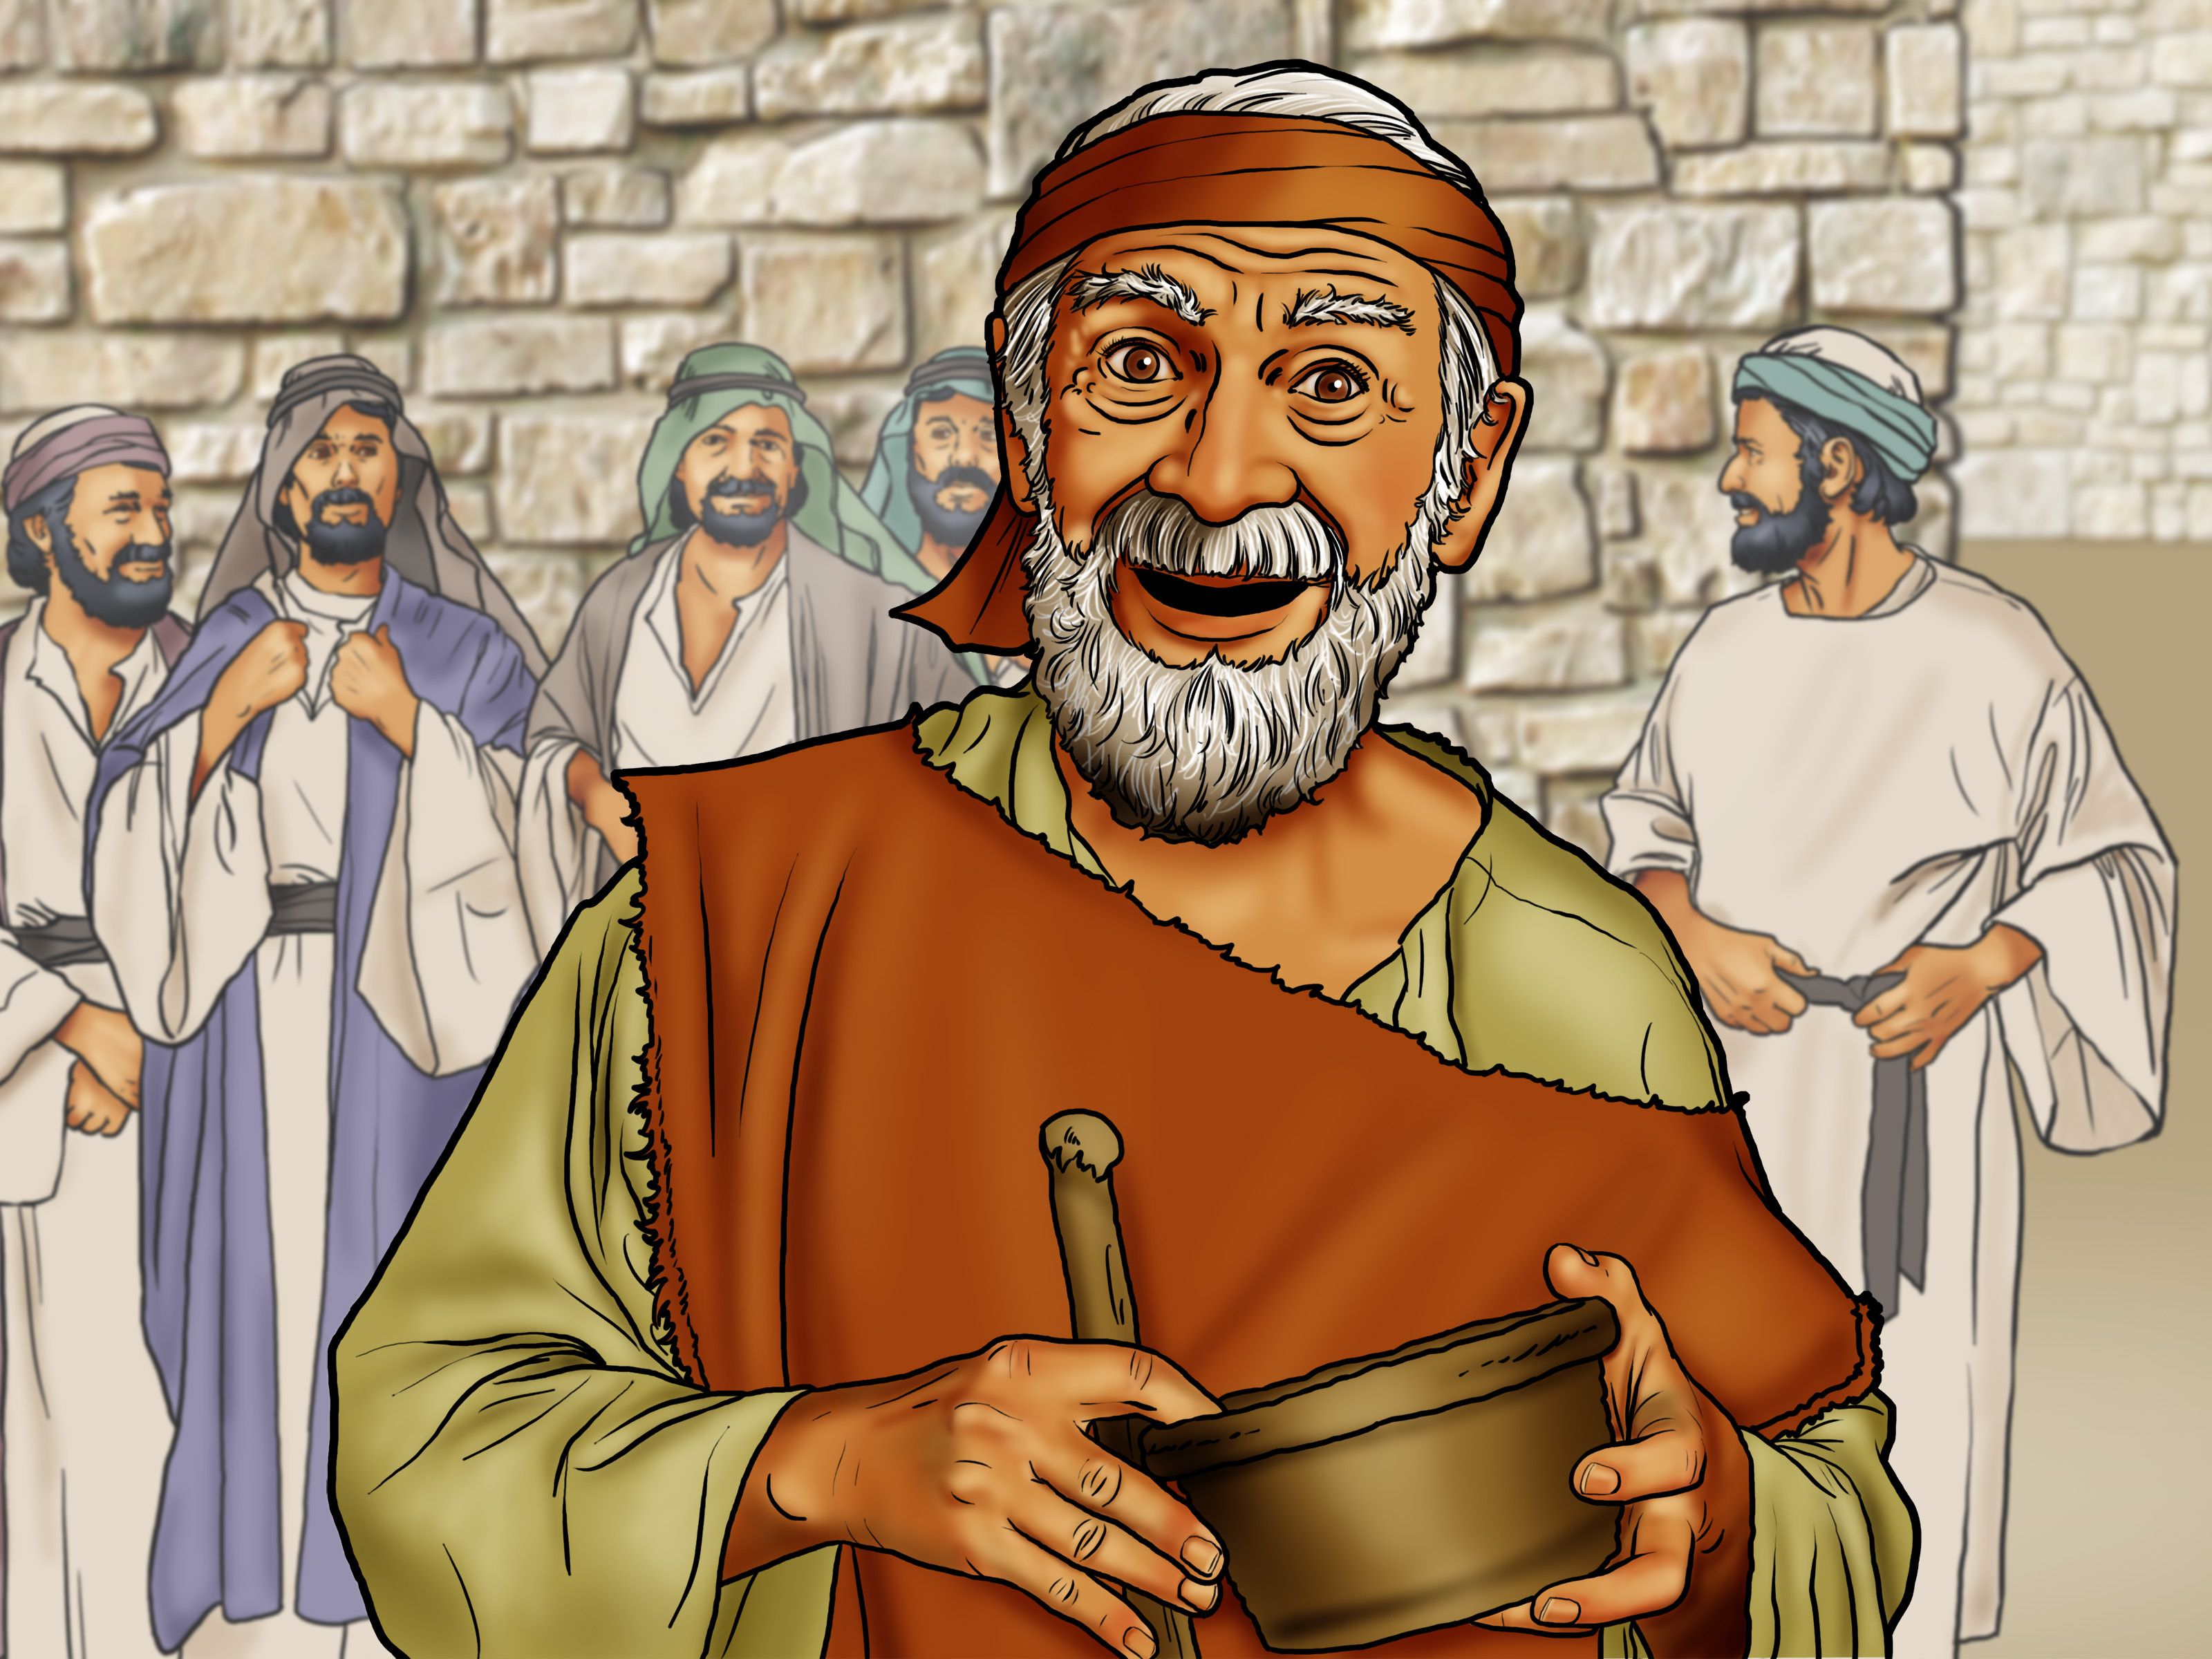

Slide 10
Praise God
for His Mercy!

