Slide 1

1
2
3
Touch your hand to your ear
Make your hands a telescope
Spin your arms
March in place
Jump on one foot
Clap your hands
Stand on your tiptoes
Do jumping jacks
Turn around
Run in place
Lean to
the right
Jump in place
4
5
6
Notes:
Instructions: Split the children into two teams. Alternate between the teams when choosing children who will choose the actions. Have the child choose a diamond. Click on the diamond to reveal the actions. The team on the left will do the action on the left side of the box while the team on the right does the action on the right side of the box. Make sure the children know their action and are ready to do them. Click on either action to proceed to the verse and say it together while each team does their designated action. Click on the “home” button in the bottom right hand corner to return to the first slide.

Slide 2
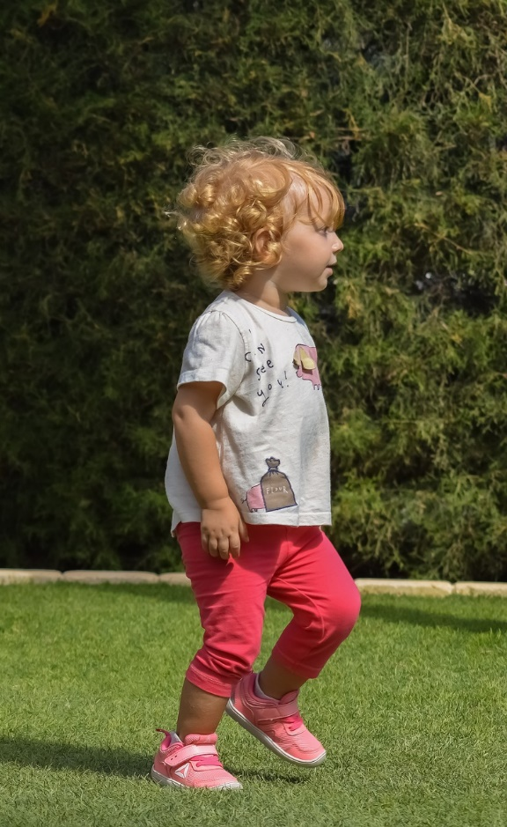
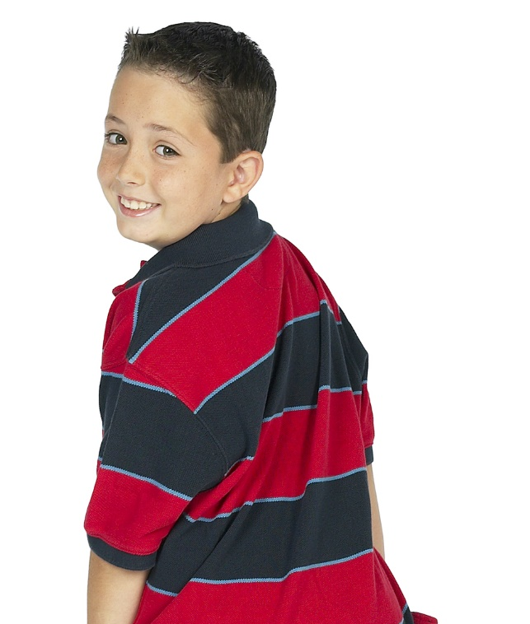
He that believeth on the Son hath everlasting life:
and he that believeth
not the Son
shall not see
life; but the
wrath of God
abideth on him.
John 3:36

Slide 3
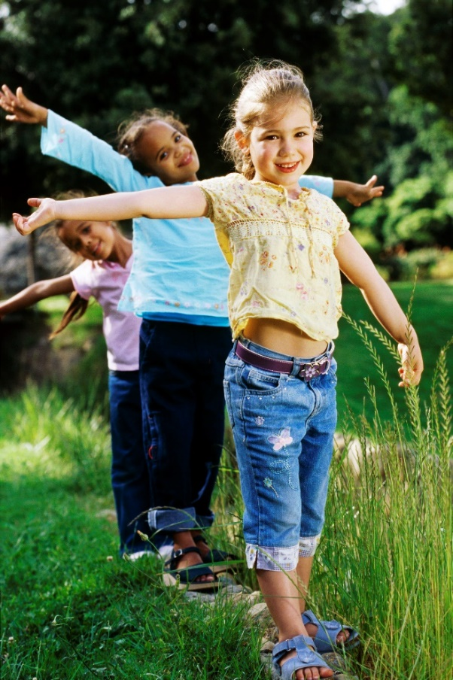
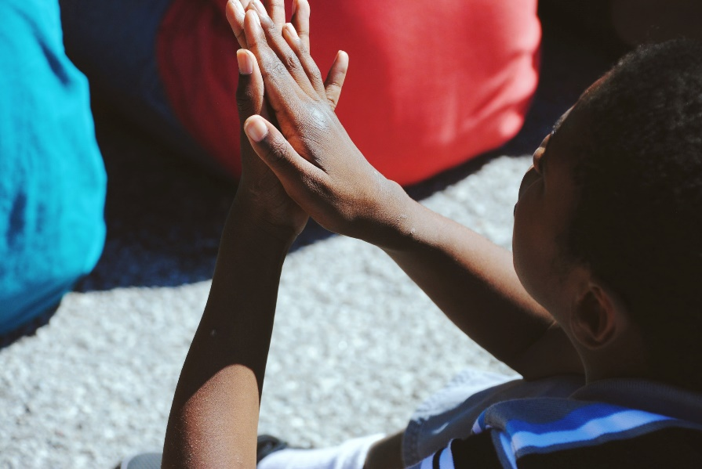
He that believeth on the Son hath everlasting life: and he that believeth
not the Son
shall not see
life; but the wrath of
God abideth on him.
John 3:36

Slide 4
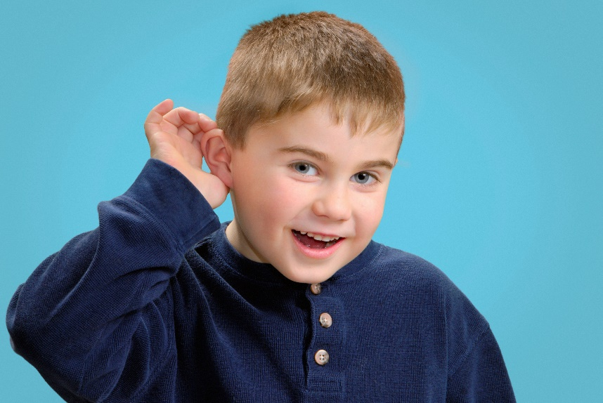
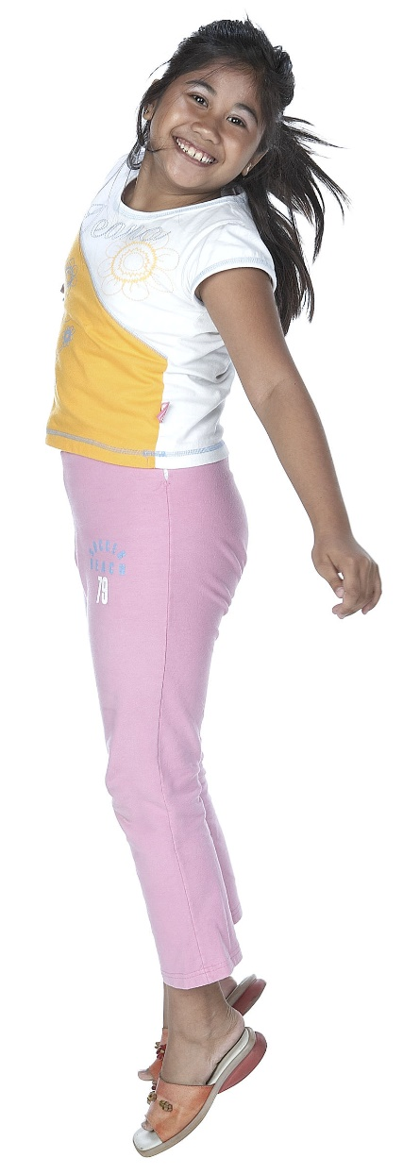
He that believeth
on the Son
hath everlasting
life: and he that believeth not the Son shall not
see life; but the wrath
of God abideth on him.
John 3:36

Slide 5
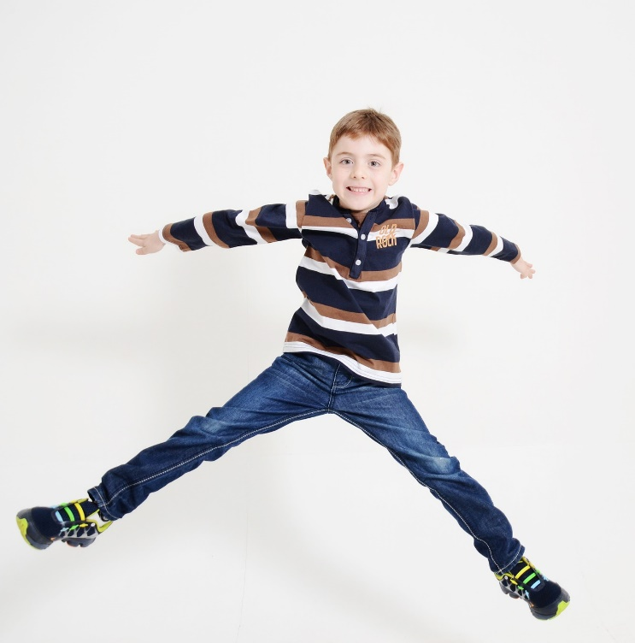

He that believeth on the Son hath everlasting life: and he that believeth not the Son shall
not see life; but the wrath of God abideth on him.
John 3:36

Slide 6


He that believeth on the Son hath everlasting life:
and he that
believeth not
the Son shall
not see life;
but the wrath of God
abideth on him.
John 3:36

Slide 7


He that believeth
on the Son hath everlasting life: and he that believeth
not the Son
shall not see life,
but the wrath of
God abideth on him.
John 3:36

