Slide 1

1
2
3
Touch your hand to your ear
Make your hands a telescope
Jump on one foot
March in place
Spin your arms
Clap your hands
Stand on your tiptoes
Do jumping jacks
Turn around
Run in place
Lean to
the right
Jump in place
4
5
6
Notes:
Instructions: Split the children into two teams. Alternate between the teams when choosing children who will choose the actions. Have the child choose a diamond. Click on the diamond to reveal the actions. The team on the left will do the action on the left side of the box while the team on the right does the action on the right side of the box. Make sure the children know their action and are ready to do them. Click on either action to proceed to the verse and say it together while each team does their designated action. Click on the “home” button in the bottom right hand corner to return to the first slide.

Slide 2
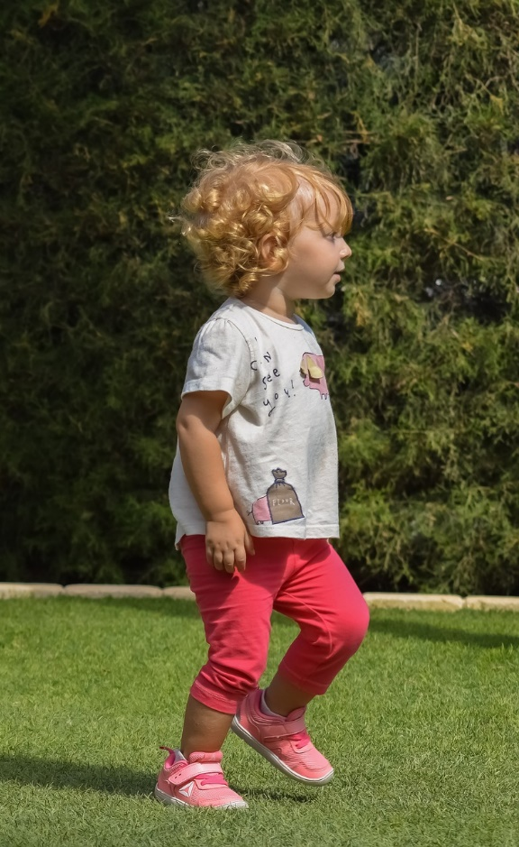
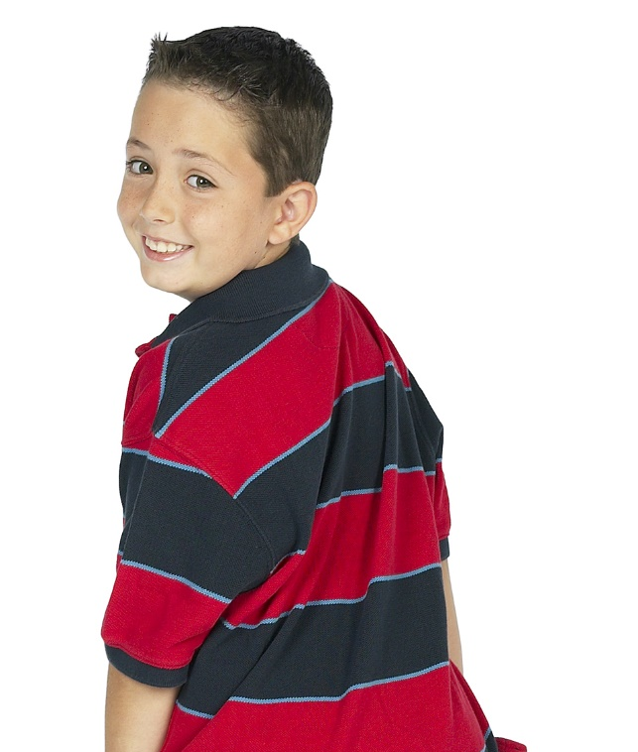
Whoever believes in the Son has eternal life;
whoever does not
obey the Son
shall not see
life, but the
wrath of God
remains on him.
John 3:36

Slide 3
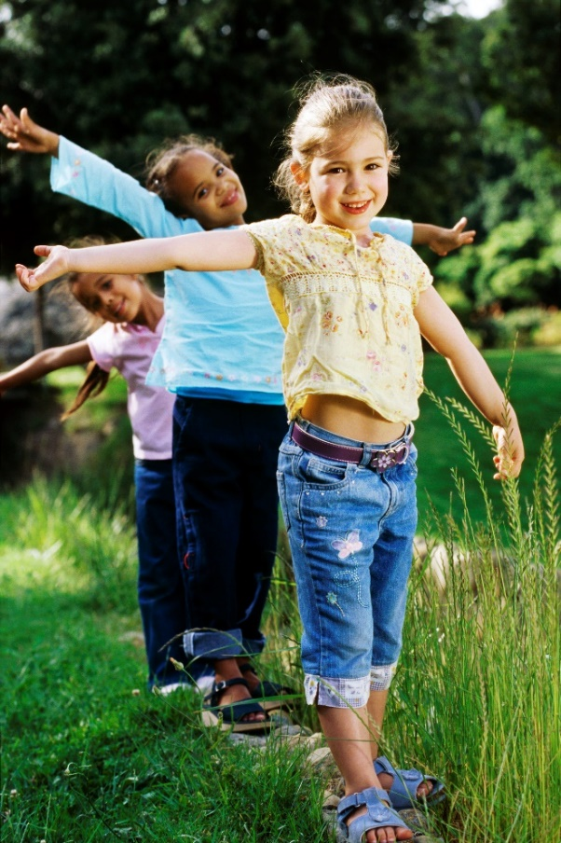
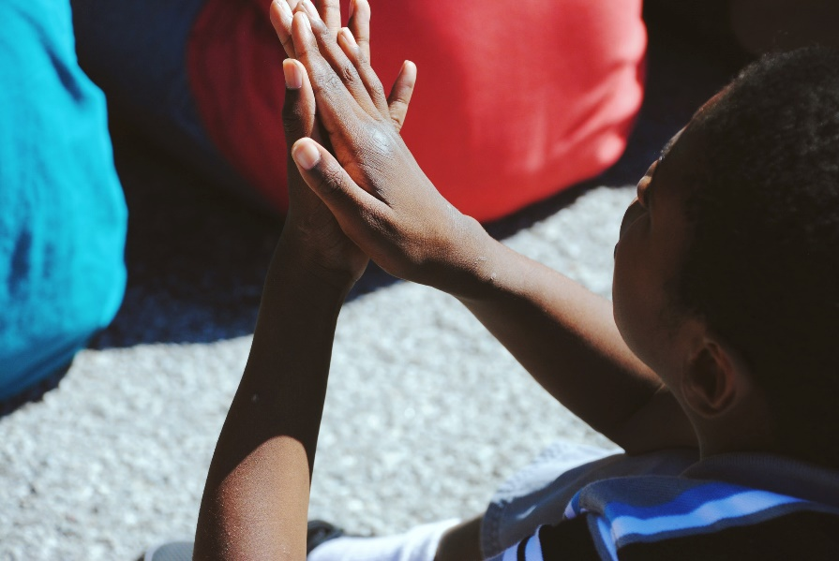
Whoever believes in the Son has eternal life;
whoever does not obey
the Son shall not
see life, but the wrath of God
remains on him.
John 3:36

Slide 4
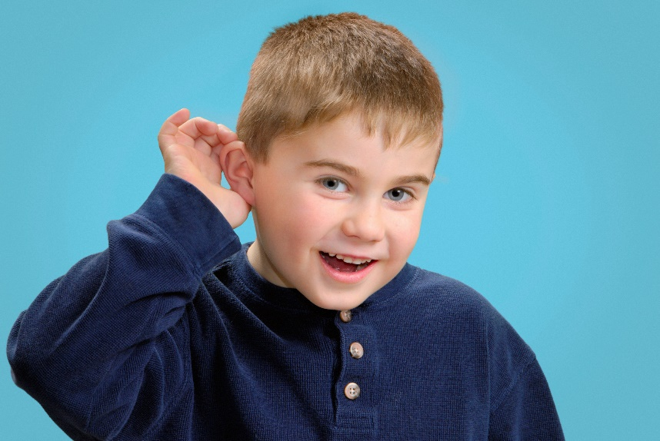
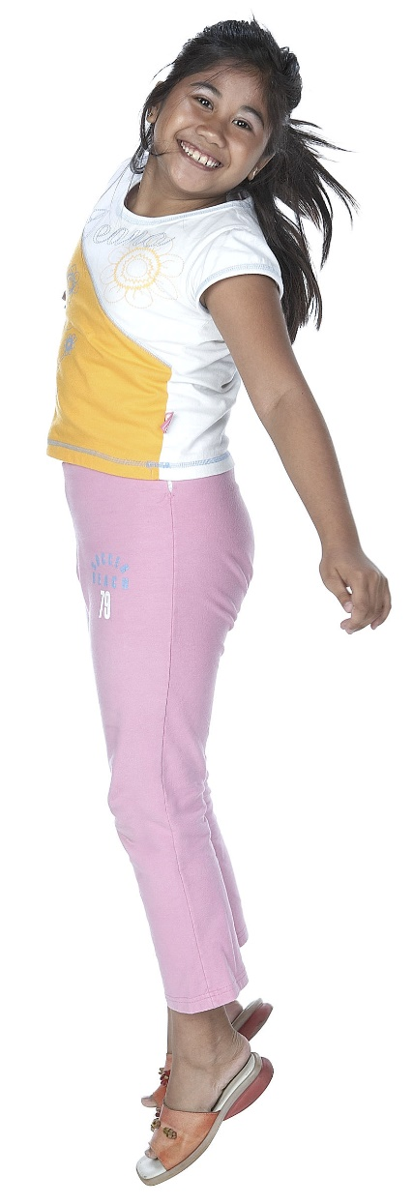
Whoever believes
in the Son has
eternal life;
whoever does not
obey the Son shall not see life, but the wrath of God remains on him.
John 3:36

Slide 5
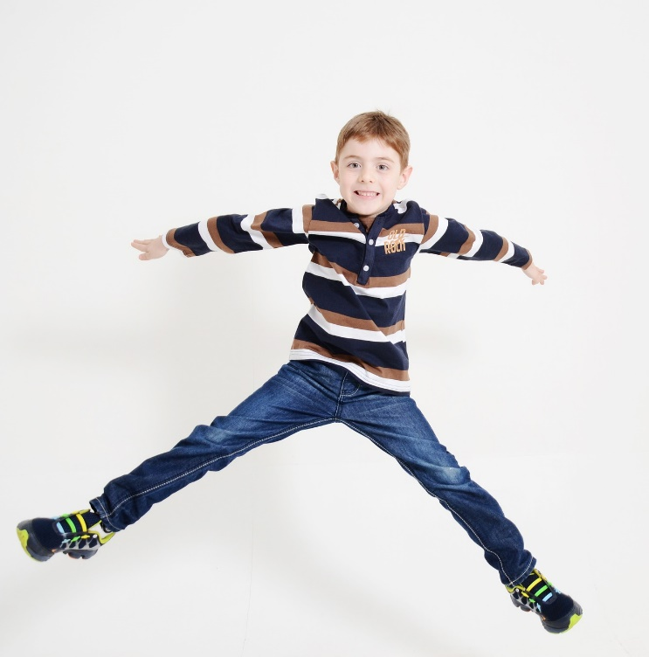
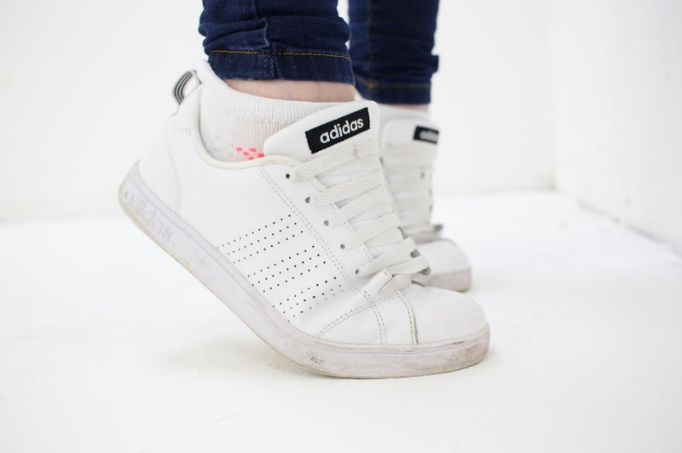
Whoever believes in the Son has eternal life;
whoever does not obey
the Son shall not see life,
but the wrath
of God remains
on him.
John 3:36

Slide 6

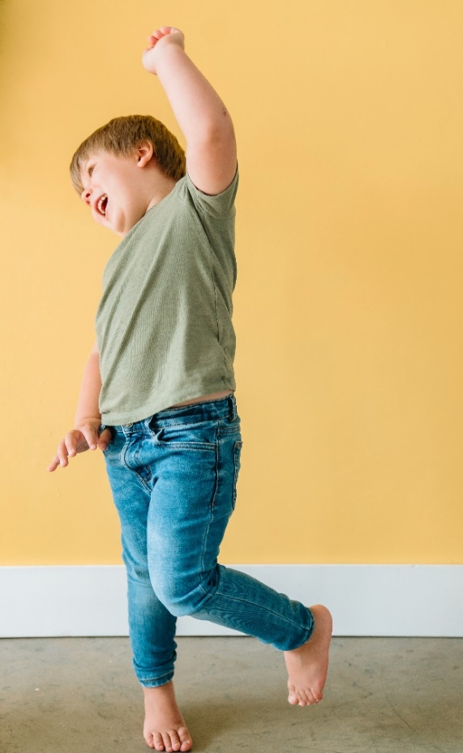
Whoever believes in the Son has eternal life; whoever
does not obey the
Son shall not see life,
but the wrath of God remains on him.
John 3:36

Slide 7

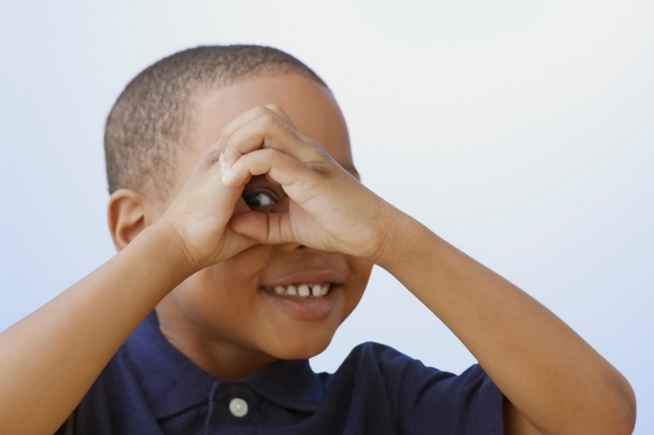
Whoever believes in the Son has eternal life;
whoever does not obey the Son
shall not
see life, but the wrath of God remains on him.
John 3:36

