Slide 1

GALILEE
Capernaum
Cana
Sea of
Galilee
Nazareth
Mt.
Carmel
Mediterranean Sea
Jordan River
SAMARIA

Slide 2
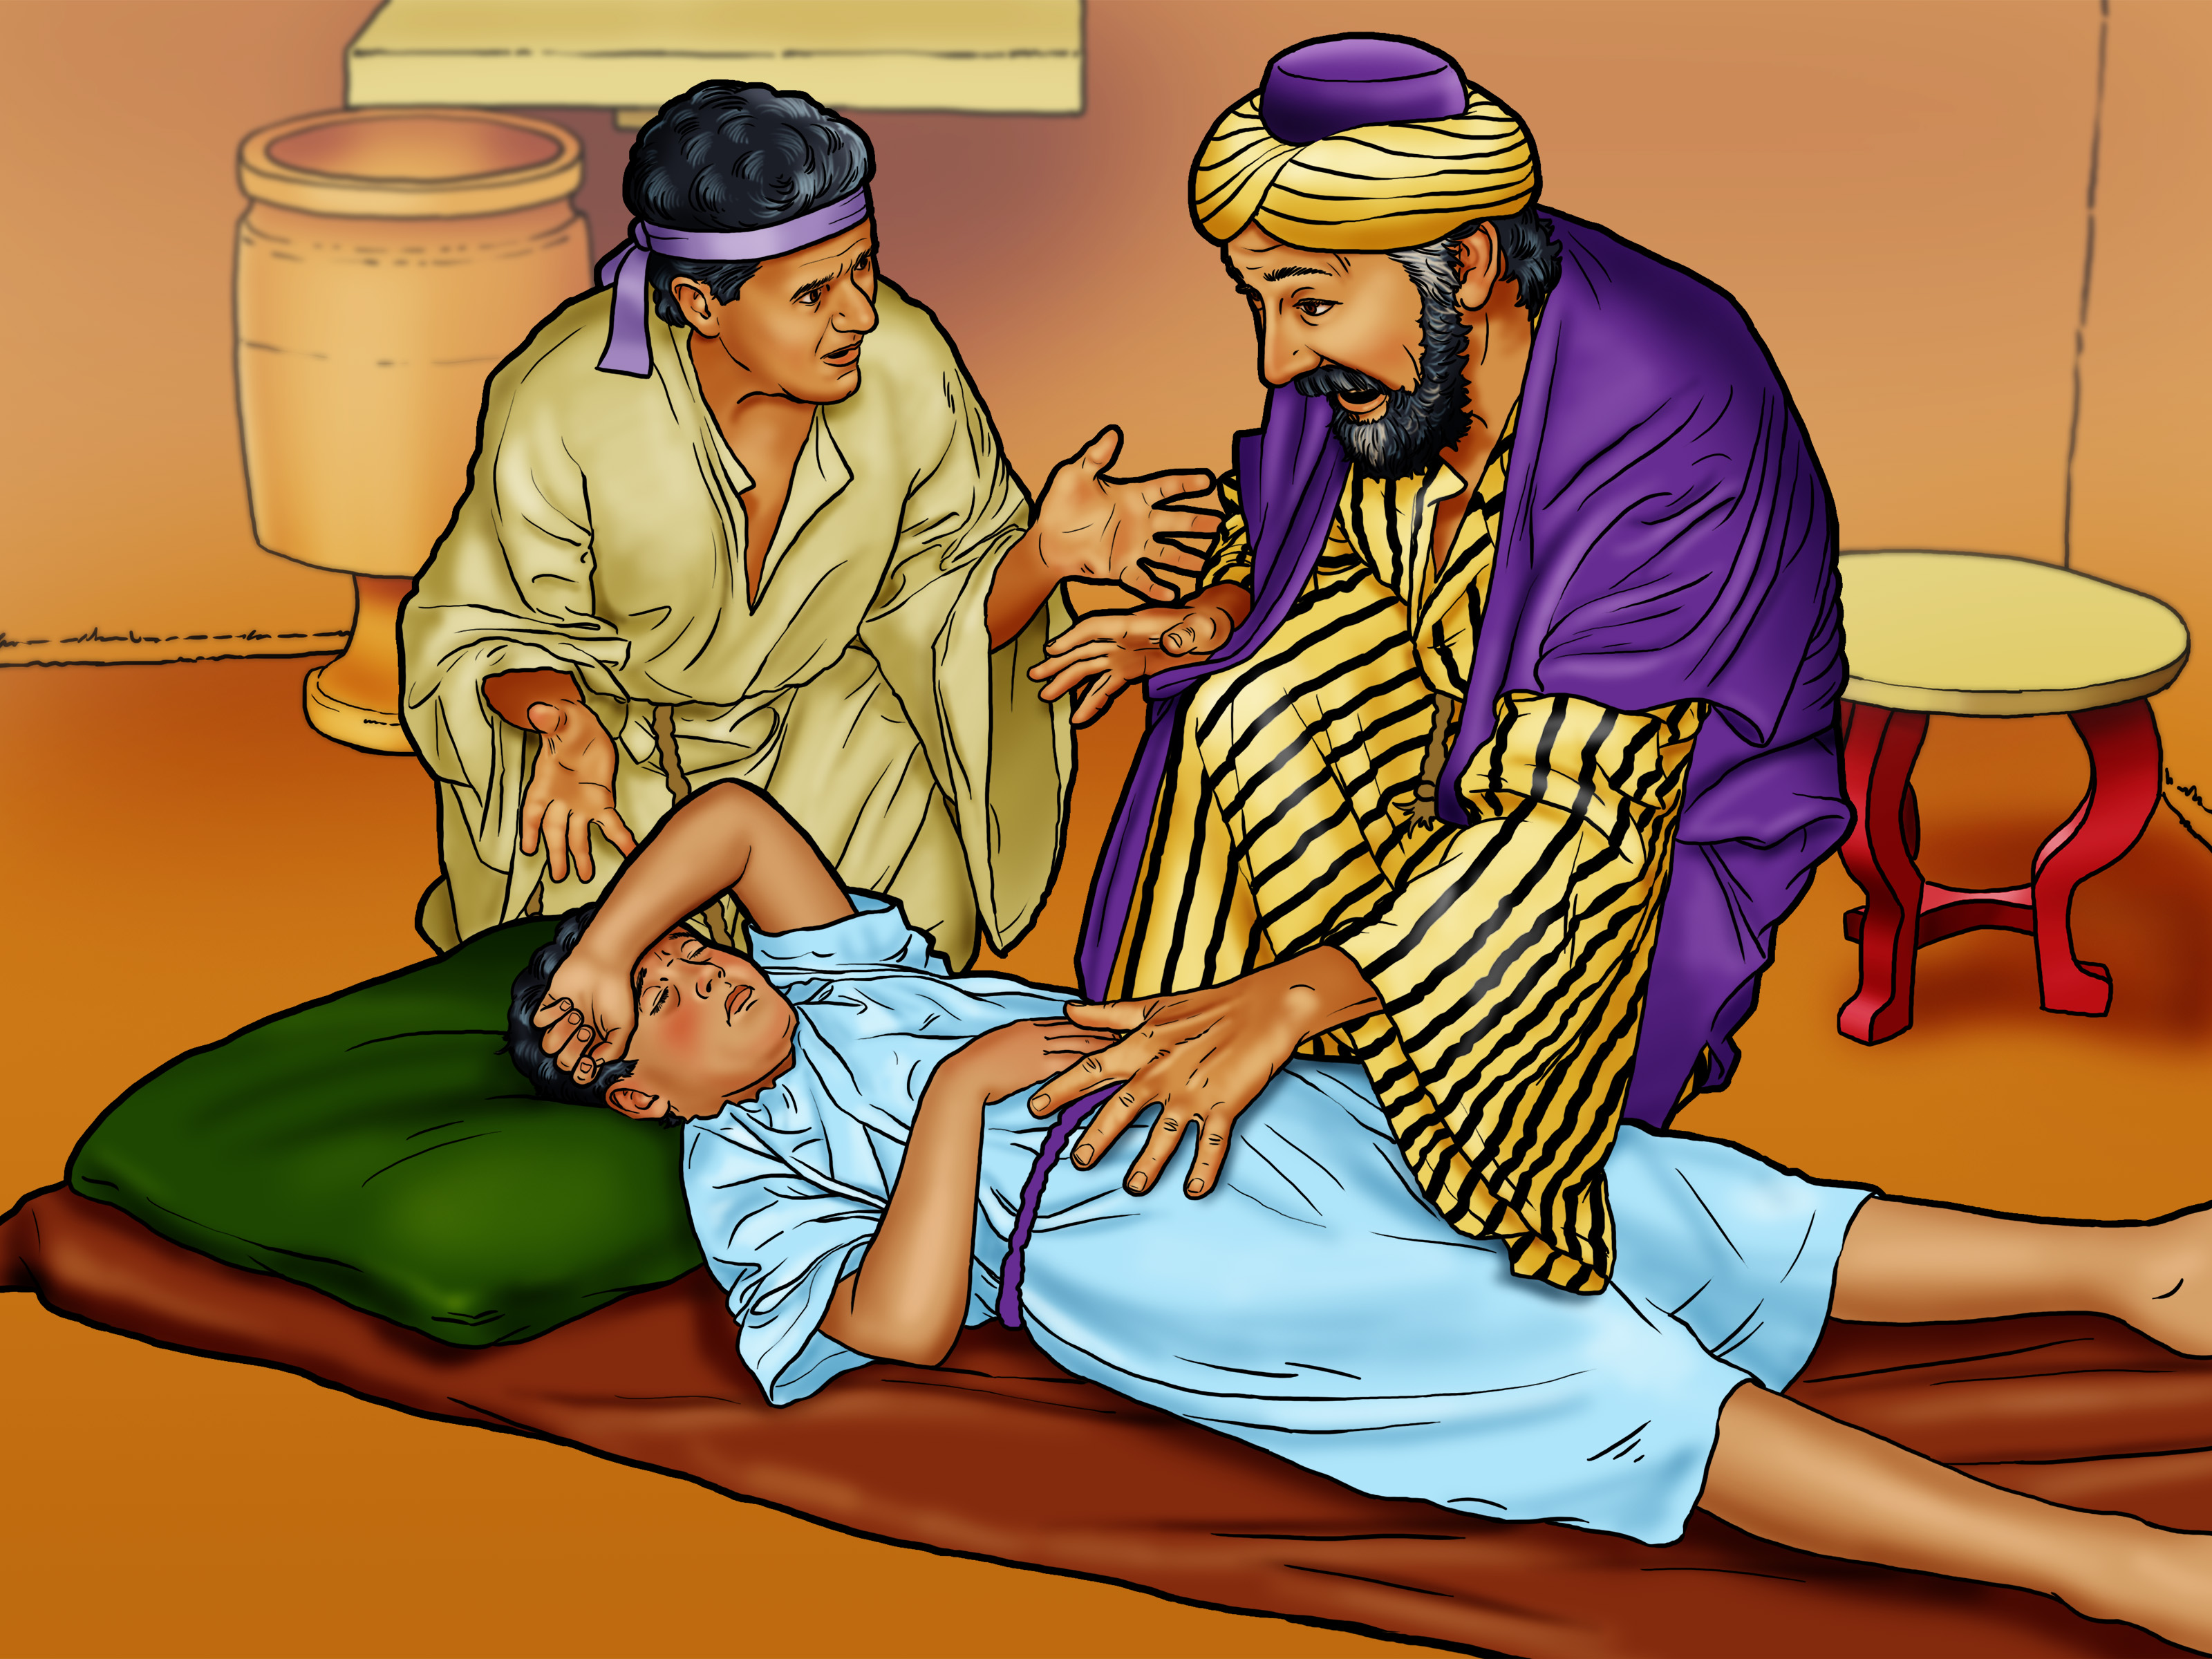

Slide 3
GALILEE
Capernaum
Cana
Sea of
Galilee
Nazareth
Mt.
Carmel
Mediterranean Sea
Jordan River
SAMARIA

Slide 4
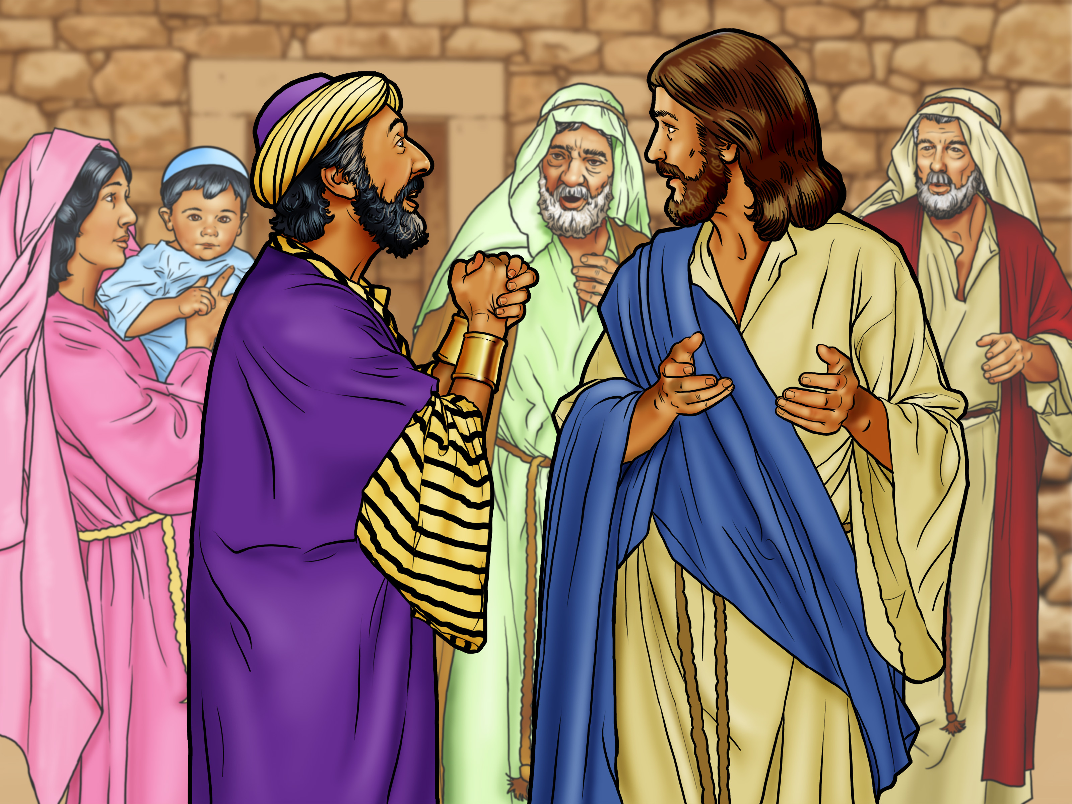

Slide 5
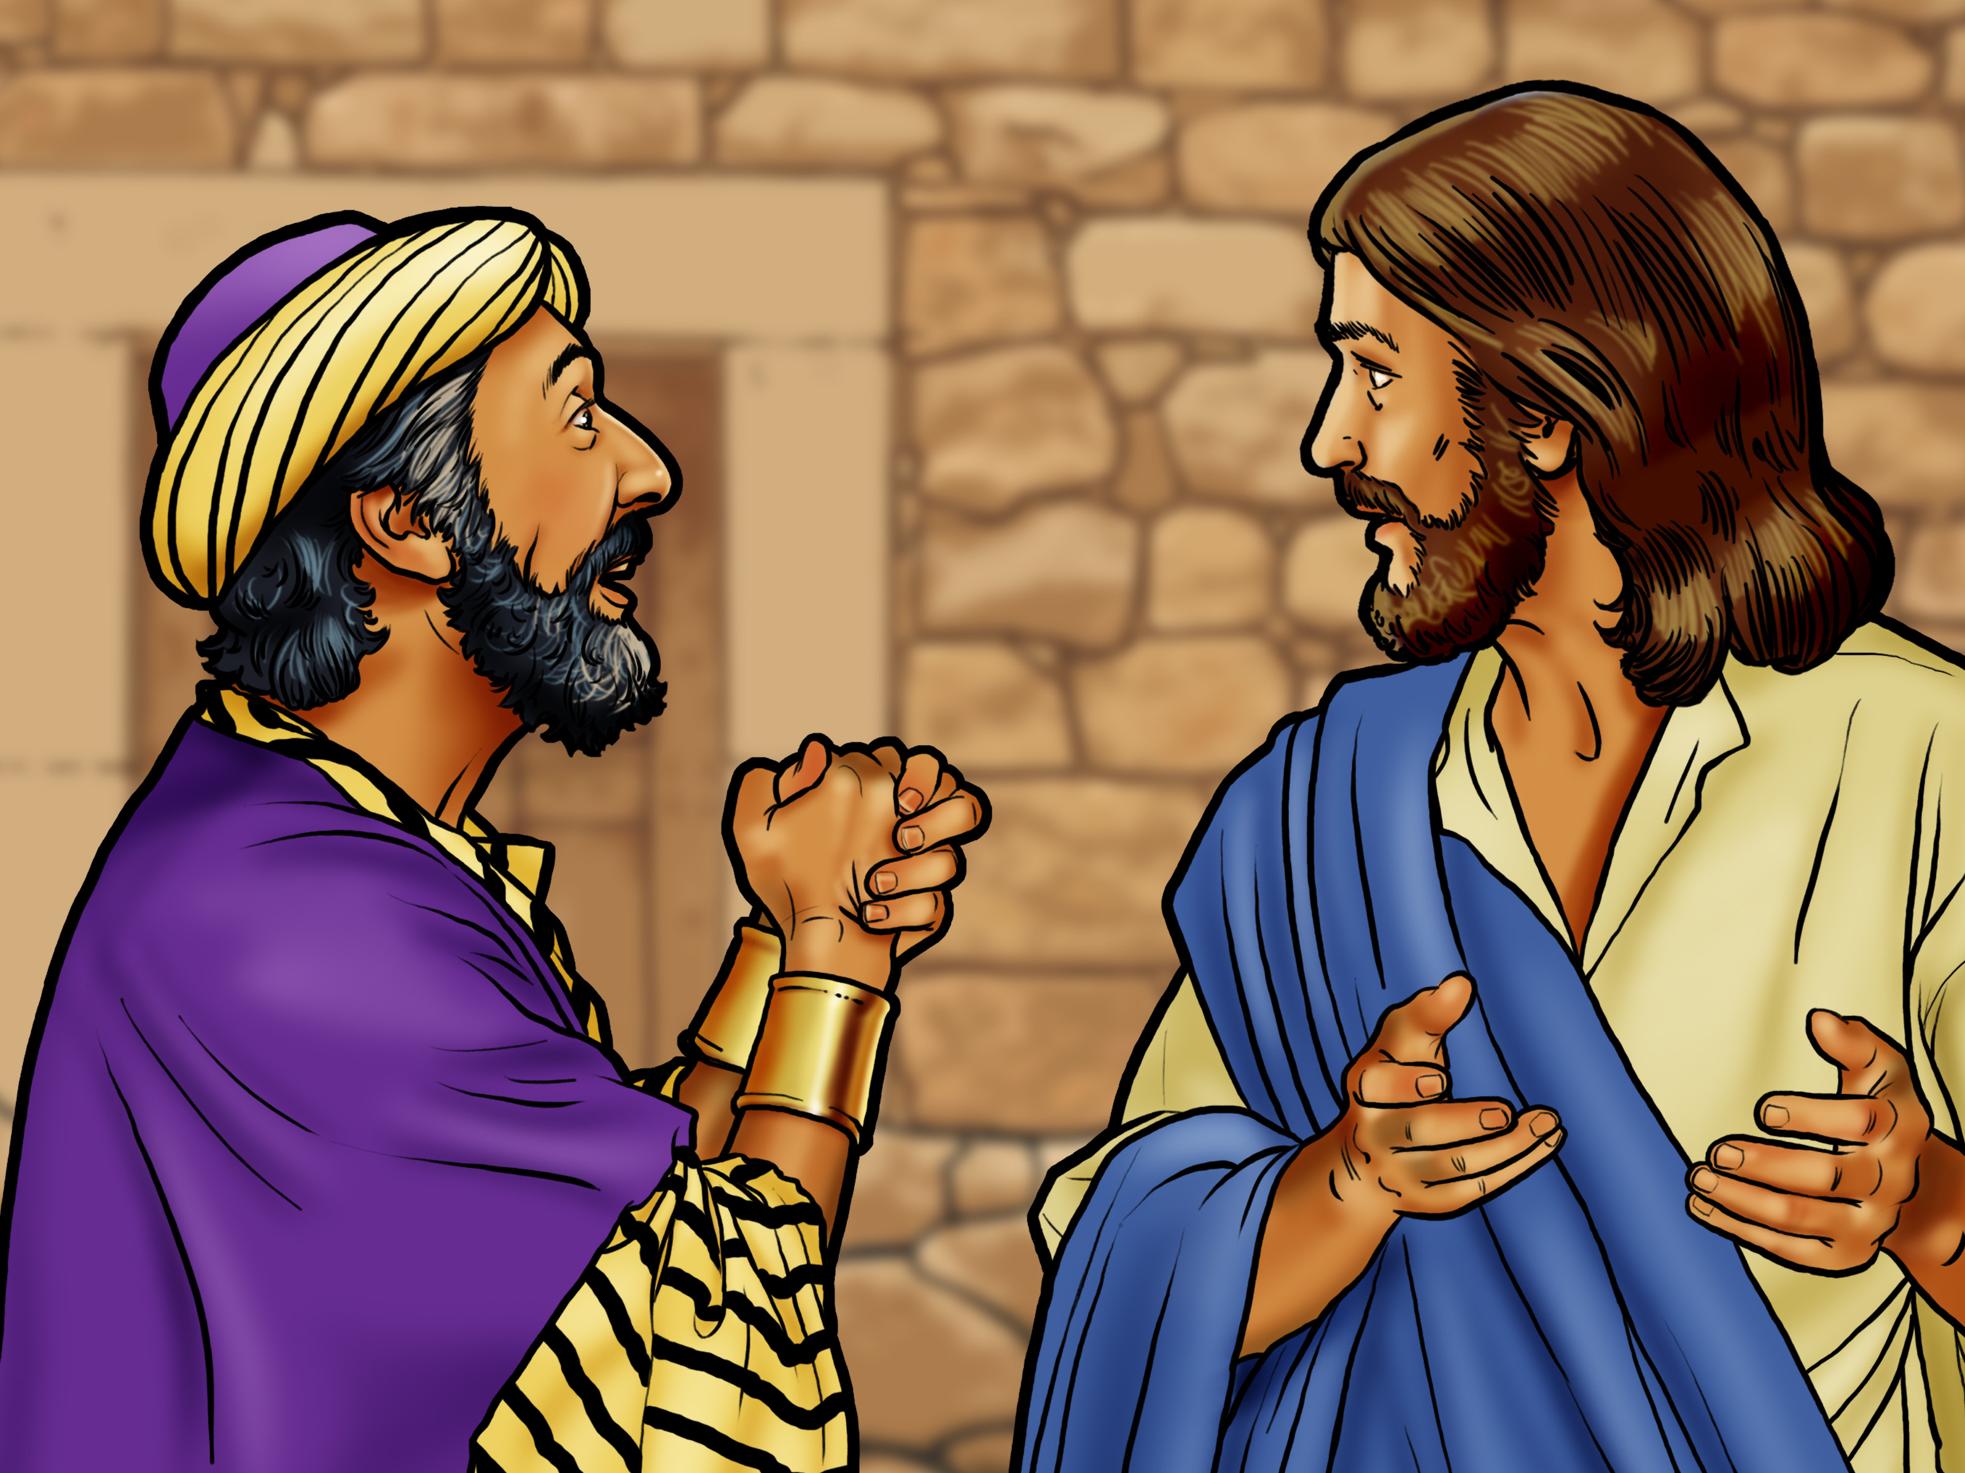

Slide 6

OMNISCIENT

Slide 7

OMNIPOTENT

Slide 9
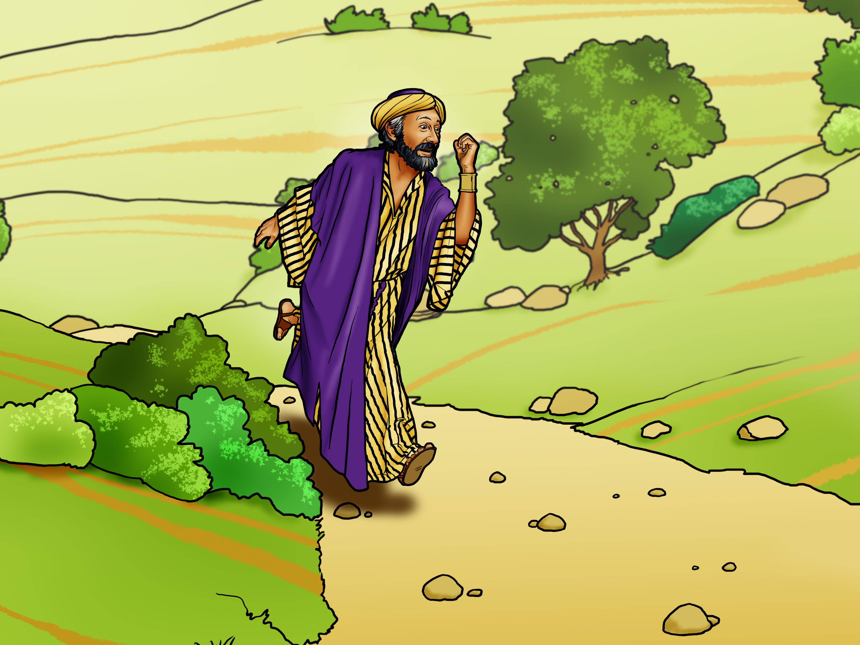

Slide 10
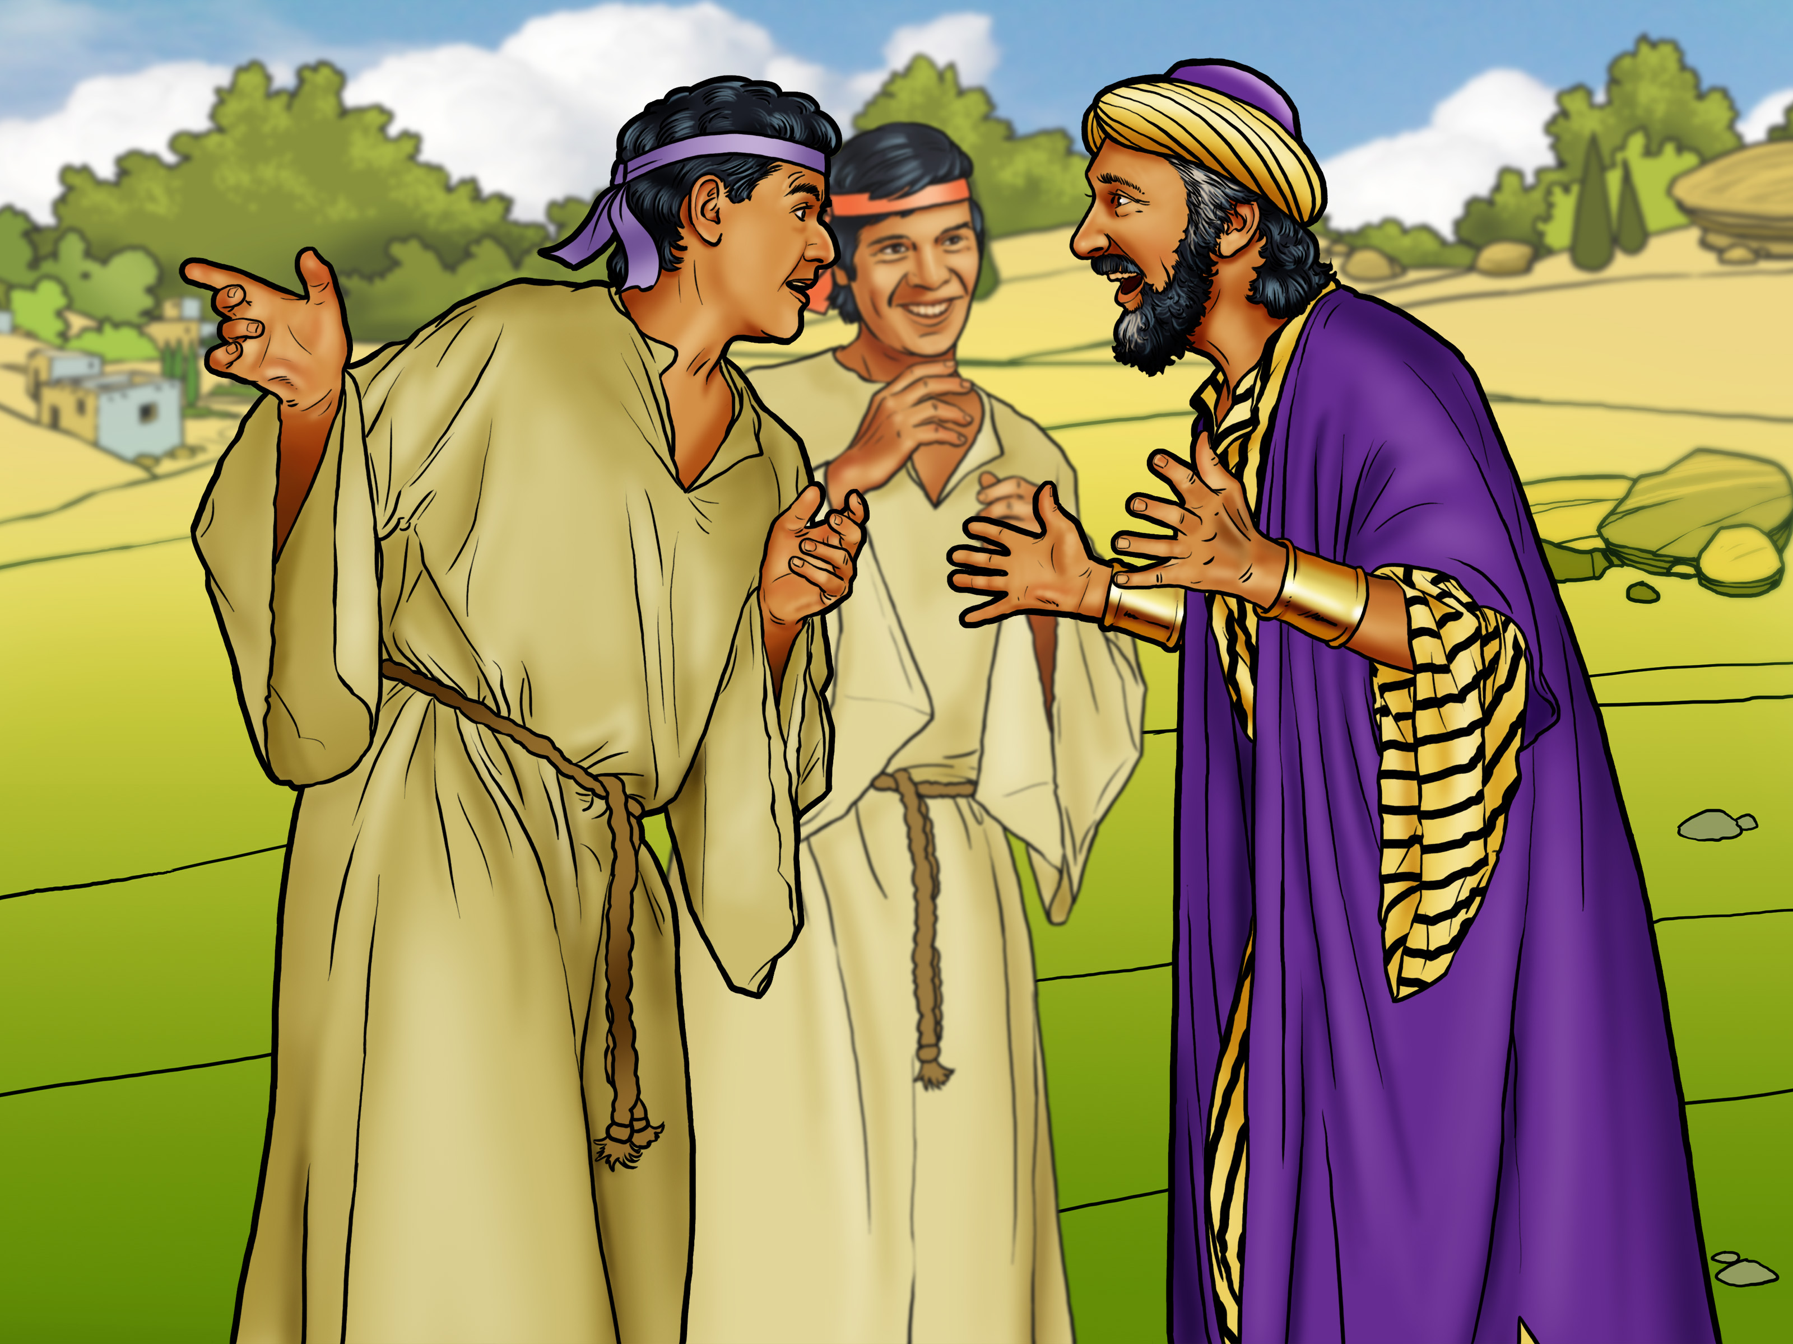

Slide 11

Believe
God’s
promises!

Slide 13
