Slide 1
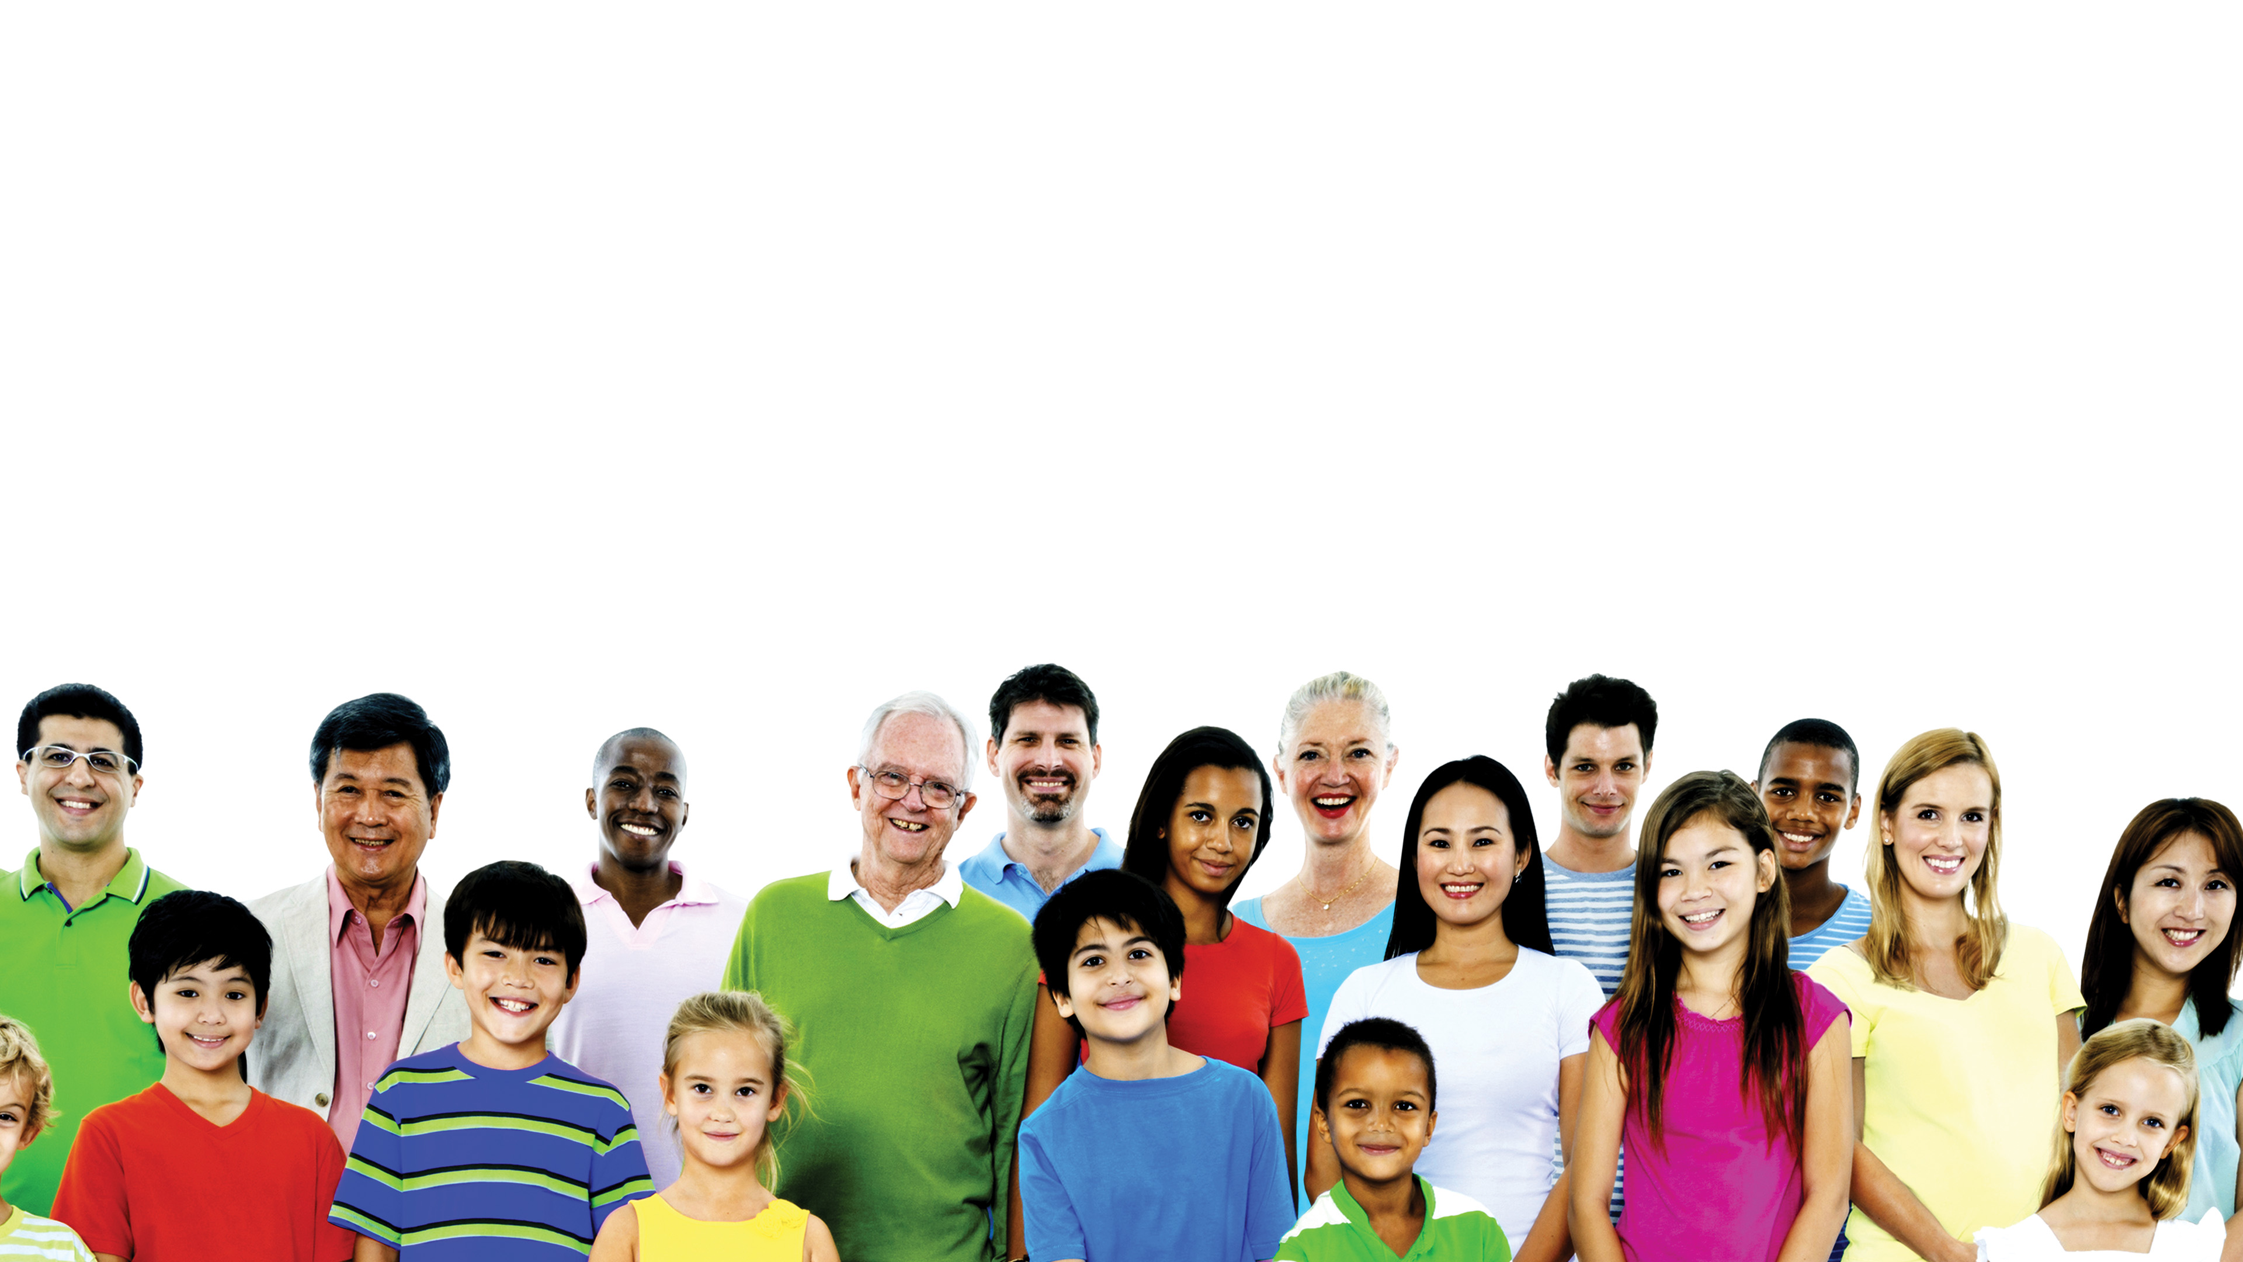
Jesus loves
everyone!

