Slide 1

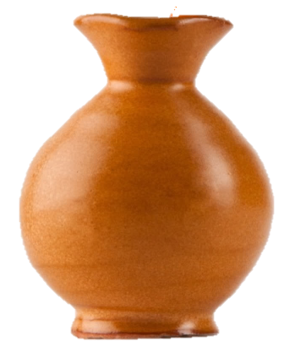
1
2
3
4
100
400
200
100
5
6
7
8
200
300
400
300
Notes:
Instructions: If the child answers the questions correctly, have him choose a water jar. Click on the water jar to reveal a point value. If the points are in blue, give them to the child’s team. If they are in red, give them to the other team. Click the point value again to make it disappear before moving on.

