Slide 1

SAMARIA
Jordan River
Shiloh
Bethel
Jericho
JUDEA
Mount of
Olives
Jerusalem
Bethlehem
Bethany

Slide 2
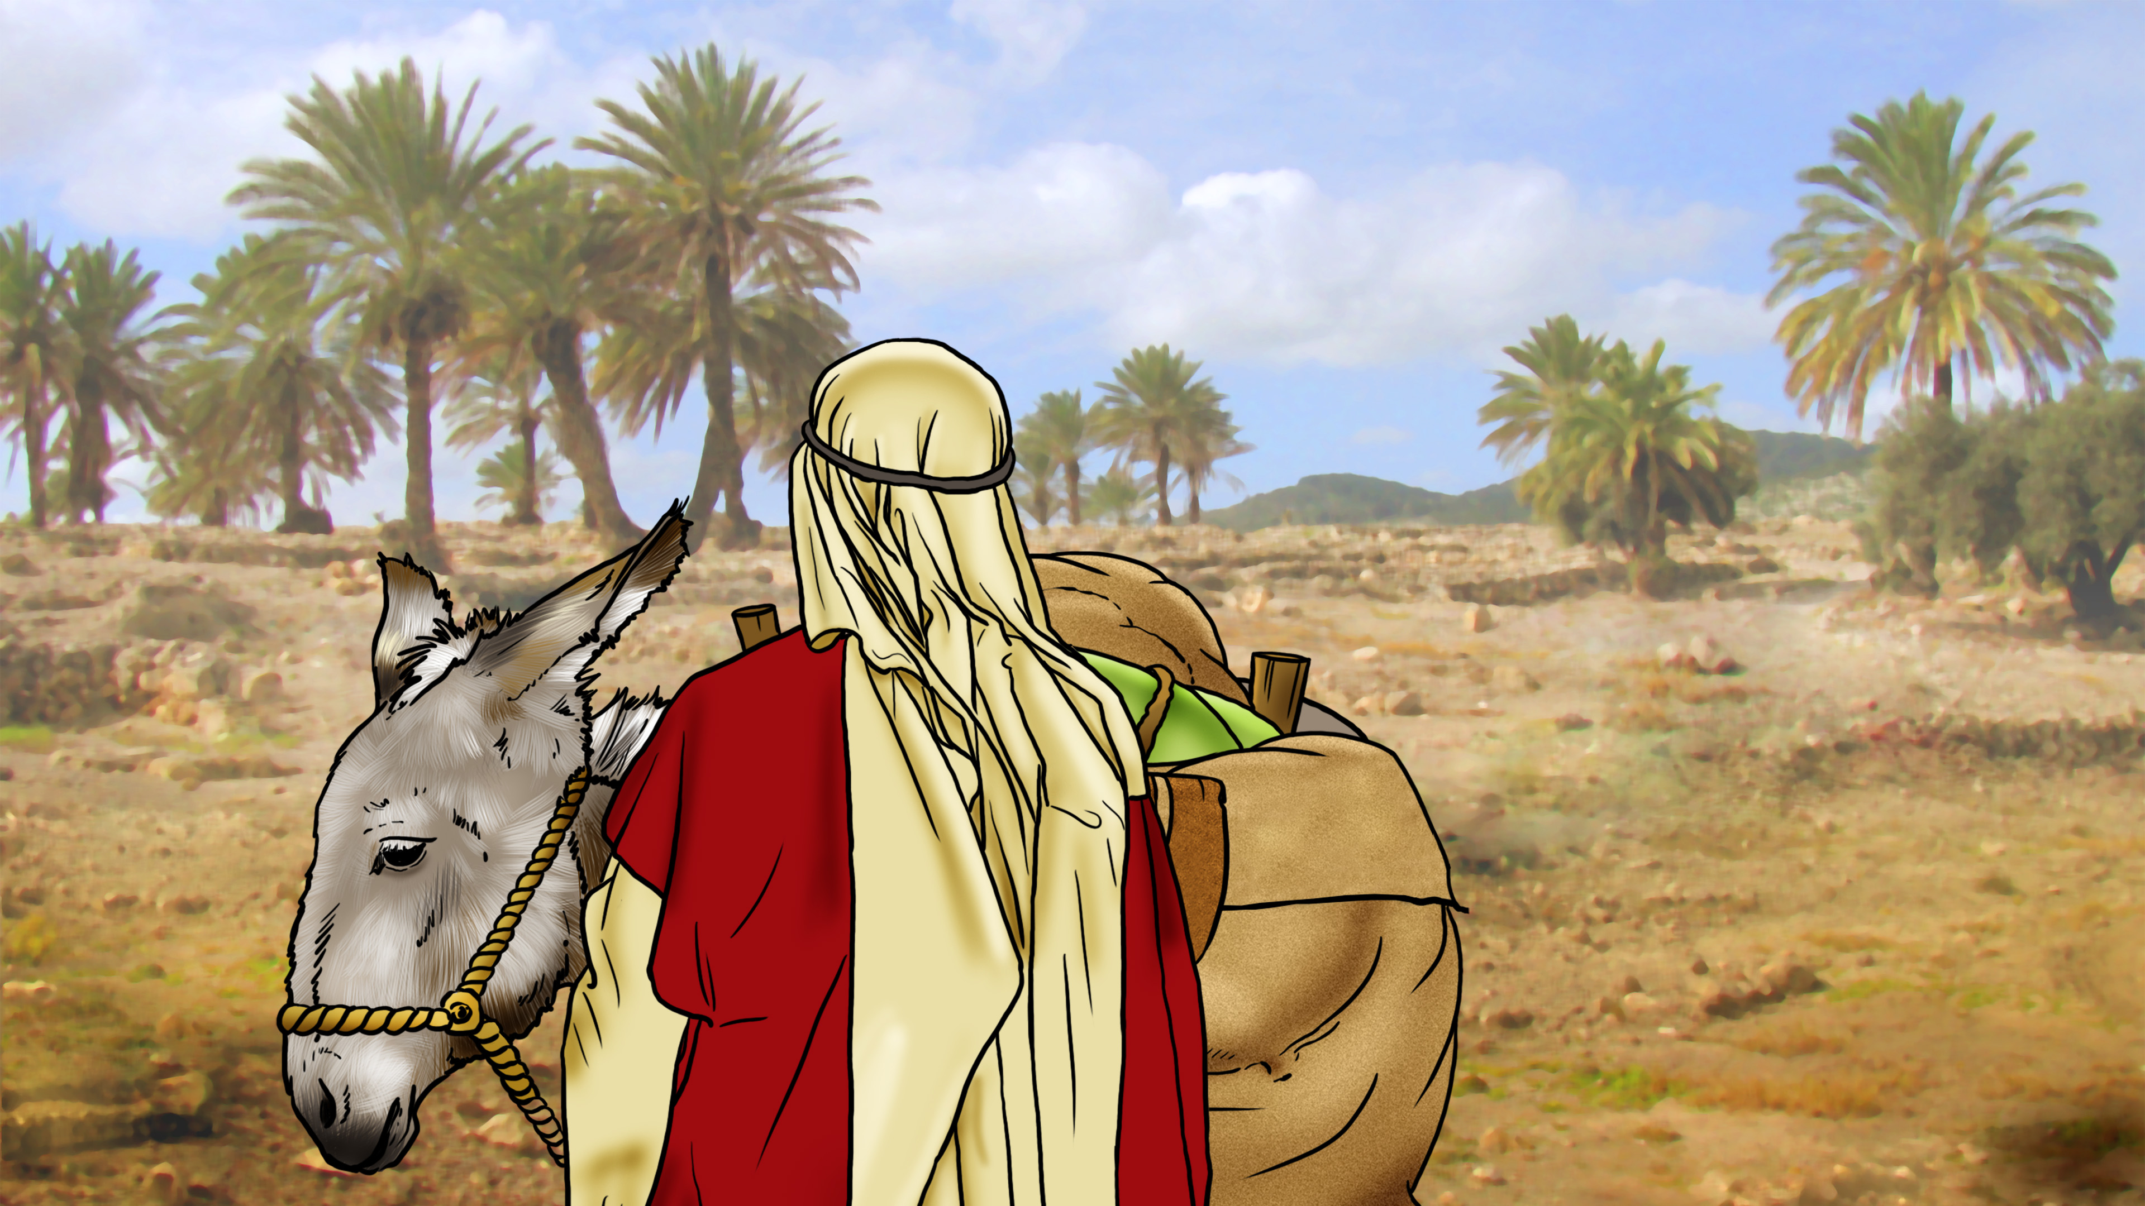

Slide 3
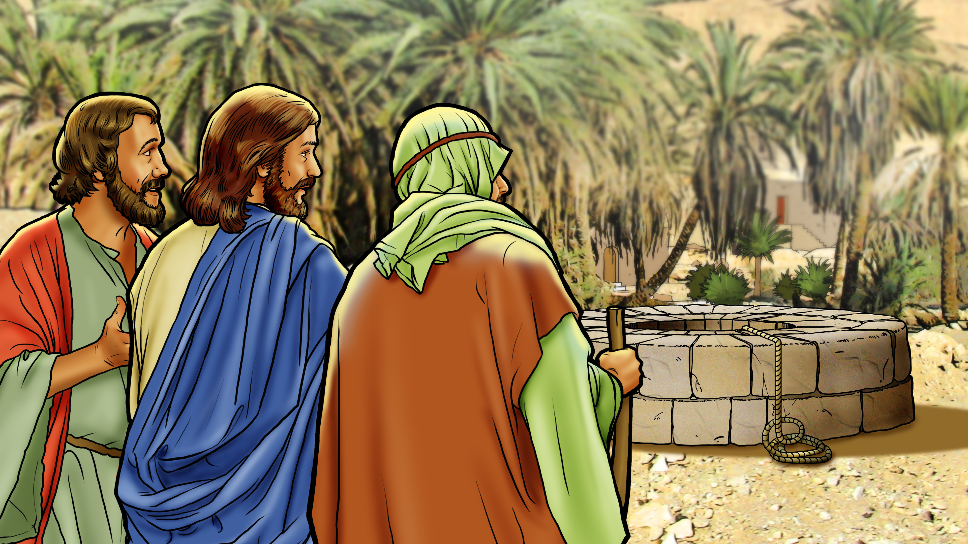

Slide 4

Jesus loves
everyone!

Slide 6
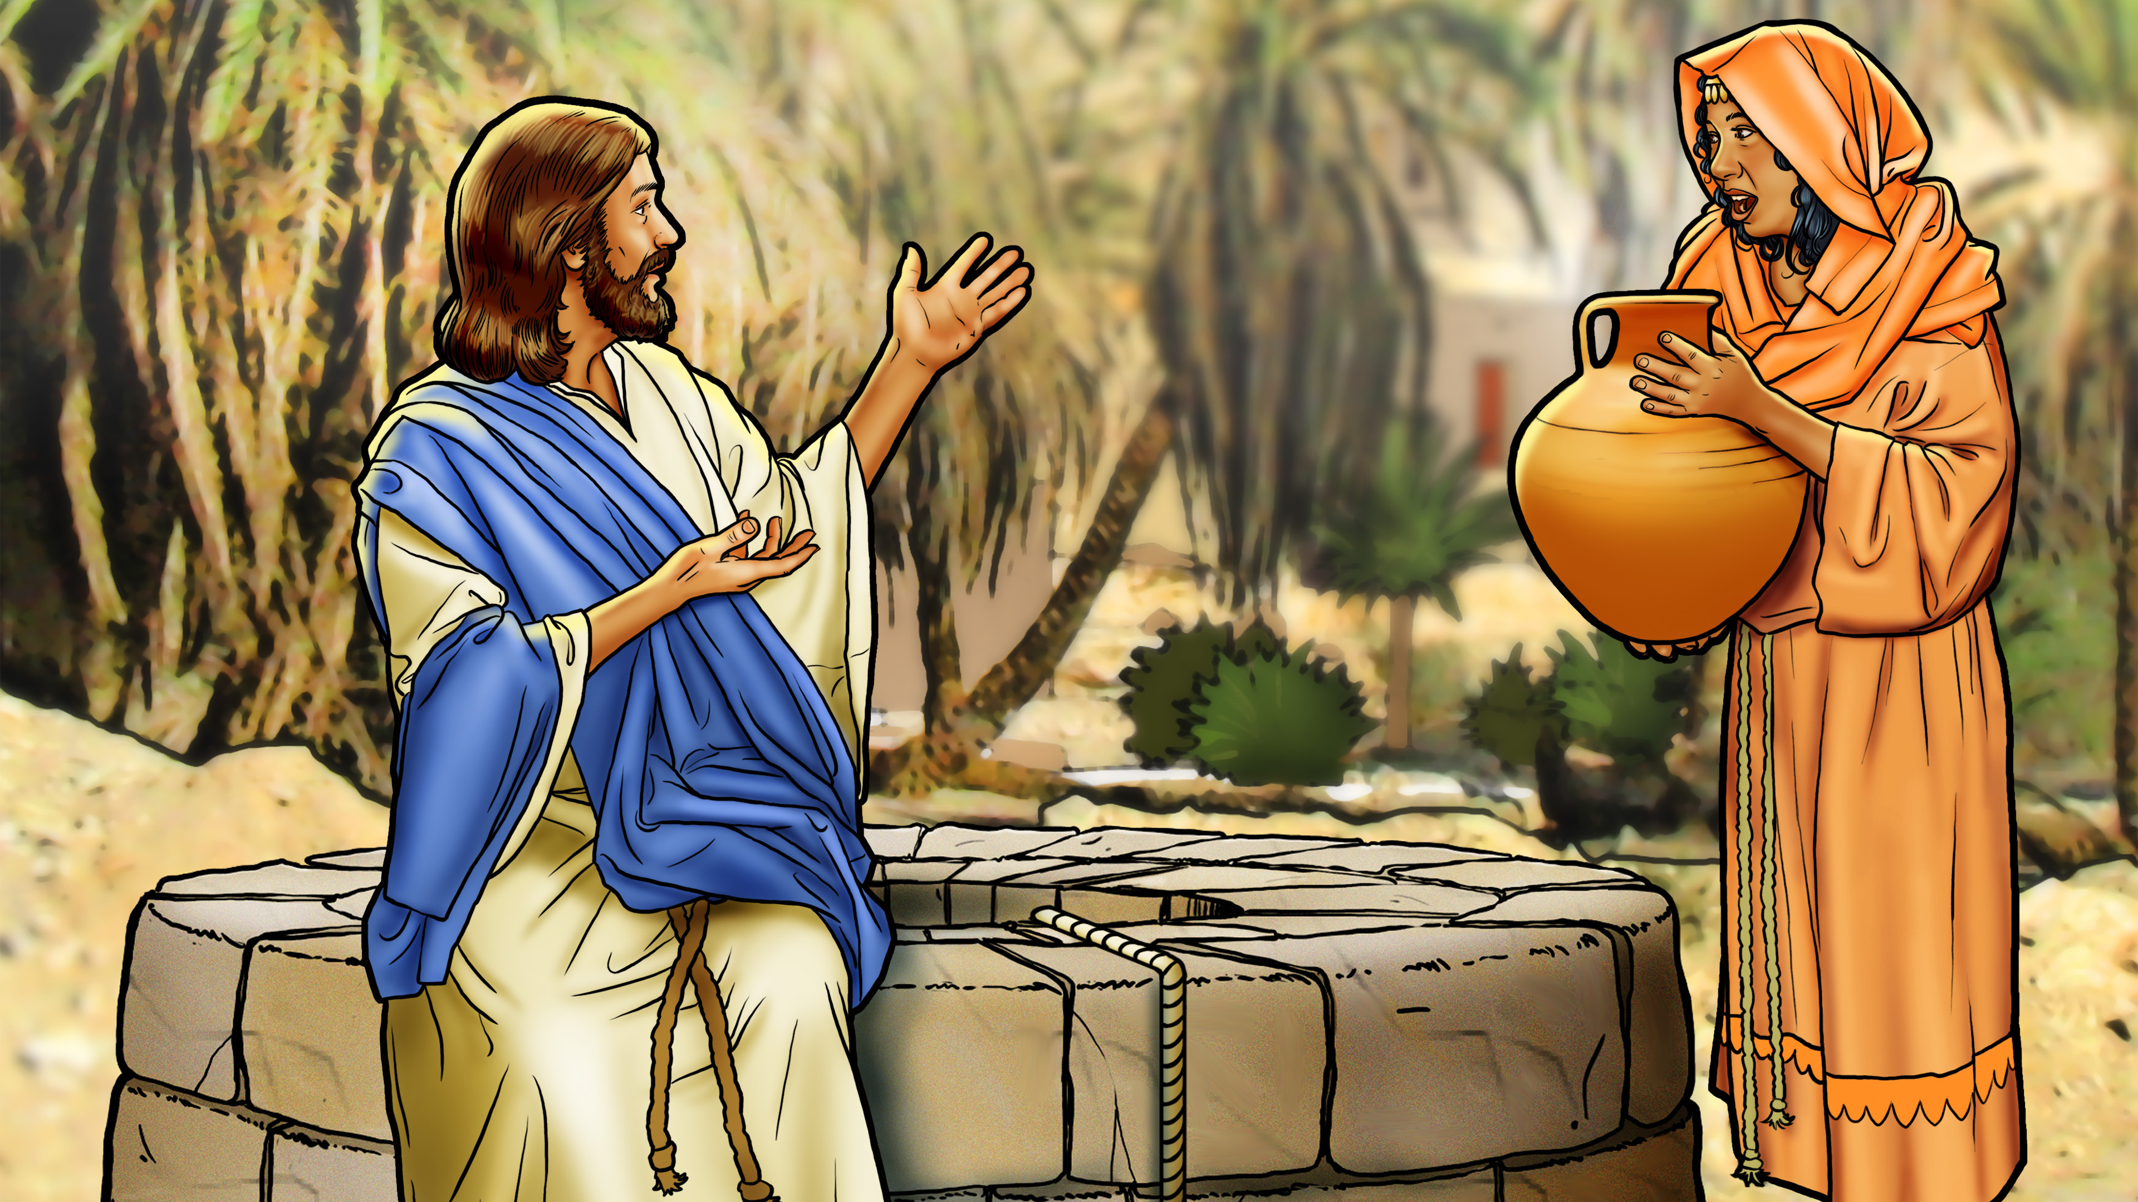

Slide 7
Jesus loves
everyone!

Slide 8
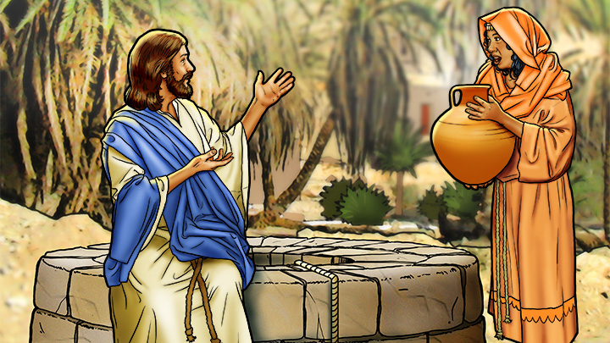

Slide 9
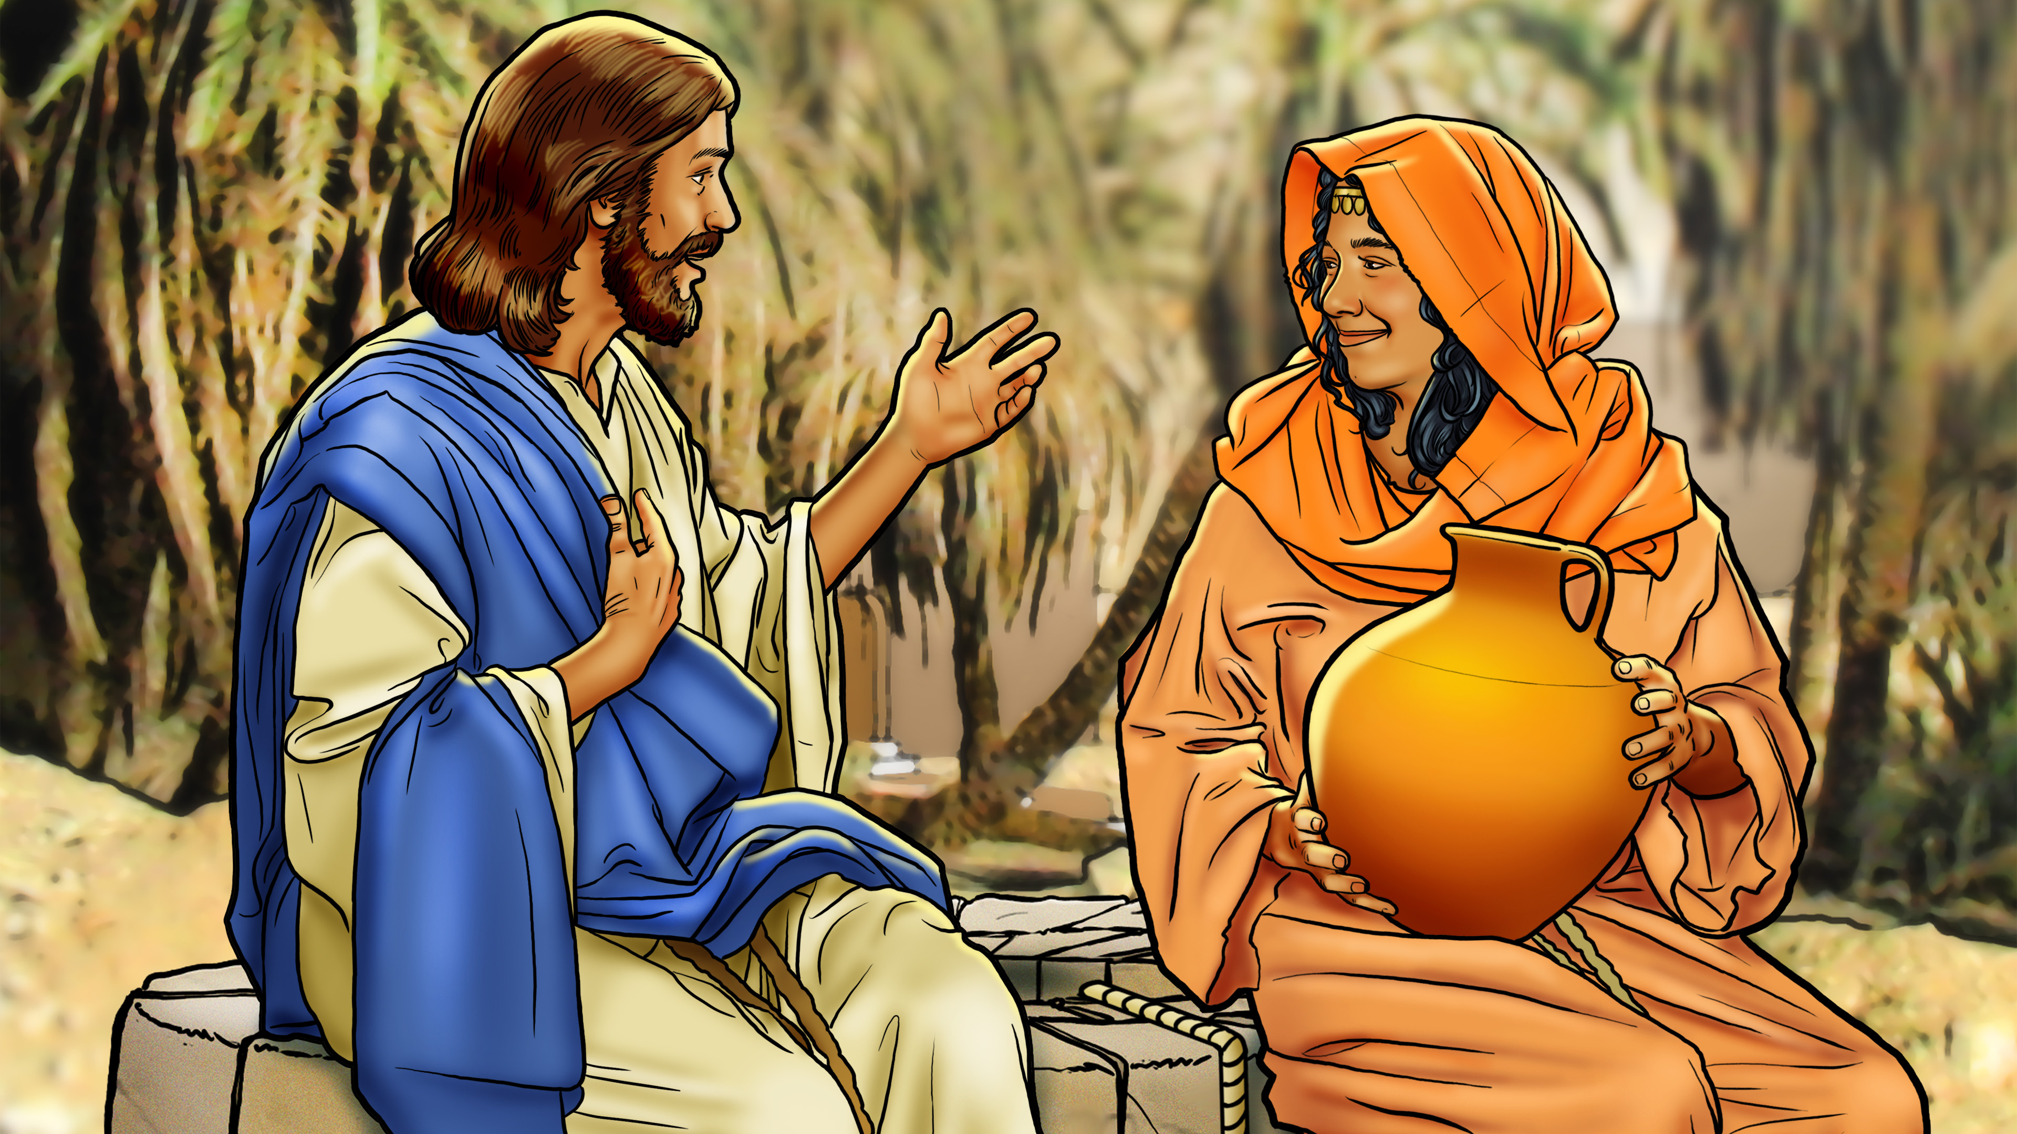

Slide 10

OMNISCIENT

Slide 12
Jesus loves
everyone!

Slide 14
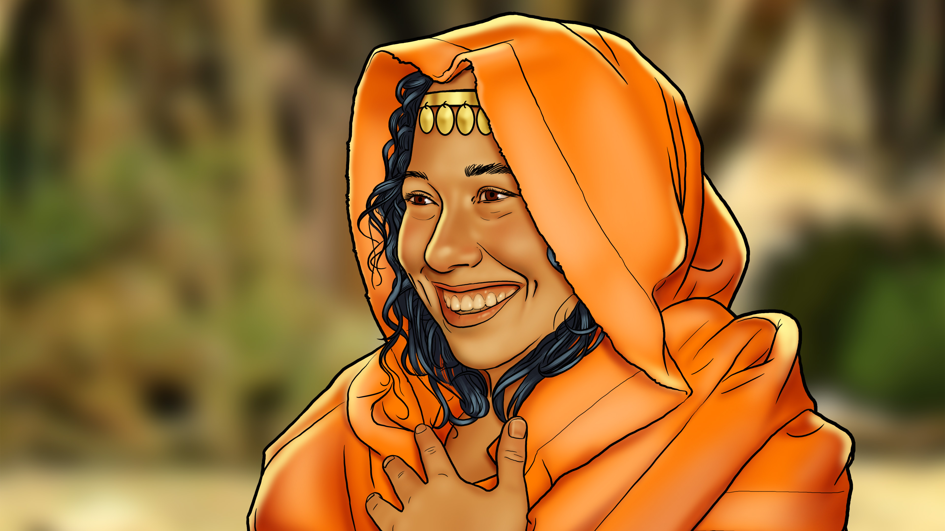

Slide 15
