Slide 1

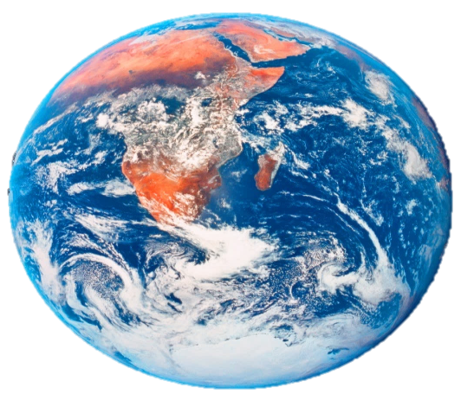




1
2
3
Whoever is wearing Shoes
Whoever likes to read
Whoever has short hair
4
5
6
Whoever has long hair
Whoever likes video games
Whoever likes swimming
Notes:
Instructions: Have a child choose an “Earth” to reveal who will say the verse (e.g. those wearing shoes, who like swimming, have short hair etc.) Click on the statement to go to a corresponding slide with the memory verse. Have children who identify with the statement stand and say the verse together. Click on the home button in the bottom right-hand corner to return to the home screen to choose another Earth.

Slide 2
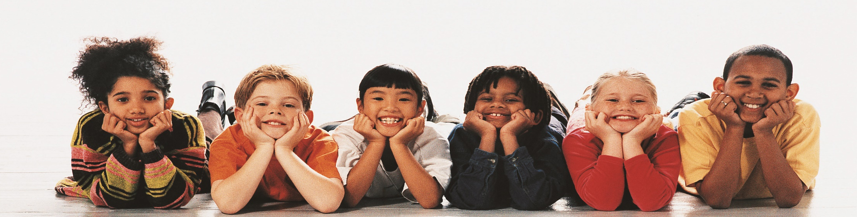
For God so loved the world, that he gave his only begotten Son, that whosoever believeth in him should not perish, but have everlasting life.
John 3:16

Slide 3
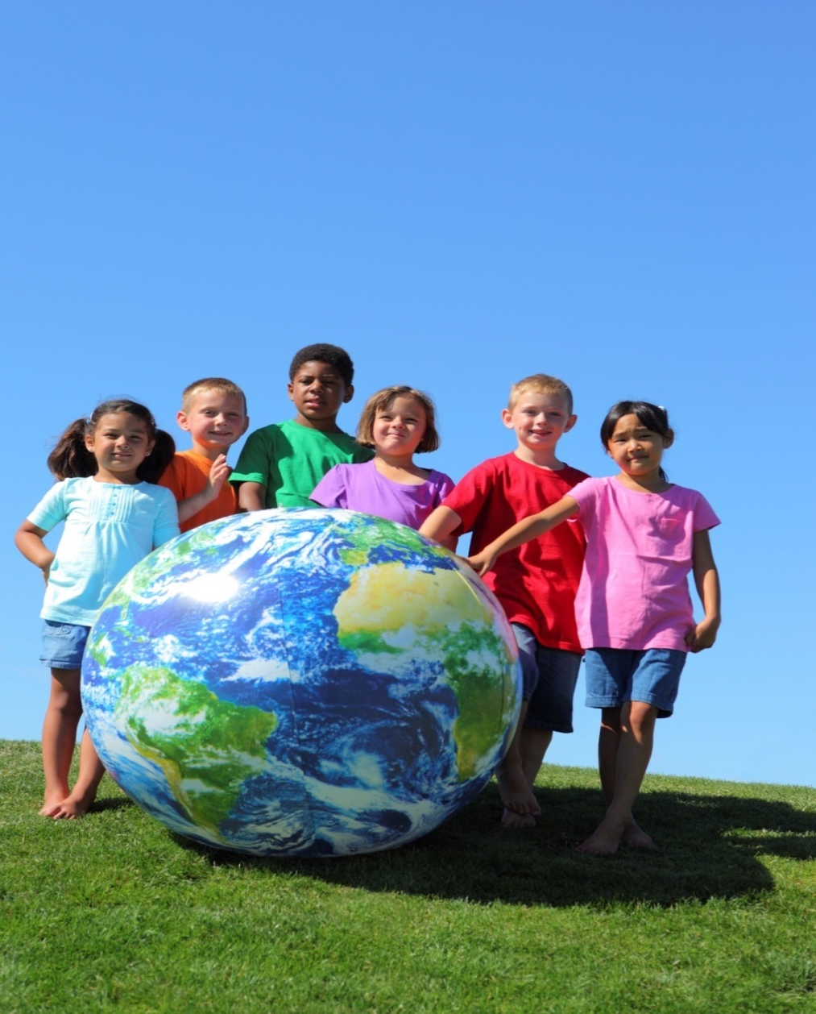
For God so loved the world, that he gave his only begotten Son, that whosoever believeth in him should not perish, but have everlasting life.
John 3:16

Slide 4
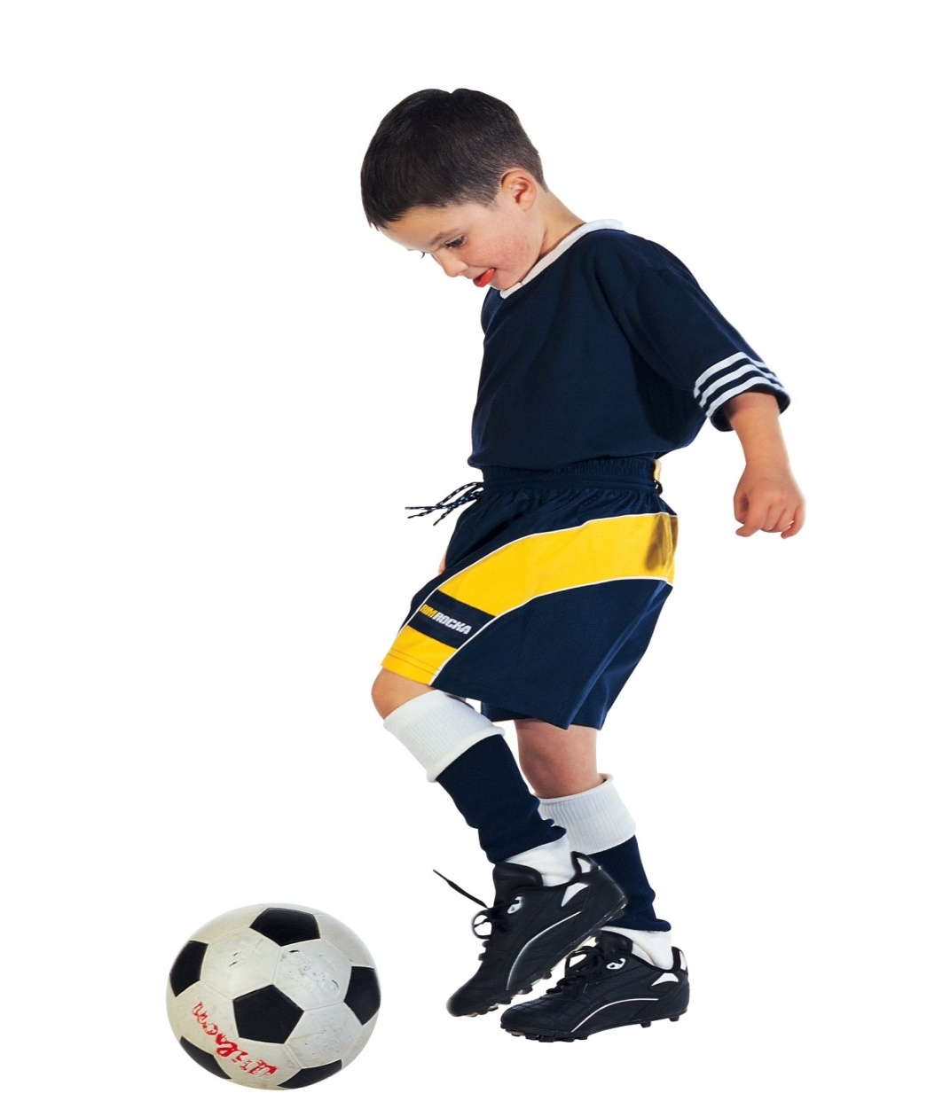
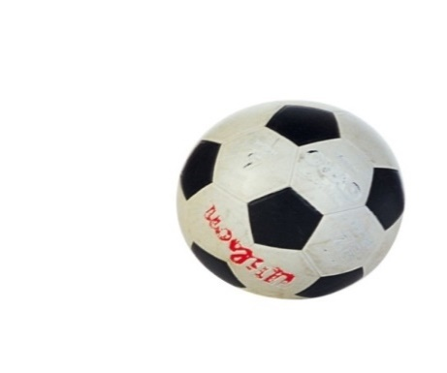
For God so loved the world, that he gave his only begotten Son, that whosoever believeth in him should not perish, but have everlasting life.
John 3:16

Slide 5
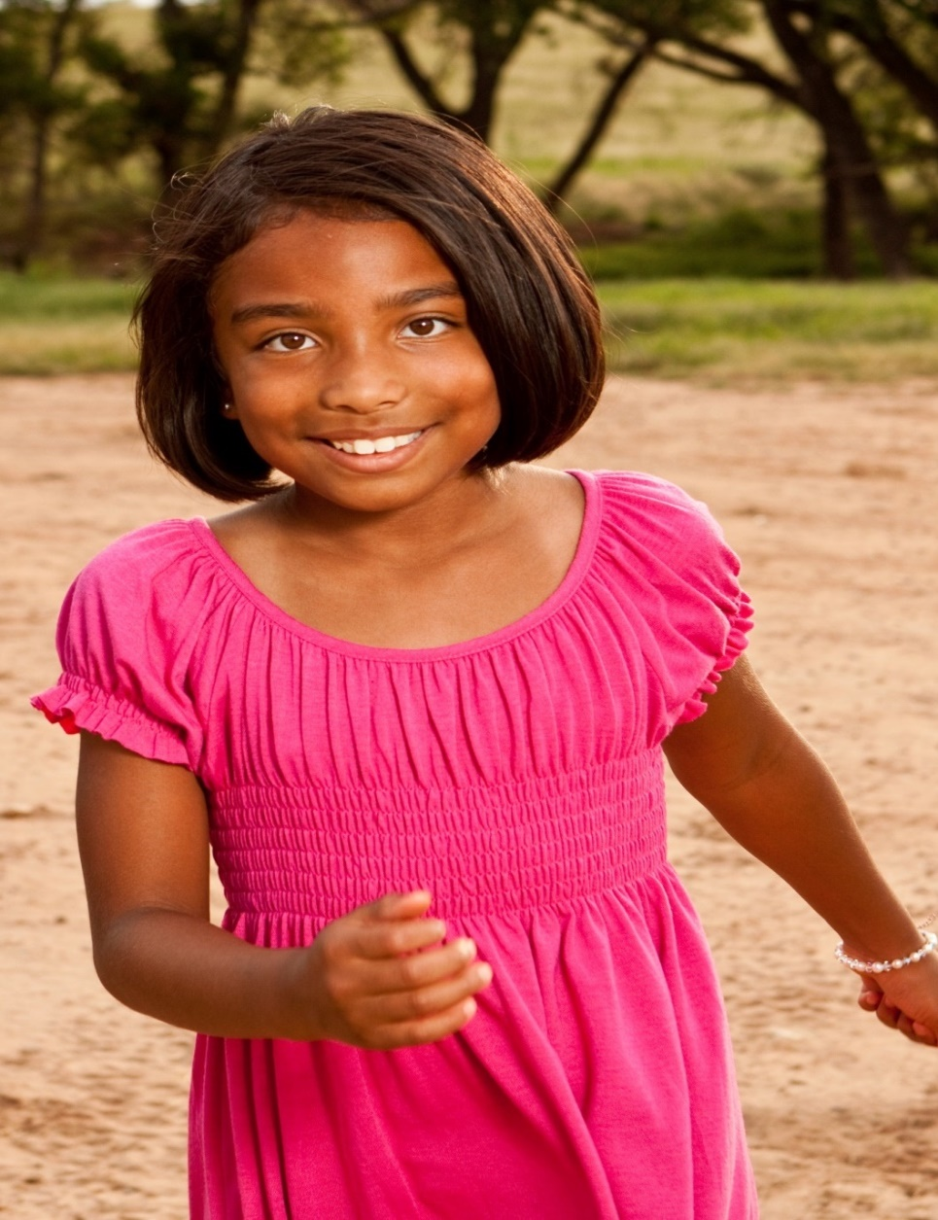
For God so loved the world, that he gave his only begotten Son, that whosoever believeth in him should not perish, but have everlasting life.
John 3:16

Slide 6
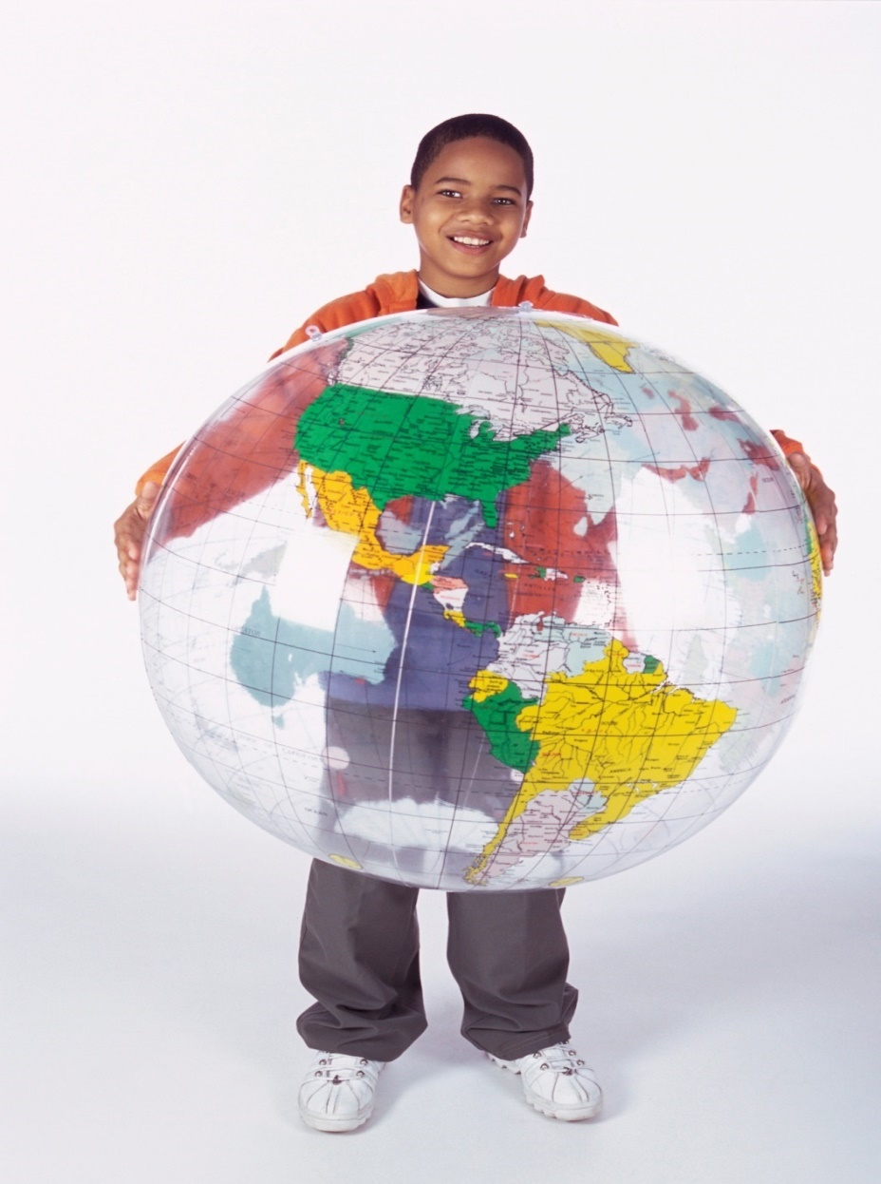
For God so loved the world, that he gave his only begotten Son, that whosoever believeth in him should not perish, but have everlasting life.
John 3:16

Slide 7
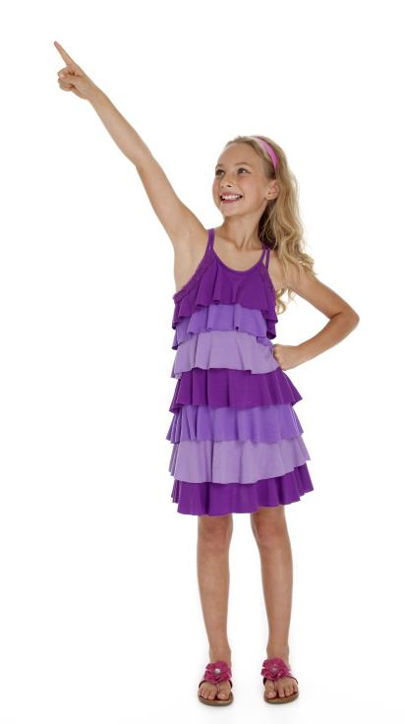
For God so loved the world, that he gave his only begotten Son, that whosoever believeth in him should not perish, but have everlasting life.
John 3:16

