Slide 1
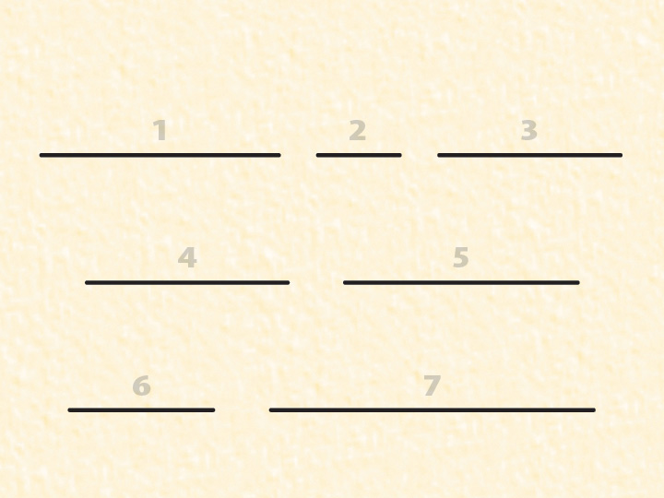








Slide 2
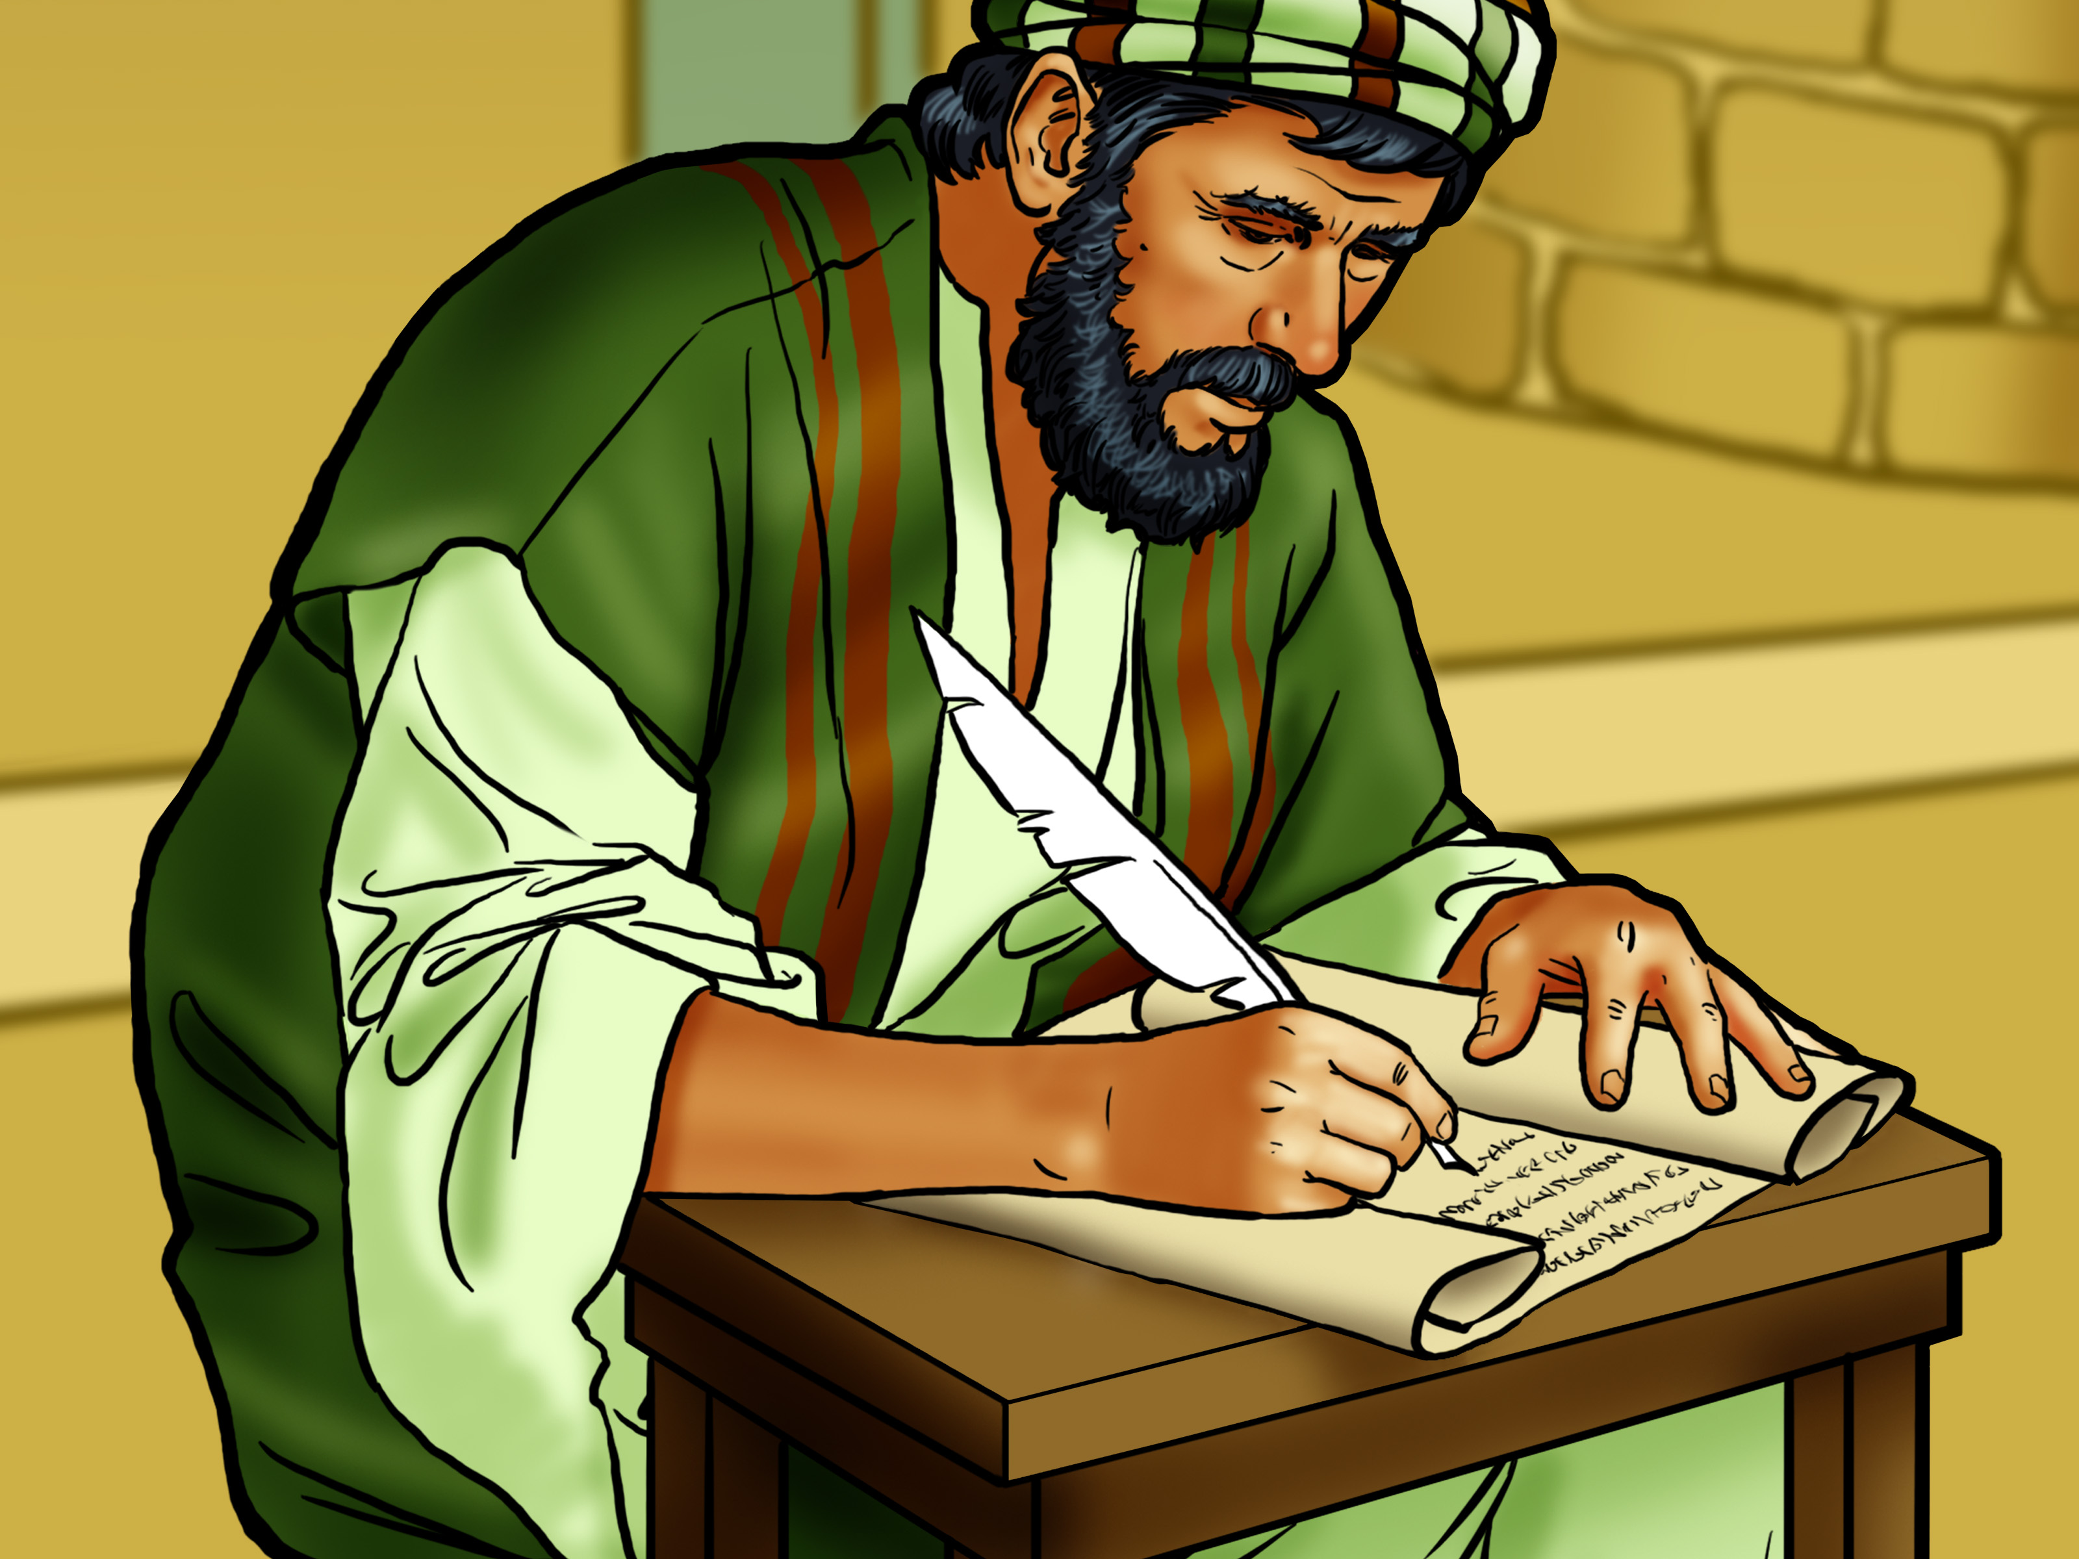

Slide 3

Jesus is
the almighty
God!

Slide 4
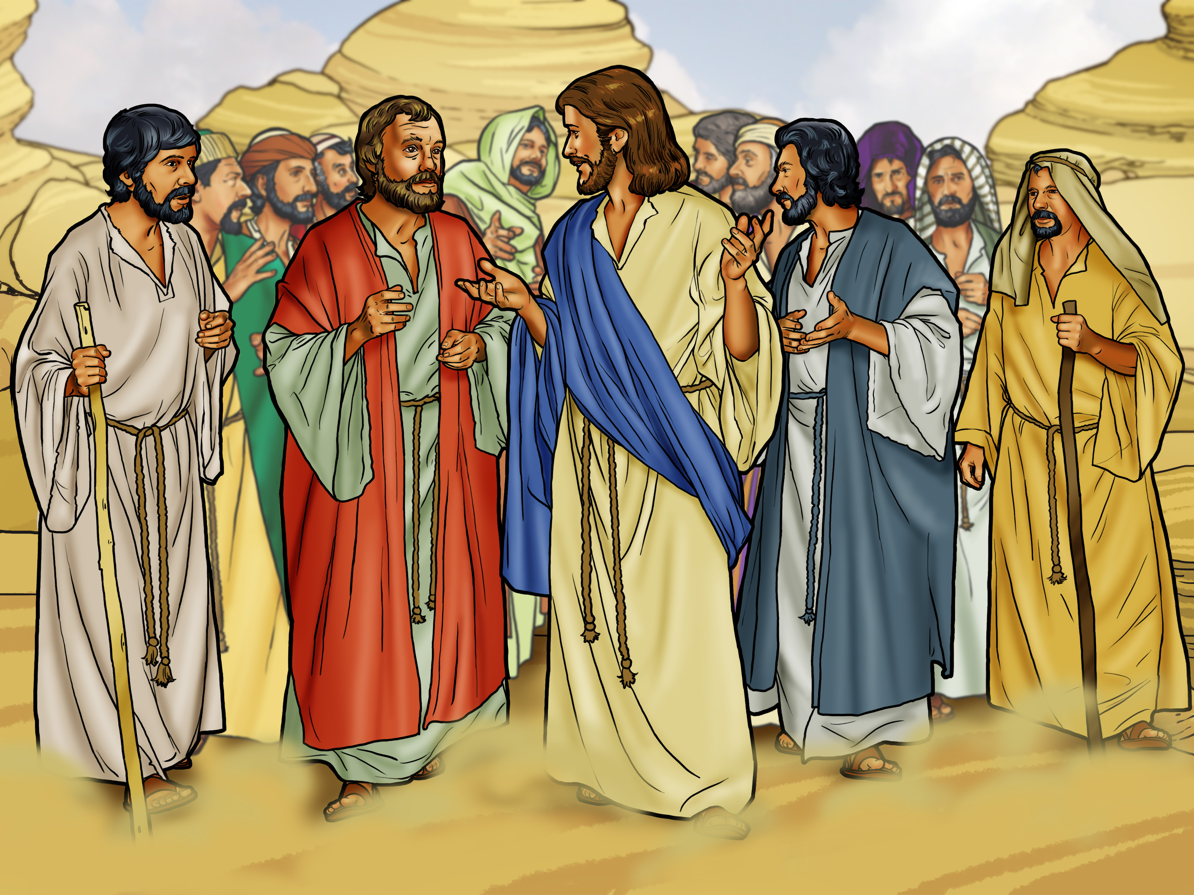

Slide 5
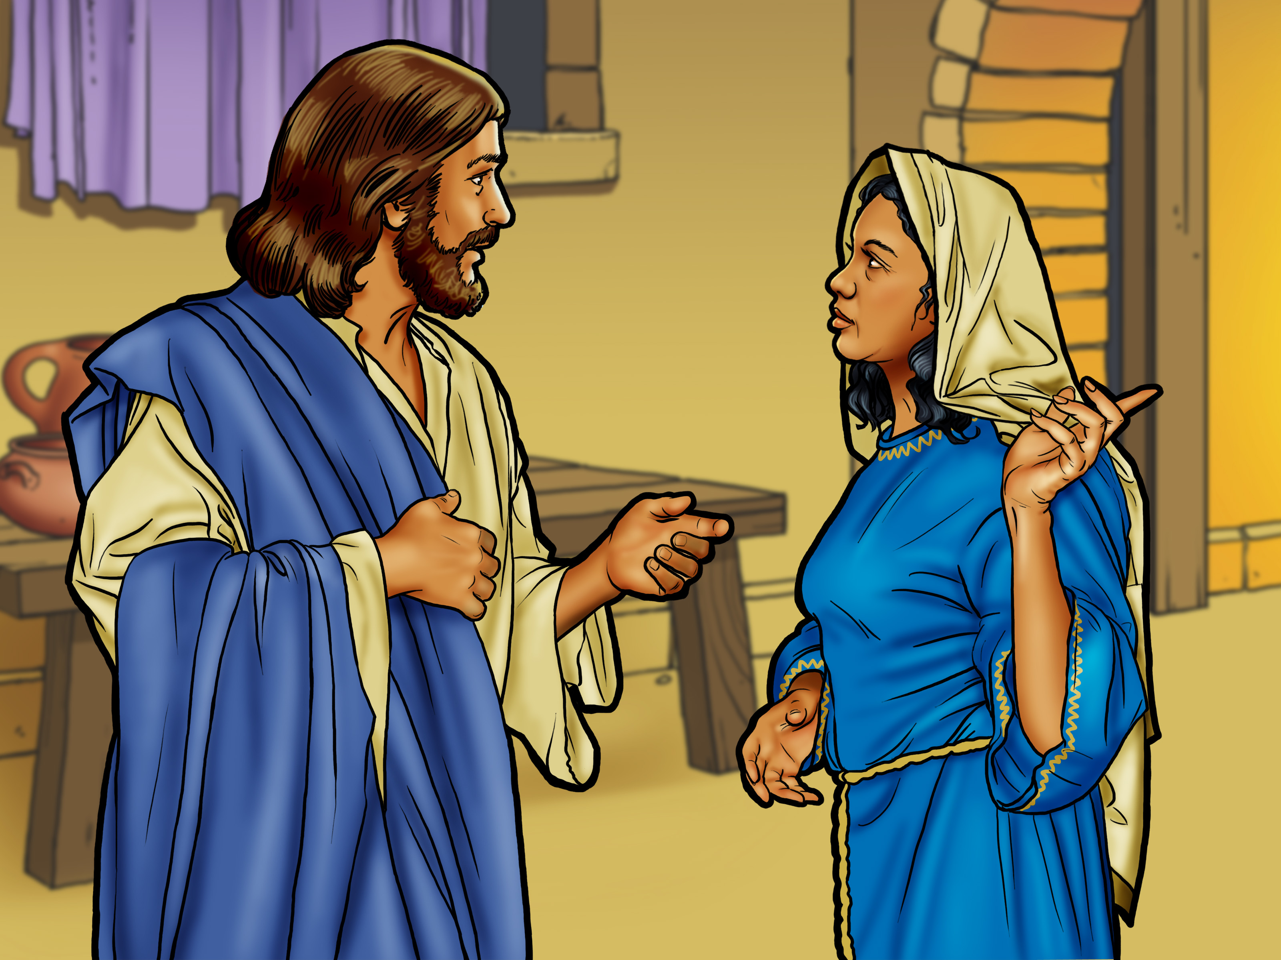

Slide 6
Jesus is
the almighty
God!

Slide 7
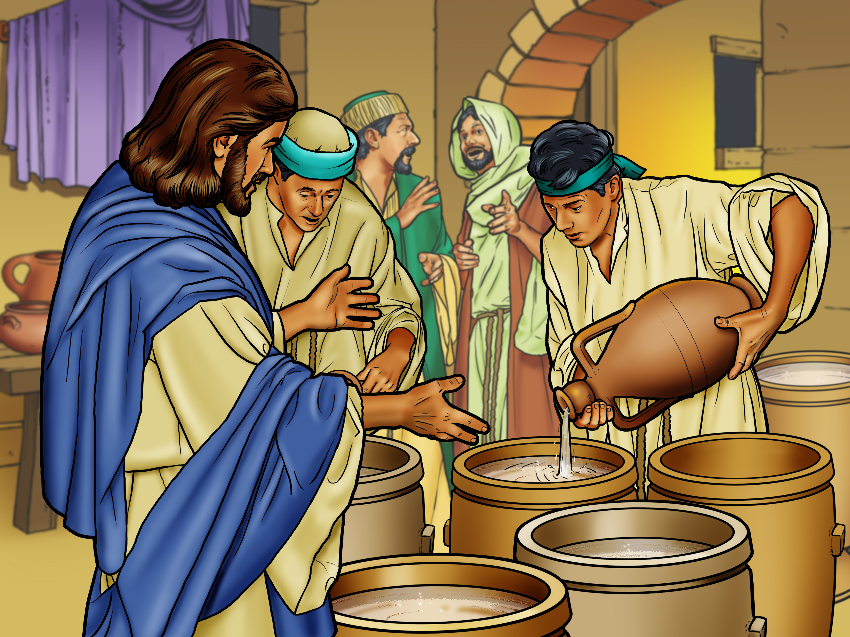

Slide 8
Jesus is
the almighty
God!

Slide 9


Slide 10


Slide 11
Jesus is
the almighty
God!

